Slide 1
Music Box Project

Slide 2
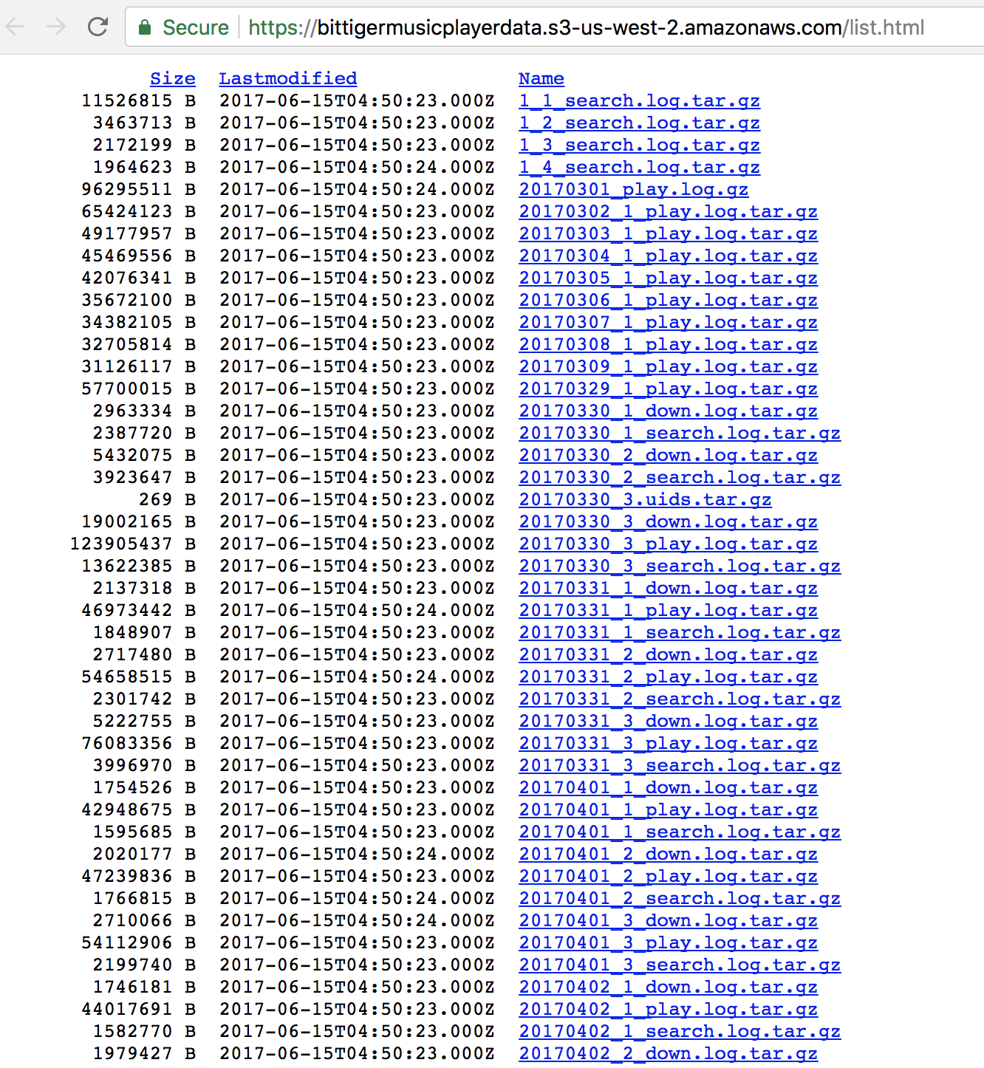
Data
https://bittigermusicplayerdata.s3-us-west-2.amazonaws.com/list.html

Slide 3
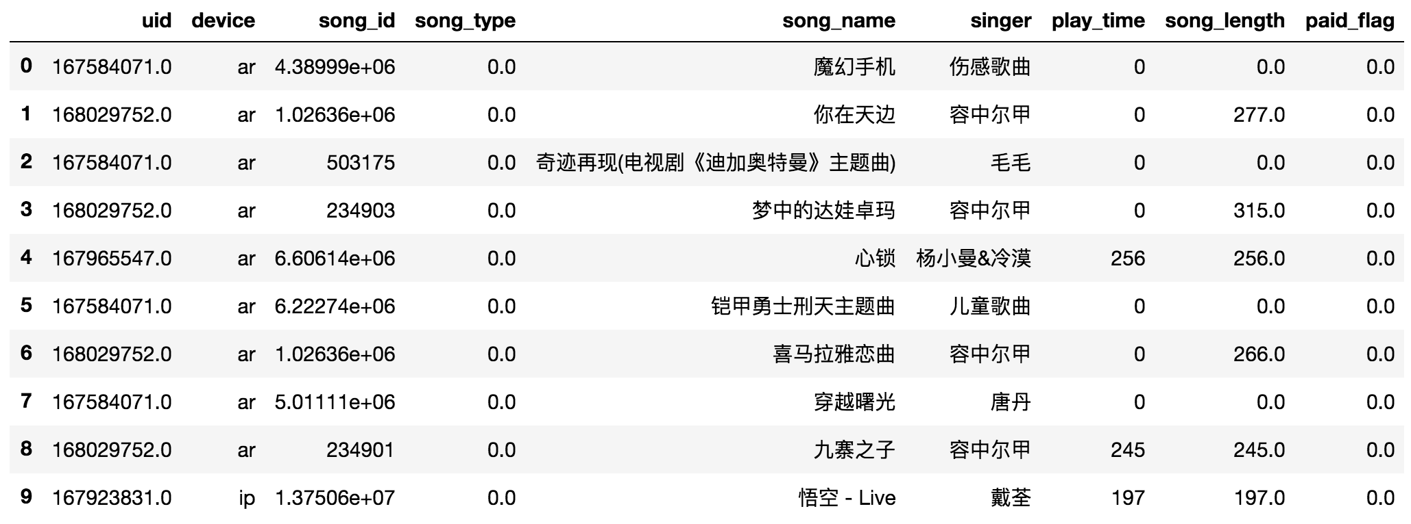
Play Data

Slide 4
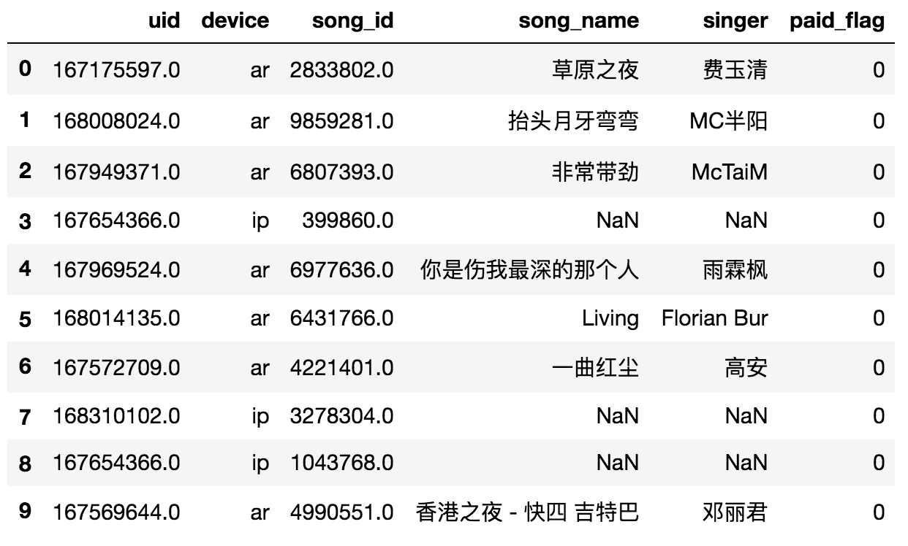
Download Data

Slide 5
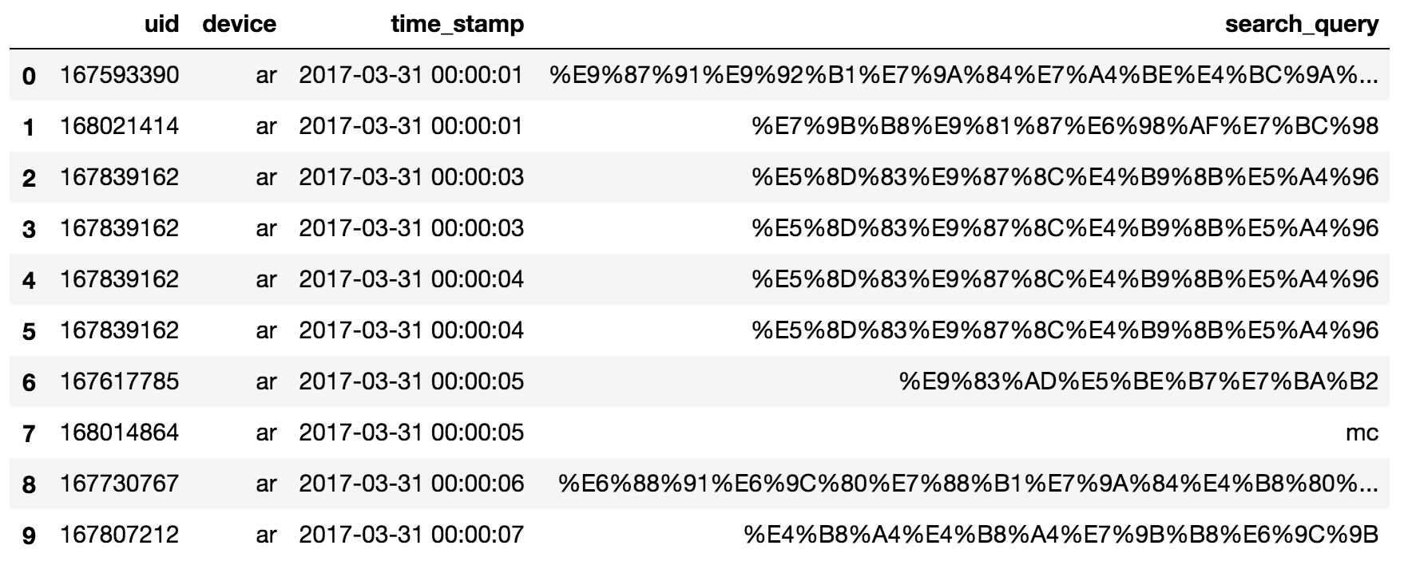
Search Data

Slide 6
Sample Code
Shell Script: Process Raw Data
unpack_and_clean_files.sh
Load Raw Data
src/load_raw_data.ipynb
Load and Visualize Play Data
src/load_processed_playd_ata.ipynb

Slide 7
Churn

Slide 8
Churn Label Definition
Define churn
Inactive in fixed window (outcome window) 0/1
Fixed window can be e.g. last 2 weeks (4/29-5/12)
Population
Inclusion:
3/30-4/28 all active users
Exclusion:
inactive user observation window
bot

Slide 9
Churn Feature Generation - User Activities
Frequency (of Events over Time Window):
Window (Number of Days): 1, 3, 7, 14, 30
Type of Events: Play, Download, Search
15 features
Recency (of Events):
Last Event Time from Now (Snapshot Time)
Play, Download, Search
3 features
Acceleration (Optional)
Ratio of frequency of different time window (acceleration), e.g.
play_1d_over_play_7d,
play_1d_over_down_1d
play_1d_over_down_7d …
Rate (Not Applicable)
Life length (Optional)
Play time percentage of song length (Optional)
mean, max, min, std, mean weighted by recency

Slide 10
Churn Feature Generation - User Profile
User subscription time
User preferred device
User preferred genre: classic, new songs
Gender
User age
….
User Profile not available in this data

Slide 11
Data Processing
User down-sampling
Have to be user level
Get all the disctinct user_ids
Down-sample user_ids and put into set
Pass data once and keep only if user_id in the set
Pandas exploration/ feature generation
Spark
SQL (SQLite local version)

Slide 12
Train model
Supervised Methods
Logistic regression
Random Forest
GBDT
Performance
AUC benchmark ~ 0.8

Slide 13
Recommendation

Slide 14
Recommendation
Prepare Utility Matrix
Uid
Song_id
Target (Rating)
Define Target Variable (Implicit)
Intuitively:
Play frequency over fixed time window
Download frequency over fixed time window
Play/song length
More Sophisticated
Weight different targets
Bucket to levels, e.g. 5

Slide 15
Data Cleaning
What you can think of?
Dig into the data

Slide 16
Data Size
SQL Lite
Spark
Down Sample (last resort, user level)

Slide 17
Train Recommender
Collaborative Filtering
Item-Based
Matrix Factorization
GraphLab
Spark ALS (DataBricks, Google(credit), AWS(small $),IBM(free))

Slide 18
Performance Evaluation
Mask Data Validation
Performance benchmark
5 level rating: RMSE~1.2-1.5, or <2

Slide 19
Capstone Standard
Good work
Complete, sound, correct formulation
Excellent work
Unique in one or more of the aspect
Formulation: novel, different from others in a better way
Data utilization: e.g. use more
Engineering: SQL, python sweep, spark (can be local version)
Performance evaluation
Business impact analysis with concrete numbers
And more
Unique here means “different from others in a better way”

