Slide 1
Unsupervised Domain Adaptation: From Practice to Theory
John Blitzer
TexPoint fonts used in EMF.
Read the TexPoint manual before you delete this box.: AAAAAAAAA

Slide 2






Unsupervised Domain Adaptation
Avante Deep Fryer; Black
Title: lid does not work well...
I love the way the Tefal deep fryer cooks, however, I am returning my second one due to a defective lid closure. The lid may close initially, but after a few uses it no longer stays closed. I won’t be buying this one again.
?
Running with Scissors
Title: Horrible book, horrible.
This book was horrible. I read half, suffering from a headache the entire time, and eventually i lit it on fire. 1 less copy in the world. Don't waste your money. I wish i had the time spent reading this book back. It wasted my life
?
.
.
.
.
.
.
.
.
.
.
.
.
?
Source
Target

Slide 3
Target-Specific Features
Avante Deep Fryer; Black
Title: lid does not work well...
I love the way the Tefal deep fryer cooks, however, I am returning my second one due to a defective lid closure. The lid may close initially, but after a few uses it no longer stays closed. I won’t be buying this one again.
?
Running with Scissors
Title: Horrible book, horrible.
This book was horrible. I read half, suffering from a headache the entire time, and eventually i lit it on fire. 1 less copy in the world. Don't waste your money. I wish i had the time spent reading this book back. It wasted my life
?
.
.
.
.
.
.
.
.
.
.
.
.
.
.
.
.
.
.
?
Source
Target
Notes:
Write source & target here

Slide 4


Learning Shared Representations
Source
Target
fantastic
highly recommended
fascinating
boring
read half
couldn’t put it down
defective
sturdy
leaking
like a charm
waste of money
horrible

Slide 5
Shared Representations: A Quick Review
Blitzer et al. (2006, 2007). Shared CCA.
Tasks: Part of speech tagging, sentiment.
Xue et al. (2008). Probabilistic LSA
Task: Cross-lingual document classification.
Guo et al. (2009). Latent Dirichlet Allocation
Task: Named entity recognition
Huang et al. (2009). Hidden Markov Models
Task: Part of Speech Tagging

Slide 6

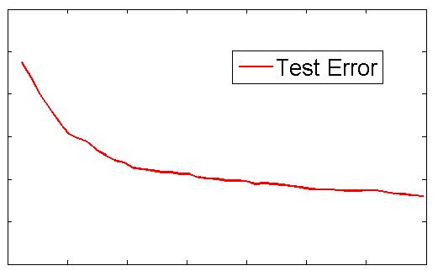



What do you mean, theory?

Slide 7
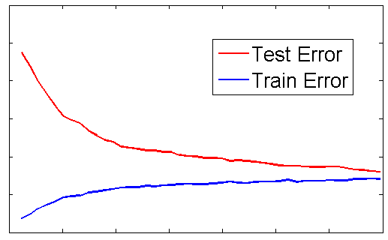
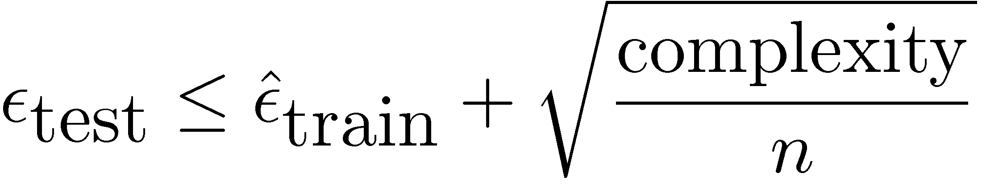
What do you mean, theory?
Statistical Learning Theory:

Slide 8
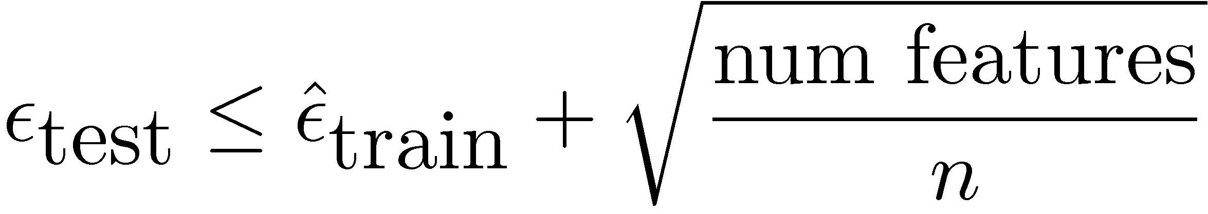
What do you mean, theory?
Statistical Learning Theory:

Slide 9
What do you mean, theory?
Classical Learning Theory:

Slide 10
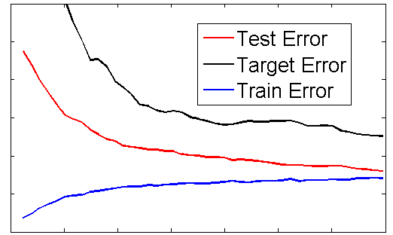

What do you mean, theory?
Adaptation Learning Theory:

Slide 11
Goals for Domain Adaptation Theory
A computable (source) sample bound on target error
A formal description of empirical phenomena
Why do shared representations algorithms work?
Suggestions for future research

Slide 12


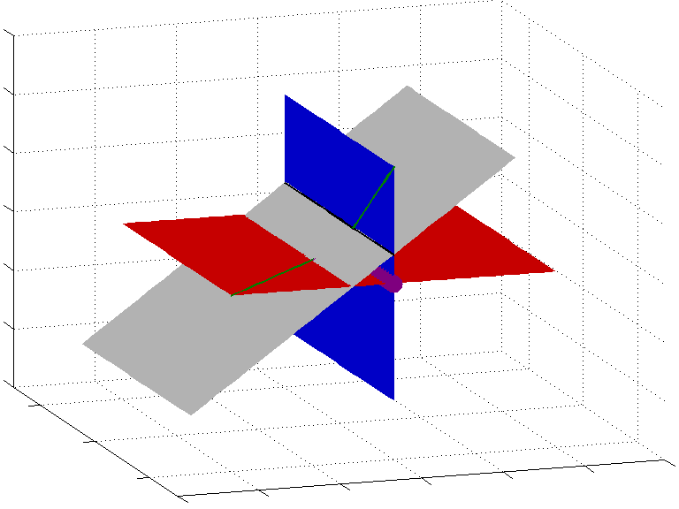
Talk Outline
Target Generalization Bounds using Discrepancy Distance [BBCKPW 2009] [Mansour et al. 2009]
Coupled Subspace Learning
[BFK 2010]

Slide 13
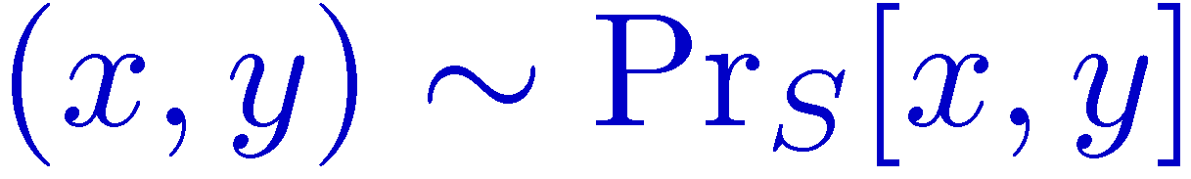
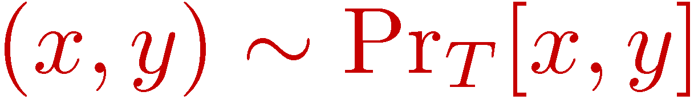
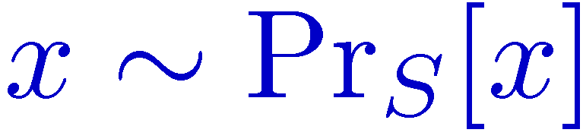
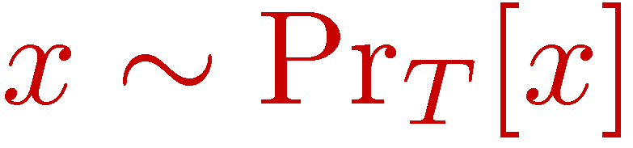
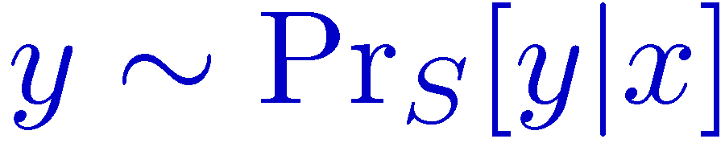
Formalizing Domain Adaptation
Source distribution
Target distribution
Source labeled data
Target unlabeled data

Slide 14
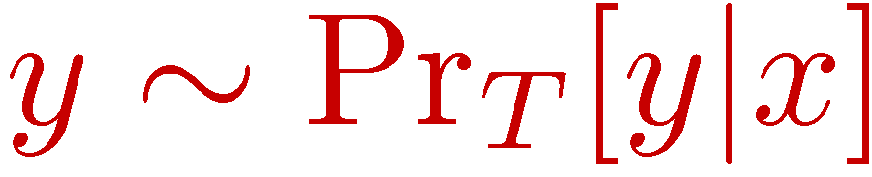
Formalizing Domain Adaptation
Source distribution
Target distribution
Source labeled data
Target unlabeled data
Semi-supervised adaptation
Some target labels

Slide 15
Formalizing Domain Adaptation
Source distribution
Target distribution
Source labeled data
Target unlabeled data
Semi-supervised adaptation
Not in this talk

Slide 16
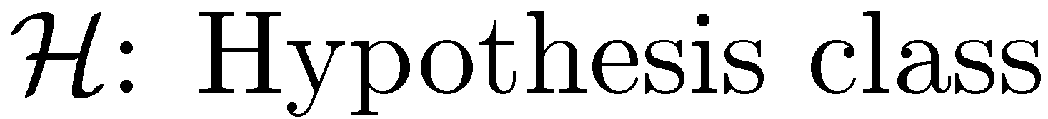
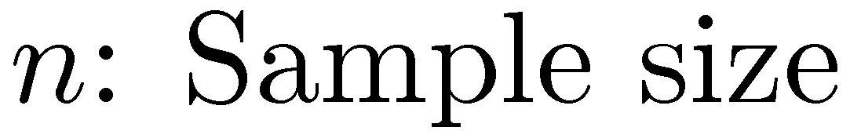
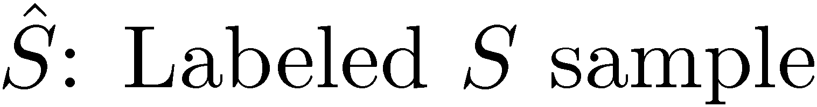
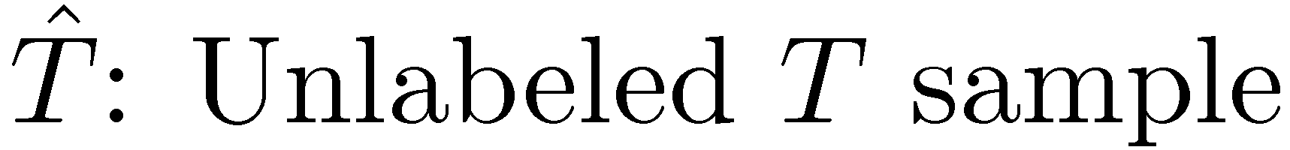
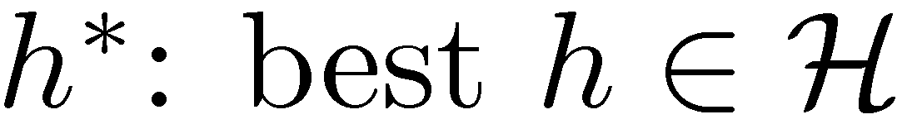
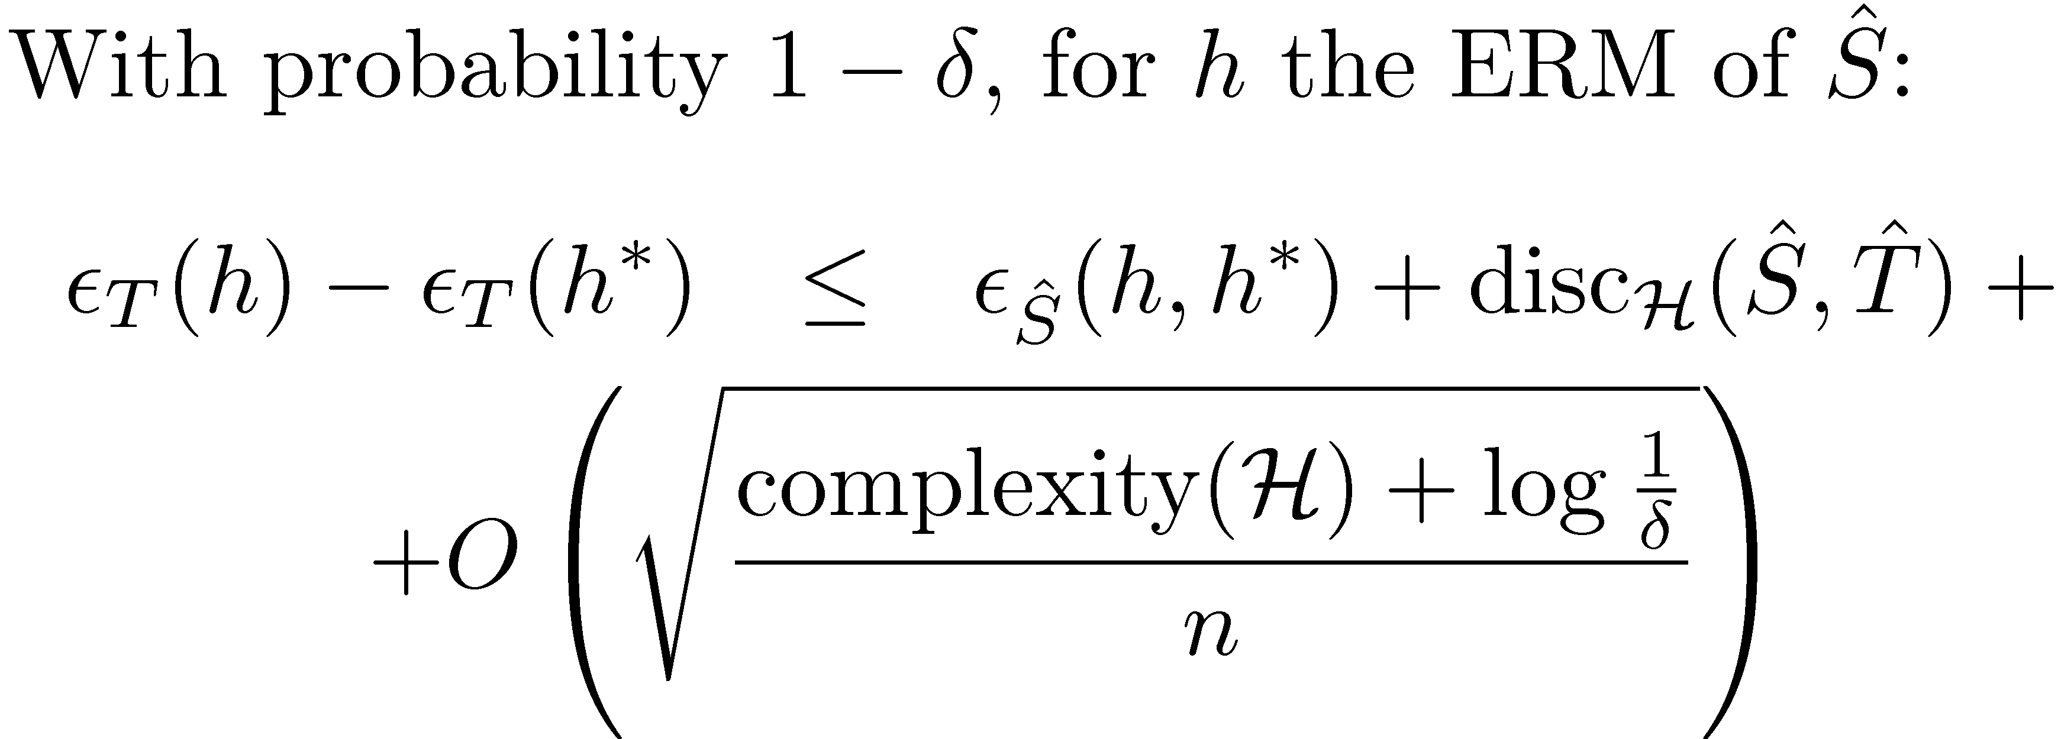
A Generalization Bound
Notes:
Say: If there is some good hypothesis for both domains, then this bound tells how well you can learn from only source labeled data

Slide 17
A new adaptation bound
Bound from [MMR09]
Notes:
Say: If there is some good hypothesis for both domains, then this bound tells how well you can learn from only source labeled data

Slide 18
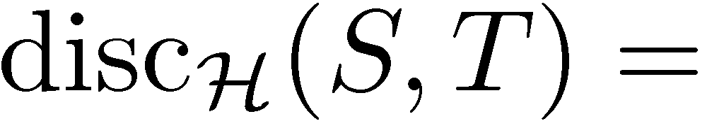
Discrepancy Distance
When good source models go bad

Slide 19
Binary Hypothesis Error Regions
+

Slide 20
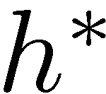
Binary Hypothesis Error Regions
+
+

Slide 21
Binary Hypothesis Error Regions
+
+

Slide 22
Binary Hypothesis Error Regions

Slide 23
Discrepancy Distance
When good source models go bad
low
low
high

Slide 24
Computing Discrepancy Distance
Learn pairs of hypotheses to discriminate source from target

Slide 25
Computing Discrepancy Distance
Learn pairs of hypotheses to discriminate source from target

Slide 26
Computing Discrepancy Distance
Learn pairs of hypotheses to discriminate source from target

Slide 27
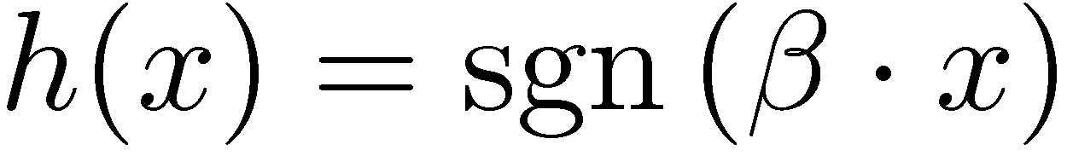
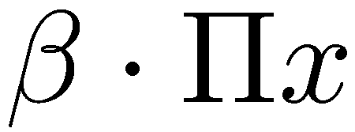






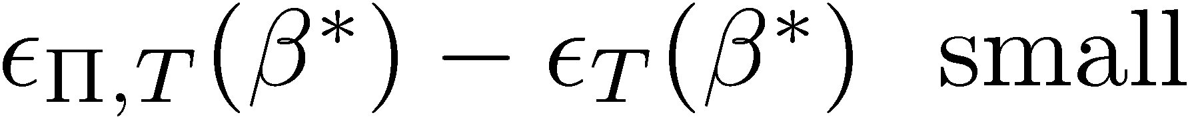
Hypothesis Classes & Representations
Linear Hypothesis Class:
Induced classes from projections
30
1001
.
.
.
Goals for

Slide 28
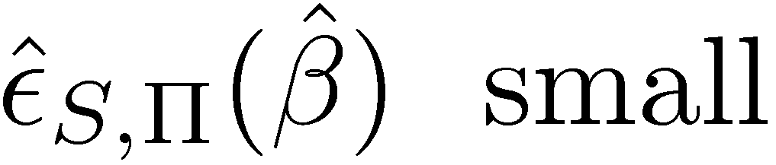
A Proxy for the Best Model
Linear Hypothesis Class:
Induced classes from projections
30
1001
.
.
.
Goals for

Slide 29
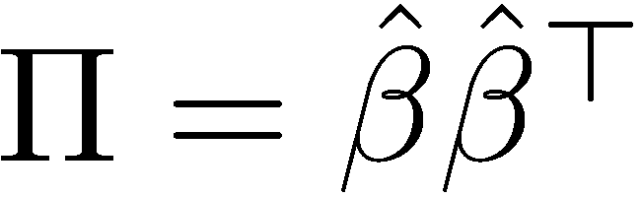
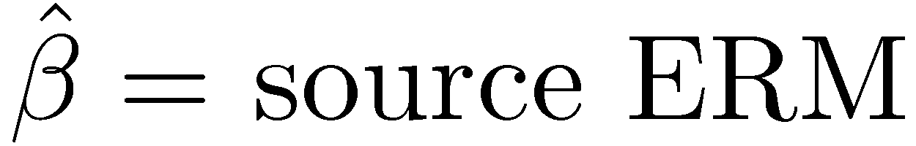
Problems with the Proxy
30
100
.
.
.
2)

Slide 30

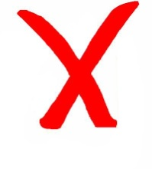
Goals
A computable bound
Description of shared representations
Suggestions for future research

Slide 31
Talk Outline
Target Generalization Bounds using Discrepancy Distance [BBCKPW 2009] [Mansour et al. 2009]
Coupled Subspace Learning
[BFK 2010]

Slide 32
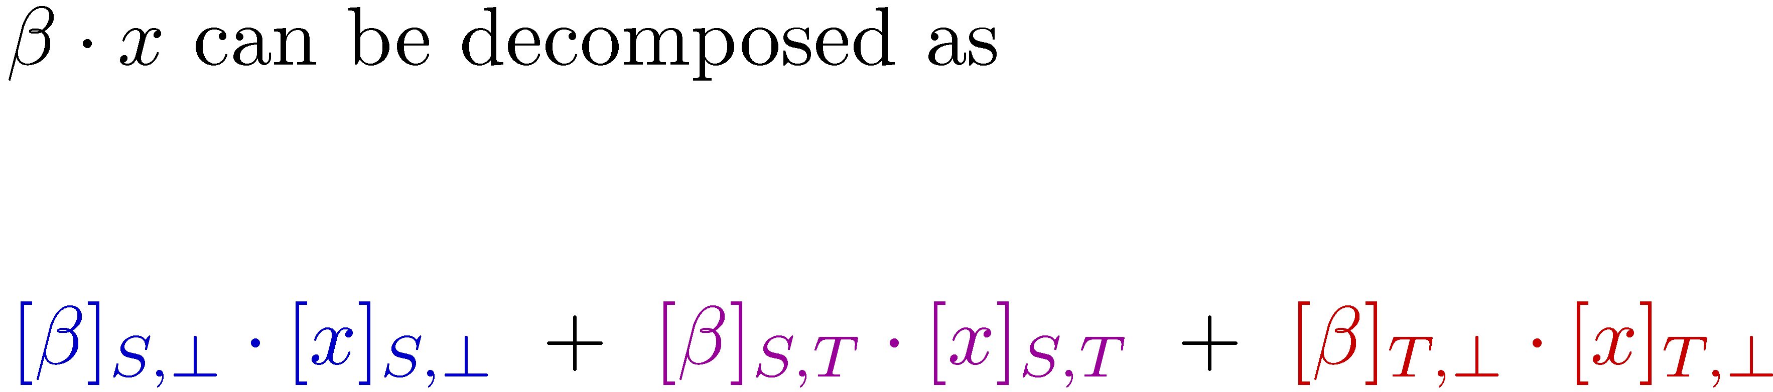
Assumption: Single Linear Predictor
source-specific
shared
target-specific
target-specific can’t be estimated from source alone
. . . yet

Slide 33
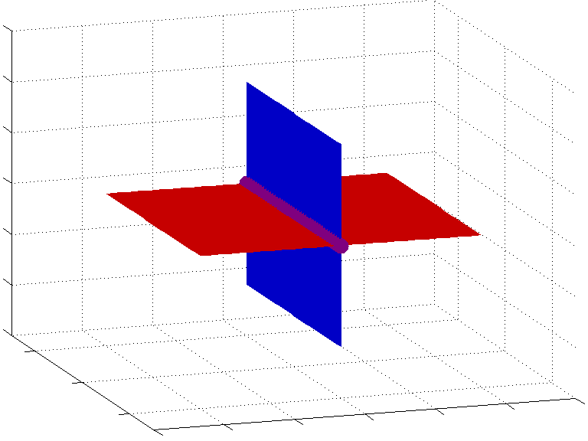
Visualizing Single Linear Predictor
source
target
fascinating
shared
don’t buy
works well

Slide 34

Visualizing Single Linear Predictor
fascinating
don’t buy
works well

Slide 35

Visualizing Single Linear Predictor
fascinating
don’t buy
works well

Slide 36
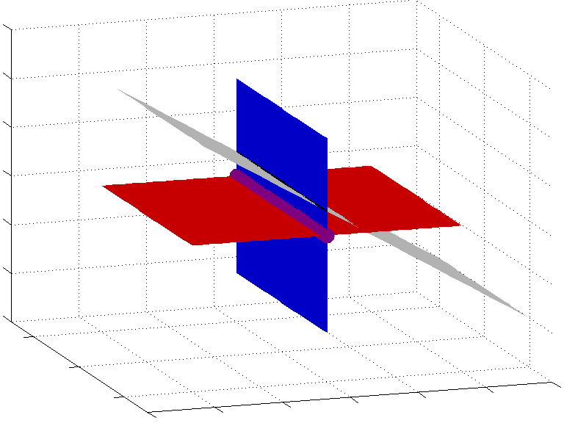
Visualizing Single Linear Predictor
fascinating
don’t buy
works well

Slide 37
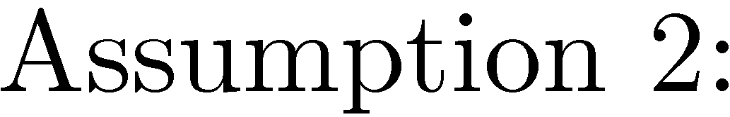
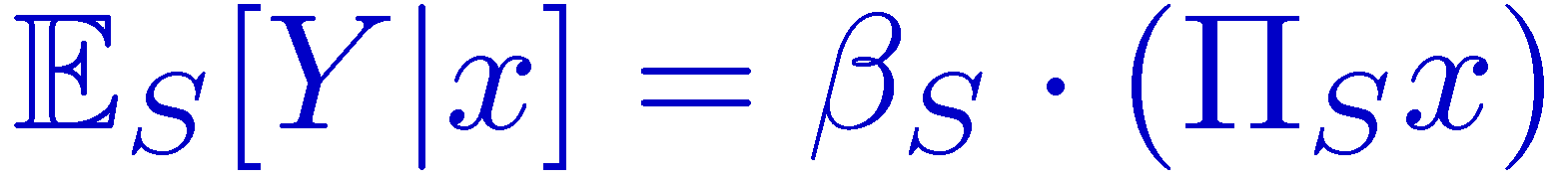
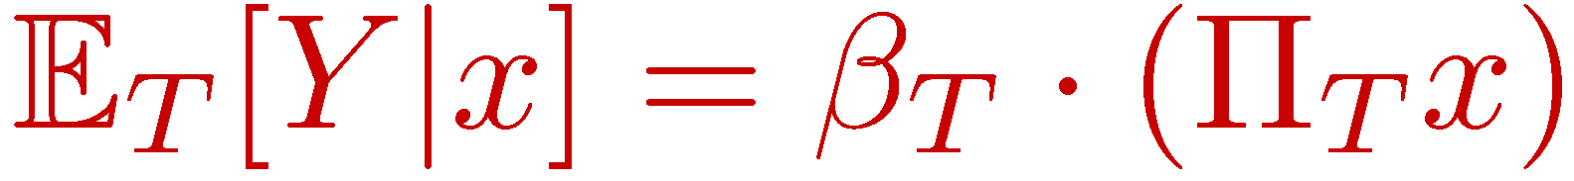
Dimensionality Reduction Assumption
Notes:
Mention all these other algorithms

Slide 38
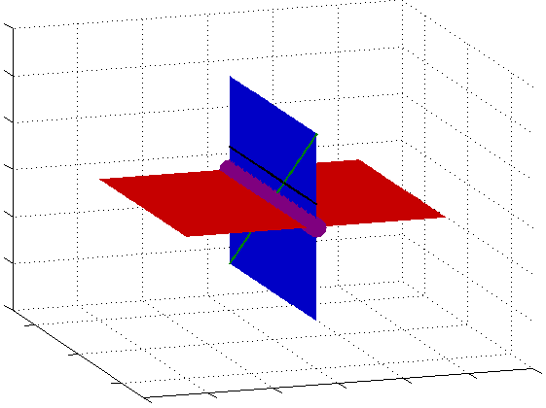
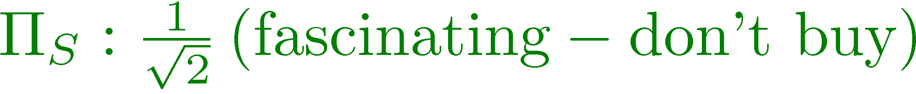
Visualizing Dimensionality Reduction
fascinating
don’t buy
works well

Slide 39
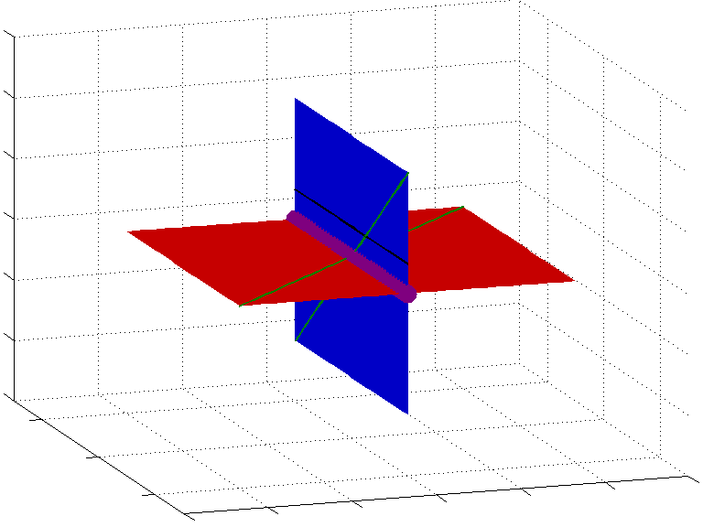
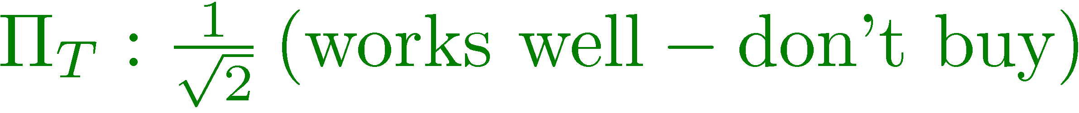
Visualizing Dimensionality Reduction
fascinating
don’t buy
works well

Slide 40
Representation Soundness
fascinating
don’t buy
works well

Slide 41

Representation Soundness
fascinating
don’t buy
works well

Slide 42

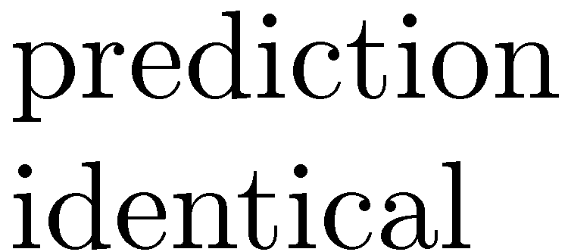
Representation Soundness
fascinating
don’t buy
works well

Slide 43
Perfect Adaptation
fascinating
don’t buy
works well
Notes:
Say: With the right Pis and Pit, then by learning on the source, we can find a perfect target predictor

Slide 44

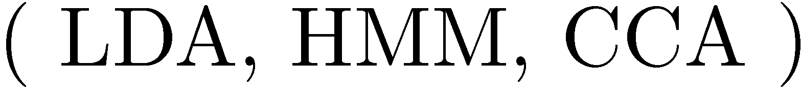
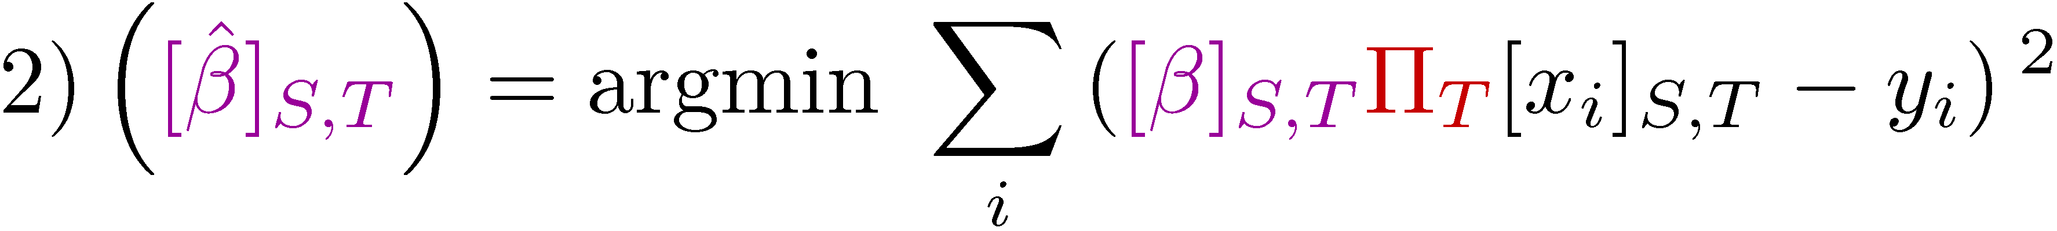



Algorithm

Slide 45
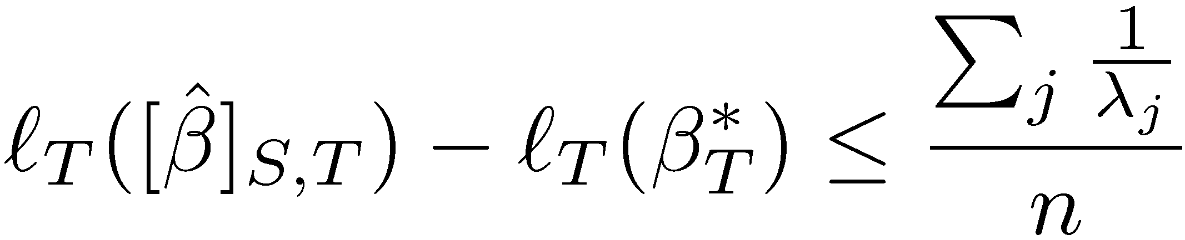
Generalization

Slide 46
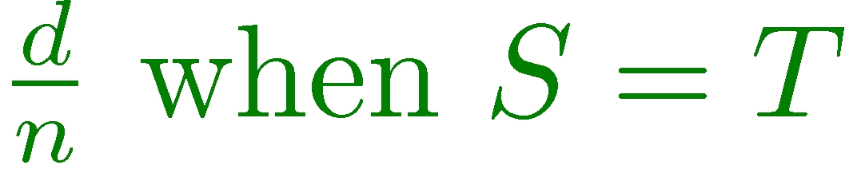
Generalization

Slide 47
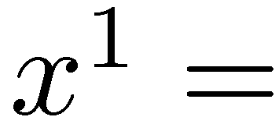
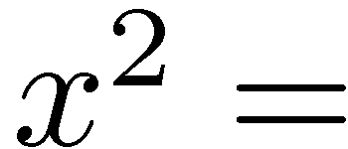
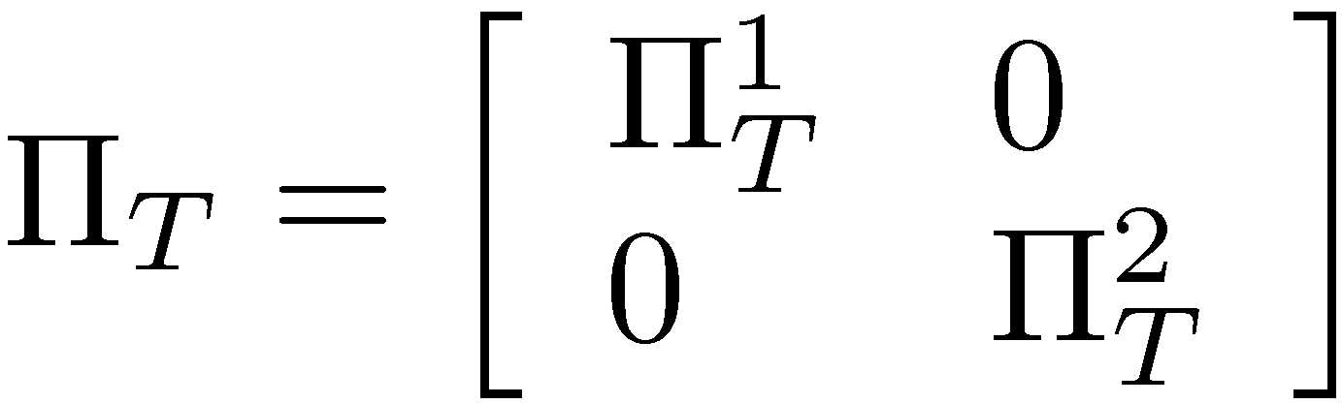
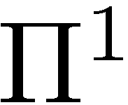
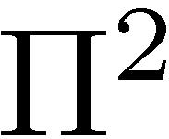
Canonical Correlation Analysis (CCA) [Hotelling 1935]
1) Divide feature space into disjoint views
Do not buy the Shark portable steamer. The trigger mechanism is defective.
not buy
trigger
defective
mechanism
2) Find maximally correlating projections
not buy
trigger
defective
mechanism

Slide 48
Canonical Correlation Analysis (CCA) [Hotelling 1935]
1) Divide feature space into disjoint views
Ando and Zhang (ACL 2005)
Kakade and Foster (COLT 2006)
Do not buy the Shark portable steamer. The trigger mechanism is defective.
not buy
trigger
defective
mechanism
2) Find maximally correlating projections
not buy
trigger
defective
mechanism

Slide 49
Square Loss: Kitchen Appliances
Square loss ( s)
Source Domain
Notes:
Fix development here. Start with ideal bar on the end.

Slide 50
Square Loss: Kitchen Appliances
Square loss ( s)
Source Domain
Notes:
Fix development here. Start with ideal bar on the end.

Slide 51


Using Target-Specific Features
books → kitchen
super easy
great product
mush
bad quality
warranty
evenly
dishwasher
kitchen → books
critique
the publisher
illustrations
trite
the author
introduction to
good reference
Notes:
Fix development here. Start with ideal bar on the end.

Slide 52
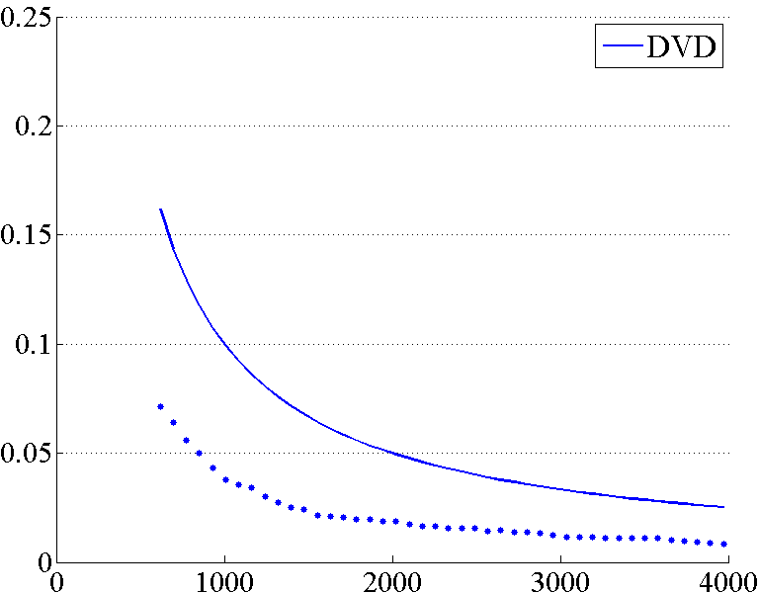
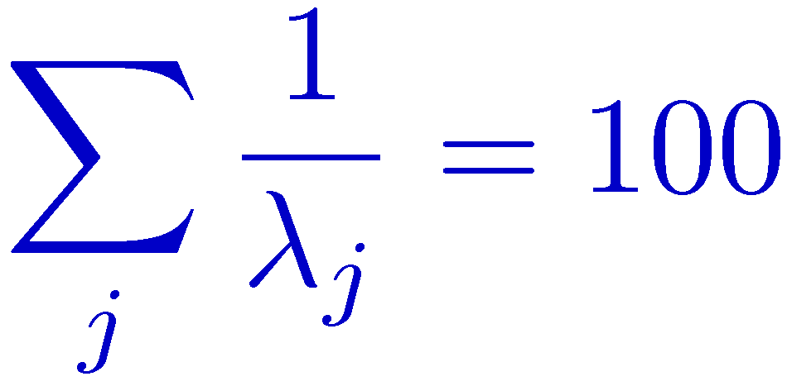
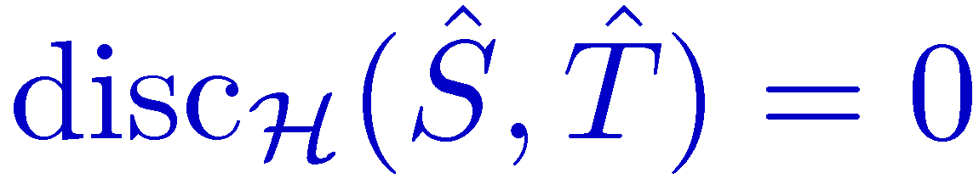
Comparing Discrepancy & Coupled Bounds
Target: DVDs
coupled bound
Square Loss
true error
Source Instances
Notes:
Fix development here. Start with ideal bar on the end.

Slide 53



Comparing Discrepancy & Coupled Bounds
Target: DVDs
Square Loss
Source Instances
Notes:
Fix development here. Start with ideal bar on the end.

Slide 54



Comparing Discrepancy & Coupled Bounds
Target: DVDs
Square Loss
Source Instances
Notes:
Fix development here. Start with ideal bar on the end.

Slide 55



Idea: Active Learning
Piyush Rai et al. (2010)
Notes:
Fix development here. Start with ideal bar on the end.

Slide 56
Goals
A computable bound
Description of shared representations
Suggestions for future research

Slide 57
Conclusion
Theory can help us understand domain adaptation better
Good theory suggests new directions for future research
There’s still a lot left to do
Connecting supervised and unsupervised adaptation
Unsupervised adaptation for problems with structure
Notes:
Fix development here. Start with ideal bar on the end.

Slide 58
Thanks
Collaborators
Shai Ben-David
Koby Crammer
Dean Foster
Sham Kakade
Alex Kulesza
Fernando Pereira
Jenn Wortman
References
Ben-David et al. A Theory of Learning from Different Domains. Machine Learning 2009.
Mansour et al. Domain Adaptation: Learning Bounds and Algorithms. COLT 2009.
Notes:
Fix development here. Start with ideal bar on the end.

