Slide 1

Domain Adaptation with Structural Correspondence Learning
John Blitzer
Joint work with
Shai Ben-David, Koby Crammer, Mark Dredze, Ryan McDonald, Fernando Pereira

Slide 2
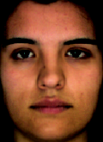
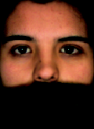
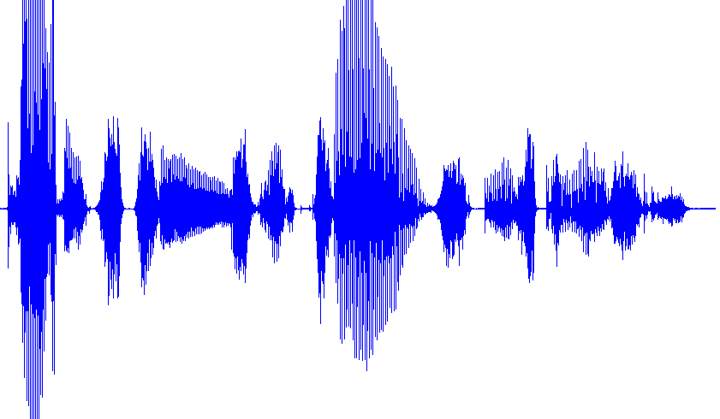
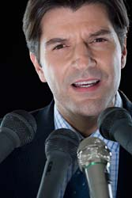
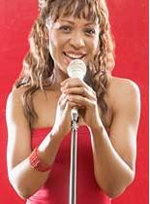
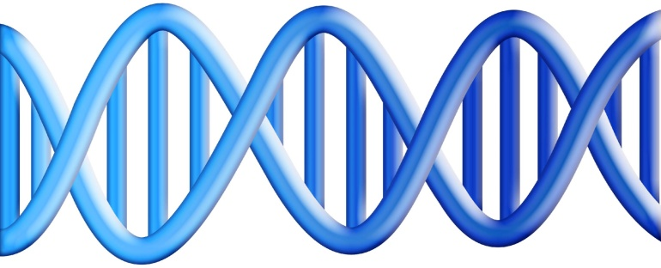
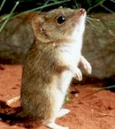
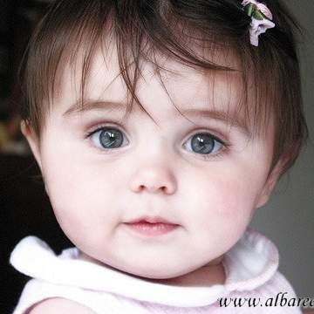
Statistical models, multiple domains

Slide 3

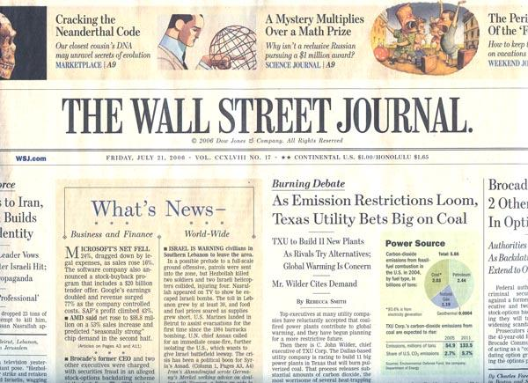
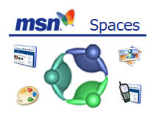
Different Domains of Text
Huge variation in vocabulary & style
“Ok, I’ll just build models for each domain I encounter”
politics
blogs
tech
blogs
sports
blogs
. . .
. . .
Yahoo 360
. . .
Yahoo 360
. . .
Yahoo 360

Slide 4

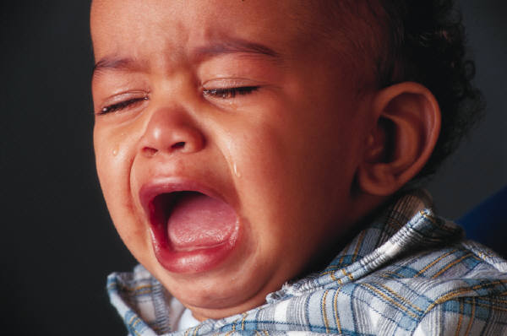
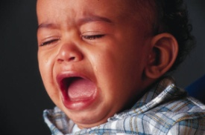
Sentiment Classification for Product Reviews
Product Review
Multiple Domains
SVM, Naïve
Bayes, etc.
kitchen appliances
Classifier
books
??
??
. . .
Positive
Negative
??
Notes:
Say: “Many companies are working on this problem. You want to mine the web for particular instances of positive or negative sentiment”

Slide 5
books & kitchen appliances
Running with Scissors: A Memoir
Title: Horrible book, horrible.
This book was horrible. I read half of it, suffering from a headache the entire time, and eventually i lit it on fire. One less copy in the world...don't waste your money. I wish i had the time spent reading this book back so i could use it for better purposes. This book wasted my life
Running with Scissors: A Memoir
Title: Horrible book, horrible.
This book was horrible. I read half of it, suffering from a headache the entire time, and eventually i lit it on fire. One less copy in the world...don't waste your money. I wish i had the time spent reading this book back so i could use it for better purposes. This book wasted my life
Avante Deep Fryer, Chrome & Black
Title: lid does not work well...
I love the way the Tefal deep fryer cooks, however, I am returning my second one due to a defective lid closure. The lid may close initially, but after a few uses it no longer stays closed. I will not be purchasing this one again.
Avante Deep Fryer, Chrome & Black
Title: lid does not work well...
I love the way the Tefal deep fryer cooks, however, I am returning my second one due to a defective lid closure. The lid may close initially, but after a few uses it no longer stays closed. I will not be purchasing this one again.
Error increase: 13% → 26%

Slide 6


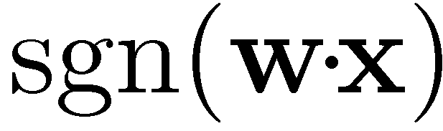
Features & Linear Models
0.3
horrible
-1
0
0.1
.
.
.
.
.
.
0
1.1
0.1
read_half
-2
0
0
0
.
.
.
.
.
.
0
-0.3
0.2
waste
-1.2
Problem: If we’ve only trained on book reviews, then w(defective) = 0

Slide 7
Structural Correspondence Learning (SCL)
Cut adaptation error by more than 40%
Use unlabeled data from the target domain
Induce correspondences among different features
read-half, headache defective, returned
Labeled data for source domain will help us build a good classifier for target domain
Maximum likelihood linear regression (MLLR) for speaker adaptation (Leggetter & Woodland, 1995)

Slide 8
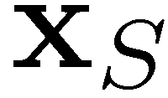

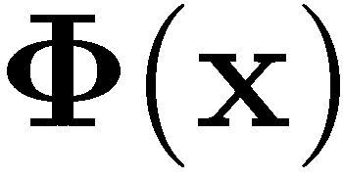
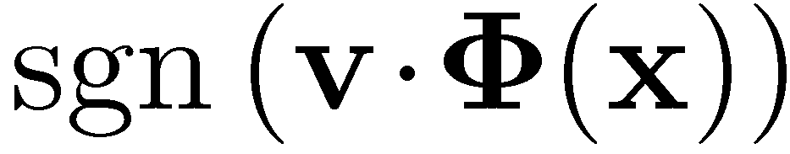

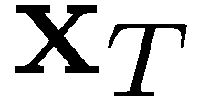
SCL: 2-Step Learning Process
Step 1: Unlabeled – Learn correspondence mapping
Step 2: Labeled – Learn weight vector
Labeled. Learn
0.1
Unlabeled.
Learn
0
.
.
.
0
0.3
should make the domains look as similar as possible
But should also allow us to classify well
0.3
-1.0
.
.
.
0
0.7
-1
-2.1
.
.
.
0
-0.7

Slide 9
SCL: Making Domains Look Similar
Incorrect classification of kitchen review
defective lid
Unlabeled kitchen contexts
Unlabeled books contexts
Do not buy the Shark portable steamer …. Trigger mechanism is defective.
the very nice lady assured me that I must have a defective set …. What a disappointment!
Maybe mine was defective …. The directions were unclear
The book is so repetitive that I found myself yelling …. I will definitely not buy another.
A disappointment …. Ender was talked about for <#> pages altogether.
it’s unclear …. It’s repetitive and boring

Slide 10
SCL: Pivot Features
Pivot Features
Occur frequently in both domains
Characterize the task we want to do
Number in the hundreds or thousands
Choose using labeled source, unlabeled source & target data
SCL: words & bigrams that occur frequently in both domains
SCL-MI: SCL but also based on mutual information with labels
book one <num> so all very about they like good when | a_must a_wonderful loved_it weak don’t_waste awful highly_recommended and_easy

Slide 11
SCL Unlabeled Step: Pivot Predictors
Use pivot features to align other features
(1) The book is so repetitive that I found myself yelling …. I will definitely not buy another.
(2) Do not buy the Shark portable steamer …. Trigger mechanism is defective.
Binary problem: Does “not buy” appear here?
Mask and predict pivot features using other features
Train N linear predictors, one for each binary problem
Each pivot predictor implicitly aligns non-pivot features from source & target domains

Slide 12
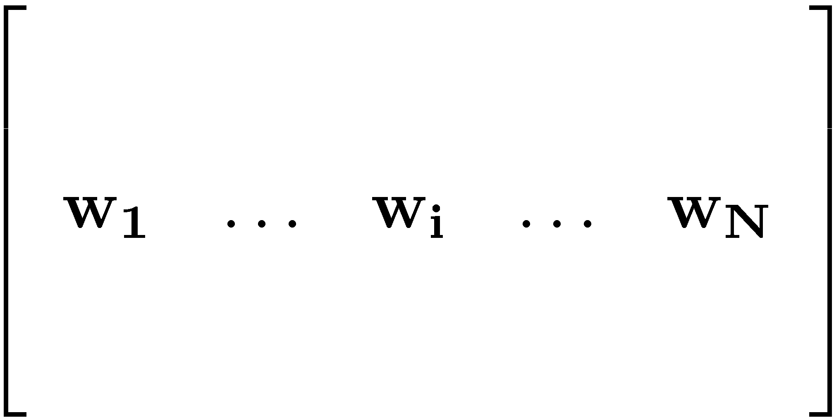

SCL: Dimensionality Reduction
gives N new features
value of i^{th} feature is the propensity to see “not buy” in the same document
We still want fewer new features (1000 is too many)
Many pivot predictors give similar information
“horrible”, “terrible”, “awful”
Compute SVD & use top left singular vectors
Latent Semantic Indexing (LSI), (Deerwester et al. 1990)
Latent Dirichlet Allocation (LDA), (Blei et al. 2003)
Notes:
********* We model an explicitly constructed feature-feature matrix by choosing pivots *********
********* We estimate the entries of that matrix discriminatively *********

Slide 13
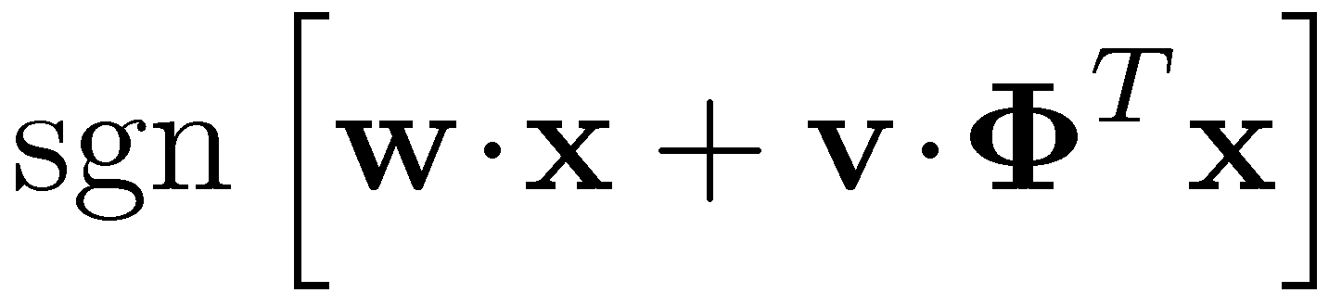

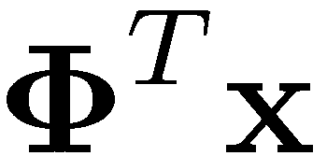
Back to Linear Classifiers
0.3
Classifier
0
.
.
.
0
Source training: Learn & together
Target testing: First apply , then apply and
0.1
0.3
-1.0
.
.
.
0.7
-2.1

Slide 14
Inspirations for SCL
Alternating Structural Optimization (ASO)
Ando & Zhang (JMLR 2005)
Inducing structures for semi-supervised learning
Correspondence Dimensionality Reduction
Ham, Lee, & Saul (AISTATS 2003)
Learn a low-dimensional representation from high-dimensional correspondences

Slide 15
Sentiment Classification Data
Product reviews from Amazon.com
Books, DVDs, Kitchen Appliances, Electronics
2000 labeled reviews from each domain
3000 – 6000 unlabeled reviews
Binary classification problem
Positive if 4 stars or more, negative if 2 or fewer
Features: unigrams & bigrams
Pivots: SCL & SCL-MI
At train time: minimize Huberized hinge loss (Zhang, 2004)

Slide 16
Visualizing (books & kitchen)
negative vs. positive
books
engaging
must_read
plot
<#>_pages
predictable
fascinating
grisham
poorly_designed
awkward_to
espresso
years_now
the_plastic
leaking
are_perfect
a_breeze
kitchen

Slide 17
Empirical Results: books & DVDs
baseline loss due to adaptation: 7.6%
SCL-MI loss due to adaptation: 0.7%

Slide 18
Empirical Results: electronics & kitchen

Slide 19
Empirical Results: books & DVDs
Sometimes SCL can cause increases in error
With only unlabeled data, we misalign features

Slide 20
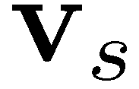
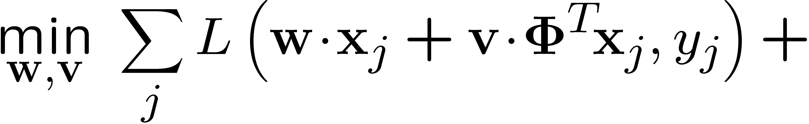
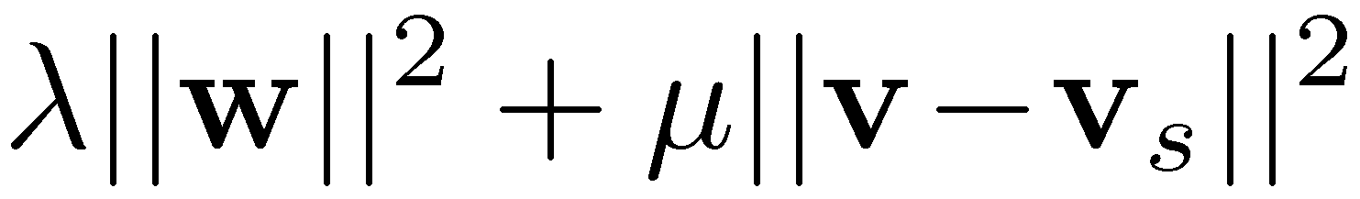
Using Labeled Data
50 instances of labeled target domain data
Source data, save weight vector for SCL features
Target data, regularize weight vector to be close to
Chelba & Acero, EMNLP 2004
Huberized hinge loss
Keep SCL weights close to source weights
Avoid using high-dimensional features

Slide 21
Empirical Results: labeled data
With 50 labeled target instances, SCL-MI always improves over baseline

Slide 22
Average Improvements
model | base | base +targ | scl | scl-mi | scl-mi +targ
Avg Adaptation Loss | 9.1 | 9.1 | 7.1 | 5.8 | 4.9
scl-mi reduces error due to transfer by 36%
adding 50 instances [Chelba & Acero 2004] without SCL does not help
scl-mi + targ reduces error due to transfer by 46%

Slide 23
Error Bounds for Domain Adaptation
Training and testing data are drawn from different distributions
Exploit unlabeled data to give computable error bounds for domain adaptation
Use these bounds in an adaptation active learning experiment

Slide 24
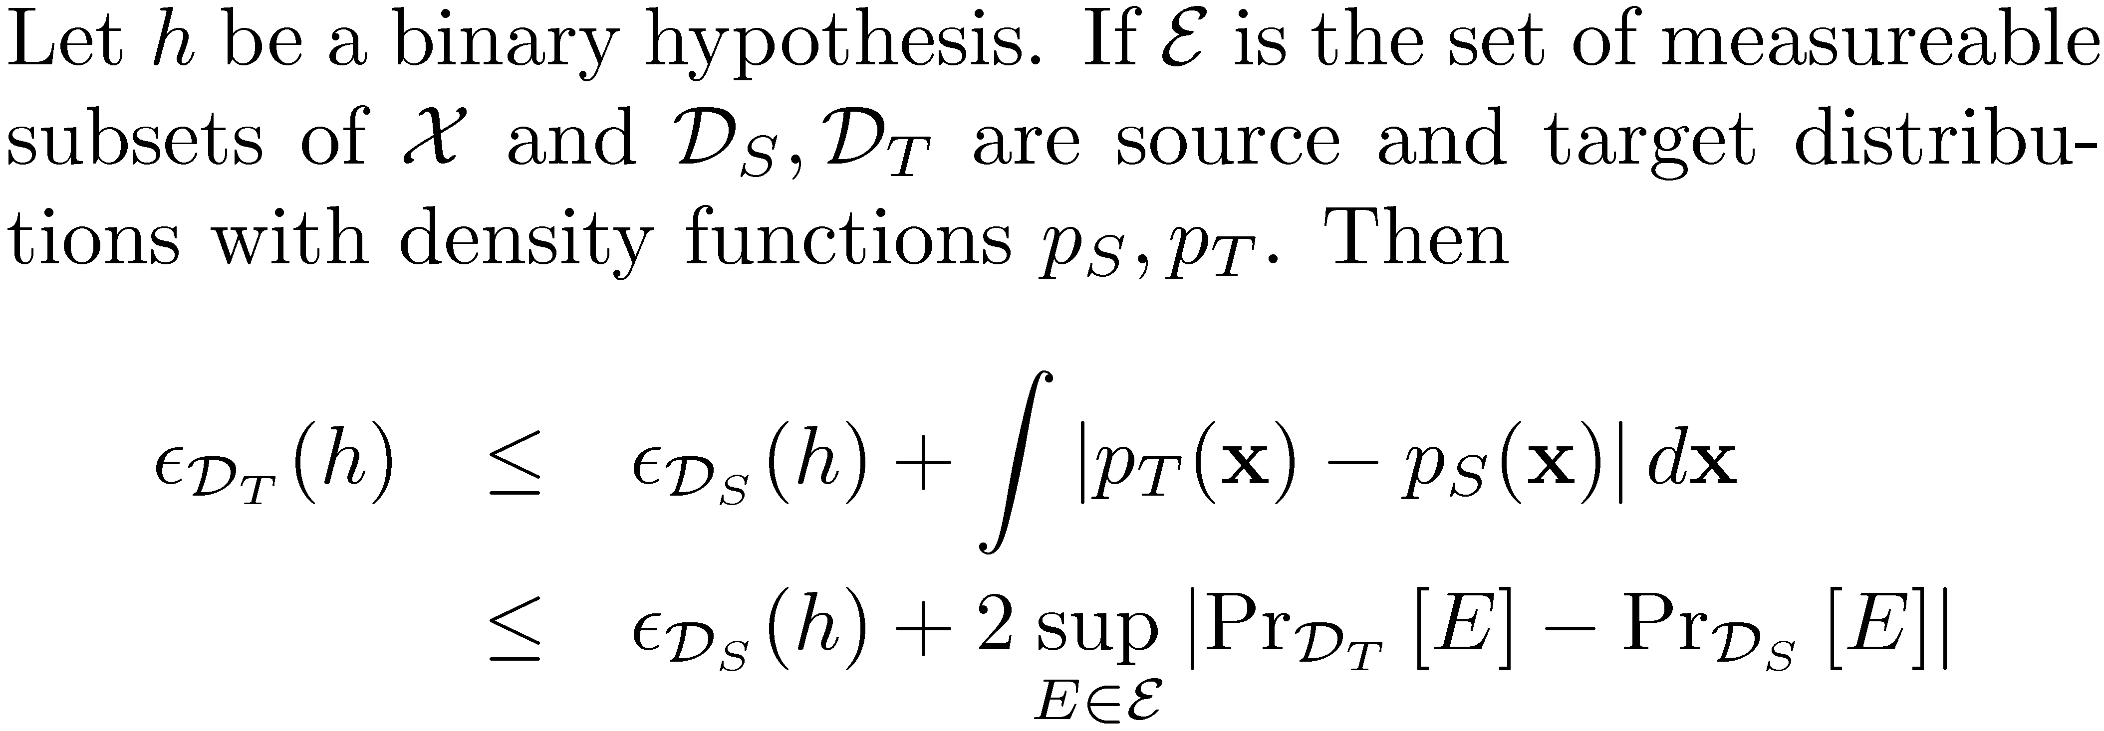
A Bound on the Adaptation Error
Difference across all measurable subsets cannot be estimated from finite samples
We’re only interested in differences related to classification error

Slide 25
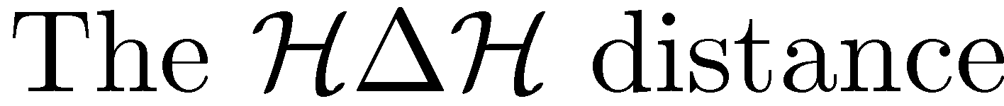
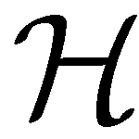
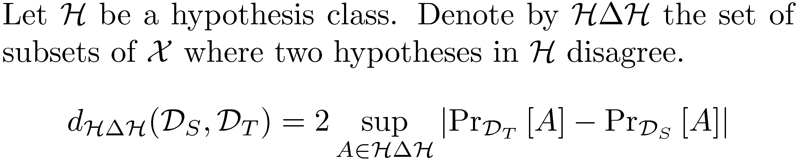
Idea: Measure subsets where hypotheses in disagree
Subsets A are error sets of one hypothesis wrt another
Always lower than L₁
computable from finite unlabeled samples.
train classifier to discriminate between source and target data

Slide 26
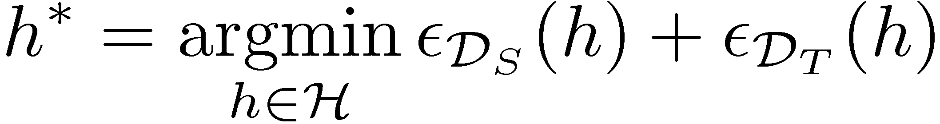
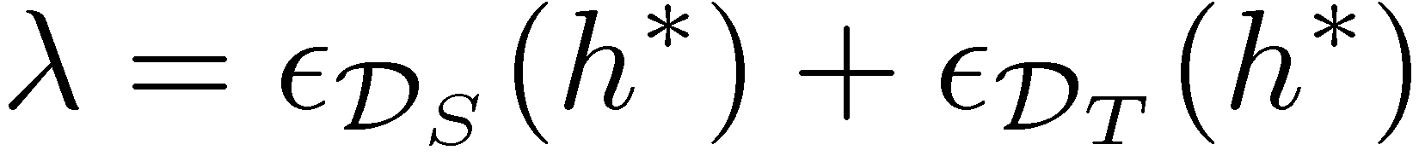
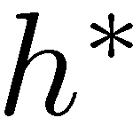

The optimal joint hypothesis
is the hypothesis with minimal combined error
is that error

Slide 27
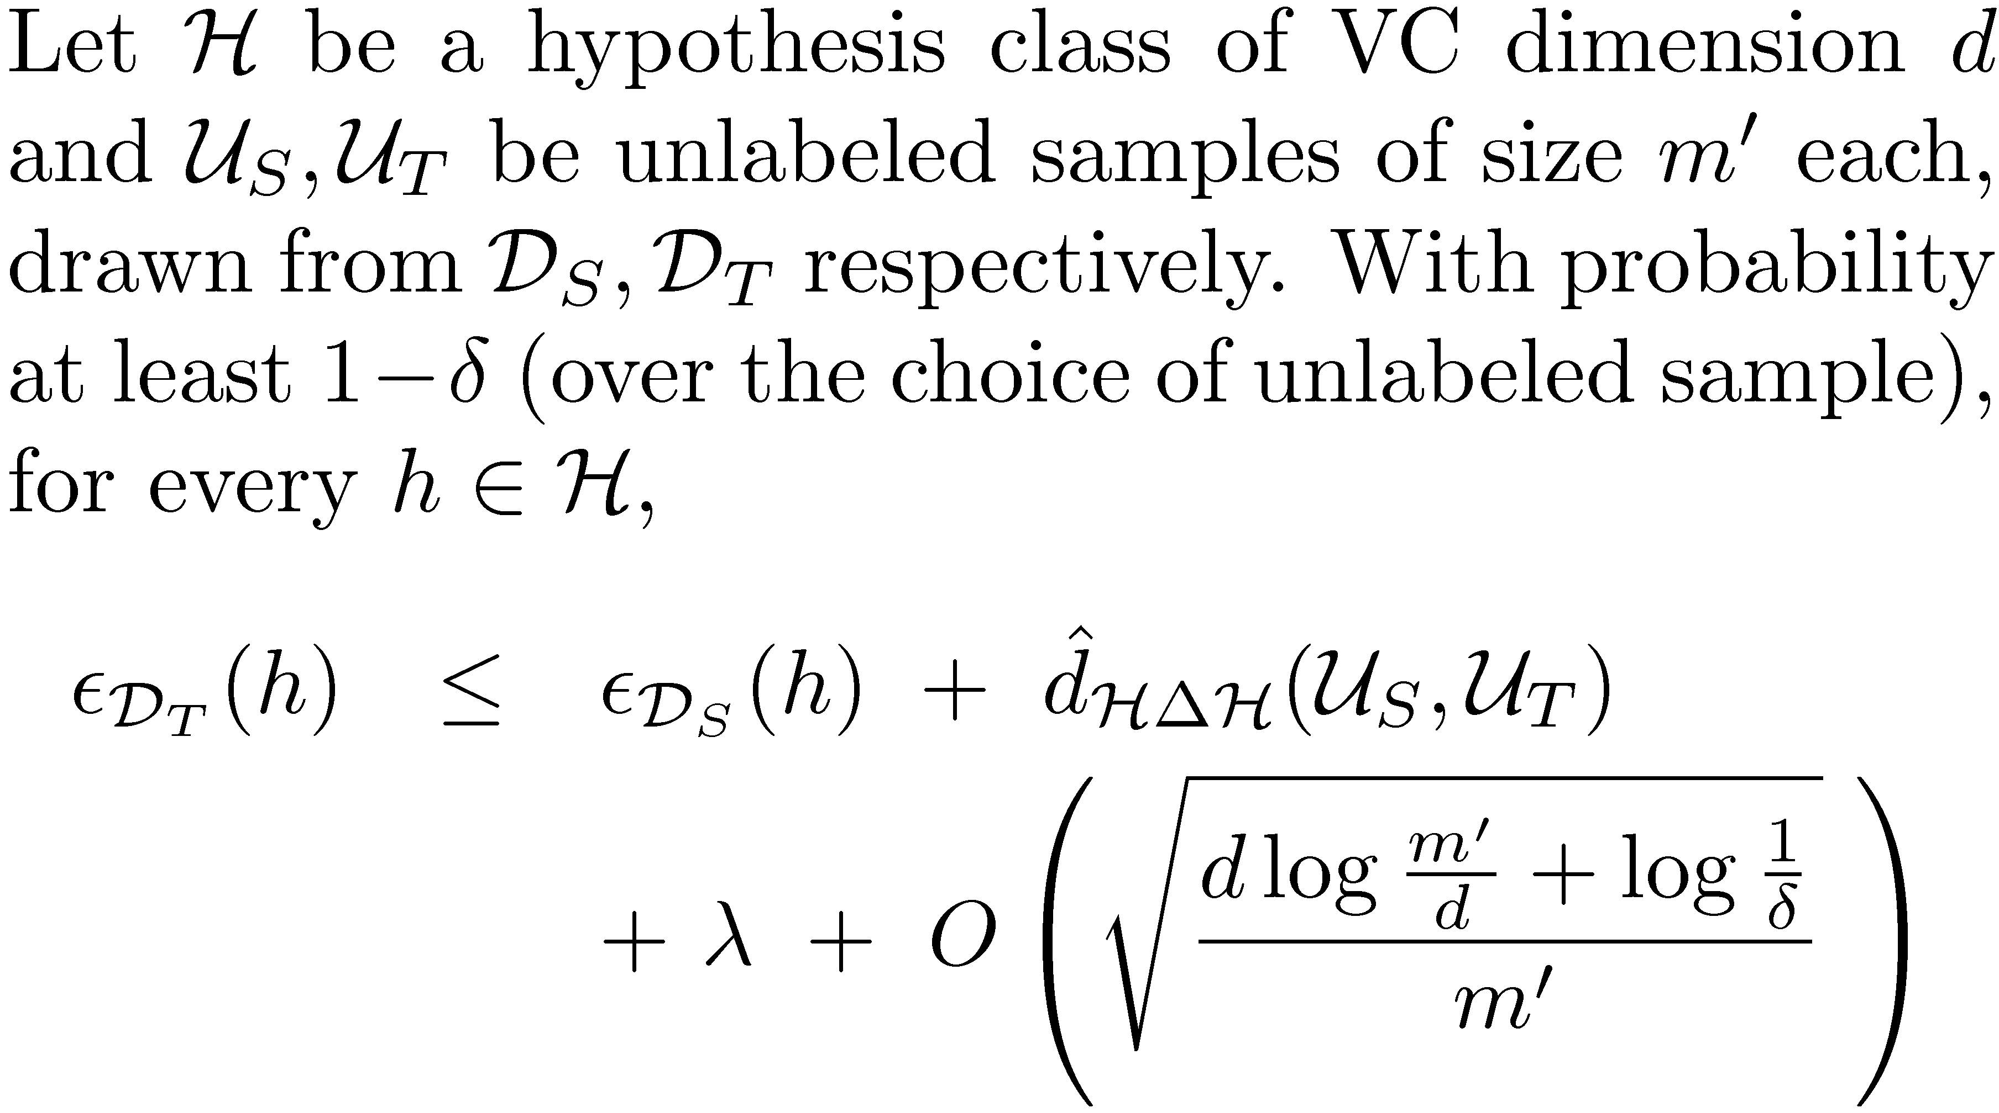
A Computable Adaptation Bound
Divergence estimation complexity
Dependent on number of unlabeled samples

Slide 28
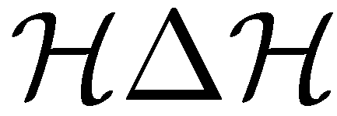
Adaptation Active Learning
Given limited resources, which domains should we label?
Train a classifier to distinguish between unlabeled source and target instances
Proxy - distance: classifier margin
Label domains to get the most coverage
one of (books, DVDs)
one of (electronics, kitchen)

Slide 29


Slide 30
Adaptation & Ranking
Input: query & list of top-ranked documents
Output: Ranking
Score documents based on editorial or click-through data
Adaptation: Different markets or query types
Pivots: common relevant features

Slide 31
Advertisement: More SCL & Theory
Domain Adaptation with Structural Correspondence Learning.
John Blitzer, Ryan McDonald, Fernando Pereira.
EMNLP 2006.
Learning Bounds for Domain Adaptation.
John Blitzer, Koby Crammer, Alex Kulesza, Fernando Pereira, Jenn Wortman.
Currently under review.

Slide 32
Pipeline Adaptation: Tagging & Parsing
Accuracy for different tagger inputs
Dependency Parsing
McDonald et al. 2005
Uses part of speech tags as features
Train on WSJ, test on MEDLINE
Use different taggers for MEDLINE input features
Accuracy
# of WSJ training sentences

Slide 33
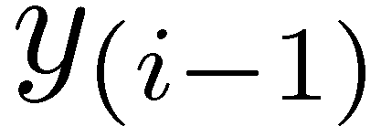
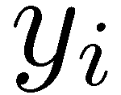
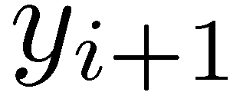
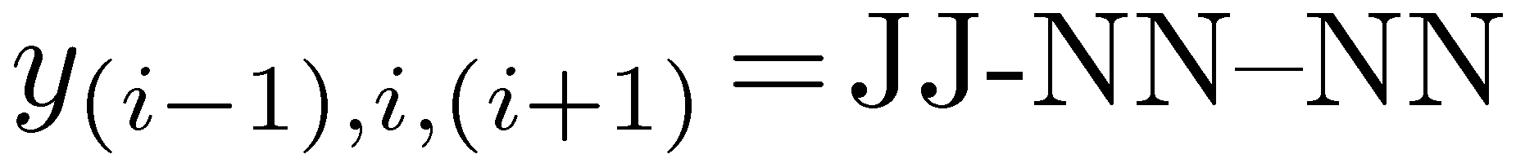
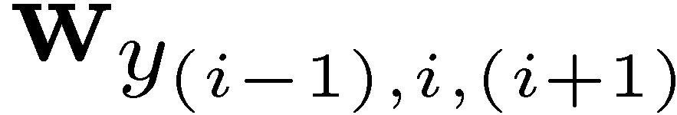
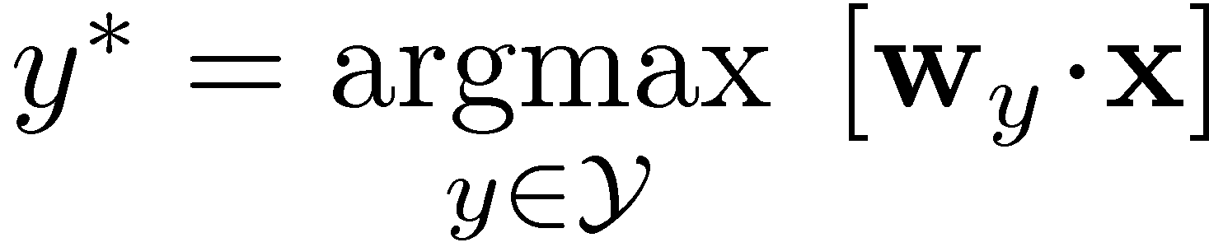
Features & Linear Models
normal signal transduction
1
LW=normal
0.5
normal signal transduction
1
RW=transduction
0.7
0
.
.
.
.
.
.
0
-2
1
MW=signal
1.1
0
0
Problem: If we’ve only trained on financial news, then w(RW=transduction) = 0

Slide 34
Future Work
SCL for other problems & modalities
named entity recognition
vision (aligning SIFT features)
speaker / acoustic environment adaptation
Learning low-dimensional representations for multi-part prediction problems
natural language parsing, machine translation, sentence compression

Slide 35
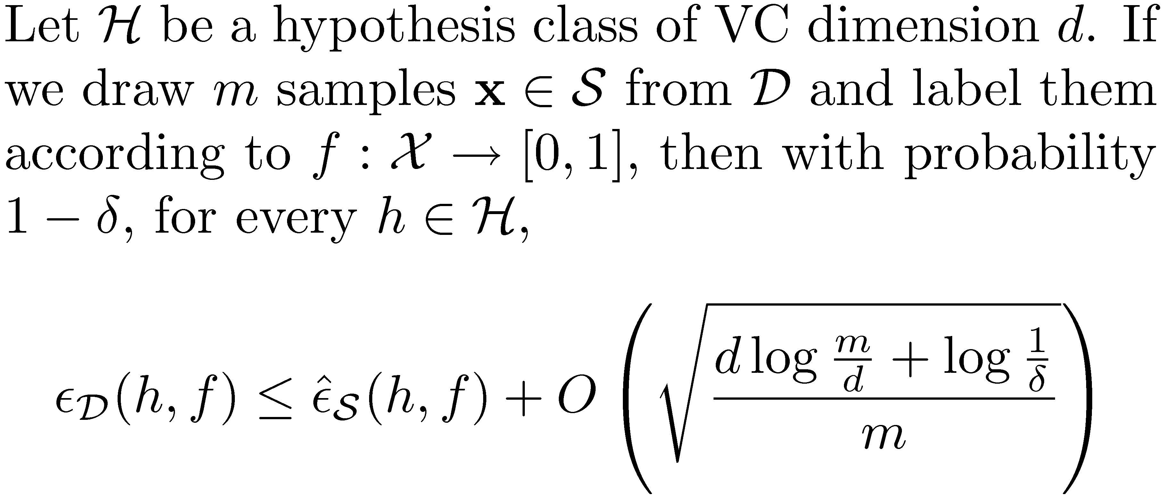
Learning Bounds for Adaptation
Standard learning bound, binary classification
Target data is drawn from a different distribution than source data

