Slide 1

Domain Adaptation with Structural Correspondence Learning
John Blitzer
Joint work with
Shai Ben-David, Koby Crammer, Mark Dredze, Ryan McDonald, Fernando Pereira

Slide 2
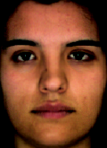
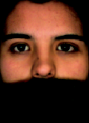
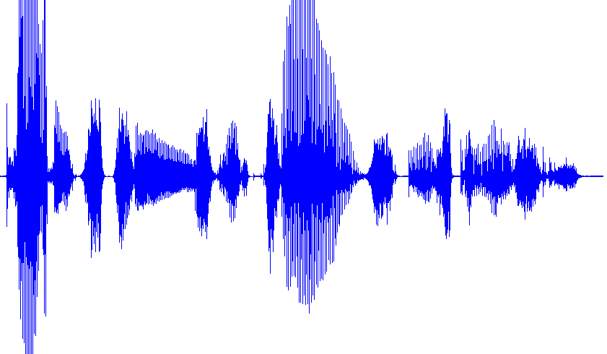
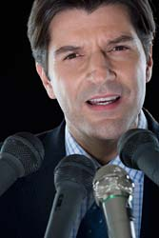
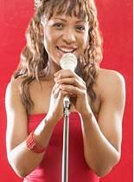

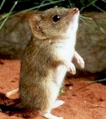
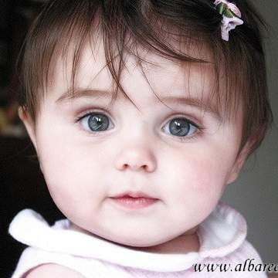
Statistical models, multiple domains

Slide 3
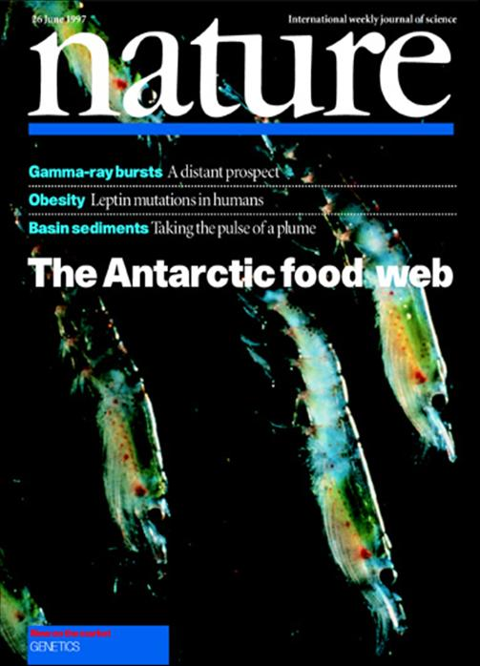


Different Domains of Text
Huge variation in vocabulary & style
“Ok, I’ll just build models for each domain I encounter”
politics
blogs
tech
blogs
sports
blogs
. . .
. . .
Yahoo 360
. . .
Yahoo 360
. . .
Yahoo 360

Slide 4

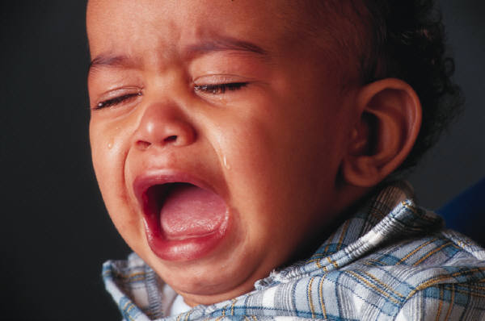
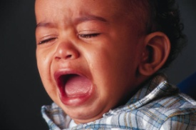
Sentiment Classification for Product Reviews
Product Review
Multiple Domains
SVM, Naïve
Bayes, etc.
kitchen appliances
Classifier
books
??
??
. . .
Positive
Negative
??
Notes:
Say: “Many companies are working on this problem. You want to mine the web for particular instances of positive or negative sentiment”

Slide 5
books & kitchen appliances
Running with Scissors: A Memoir
Title: Horrible book, horrible.
This book was horrible. I read half of it, suffering from a headache the entire time, and eventually i lit it on fire. One less copy in the world...don't waste your money. I wish i had the time spent reading this book back so i could use it for better purposes. This book wasted my life
Running with Scissors: A Memoir
Title: Horrible book, horrible.
This book was horrible. I read half of it, suffering from a headache the entire time, and eventually i lit it on fire. One less copy in the world...don't waste your money. I wish i had the time spent reading this book back so i could use it for better purposes. This book wasted my life
Avante Deep Fryer, Chrome & Black
Title: lid does not work well...
I love the way the Tefal deep fryer cooks, however, I am returning my second one due to a defective lid closure. The lid may close initially, but after a few uses it no longer stays closed. I will not be purchasing this one again.
Avante Deep Fryer, Chrome & Black
Title: lid does not work well...
I love the way the Tefal deep fryer cooks, however, I am returning my second one due to a defective lid closure. The lid may close initially, but after a few uses it no longer stays closed. I will not be purchasing this one again.
Error increase: 13% → 26%

Slide 6
Part of Speech Tagging
Wall Street Journal (WSJ)
DT NN VBZ DT NN IN DT JJ NN CC
The clash is a sign of a new toughness and
NN IN NNP POS JJ JJ NNS .
divisiveness in Japan ‘s once-cozy financial circles .
DT NN VBZ DT NN IN DT JJ NN CC
The clash is a sign of a new toughness and
NN IN NNP POS JJ JJ NNS .
divisiveness in Japan ‘s once-cozy financial circles .
Error increase: 3% → 12%
MEDLINE Abstracts (biomed)
DT JJ VBN NNS IN DT NN NNS VBP
The oncogenic mutated forms of the ras proteins are
RB JJ CC VBP IN JJ NN
constitutively active and interfere with normal signal
NN .
transduction .
DT JJ VBN NNS IN DT NN NNS VBP
The oncogenic mutated forms of the ras proteins are
RB JJ CC VBP IN JJ NN
constitutively active and interfere with normal signal
NN .
transduction .

Slide 7


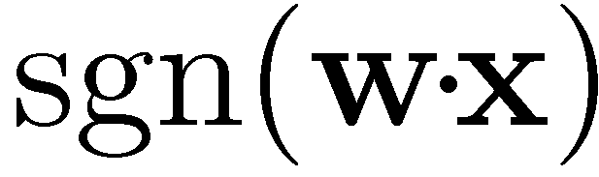
Features & Linear Models
0.3
horrible
-1
0
0.1
.
.
.
.
.
.
0
1.1
0.1
read_half
-2
0
0
0
.
.
.
.
.
.
0
-0.3
0.2
waste
-1.2
Problem: If we’ve only trained on book reviews, then w(defective) = 0

Slide 8
Structural Correspondence Learning (SCL)
Cut adaptation error by more than 40%
Use unlabeled data from the target domain
Induce correspondences among different features
read-half, headache defective, returned
Labeled data for source domain will help us build a good classifier for target domain
Maximum likelihood linear regression (MLLR) for speaker adaptation (Leggetter & Woodland, 1995)

Slide 9
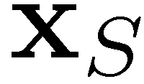

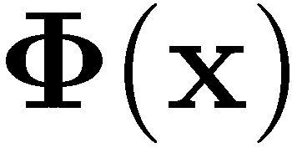
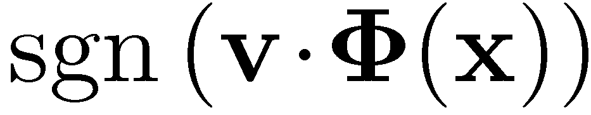

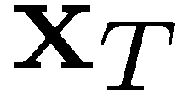
SCL: 2-Step Learning Process
Step 1: Unlabeled – Learn correspondence mapping
Step 2: Labeled – Learn weight vector
Labeled. Learn
0.1
Unlabeled.
Learn
0
.
.
.
0
0.3
should make the domains look as similar as possible
But should also allow us to classify well
0.3
-1.0
.
.
.
0
0.7
-1
-2.1
.
.
.
0
-0.7

Slide 10
SCL: Making Domains Look Similar
Incorrect classification of kitchen review
defective lid
Unlabeled kitchen contexts
Unlabeled books contexts
Do not buy the Shark portable steamer …. Trigger mechanism is defective.
the very nice lady assured me that I must have a defective set …. What a disappointment!
Maybe mine was defective …. The directions were unclear
The book is so repetitive that I found myself yelling …. I will definitely not buy another.
A disappointment …. Ender was talked about for <#> pages altogether.
it’s unclear …. It’s repetitive and boring

Slide 11
SCL: Pivot Features
Pivot Features
Occur frequently in both domains
Characterize the task we want to do
Number in the hundreds or thousands
Choose using labeled source, unlabeled source & target data
SCL: words & bigrams that occur frequently in both domains
SCL-MI: SCL but also based on mutual information with labels
book one <num> so all very about they like good when | a_must a_wonderful loved_it weak don’t_waste awful highly_recommended and_easy

Slide 12
SCL Unlabeled Step: Pivot Predictors
Use pivot features to align other features
(1) The book is so repetitive that I found myself yelling …. I will definitely not buy another.
(2) Do not buy the Shark portable steamer …. Trigger mechanism is defective.
Binary problem: Does “not buy” appear here?
Mask and predict pivot features using other features
Train N linear predictors, one for each binary problem
Each pivot predictor implicitly aligns non-pivot features from source & target domains

Slide 13
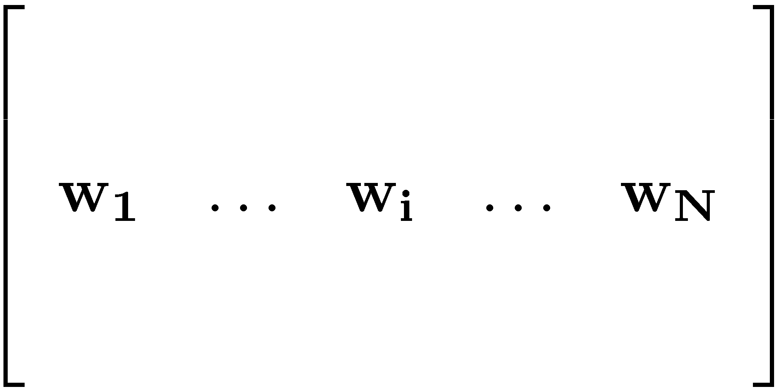

SCL: Dimensionality Reduction
gives N new features
value of i^{th} feature is the propensity to see “not buy” in the same document
We still want fewer new features (1000 is too many)
Many pivot predictors give similar information
“horrible”, “terrible”, “awful”
Compute SVD & use top left singular vectors
Latent Semantic Indexing (LSI), (Deerwester et al. 1990)
Latent Dirichlet Allocation (LDA), (Blei et al. 2003)
Notes:
********* We model an explicitly constructed feature-feature matrix by choosing pivots *********
********* We estimate the entries of that matrix discriminatively *********

Slide 14
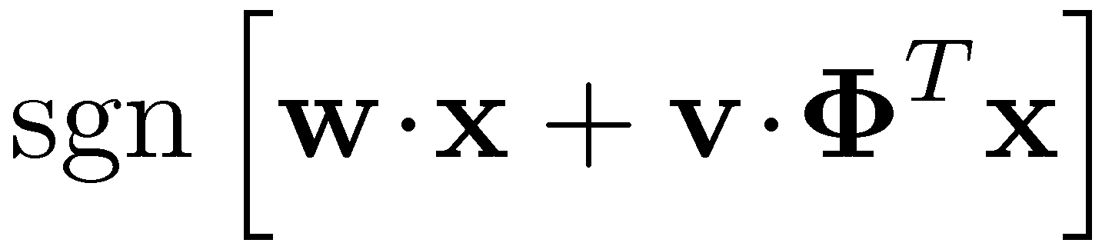

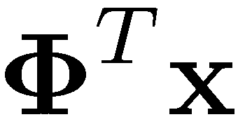
Back to Linear Classifiers
0.3
Classifier
0
.
.
.
0
Source training: Learn & together
Target testing: First apply , then apply and
0.1
0.3
-1.0
.
.
.
0.7
-2.1

Slide 15
Inspirations for SCL
Alternating Structural Optimization (ASO)
Ando & Zhang (JMLR 2005)
Inducing structures for semi-supervised learning
Correspondence Dimensionality Reduction
Verbeek, Roweis, & Vlassis (NIPS 2003).
Ham, Lee, & Saul (AISTATS 2003).
Learn a low-dimensional representation from high-dimensional correspondences

Slide 16
Sentiment Classification Data
Product reviews from Amazon.com
Books, DVDs, Kitchen Appliances, Electronics
2000 labeled reviews from each domain
3000 – 6000 unlabeled reviews
Binary classification problem
Positive if 4 stars or more, negative if 2 or less
Features: unigrams & bigrams
Pivots: SCL & SCL-MI
At train time: minimize Huberized hinge loss (Zhang, 2004)

Slide 17
Visualizing (books & kitchen)
negative vs. positive
books
engaging
must_read
plot
<#>_pages
predictable
fascinating
grisham
poorly_designed
awkward_to
espresso
years_now
the_plastic
leaking
are_perfect
a_breeze
kitchen

Slide 18
Empirical Results: books & DVDs
baseline loss due to adaptation: 7.6%
SCL-MI loss due to adaptation: 0.7%

Slide 19
Empirical Results: electronics & kitchen

Slide 20
Empirical Results: books & DVDs
Sometimes SCL can cause increases in error
With only unlabeled data, we misalign features

Slide 21
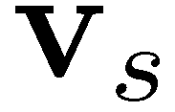
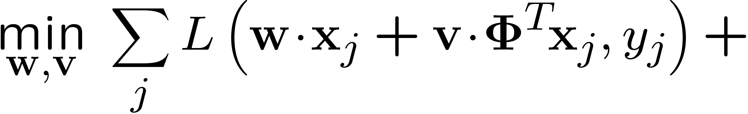
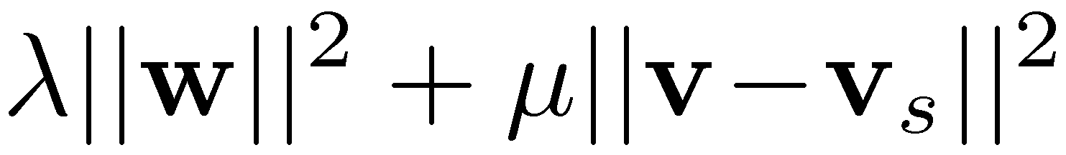
Using Labeled Data
50 instances of labeled target domain data
Source data, save weight vector for SCL features
Target data, regularize weight vector to be close to
Chelba & Acero, EMNLP 2004
Huberized hinge loss
Keep SCL weights close to source weights
Avoid using high-dimensional features

Slide 22
Empirical Results: labeled data
With 50 labeled target instances, SCL-MI always improves over baseline

Slide 23
Average Improvements
model | base | base +targ | scl | scl-mi | scl-mi +targ
Avg Adaptation Loss | 9.1 | 9.1 | 7.1 | 5.8 | 4.9
scl-mi reduces error due to transfer by 36%
adding 50 instances [Chelba & Acero 2004] without SCL does not help
scl-mi + targ reduces error due to transfer by 46%

Slide 24
PoS Tagging: Data & Model
Data
40k Wall Street Journal (WSJ) training sentences
100k unlabeled biomedical sentences
100k unlabeled WSJ sentences
Supervised Learner
MIRA CRF: Online max-margin learner
Separate correct label from top k=5 incorrect labels
Crammer et al. JMLR 2006
Pivots: Common left/middle/right words

Slide 25
Visualizing PoS Tagging
nouns vs. adjs & dets
MEDLINE
assays
neuronal
transient
receptors
mutation
lesions
metastatic
functional
transaction
officials
political
your
company
investors
short-term
pretty
Wall Street Journal

Slide 26
Empirical Results
561 MEDLINE test sentences
Model | All Words | Unk words
MXPOST | 87.2 | 65.2
super | 87.9 | 68.4
semi-ASO | 88.4 | 70.9
SCL | 88.9 | 72.0
Accuracy
McNemar’s test
Null Hyp | p-value
semi vs. super | <0.0015
SCL vs. super | <10⁻¹²
SCL vs. semi | <0.0003
# of WSJ training sentences

Slide 27
Results: Some labeled target domain data
561 MEDLINE test sentences
Model | Accuracy
1k-SCL | 95.0
1k-super | 94.5
Nosource | 94.5
Accuracy
Use source tagger output as a feature (Florian et al. 2004)
Compare SCL with supervised source tagger
# of MEDLINE training sentences

Slide 28
Adaptation & Machine Translation
Source: Domain specific parallel corpora (news, legal text)
Target: Similar corpora from the web (i.e. blogs)
Learn translation rules / language model parameters for the new domain
Pivots: common contexts

Slide 29
Adaptation & Ranking
Input: query & list of top-ranked documents
Output: Ranking
Score documents based on editorial or click-through data
Adaptation: Different markets or query types
Pivots: common relevant features

Slide 30
Learning Theory & Adaptation
Bounds on the error of models in new domains
Analysis of Representations for Domain Adaptation.
Shai Ben-David, John Blitzer, Koby Crammer, Fernando Pereira.
NIPS 2006.
Learning Bounds for Domain Adaptation.
John Blitzer, Koby Crammer, Alex Kulesza, Fernando Pereira, Jenn Wortman.
NIPS 2007 (To Appear).

Slide 31
Pipeline Adaptation: Tagging & Parsing
Accuracy for different tagger inputs
Dependency Parsing
McDonald et al. 2005
Uses part of speech tags as features
Train on WSJ, test on MEDLINE
Use different taggers for MEDLINE input features
Accuracy
# of WSJ training sentences

Slide 32
Measuring Adaptability
Given limited resources, which domains should we label?
Idea: Train a classifier to distinguish instances from different domains
Error of this classifier is an estimate of loss due to adaptation

Slide 33
A-distance vs Adaptation loss
Suppose we can afford to label 2 domains
Then we should label 1 of electronics/kitchen and 1 of books/DVDs

Slide 34
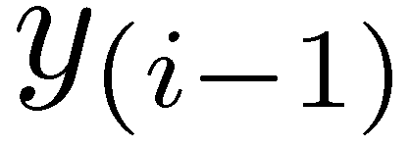
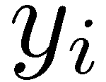
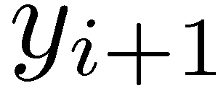
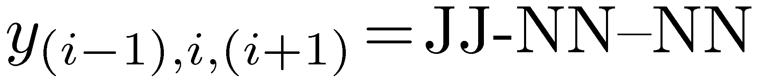
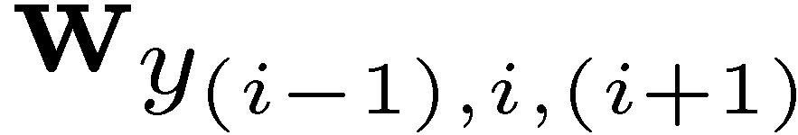
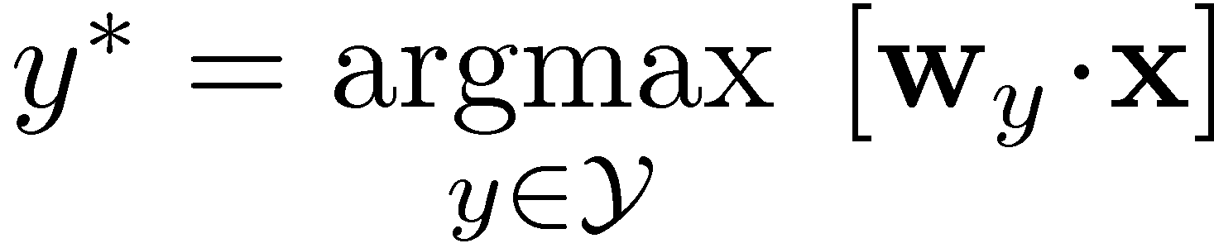
Features & Linear Models
normal signal transduction
1
LW=normal
0.5
normal signal transduction
1
RW=transduction
0.7
0
.
.
.
.
.
.
0
-2
1
MW=signal
1.1
0
0
Problem: If we’ve only trained on financial news, then w(RW=transduction) = 0

Slide 35
Future Work
SCL for other problems & modalities
named entity recognition
vision (aligning SIFT features)
speaker / acoustic environment adaptation
Learning low-dimensional representations for multi-part prediction problems
natural language parsing, machine translation, sentence compression

