Slide 1
Joint Parsing and Alignment with Weakly Synchronized Grammars
David Burkett, John Blitzer, & Dan Klein
TexPoint fonts used in EMF.
Read the TexPoint manual before you delete this box.: AAAAAAAAA

Slide 2
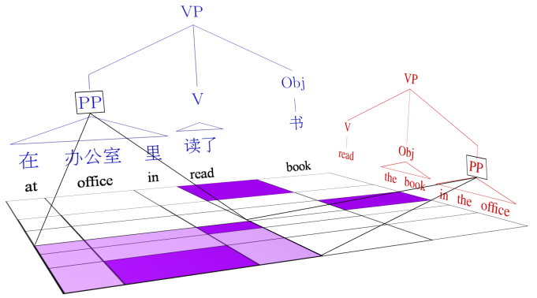
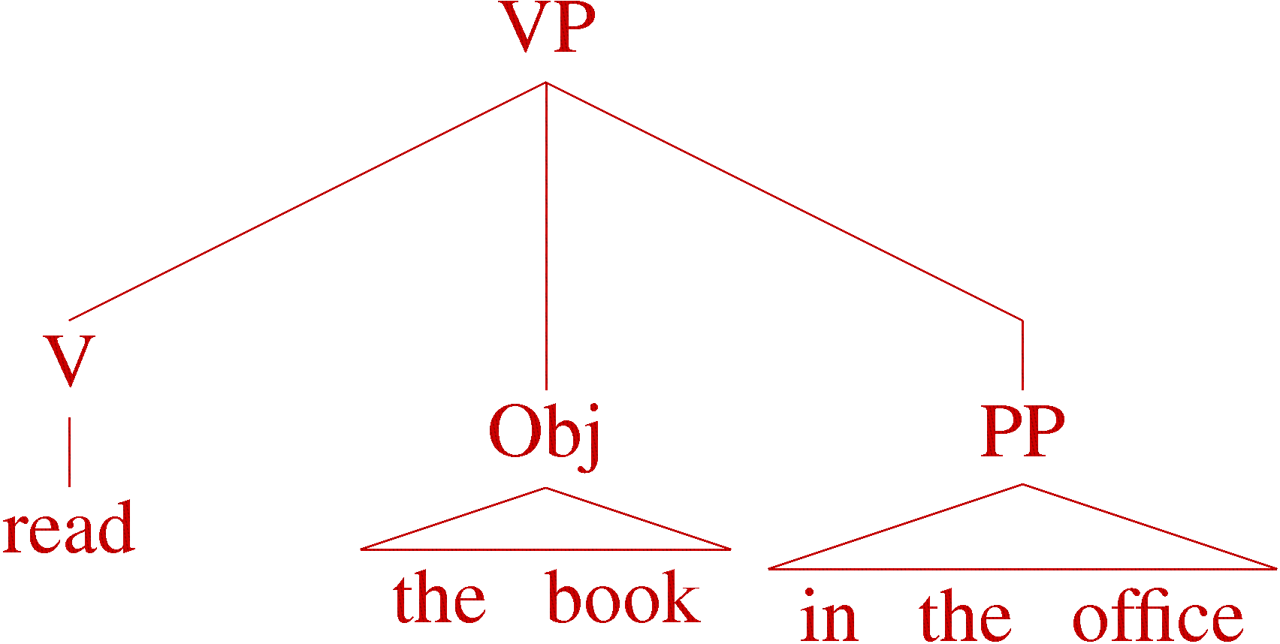
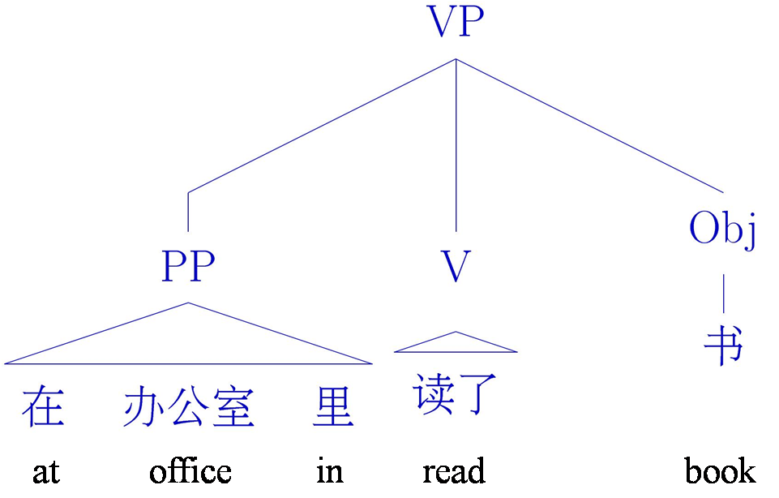
Statistical MT Training Pipeline
}
1) Align sentence pairs (GIZA++)
2) Parse English sentences (Berkeley parser)
Parse Foreign sentences
3) Extract rules (Galley et al. 2006)
4) Tune discriminative parameters
Joint model for (1) & (2)
在 at | 办公室 office | 里 in | 读了 read | 书 book
 |  |  |  |  | read
 |  |  |  |  | the
 |  |  |  |  | book
 |  |  |  |  | in
 |  |  |  |  | the
 |  |  |  |  | office

Slide 3
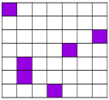
Data Setting for Joint Models
Unlabeled parallel text
Parallel, Aligned CTB
English WSJ
Chinese CTB
(EN; )
(中文; )
(EN;中文)
(EN,中文; )
(EN; )
(中文; )
(EN;中文)
(EN,中文; )
.
.
.
.
.
.
.
.
.
.
.
.
(EN; )
(中文; )
(EN;中文)
(EN,中文; )
Notes:
Show monolingual parsing here
But we actually have translations. Because of that we can do better, but only if our model represents how parts of structure correspond

Slide 4
Word alignment grids
在 at | 办公室 office | 里 in | 读了 read | 书 book
 |  |  |  |  | read
 |  |  |  |  | the
 |  |  |  |  | book
 |  |  |  |  | in
 |  |  |  |  | the
 |  |  |  |  | office

Slide 5
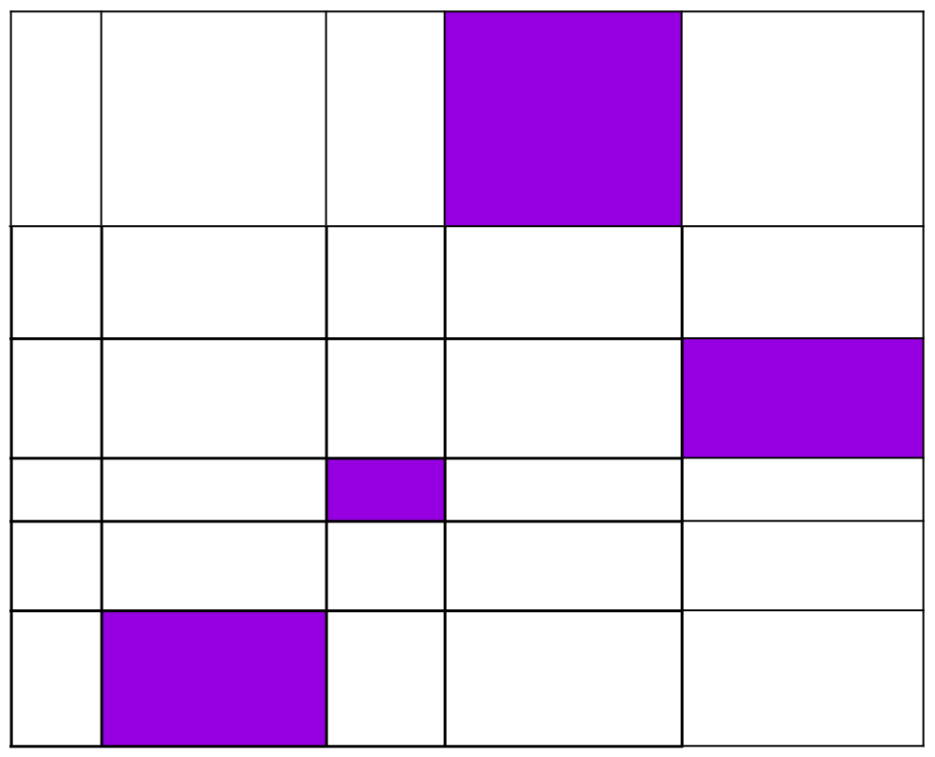
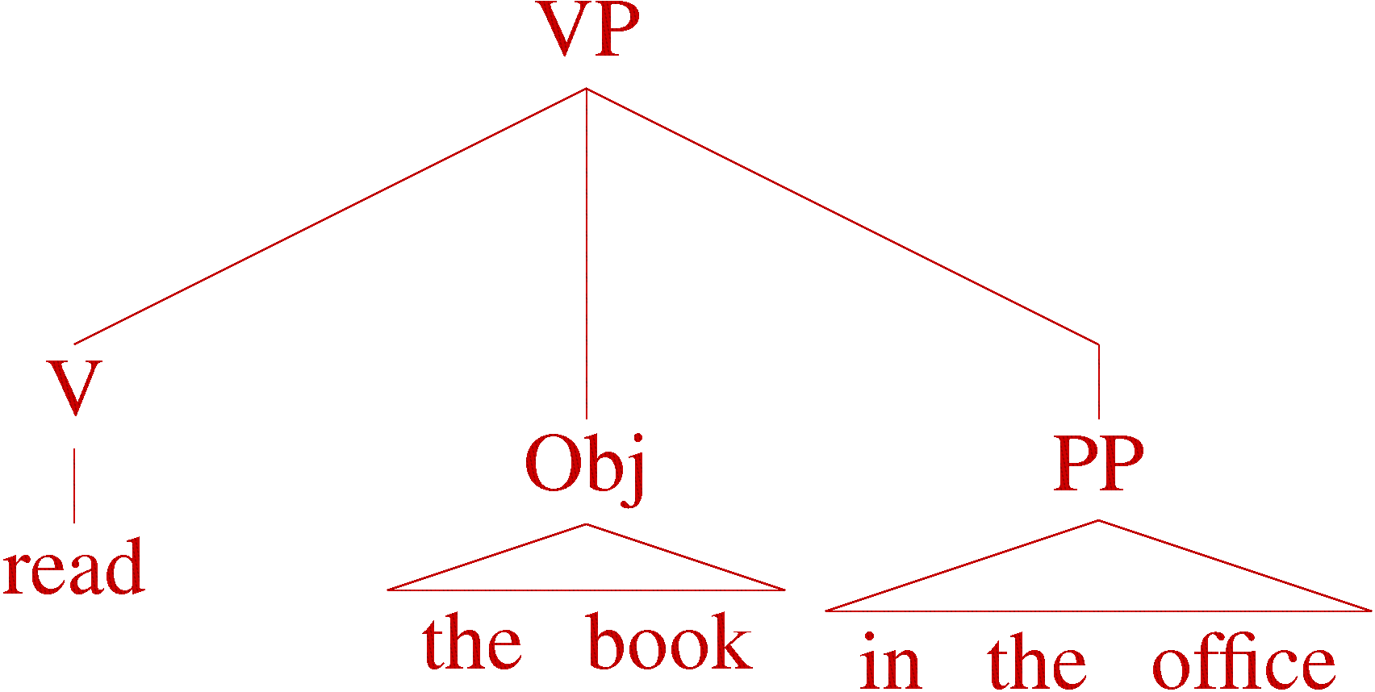


Syntactic Correspondences
Build a model
中文
EN

Slide 6
Correspondence via Synchronous Grammars
Notes:
Now how do we talk about a model which has 2 corresponding trees? Synchronicity

Slide 7
Synchronous derivation

Slide 8
Synchronous Derivation

Slide 9
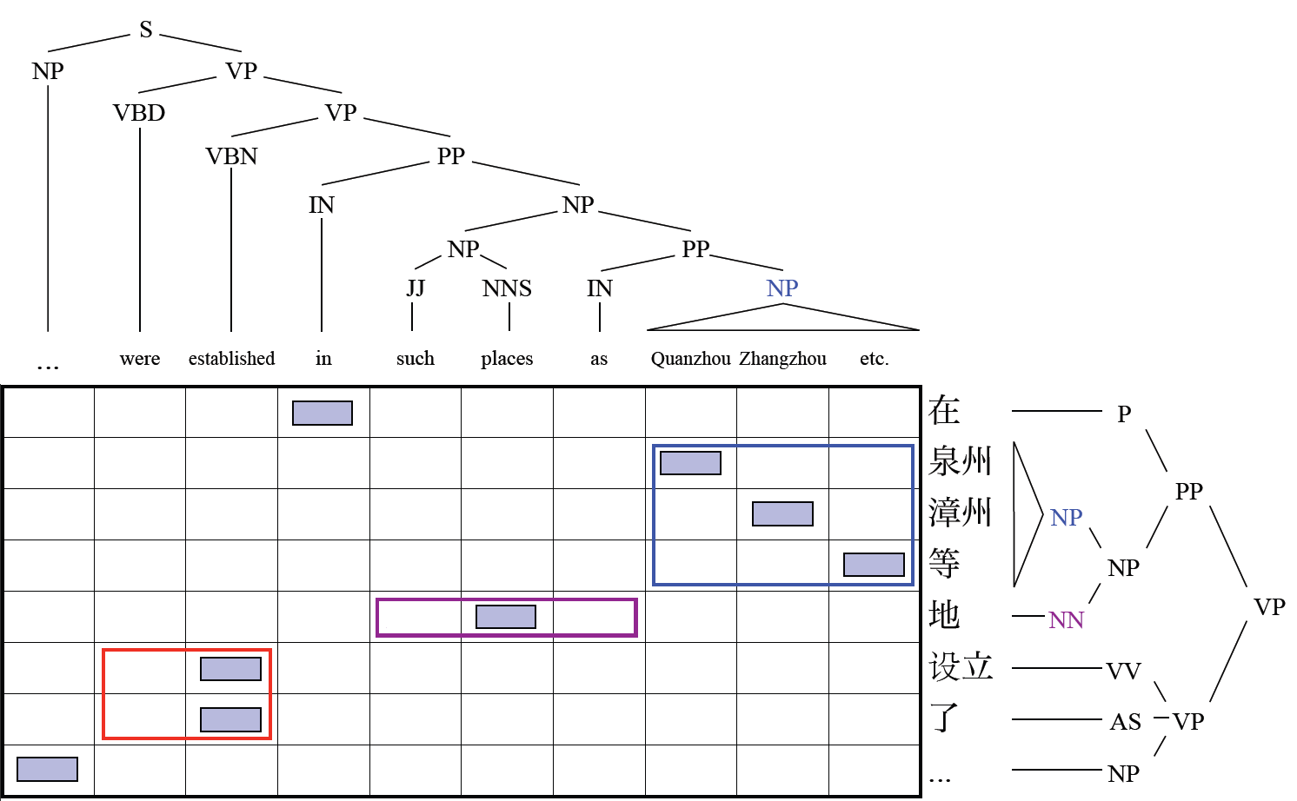
Weakly Synchronized Example

Slide 10
Weakly Synchronized Example
Separate PCFGs

Slide 11
Weakly Synchronized Example
ITG alignment

Slide 12
Weakly Synchronized Example
Points for synchronization, but not required

Slide 13




Correspondence Model & Feature Types
中文
中文
EN
中文
EN
EN
中文
EN
中文
EN
Feature type 1: Word Alignment
Feature type 3: Correspondence
EN
中文
办公室
[HBDK09]
office
PP
PP
Feature type 2: Monolingual Parser
PP
EN
in the office
Notes:
Our model can do more. We can handle non-synchronicity.

Slide 14




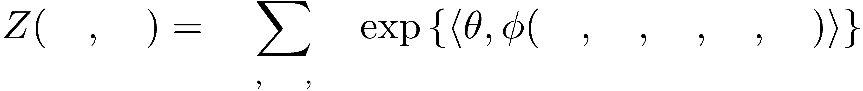


Estimating
Set to maximize the log-likelihood of the correct parses & alignments
EN
中文
EN
中文
EN
中文
normalizes to sum to 1
EN
中文
EN
中文
EN
中文

Slide 15


Computing
EN
中文
EN
中文
EN
中文
Individual , , have polynomial-time dynamic programming algorithms
Correspondence features tie pieces together
Computing exactly is intractable
PP
PP
EN
中文

Slide 16


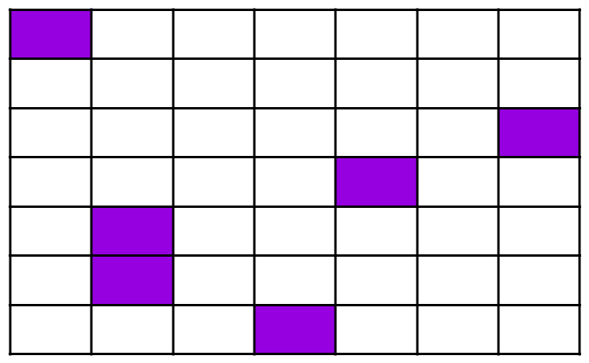
Approximating : Mean Field
EN
中文
Exploit tractability in individual models:
Factored approximation:
EN
中文
Set to minimize
EN
中文
Algorithm
Initialize separately
Iterate:
PP
PP

Slide 17
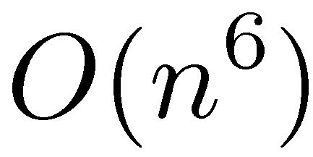
Large scale inference
We can approximate in polynomial time, but . . .
EN
中文
Sum over possible alignments is an algorithm.
But computers are fast, right?
Medium-length sentences are 50 words long
Small translation data sets are 250,000 sentences
~4 quadrillion operations (See for speedup details)
[BBK10, HBDK09]

Slide 18
Quantitative Results: Parsing

Slide 19
Quantitative Results: Parsing
85.7%
83.6%

Slide 20
Quantitative Results: Parsing
84.5%
81.2%

Slide 21
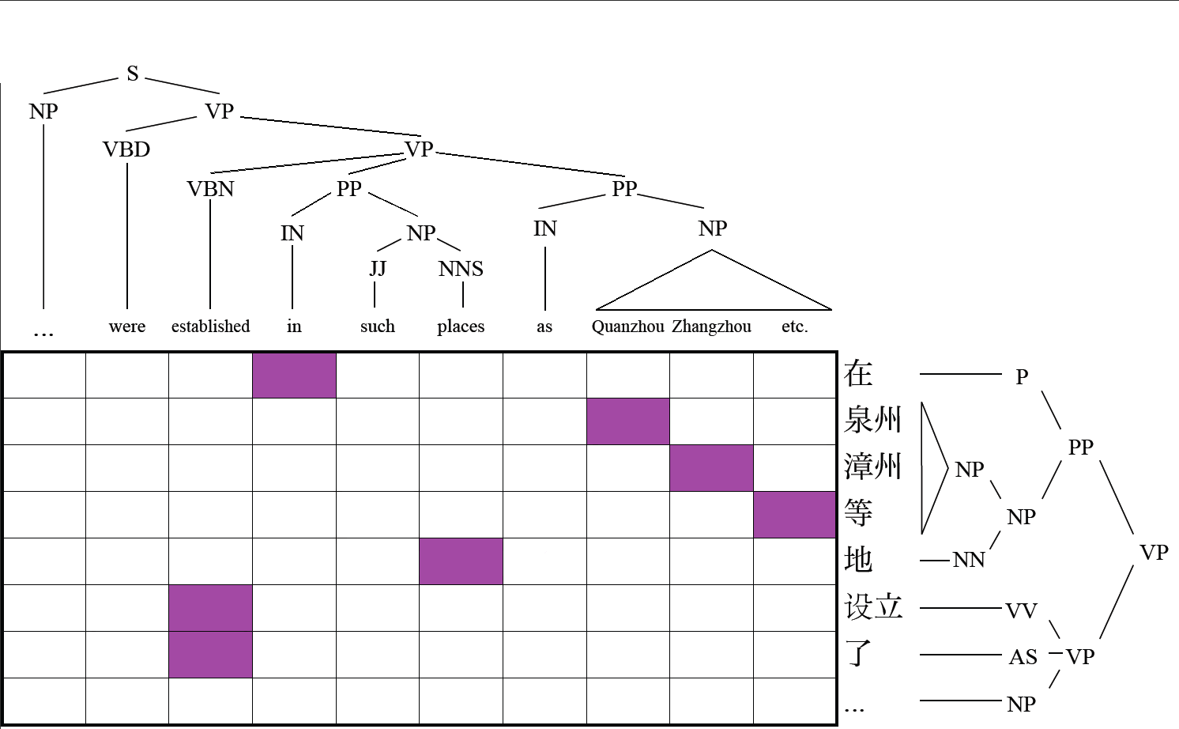
Incorrect English PP Attachment

Slide 22

Corrected English PP Attachment

Slide 23
Quantitative Results: Translation
BLEU improvement from 29.4 to 30.6
85.0%
79.5%
69.5%

Slide 24
Better Translations with Bilingual Adaptation
目前 | 导致 | 飞机 | 相撞 | 的 | 原因 | 尚 | 不 | 清楚, | 当地 | 民航 | 部门 | 将 | 对此 | 展开 | 调查
Cur-rently | cause | plane | crash | DE | reason | yet | not | clear, | local | civil aero-nautics | bureau | will | toward | open | investi-gations
Reference
At this point the cause of the plane collision is still unclear. The local caa will launch an investigation into this .
Baseline (GIZA++)
The cause of planes is still not clear yet, local civil aviation department will investigate this .
Bilingual Adaptation Model
The cause of plane collision remained unclear, local civil aviation departments will launch an investigation .
Notes:
mu4qian1 dao3zhi4 fei1ji1 xiang1zhuang4 DE yuan2yin1 shang4 bu4 qing1chu3, dang1di4 min2hang2 bu4men2 jiang1 dui4ci3 zhan3kai1 diao4cha2

Slide 25
Thanks

