Slide 1
Learning Better Monolingual Models from Bilingual Data
John Blitzer
David Burkett, Wei Gao, Dan Klein, Slav Petrov, Ming Zhou
TexPoint fonts used in EMF.
Read the TexPoint manual before you delete this box.: AAAAAAAAAAA

Slide 2
Improving Named Entity Recognition (NER)
ORG₁
die
Berichte
des
Europaischen
Rechnungshofes
the
reports
of
the
European
Court
of
Auditors
ORG₁
English parallel text can improve German NER

Slide 3
Improving Syntactic Parsing
(a)
S
(b)
S
VP
VP
NP
NP₁
NP
NP
PP
PP
NP
NP
PP
PP
VB
VB
These measures
increased
the attractiveness
of Tianjin
to Taiwanese merchants
These measures
increased
the attractiveness
of Tianjin
to Taiwanese merchants
这些措施
增加了
天津
对台商
的
吸引力
这些措施
增加了
天津
对台商
的
吸引力
VB
NNP
DE
NN
VB
NNP
DE
NN
NP
PP
NP
PP
NP₁
NP₁
VP
VP
S
S
Chinese parallel text can improve English PP attachment

Slide 4
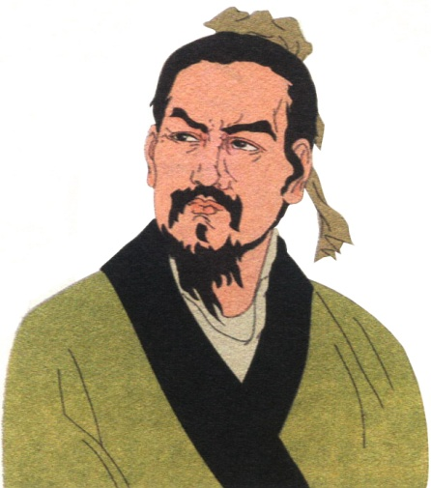

Improving Web Search
Han Feizi - China culture
Han Fei, Li Si, Xunzi Han Feizi, Han Fei, Confucianism
General (but short) introduction to Han Feizi
韩非子 – 搜狐博客 Translate this page
韩非子 韩非子 ... 客服留言板 | 客服博客 | 客服邮箱 | 24小时客服热线:010-58511234
Chinese Spam
Han Feizi (book) - Wikipedia
The Han Feizi is a work written by Han Feizi at the end of the Warring States Period
On topic, but missing some information
韩非子_百度百科
是中国古代著名的哲学家、思想家，政论家和散文家，法家思想的集大成者，后世称“韩子”或“韩非子”。
Very complete biography of Han Feizi
韩非子
目录. ● 初见秦第一 ● 存韩第二 ● 难言第三 ● 爱臣第四 ● 主道第五 ● 有度第六 ● 二柄第七 ● 扬榷第八
The complete works of Han Feizi
. . . . Lower . . . .
www.hawickert.de/HanFeizi.htm
A much more complete description of Han Feizi’s work, with excerpts

Slide 5
Part 1: Sentence-Level Models
Input:
Original Monolingual Models
Bilingual Data
Output:
Bilingual Model
Improved Monolingual Models
Multi-view Training
(1) Label bilingual data with original monolingual models
(2) Train bilingual model on the output of the monolingual models
(3) Combine bilingual and monolingual models
(4) Retrain improved monolingual models on combined output

Slide 6
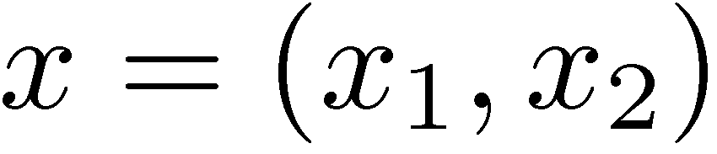
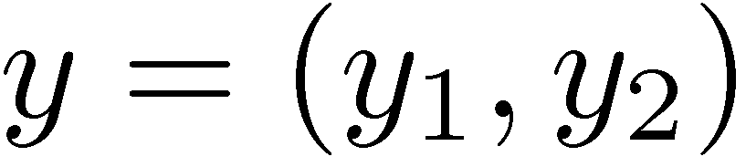
Some Notation
S
S
VP
VP
NP
NP
NP
NP
PP
PP
NP
PP
VB
VB
NNP
DE
NN
These measures
increased
the attractiveness
of Tianjin
to Taiwanese merchants
这些措施
增加了
天津
对台商
的
吸引力

Slide 7
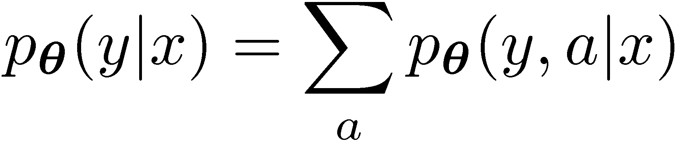
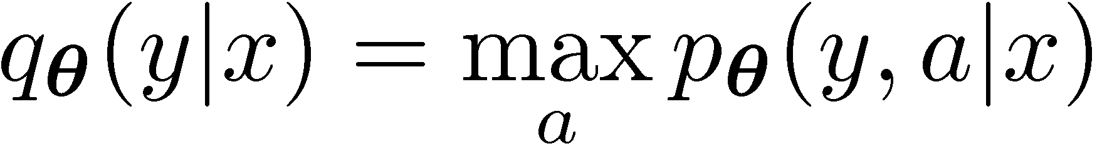
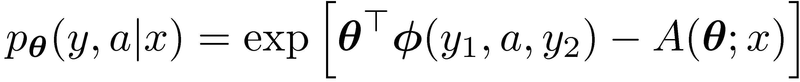
Bilingual label-label alignments
We want features that generalize (i.e. only use pairs of nodes in each tree)
But we don’t know how label pieces correspond
S
S
VP
VP
NP
NP
NP
NP
PP
PP
NP
PP
VB
These measures
increased
the attractiveness
of Tianjin
to Taiwanese merchants
VB
NNP
DE
NN
这些措施
增加了
天津
对台商
的
吸引力

Slide 8


Bilingual Training: Inside Ratio Feature
天津
NNP
对
NP
PP
台商
的
吸引力
of
to
Tianjin
Taiwanese
attractiveness
merchants
PP
NP

Slide 9
Monolingual Features in the Bilingual Model
We need some monolingual input for accurate modeling
天津
But we can’t include the full monolingual models as features
对
台商
的
VP
We include weakened versions of the monolingual models
吸引力
of
to
Tianjin
merchants
attractiveness
Taiwanese
VP

Slide 10
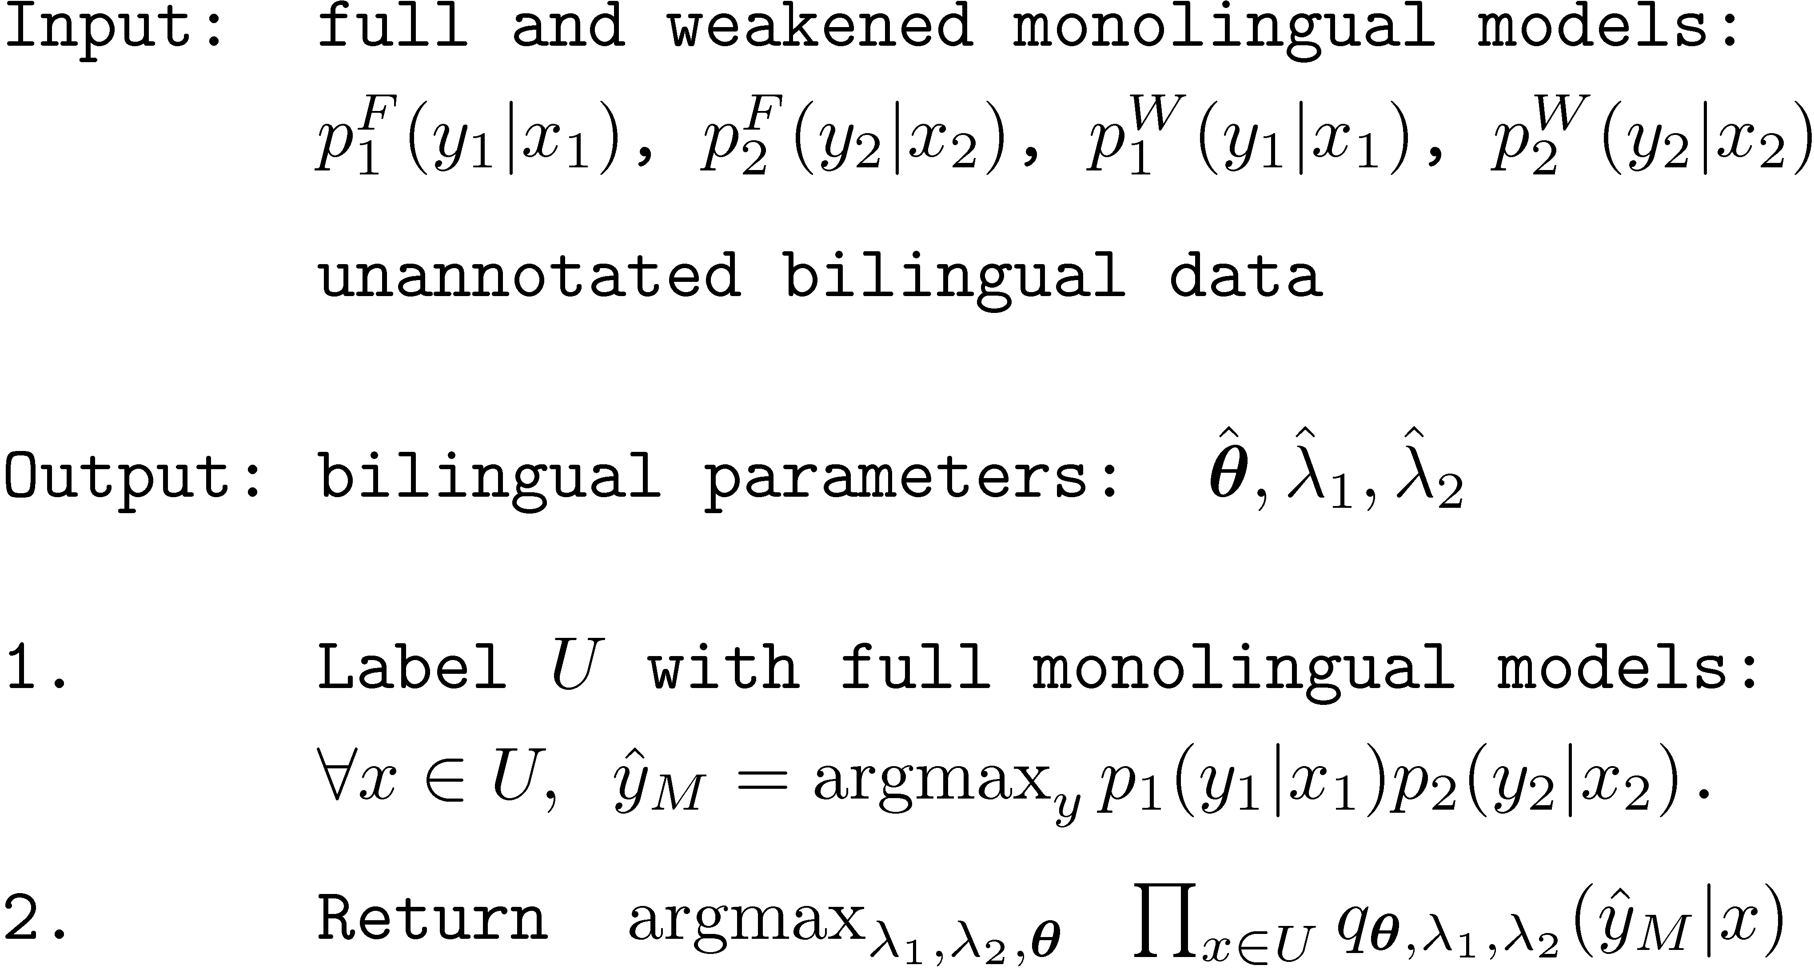
Final Training Procedure

Slide 11
Combining Mono and Bilingual Models
How to do prediction? 3 Choices:
1) Bilingual model only:
2) Uniform combination:
3) Replace weakened with full monolingual model:

Slide 12
Parsing Data and Setup
Labeled Data: Penn Treebank and Chinese Treebank
Parser: Berkeley Parser (State-split, latent variable parser)
Weakened Models: 3 iters of state splitting (5 for full model)
Unlabeled Data: Parallel portion of Chinese treebank
Testing Data: Parallel portion of Chinese treebank
Bilingual Features: Burkett & Klein (2008)

Slide 13
Parsing Results – Chinese & English
Model | Chinese F1 | English F1
Monolingual Baselines
Weakened Monolingual | 78.3 | 67.6
Full Monolingual | 84.2 | 75.4
Bilingual Models
Bilingual only | 80.4 | 70.8
Bilingual + Monolingual | 85.9 | 77.5
Retrained Monolingual Models
Self-Retrained | 83.6 | 76.7
Bilingual Retrained | 83.9 | 77.4

Slide 14
Syntactic MT Rule Extraction
Unlabeled Data: 100,000 parallel Chinese-English sentences
Testing Data: 1-reference test set from the same domain
Model | BLEU
Phrase-based
Moses | 18.8
Syntactic (Galley et al. 2006) Models
Penn Treebank | 18.7
Burkett & Klein (2008) | 21.1
Bilingual | 21.2

Slide 15

Comparing Prediction Methods
Uniform combination
+ Weakened Weights
* Optimal

Slide 16
Part 2: Bilingual Web Search Ranking
Input:
Bilingual query log, documents
Click-through statistics for each query-document pair
Output:
Improved Ranking Model for Bilingual Queries
Training
(1) Create a bilingual ranking problem, where instances consist of pairs of similar web pages (one from each language)
(2) Train a ranking model that exploits bilingual and monolingual features
Prediction:
Reconstruct monolingual ranking from bilingual ranking
We never need to show machine-translated pages to an end user!

Slide 17
Creating training data: From clickthrough rates to rankings
Input: Query pair, documents, & clickthroughs for each language
Bilingual query pair (Mazda, 马自达)
e1>e2
e1>e3
…
e2>e3
e2>e4
…
e4>e5
doc
URL
Aggr. click #
e1
e2
e3
e4
e5
www.mazda.com
www.mazdausa.com
www.mazda.co.uk
www.starmazda.com
www.mazdamotorsports.com
……
229
185
5
2
2
c1>c2
c1>c3
…
c2>c3
c2>c4
…
c4>c5
c1
c2
c3
c4
c5
www.faw-mazda.com
price.pcauto.com.cn/brand.jsp?bid=17
auto.sina.com.cn/salon/FORD/MAZDA.shtm
car.autohome.com.cn/brand/119/
jsp.auto.sohu.com/view/brand-bid-263.html
……
50
43
20
18
9

Slide 18
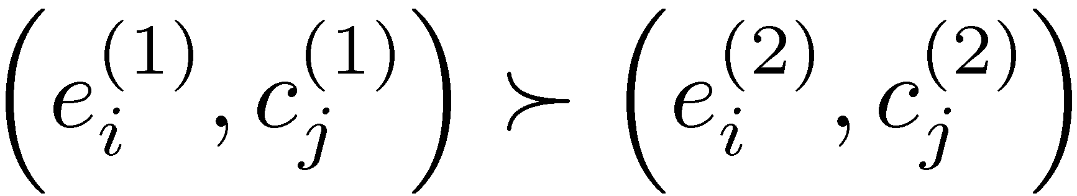
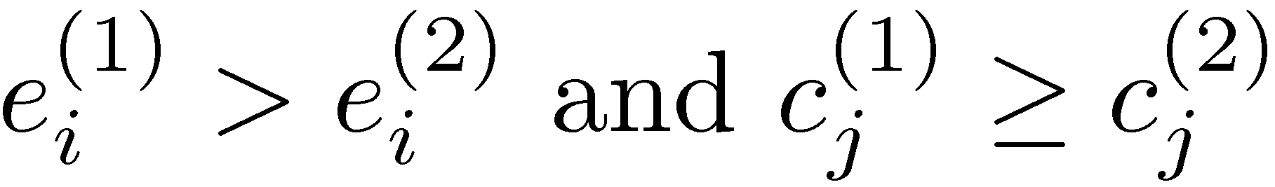
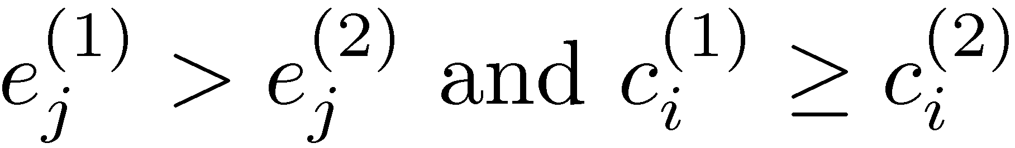
From monolingual to bilingual rankings
2 natural conditions for constructing a bilingual ranking from monolingual rankings
if and only if
or
e1>e2, e1>e3, e1>e4
e2>e3, e2>e4
(e1,c1) > (e1, c2), (e1,c1) > (e2, c1)
(e1, c2) > (e1, c3), (e1, c2) > (e2, c2)
. . . .
(e2, c3) > (e2, c4), (e2, c3) > (e3, c3)
c1>c2, c1>c3, c1>c4
c2>e3, c2>c4

Slide 19


Learning a bilingual ranking function
Training data
(e1,c1) > (e1, c2), (e1,c1) > (e2, c1)
(e1, c2) > (e1, c3), (e1, c2) > (e2, c2)
. . . .
(e2, c3) > (e2, c4), (e2, c3) > (e3, c3)
Score given by allows us to reproduce the ranking
We learn a linear function with RankSVM (Herbrich et al. 2000)

Slide 20
Features
Monolingual Features
BM 25 features
language model ranking, pseudo-relevance feedback, etc.
PageRank (Brin and Page 1998) & HITS (Kleinberg 1999)
Bilingual Features
Dictionary-based cosine similarity
Machine translation based similarities (forward & backward)
URL LCS ratio (URL)
www.airbus.com vs. www.airbus.com.cn

Slide 21
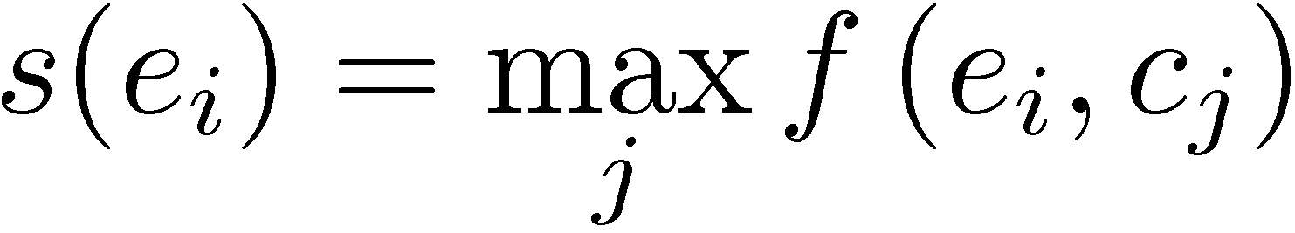
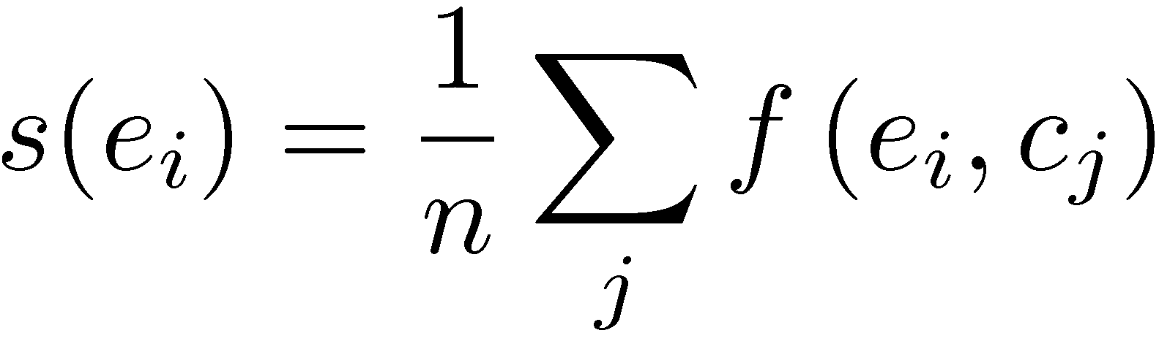
Prediction – Construct monolingual ranking
Reconstructing a monolingual ranking is over-constrained
(e1,c1): 0.4 (e1,c2): 0.3 (e2,c1): 0.1 (e2,c2): 0.5 (e3,c1): 0.6 (e3,c2): 0.2
Two heuristics (English):
H-1 (max score)
H-2 (avg score)
e3: 0.6 e2: 0.5 e1: 0.4
e3: 0.4
e1: 0.35 e2: 0.3

Slide 22
How many queries are bilingual?
Bilingual queries by type
Examples of local (monolingual) queries
Proportion of queries in query logs of
different languages
English:
Chinese:
Map of Alabama
阿拉巴马地图
50%
45%
English
40%
Chinese
长虹电视机 Changhong TV set
35%
30%
25%
20%
Statistics – Bilingual queries by token
15%
10%
5%
English query log: 1.3%
Chinese query log: 2.3%
0%
1
5
10
50
100
500
1000
5000
10000
50000
Frequency (# of times queries are issued)
Figure 1: Proportion of bilingual queries in the query logs of different languages

Slide 23
Evaluation Setup
Query logs: AOL (English) and Sougou (Chinese)
Total bilingual queries : 1,000 after discarding low click-through documents
Total document count: 21,000 English, 28,000 Chinese
Evaluation: Kendall’s Tau on heldout click-through

Slide 24
Chinese Ranking Performance
 | Pair | H-1 (max) | H-2 (mean)
Monolingual baseline | n/a | 0.2935 | 0.2935
IR (no similarity) | 0.3201 | 0.2938 | 0.2938
IR+DIC | 0.3220 | 0.2970* (p=0.0060) | 0.2973* (p=0.0020)
IR+MT | 0.3299 | 0.2992* (p=0.0034) | 0.3008* (p=0.0003)
IR+DIC+MT | 0.3295 | 0.2991* (p=0.0014) | 0.3004* (p=0.0008)
IR+DIC+MT+URL | 0.2979 | 0.2981* (p=0.0005) | 0.3024* (p=1.5e-6)

Slide 25
Top Improved Queries
Most improved CH queries | Most improved EN queries
沙门氏菌 (salmonella) | free online tv (免费在线电视)
苏格兰 (scotland) | weapons (武器)
咖啡因 (caffeine) | lily (百合)
墓志铭 (epitaph) | cable (电缆)
英国历史 (british history) | sunrider (仙妮蕾德)
政治漫画 (political cartoons) | aniston (安妮斯顿)

Slide 26
Conclusions
Bilingual data is plentiful & covers many domains
Monolingual models can be improved with bilingual data
MT is useful as a backend, as well as a goal in itself

Slide 27
Thanks!

Slide 28
NER Data and Setup
Labeled Data: CoNLL 2003 German and English corpora
Weakened Models: Obtained by dropping features
Unlabeled Data: European Parliamentary Proceedings
Testing Data: Manually annotated parliamentary proceedings and parallel newswire text
Bilingual Features: Typed and untyped bispan INS-OUT

Slide 29
NER Results – German Parliament
Model | Precision | Recall | F1
Monolingual Baselines
Weakened Monolingual | 71.3 | 36.4 | 48.2
Full Monolingual | 69.4 | 44.4 | 54.0
Bilingual Models
Bilingual only | 70.1 | 66.3 | 68.2
Bilingual + Monolingual | 70.1 | 70.1 | 70.1
Retrained Monolingual Models
Self-Retrained | 70.4 | 44.4 | 54.2
Bilingual Retrained | 74.5 | 63.6 | 68.6

