Slide 1
Adapting Natural Language Processing Systems to New Domains
John Blitzer
Joint with: Shai Ben-David, Koby Crammer, Mark Dredze, Fernando Pereira, Alex Kulesza, Ryan McDonald, Jenn Wortman
TexPoint fonts used in EMF.
Read the TexPoint manual before you delete this box.: AAAAAAAAA

Slide 2
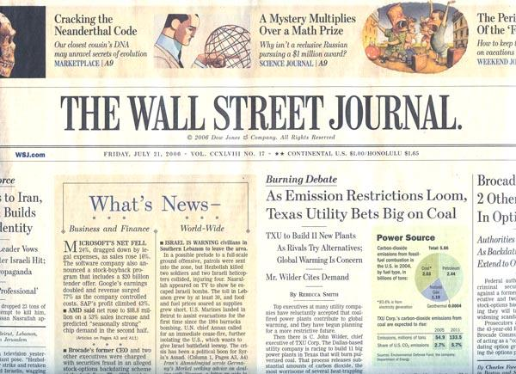
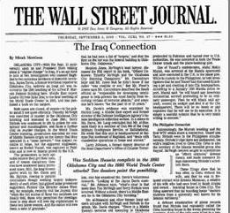
NLP models – Single domain setting
Model estimation (training)
Syntactic analysis
Information extraction
Content-based advertisement
}
data annotation
training procedure
NLP
System
Model application (testing)
NLP
System
predictions

Slide 3
NLP models – Single domain setting
Training and testing samples are from the same distribution
Theoretical guarantees for large training samples
In practice, state-of-the art models have low error

Slide 4
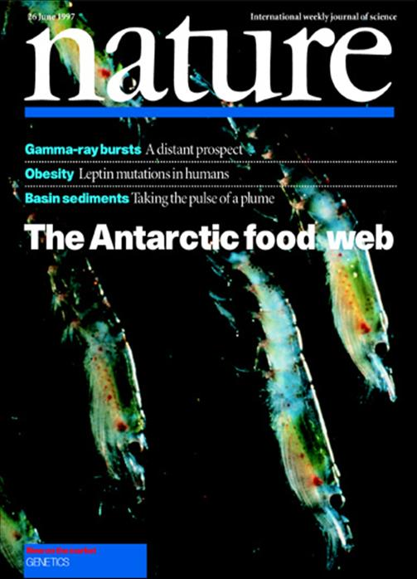
NLP models, different domains
Model estimation (training)
Source domain
data annotation
training procedure
NLP
System
Model application (testing)
Target domain
NLP
System
predictions

Slide 5
NLP models, different domains
When we apply models in different domains, we encounter differences in vocabulary
No theoretical guarantees for large source samples
State of the art models more than double in error

Slide 6
2-part talk
Structural correspondence learning (SCL)
A formal analysis of domain adaptation
Notes:
Say: There’s a lot of material in here, and some of it will be a review of the proposal. But please stop me and ask

Slide 7

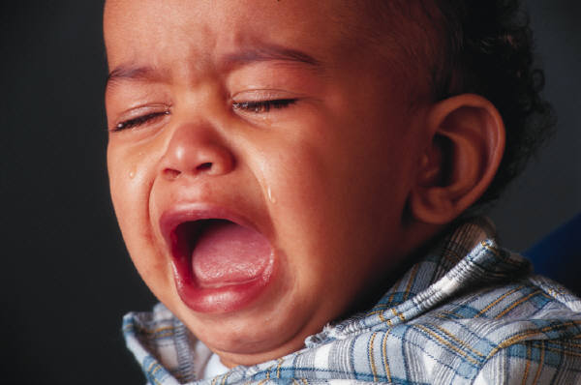
Sentiment classification
Product Review
Multiple Domains
kitchen appliances
Linear
classifier
books
??
??
. . .
Positive
Negative
??
Notes:
Say: “Many companies are working on this problem. You want to mine the web for particular instances of positive or negative sentiment”

Slide 8
Books & kitchen appliances
Running with Scissors: A Memoir
Title: Horrible book, horrible.
This book was horrible. I read half of it, suffering from a headache the entire time, and eventually i lit it on fire. One less copy in the world...don't waste your money. I wish i had the time spent reading this book back so i could use it for better purposes. This book wasted my life
Running with Scissors: A Memoir
Title: Horrible book, horrible.
This book was horrible. I read half of it, suffering from a headache the entire time, and eventually i lit it on fire. One less copy in the world...don't waste your money. I wish i had the time spent reading this book back so i could use it for better purposes. This book wasted my life
Avante Deep Fryer, Chrome & Black
Title: lid does not work well...
I love the way the Tefal deep fryer cooks, however, I am returning my second one due to a defective lid closure. The lid may close initially, but after a few uses it no longer stays closed. I will not be purchasing this one again.
Avante Deep Fryer, Chrome & Black
Title: lid does not work well...
I love the way the Tefal deep fryer cooks, however, I am returning my second one due to a defective lid closure. The lid may close initially, but after a few uses it no longer stays closed. I will not be purchasing this one again.
Error increase: 13% → 26%

Slide 9
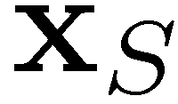

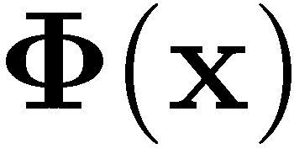
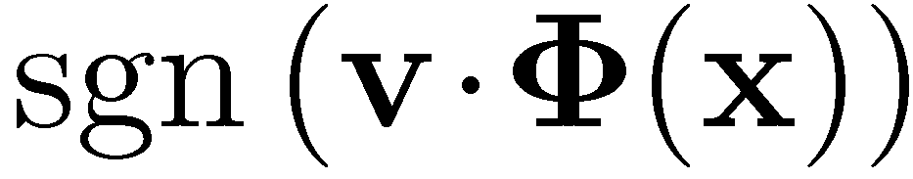


SCL: 2-step learning process
Step 1: Unlabeled – Learn correspondence mapping
Step 2: Labeled – Learn weight vector
Labeled. Learn
1
Unlabeled.
Learn
0
.
.
.
0
0.3
3
-1.0
.
.
.
0.7
should make the domains look
as similar as possible
But should also allow us to
classify well
0
1
-2.1
.
.
.
0
7

Slide 10
SCL: making domains look similar
Incorrect classification of kitchen review
defective lid
Unlabeled kitchen contexts
Unlabeled books contexts
Do not buy the Shark portable steamer
…. Trigger mechanism is defective.
the very nice lady assured me that I
must have a defective set …. What a
disappointment!
Maybe mine was defective …. The
directions were unclear
The book is so repetitive that I
found myself yelling …. I will
definitely not buy another.
A disappointment …. Ender was
talked about for <#> pages
altogether.
it’s unclear …. It’s repetitive and
boring

Slide 11
SCL: pivot features
Occur frequently in both domains
Characterize the task we want to do
Number in the hundreds or thousands
Choose using labeled source, unlabeled source & target data
Words & bigrams that occur frequently in both domains
Frequency together with conditional entropy on labels
book one <num> so all very about they like good when | a_must a_wonderful loved_it weak don’t_waste awful highly_recommended and_easy

Slide 12

SCL unlabeled step: pivot predictors
Use pivot features to align other features
The book is so repetitive that I
found myself yelling …. I will
definitely not buy another.
(2) Do not buy the Shark portable
steamer …. Trigger mechanism is defective.
Pivot predictors implictly align source & target features
Binary problem: Does “not buy” appear here?
Mask pivot features and predict them using other features
N pivots → train N linear predictors
One for each binary problem
Let be the weight vector for the i^{th} predictor

Slide 13
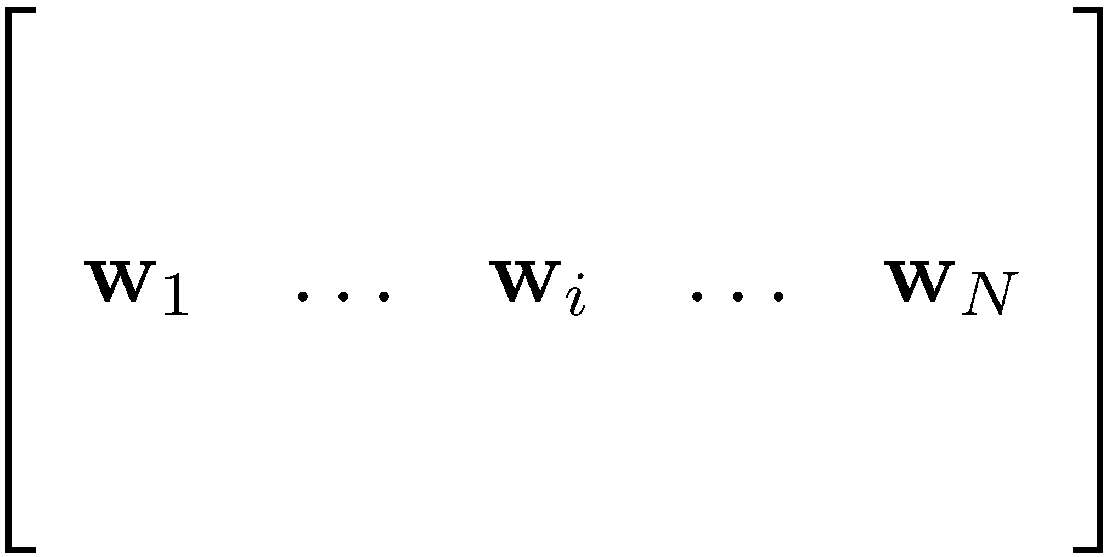


SCL: dimensionality reduction
gives N new features
value of i^{th} feature is the propensity to see “not buy” in the same document
Many pivot predictors give similar information
“horrible”, “terrible”, “awful”
Hard to solve optimization with N dense features per instance
Compute SVD of W & use top k left singular vectors
Top orthonormal principal pivot predictors
If we chose our pivots well, then will give us good features for classification in both domains
Notes:
********* We model an explicitly constructed feature-feature matrix by choosing pivots *********
********* We estimate the entries of that matrix discriminatively *********

Slide 14

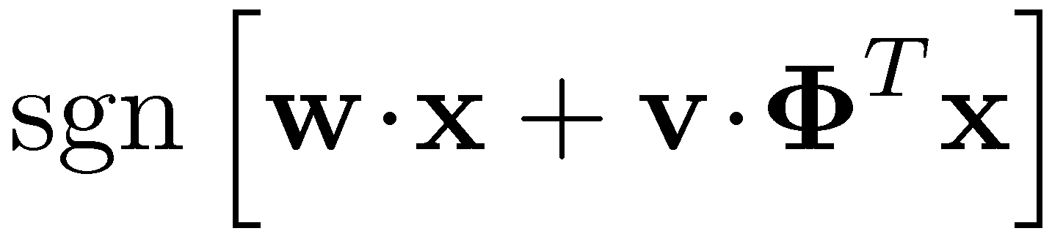

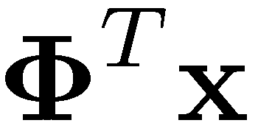
Back to labeled training / testing
1
Classifier
0
.
.
.
0
Source training: Learn & together
Target testing: First apply , then apply and
3
0.3
-1.0
.
.
.
0.7
-2.1

Slide 15


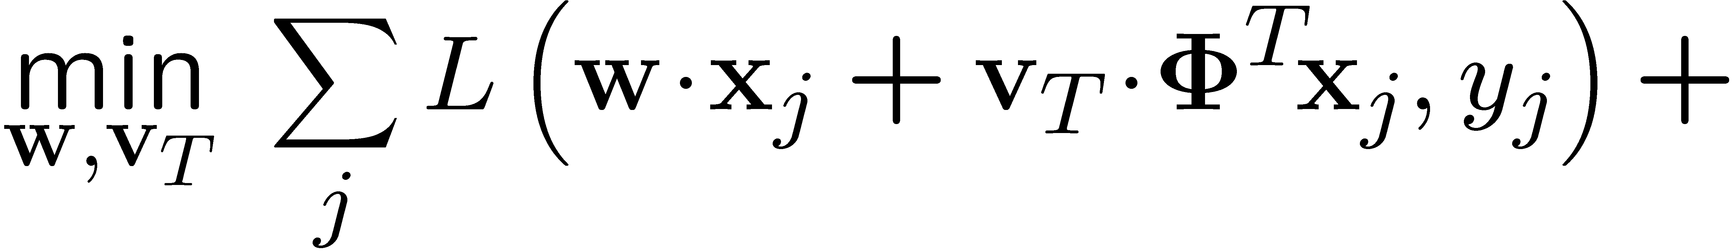
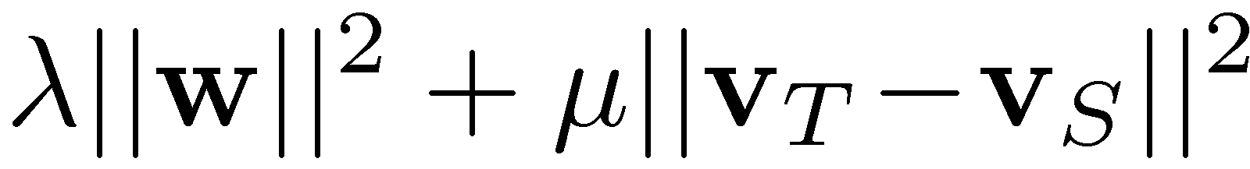
Using labeled target data
50 instances of labeled target domain data
Source data, save weights for SCL features
Target data, regularize weights to be close to
Chelba & Acero, EMNLP 2004
Huberized hinge loss
Keep SCL weights close to source weights
Avoid using high-dimensional features

Slide 16
Inspirations for SCL
Alternating Structural Optimization (ASO)
Ando & Zhang (JMLR 2005)
Training predictors using unlabeled data
Correspondence Dimensionality Reduction
Ham, Lee, & Saul (AISTATS 2003)
Learn a low-dimensional representation from high-dimensional correspondences

Slide 17
Sentiment classification data
Product reviews from Amazon.com
Books, DVDs, Kitchen Appliances, Electronics
2000 labeled reviews from each domain
3000 – 6000 unlabeled reviews
Binary classification problem
Positive if 4 stars or more, negative if 2 or fewer
Features: unigrams & bigrams

Slide 18
Visualizing (books & kitchen)
negative vs. positive
books
engaging
must_read
plot
<#>_pages
predictable
fascinating
grisham
poorly_designed
awkward_to
espresso
years_now
the_plastic
leaking
are_perfect
a_breeze
kitchen

Slide 19
Results: 50 labeled target instances
With 50 labeled target instances, SCL always
improves over baseline.
Overall relative reduction is 36% relative

Slide 20
Theoretical Analysis: Using labeled data from multiple domains
Study the tradeoff between accurate but scarce target data and plentiful but biased source data
Analyze algorithms which minimize convex combinations of source & target risk
Give a generalization bound that is computable from finite labeled & unlabeled samples

Slide 21
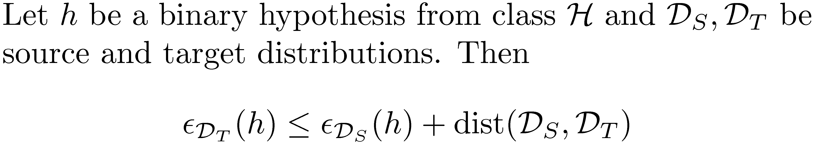

Relating source & target error
A basic bound:
Measureable from finite unlabeled samples
Related to hypothesis class
Not measurable from unlabeled samples
Small for realistic NLP problems

Slide 22

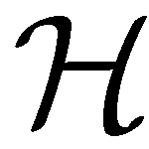
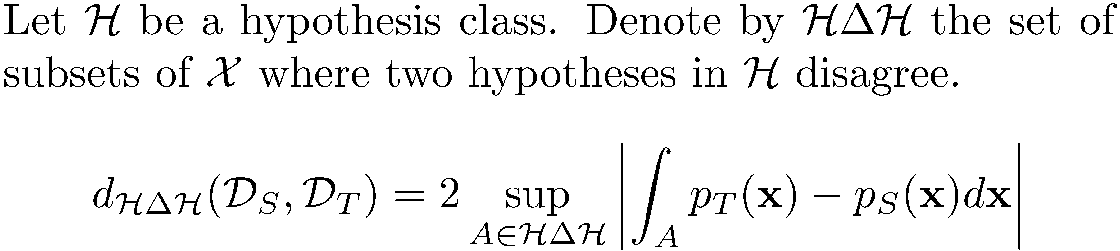
Idea: Measure subsets where hypotheses in disagree
Subsets A are symmetric differences of two hypotheses
h₁
Where does h₁ make errors
with respect to h₂?
h₂

Slide 23
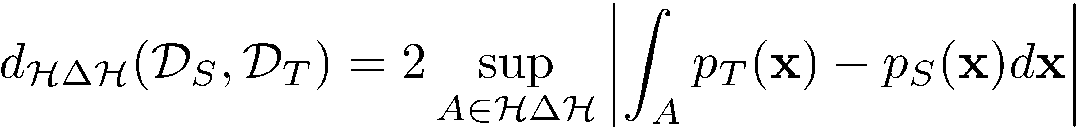
Always lower than L₁
Computable from finite unlabeled samples.
Easy to compute: train classifier to discriminate between source and target instances

Slide 24

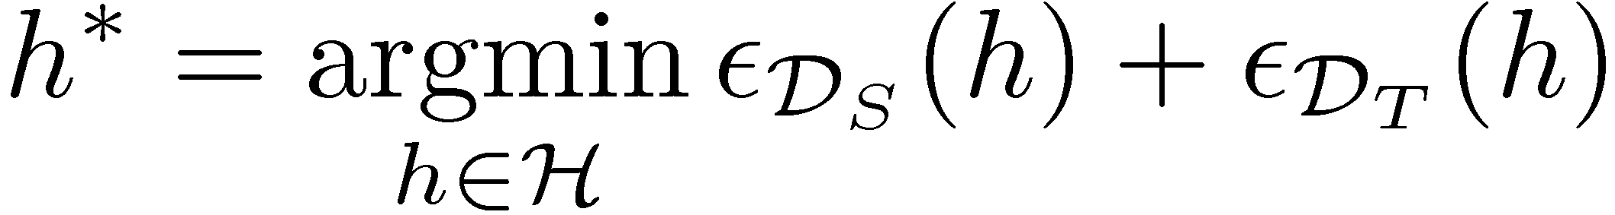
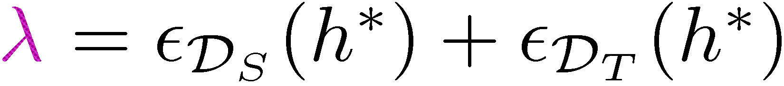
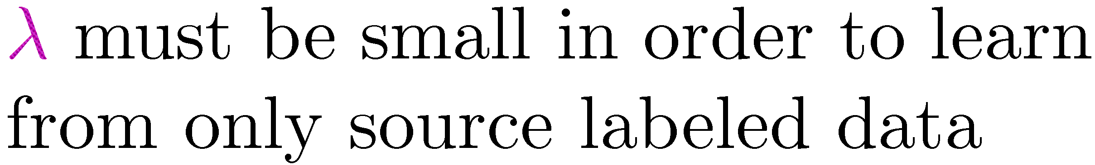
Domain Adaptation Assumption
Notes:
Say: Lambda will appear in the bound

Slide 25
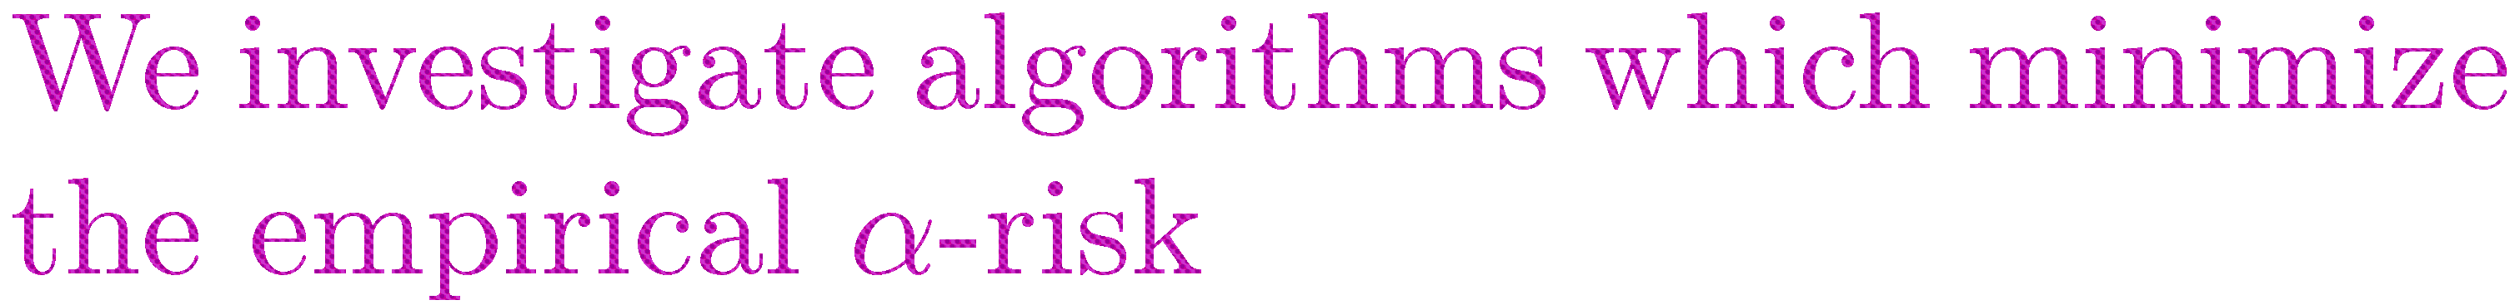
Combining source & target labeled data
Notes:
Say: As alpha → 1, we prefer to use only target data. As alpha → 0, we prefer to use only source data.

Slide 26
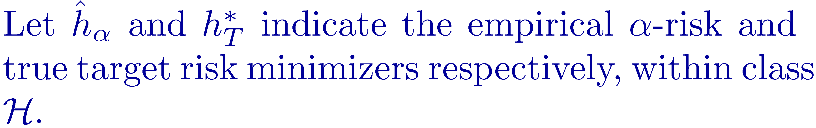
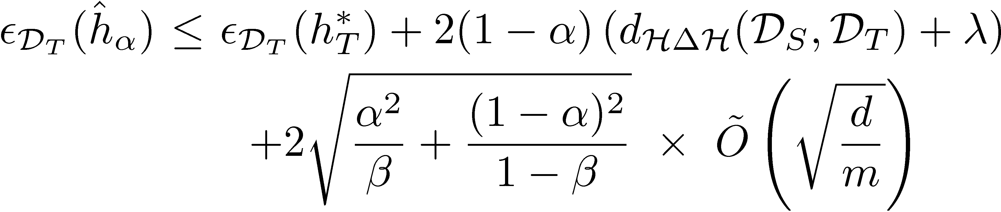
A bound on the target risk
Notes:
Say: We focus on the two middle terms

Slide 27
Computing the terms in the bound
Given as input
Computable from unlabeled data
Assumed to be small

Slide 28

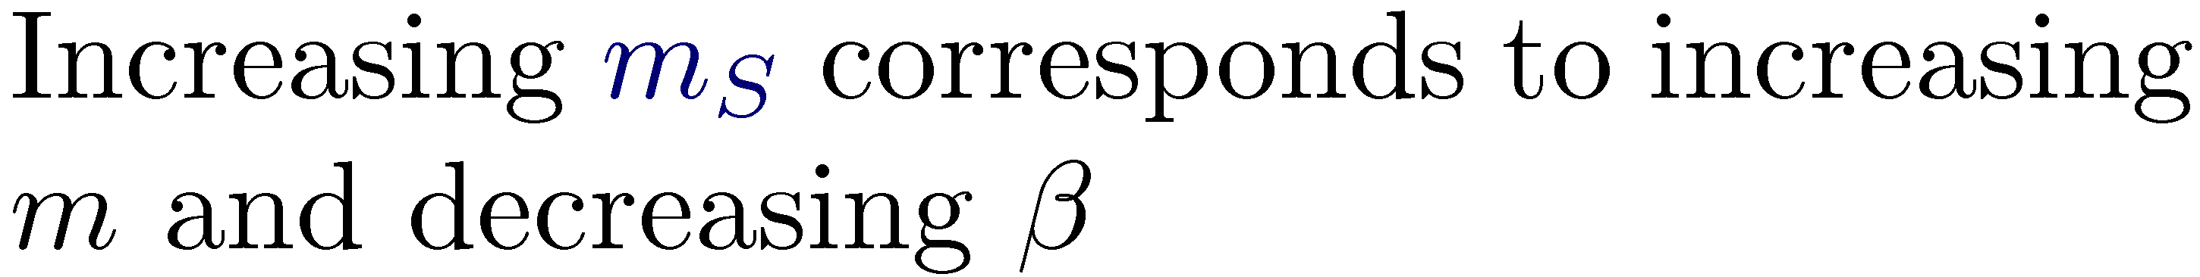
Evaluating the bound: parameters
Look at the shape of the bound vs. empirical error for different values of
Vary input parameters:
distance between source and target
amount of source data
Notes:
Say: By varying the amount of source and target, I’m varying beta and m

Slide 29

Same relative ordering: higher
distance means higher risk
Same convex shape: error-
minimizing alpha reflects
distance
Very different actual numbers:
empirical error much lower
Theoretical risk
Empirical risk
0.2

Slide 30
Theoretical risk
Same relative ordering: more
source data is better
With enough target data, it’s
always better to set α=1,
regardless of amount of
source data
Empirical risk

Slide 31



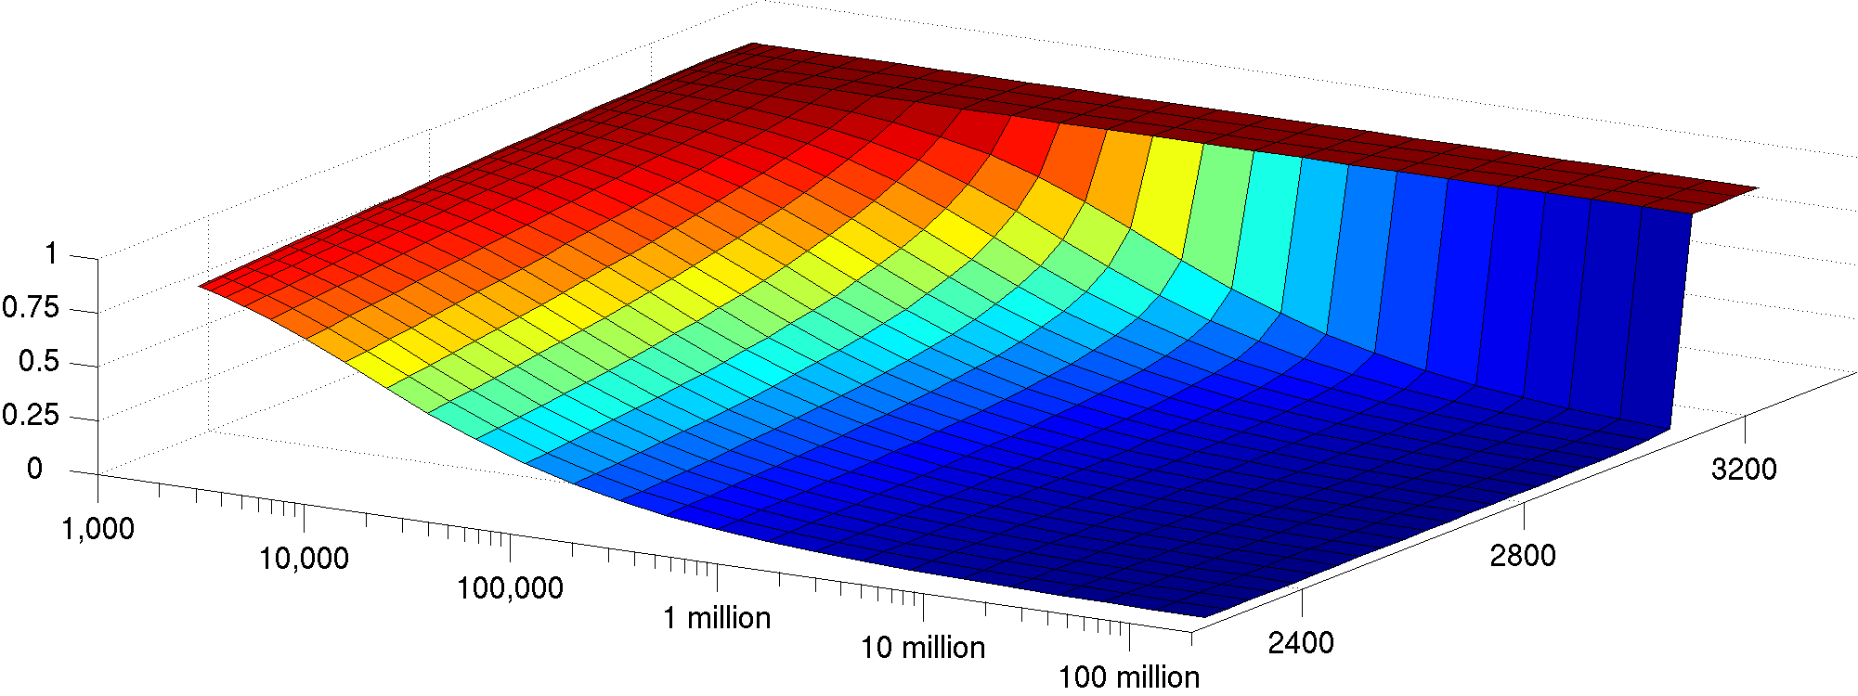
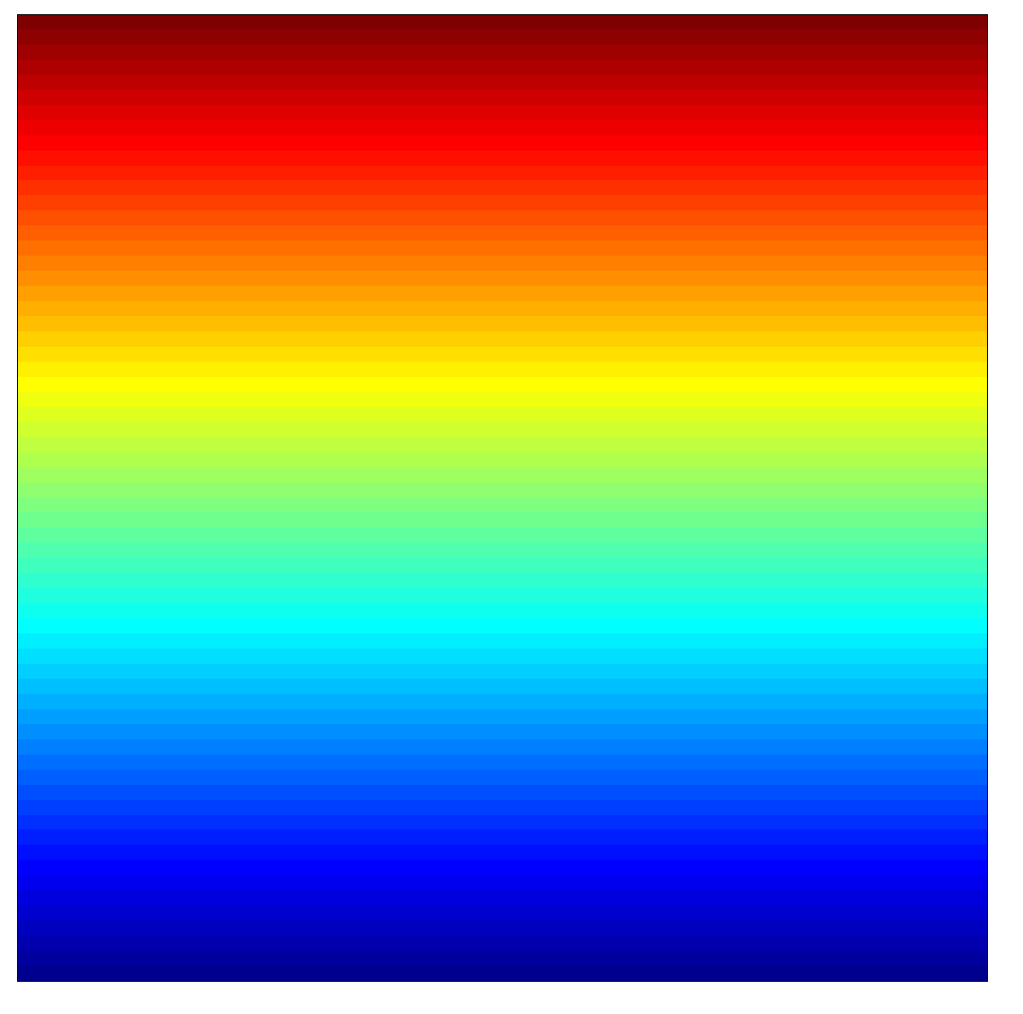
A phase transition in the optimal
After a fixed amount of target data, adding source data is not helpful
Plot optimal for varying amounts of source and target data
With 3130 or more target instances, the optimal is always 1
target instances
source instances
Notes:
Say: No matter how much source data you have, there's a minimum possible bias
After getting the target data you've reduced variance to the point that source data is no longer useful

Slide 32
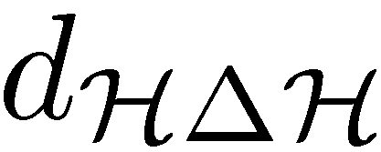
Domain Adaptation: Theory and practice
Our theory shows that decreasing can lead to a decrease in error due to adaptation
But we have no theory that suggests an algorithm for using unlabeled data in domain adaptation
What if we have many source domains
There exists a kind of hierarchical structure on sources
Can we design an algorithm which has low regret with respect to the best model from each one?
Notes:
(*) This was one major point of concern for the committee
(*) What I’m going to talk about here relates SCL and structural learning to a specific model for using unlabeled data
(*) This is genuinely new work, in the sense that even my collaborators here have not seen these slides
(*) A lot of what is here will simply be in the document
(*) But it’s inspired by work the committee asked me to do. It’s really helped me to understand SCL, and I think it’s exciting and interesting

Slide 33
Thanks
Thanks

