Slide 1
学而时习之：Being a Successful Graduate Student
John Blitzer
With materials lifted from: Jorge Cham, 孔子

Slide 2
Outline
Applying for graduate school
Graduate school is about you!
. . . .And your advisor
The importance of presentation

Slide 3


Slide 4
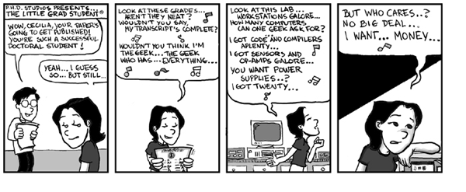
Do I want to go to graduate school?

Slide 5
Do I want to go to graduate school?
From Phil Agre
Graduate school is training in research. It is for people who love research, scholarship, and teaching for their own sake and for the difference they can sometimes make in the world. It is not for people who simply want more undergraduate courses. It is not for people who are in a hurry to get a real job.
子曰: 学而时习之不亦说乎

Slide 6

Which graduate school should I go to?
Typical answer. The top of the U.S.
News rankings!
Problem: Reporters don’t know
anything about graduate school!!
Better answer. For every school you consider,
Choose at least one professor.
Read at least 3 of her papers.
Notes:
Say: I was accepted to MIT, but I decided to go to Penn because I thought it was the better school for me.

Slide 7
Your application packet
关系
All Chinese applicants have great GRE scores and great grades
For foreign applicants to American schools, everything is 关系
Talk to your undergraduate advisor in person!

Slide 8
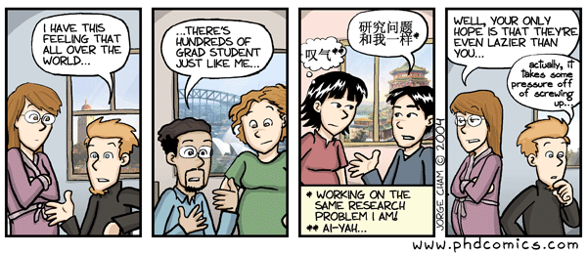
All graduate students are the same

Slide 9
Actually, graduate school is your time to shine!
As an undergraduate, you solved problems
As a graduate student, your main job is to think of your own problem
The best undergraduates are the best problem solvers
The best graduate students think of really interesting new problems to solve

Slide 10
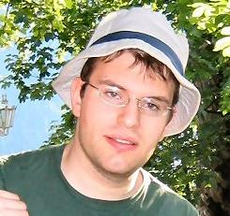

Use your strengths
I am good at learning new languages
I like historical linguistics and ancient history
My research area is natural language processing

Slide 11
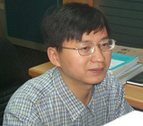
Take the time to think about a problem
周明曰：“Doing the right thing is more important than doing things right”
Before you start coding / deriving
1) Ask “Is this problem worth solving?”
2) Explain your idea to at least 1 other person.
3) Write your idea down before coding it up!

Slide 12
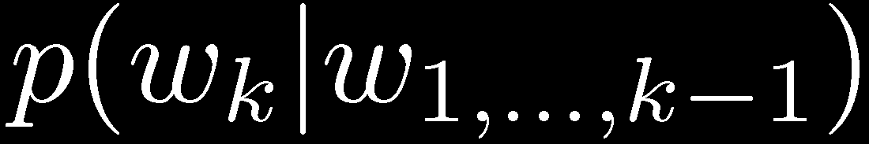
Example of a bad research topic
I worked on language modeling for 3 years!
Language modeling: predict the next word in a sentence
有朋自远方___ ?
Language modeling is a great problem for fancy models!
“Is this problem worth solving?”
No: There is so much data (the entire web), that the best language models are consistently the simplest

Slide 13
Example of a great research topic
If I had one, I would be working on it!
A great research topic is something people need
A great research topic is easy to explain
A great research topic doesn’t always involve a fancy model

Slide 14
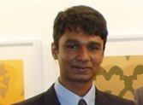
Your colleagues
子曰：不患人之不己知，患不知人也
Example: Your officemate Nikhil wants to go to lunch with you
Go to lunch with him!
Ask him about his research!

Slide 15
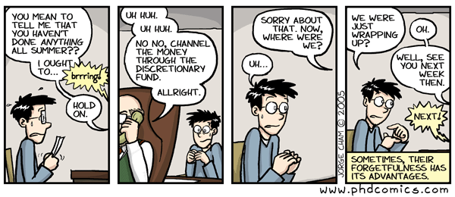
Your advisor

Slide 16
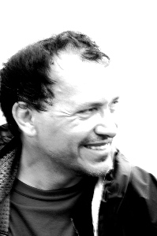
Your advisor: The real story
Fernando Pereira: “诲人不倦”
John Blitzer:
“学而不厌”
Next to you, your advisor is the most important person in graduate school
Your advisor wants you to be successful!!!

Slide 17
3 rules for meeting with your advisor
1) Be aggressive. Knock on your advisors door.
2) Prepare for meetings
Write down an agenda a meeting with your advisor.
Before the meeting, read your agenda
3) Listen to your advisor
He has much more experience than you
Fernando: “John. Nobody cares about language modeling. Stop working on it.”

Slide 18
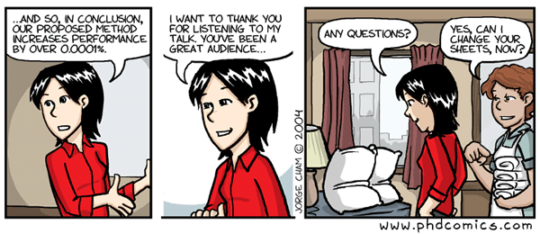
Presentations

Slide 19
Why are you including presentations?
“I’m here to do research, not write PowerPoint slides!”
Wrong. You are here to contribute to the scientific community
You do that by doing good work AND by presenting it in a clear and interesting way
Spend time on your presentations!

Slide 20
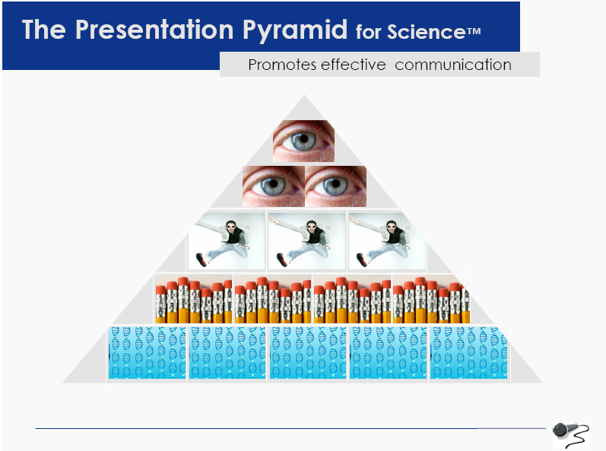

Slide 21
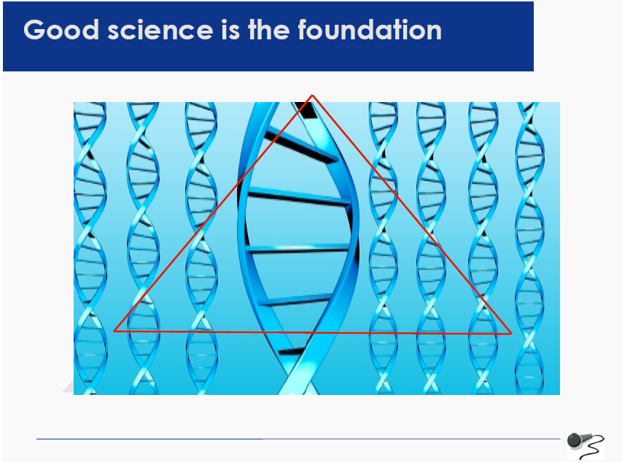

Slide 22
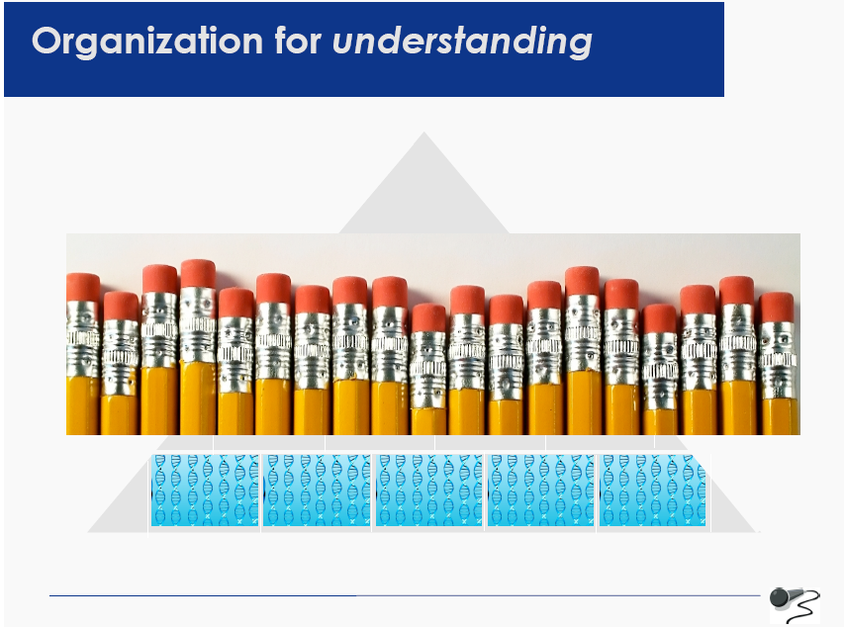

Slide 23
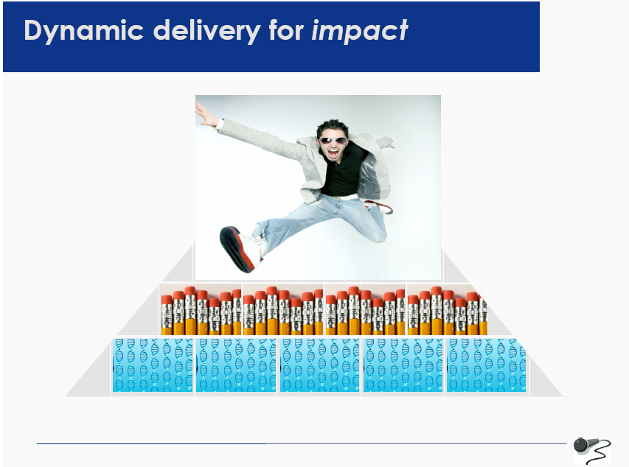

Slide 24
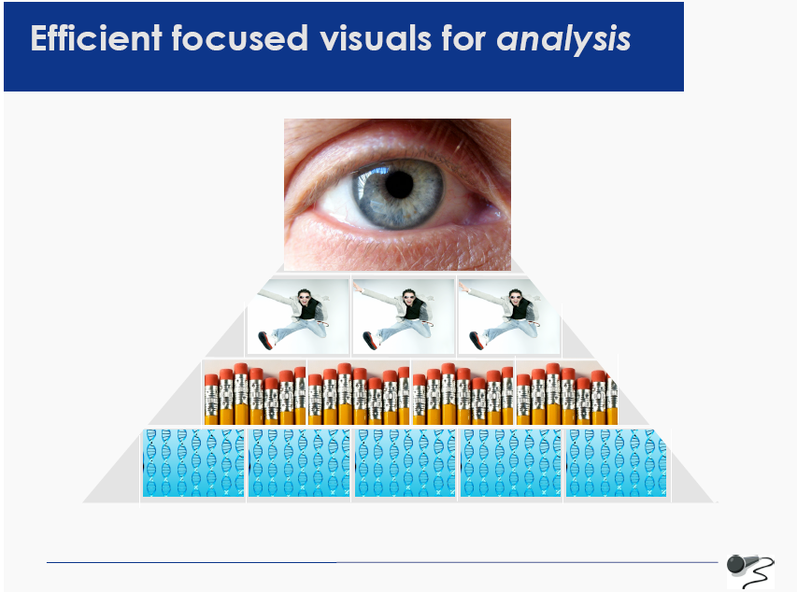

Slide 25
Want more? This is from Lisa B. Marshall http://www.lisabmarshall.com

Slide 26
Meeting people in the hallway
First impressions are important
Some simple steps for the “elevator pitch”
Also from Lisa B. Marshall
http://www.lisabmarshall.com

Slide 27
I work in the area of “A”
Specifically in the field of “B”
This field is important because of “C”
My specific work is “D”
So far the results have shown “E”

Slide 28
I work in natural language processing.
Specifically, I work on domain adaptation.
Much of the data we have for building models comes from specific domains (like financial news). NLP researchers increasingly need to apply models to different domains (like blogs or biomedical text).
My specific work uses unlabeled data to learn a new representation for adapting models to new domains. We don’t need any labeled out-of-domain data.
So far, we have applied our technique to sentiment analysis and part of speech tagging in NLP.

Slide 29
Conclusions
Applying to graduate school. Remember to really get to know your prospective schools
In graduate school. Find your own problem, and remember to think carefully about it
Advisors are there to help you. Spend as much time with yours as possible
Presentation is an important part of a researcher’s job. Learn to do it well!

Slide 30
Thanks to the following
1) PhD comics http://www.phdcomics.com
2) 孔夫子. Read 论语
3) Lisa B. Marshall http://www.lisabmarshall.com
. . . Again!!

Slide 31
Thanks to the following
1) PhD comics http://www.phdcomics.com
2) 孔夫子. Read 论语
3) Lisa B. Marshall http://www.lisabmarshall.com
. . . Again!!

