Slide 1

iSideload
A lean, self-contained Mac sideloader for iOS
Log in with a free Apple ID → auto-provision a cert → sign → install to your iPhone or iPad.
No Xcode. No AltStore server. No Python. One notarized menu-bar app.
v0.1-alpha
Notarized · Developer ID
AGPL-3.0
github.com/johnbuckman/iSideload
Current state · July 2026

Slide 2
CURRENT STATE
A complete, shipped product
The whole lean-AltServer pipeline works end-to-end and is published as a notarized app.
⤓
Free-Apple-ID login
✎
Signs on the Mac
▣
Self-contained
Sign in with any Apple ID (SMS 2-factor). iSideload auto-mints a signing certificate and 7-day profile for you.
Uses Apple-equivalent signing (zsign) to sign all 64 embedded frameworks — no on-device signer, no Xcode.
Bundles OpenSSL, libimobiledevice and the signer. No Python, no Homebrew, no AltServer. Just the app.
↻
Auto-refresh
⛃
Multi-account & multi-device
◎
Notarized & open source
Re-signs before the 7-day cert expires — on a timer and the moment a device connects.
Manage several Apple IDs and several iPhones/iPads from one menu-bar window.
v0.1-alpha DMG is notarized (zero Gatekeeper warnings). Public under AGPL-3.0.

Slide 3
HOW IT WORKS
One login → an app on your device
1
2
3
4
5
→
→
→
→
Log in
Provision
Sign
Install
Refresh
Free Apple ID
+ SMS 2FA
Auto cert +
7-day profile
zsign all 64
frameworks
libimobiledevice
over USB
Auto re-sign
before expiry
Steps 1–2 need you once. After that, refresh runs unattended.

Slide 4
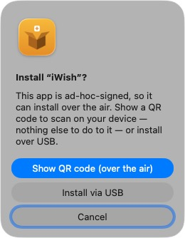
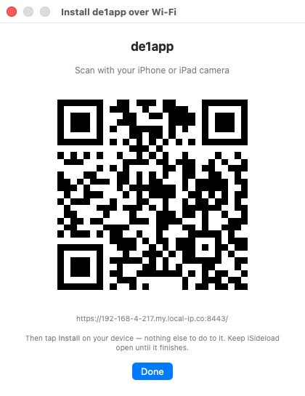
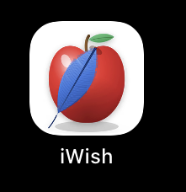
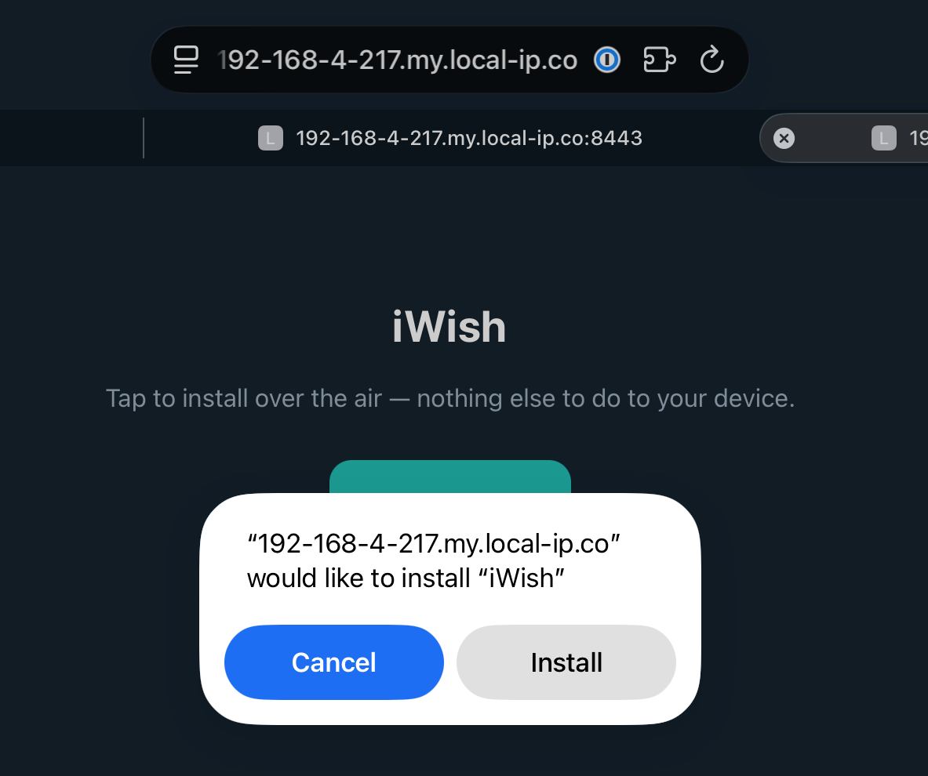
PAID ACCOUNT · AD-HOC PROVISION
Over the air — install over Wi-Fi
When the .ipa is signed by a paid Apple Developer account with an ad-hoc provisioning profile, iSideload serves it over local HTTPS and the device installs it itself — no cable, no lockdown tunnel.
1
2
3
4
→
→
→
iSideload sees the ad-hoc
signature → Show QR code
Scan the QR code with the
device camera
Tap Install — right on the
device, over Wi-Fi
Done — the app is on the
home screen

Slide 5
THE RELIABLE PATH
USB install is known to work
✓
100% reliable
⇄
Auto-trust on first plug-in
iSideload flips on Wi-Fi visibility over the cable, so no manual setup.
Plug the device in, and the full flow — trust, sign, install — just works.
⇄
Fast & deterministic
A 76 MB app installs in ~3.5 s. No flaky discovery, no timeouts.
~3 s
64
iOS 26
typical USB install
frameworks signed
validated end-to-end
⇄
The guaranteed fallback
Whenever Wi-Fi refresh can't reach a device, USB always completes.

Slide 6
FREE ACCOUNTS
Stack Apple IDs for more apps
A free Apple ID signs 3 apps at a time. Add another account and you add another 3 slots — all managed in one window.
Apple ID #1
Apple ID #2
Apple ID #3
3 / 3 slots
3 / 3 slots
3 / 3 slots
▸
iWish
▸
App four
▸
App seven
▸
de1app
▸
App five
▸
App eight
▸
Beacon
▸
App six
▸
App nine
One cert per account, persisted and reused — re-signing one app never invalidates its siblings.
✓

Slide 7
PAID DEVELOPER ACCOUNT
$99 / year lifts every limit
The same login works with a paid Apple Developer account — iSideload reads it automatically and unlocks the paid tier.
Free Apple ID
Paid — $99/yr
•
7-day signing window
✓
1-year signing window
Apps stop opening after a week unless refreshed
Sign once, use for a full year — refresh almost never needed
•
3 apps per account
✓
More apps & App IDs
Stack accounts to get more
Room for many apps without juggling accounts
•
~10 App IDs / week
✓
Rock-solid for daily use
New bundle IDs are rate-limited
Best for apps you actually depend on
iSideload shows a per-account validity badge — "7 days" for free, "1 year" for paid — so you always know which you're on.

Slide 8
THE INTERFACE
A menu-bar app that manages itself
What the window gives you
•
Lives in the menu bar
No Dock clutter — a shipping-box icon you click when you need it.
•
Per-app management
Each app shows its device, expiry countdown, Refresh and Remove.
•
Slots & validity at a glance
"2 / 3 slots", "7 days" vs "1 year" badges per account.
•
Install from URL, .json or .ipa
Load an AltStore-style source, or pick an IPA from disk.
•
Launches at login
iSideload
Registers itself so refresh keeps running quietly in the background.
Lives in your Mac menu bar

Slide 9
WORK IN PROGRESS
Wi-Fi updating — still being solved
The goal: refresh apps over Wi-Fi so you never re-plug. Discovery works; the install path is fighting the home network.
Already working
The remaining blocker
✓
!
✓
Wi-Fi install on iOS 26
→
Mac→device high ports get reset
Verified: a signed app installs over Wi-Fi in ~14 s when the device is reachable and unlocked.
On the home Eero mesh, the dynamic install ports are intermittently blocked, even with the device awake and unlocked.
✓
Device→Mac beacon
→
iOS sandbox blocks self-install
An on-device ping reaches the Mac straight through the mesh — the Mac learns the device IP with zero scanning.
An on-device app can't reach the device's own install service, so a simple relay isn't possible.
✓
Direct-IP / subnet sweep
→
Next: a device-initiated tunnel
Handles DHCP and mesh Wi-Fi by connecting to the device by IP, bypassing Apple's flaky Bonjour discovery.
Outbound-from-device path (SideStore-style) to sidestep the inbound block — the piece being prototyped now.
✓
For paid + ad-hoc IPAs, Wi-Fi install already works today (slide 4). This blocker is only the free-account refresh case.

Slide 10
Where iSideload stands
Shipped
Notarized v0.1-alpha DMG, public AGPL-3.0 repo, fully self-contained.
•
Try it
USB: solid
One-plug sign-and-install in seconds — the guaranteed path.
github.com/
johnbuckman/
iSideload
•
Accounts: flexible
3 apps per free ID, stack accounts, or go $99/yr for a full year.
•
Wi-Fi: in progress
Discovery solved; a device-initiated tunnel is the next step.
•

