Slide 1
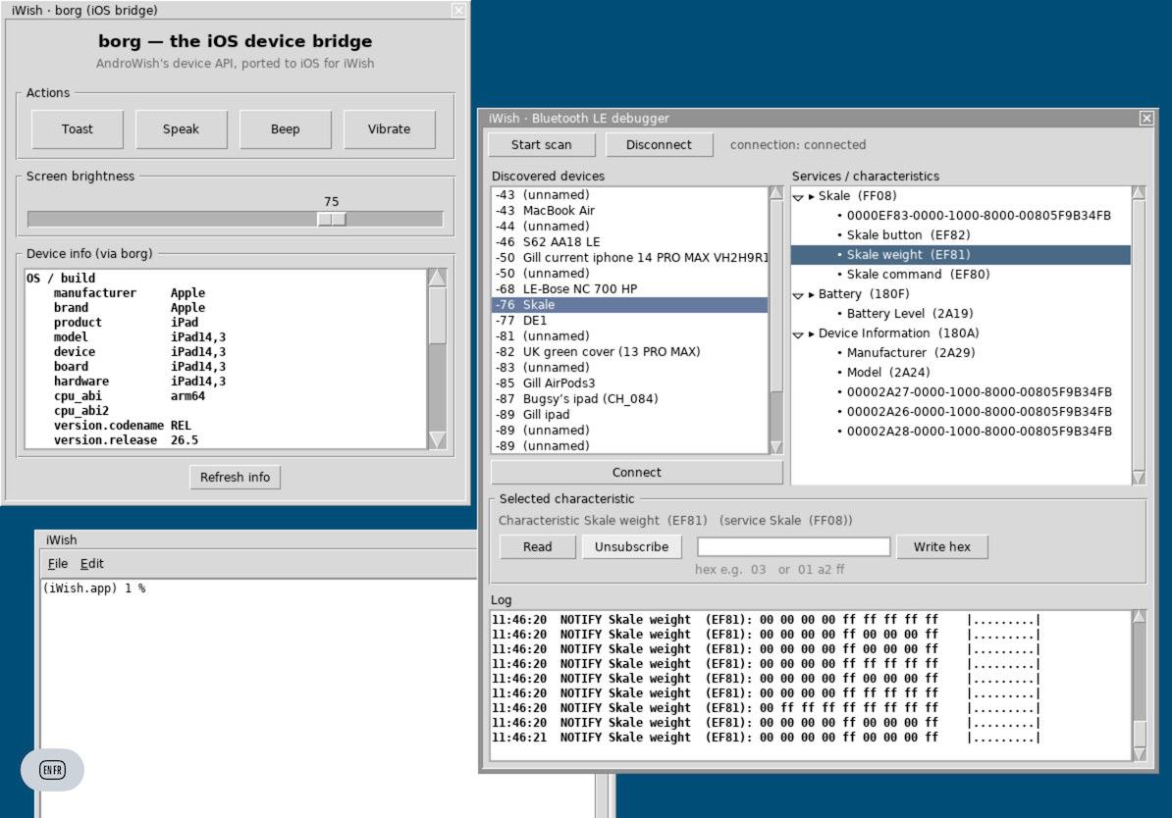
EUROTCL 2026
iWish for iOS
Running real Tcl/Tk applications on iPhone and iPad — from the newest devices back to iOS 9
https://github.com/johnbuckman/iwish
John Buckman EuroTcl 2026 · Vienna

Slide 2

MOTIVATION
Tcl/Tk runs everywhere — except in your pocket
Tk is a first-class GUI toolkit on Linux, macOS and Windows
Mobile has been the great blank spot for two decades
AndroWish brought Tk to Android via SDL2 — iOS stayed out of reach
Apple's rules: no JIT, static linking, code-signing, sandboxing
Yet the users we care about carry iPhones and iPads
The goal
One wish binary that launches your existing Tcl/Tk app on iOS — no rewrite, no web view.
EuroTcl 2026 iWish for iOS
1

Slide 3
01
From AndroWish to iWish
A single SDL2-backed Tk that already crossed one mobile platform

Slide 4



LINEAGE
Standing on the shoulders of undroidwish
AndroWish
undroidwish
iWish
Tcl/Tk on Android via SDL2. Proved that Tk's render loop can live on a mobile GPU surface and touch input.
The desktop single-file 'vwish' built on the same SDL2 core — the launch pad for new targets, including arm64 macOS.
The iOS target: statically linked, code-signed, App-Store-shaped — carrying Tk, extensions and demos in one bundle.
EuroTcl 2026 iWish for iOS
2

Slide 5
ARCHITECTURE
How the stack folds onto iOS
Your Tcl/Tk application · profiles, skins, demos
Statically linked — no dlopen, satisfies Apple's rules
Tk draws into an SDL2 texture, presented by Metal
Touches, keyboard and pencil arrive as SDL events
The whole app is one signed .ipa
Tk widgets + canvas · Tcl 8.6 core
SDL2 · window, events, GPU surface
Metal / UIKit · iOS app lifecycle + sandbox
EuroTcl 2026 iWish for iOS
3

Slide 6
PHILOSOPHY
Batteries included — always
Never ship a bare wish.
Every iWish bundle carries the extensions and demo apps a Tcl developer expects — so it runs something the moment it launches.
tls
sqlite
tkpath
vfs
tdom
tcllib
BLE
Img
Demos
bundled in every build
EuroTcl 2026 iWish for iOS
4

Slide 7
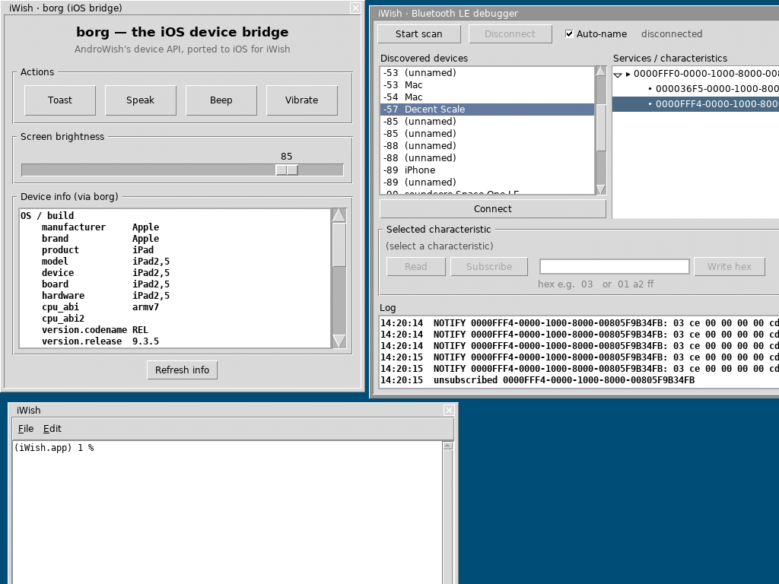
LONG TAIL
All the way back to iOS 9 and armv7
iPad mini 1 and other 32-bit devices still in daily use
Built a 32-bit armv7 slice — no modern toolchain assumes it
BLE on the old stack: solved and shipping
Self-update needed HTTPS on an ancient TLS — back-ported
Pushed to github.com/johnbuckman/iwish · ios9-armv7
iPad2,5 · armv7 · iOS 9.3.5
EuroTcl 2026 iWish for iOS
5

Slide 8
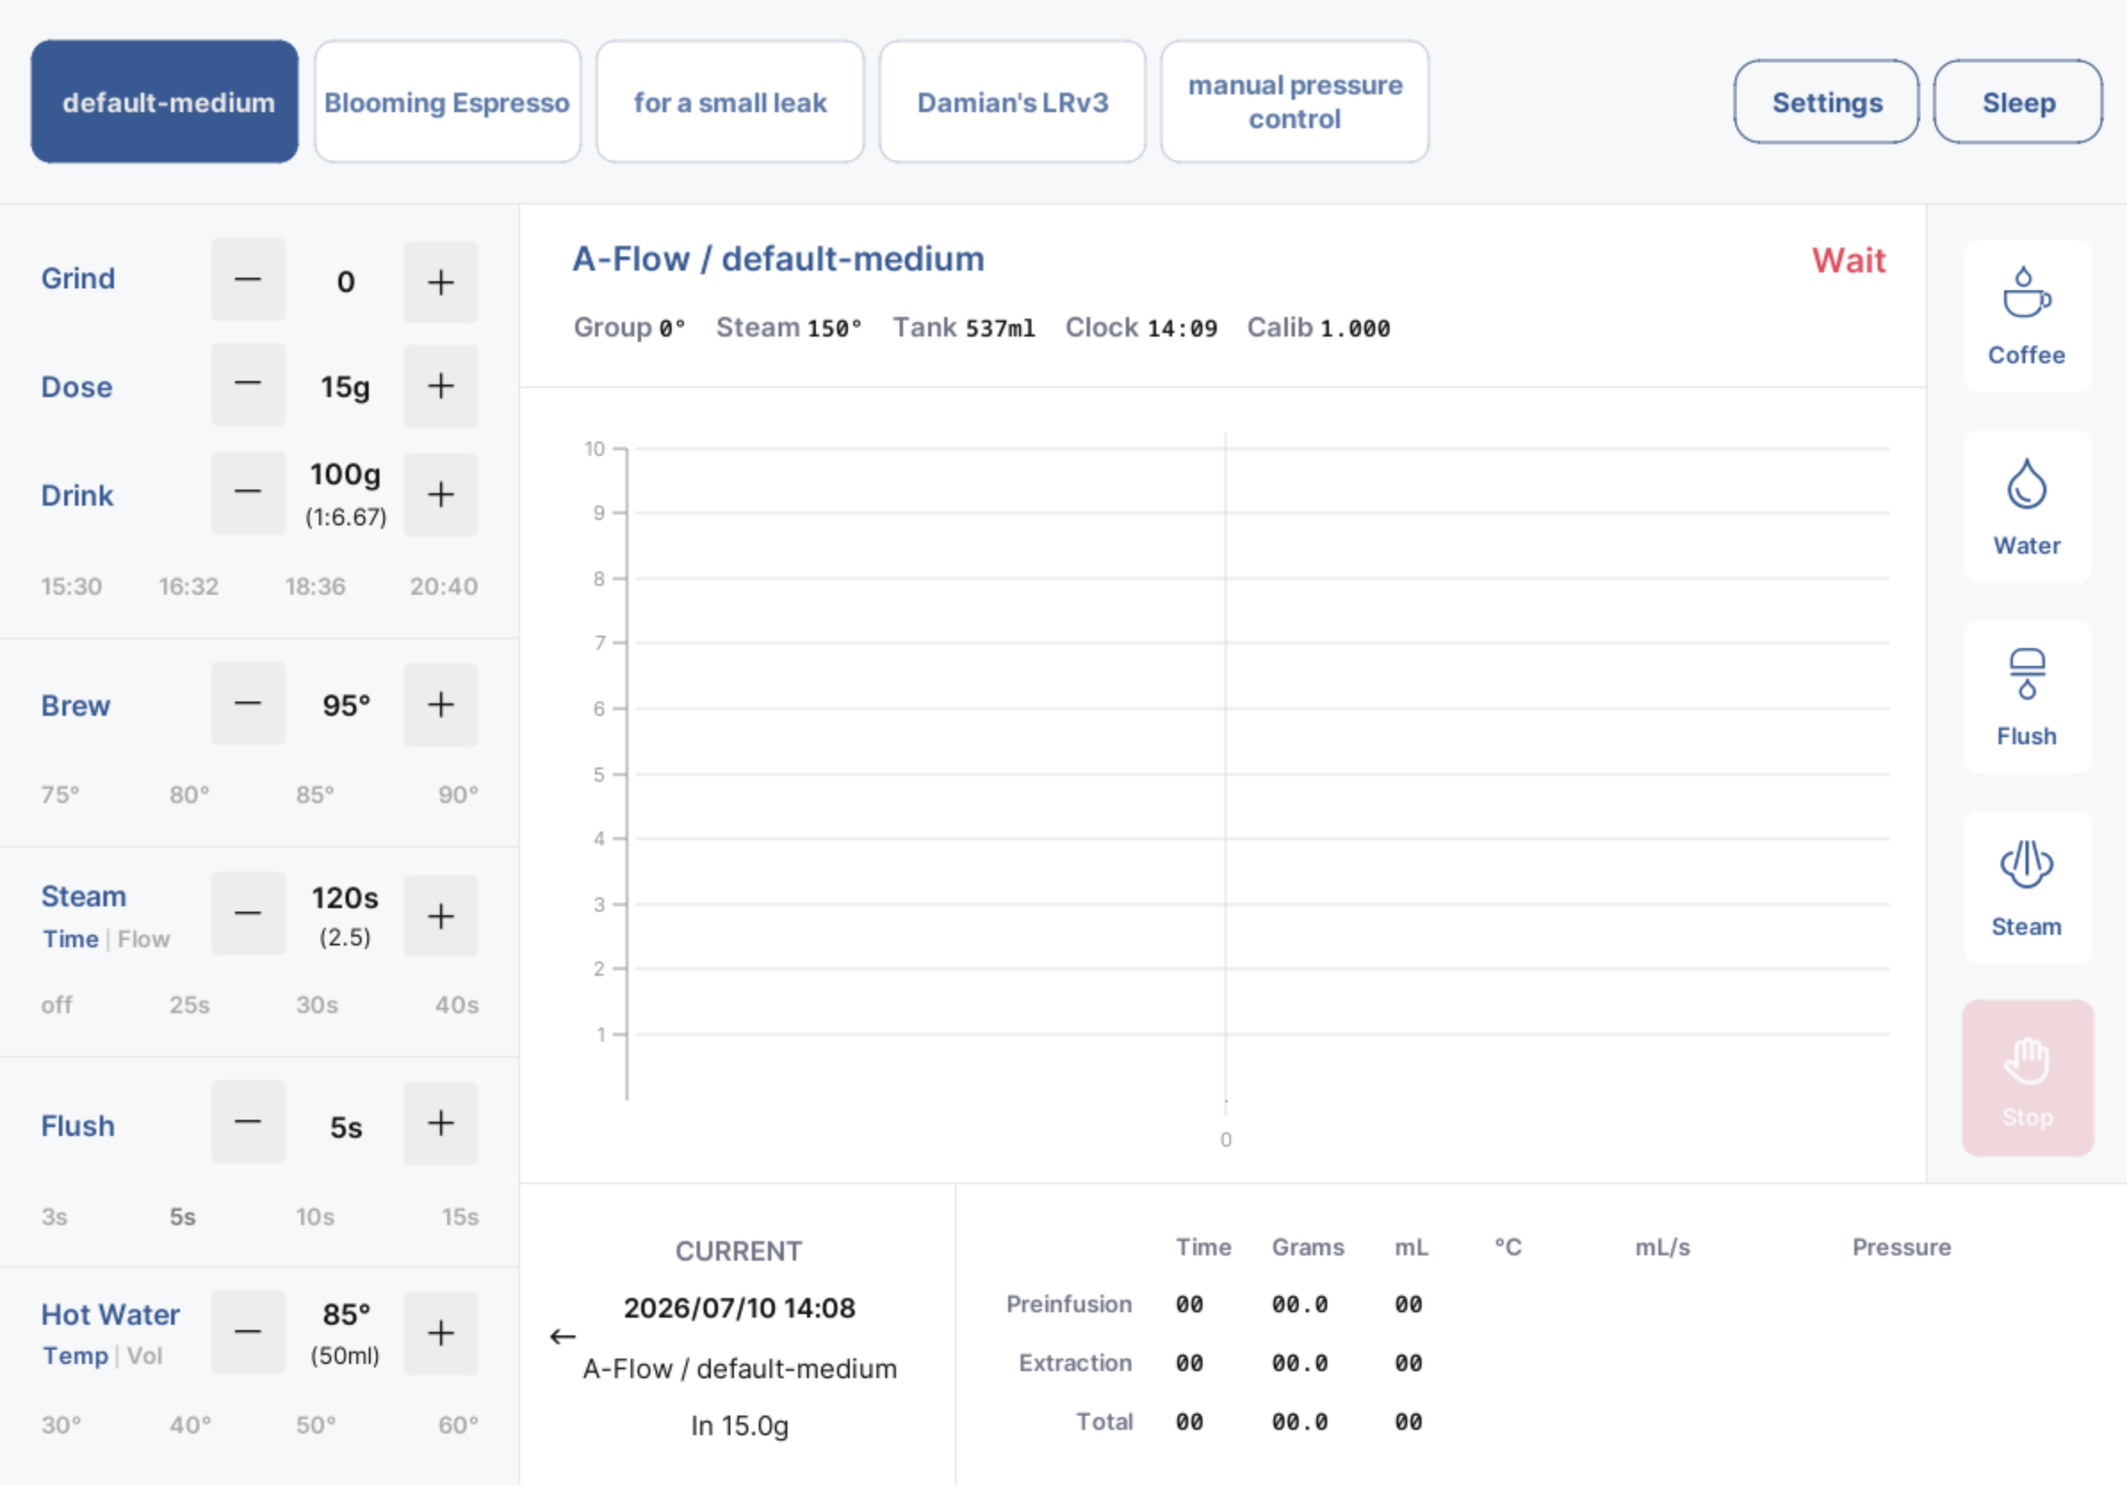
CASE STUDY
de1app — an espresso machine in your hand
Decent Espresso's control app is 100% Tcl/Tk
Tens of thousands of lines, live BLE to the machine
iWish runs it unmodified on iPhone and iPad
Real-time shot graphs via the accelerated canvas
Shipped to real customers — not a tech demo
EuroTcl 2026 iWish for iOS
6

Slide 9


APP REVIEW
Would Apple approve a Tk app?
DE1 app — likely approved
Bare wish — likely refused
Full-featured and single-purpose
Polished, native-looking UI
Talks to real hardware over BLE
Self-contained — all scripts baked in
2.5.2 — an app can't download or run code that changes it
A 'run any Tcl' launcher or code self-update breaks that
4.2 — a bare toolkit is 'minimum functionality': a dev tool
Rule of thumb: ship an app, not an interpreter.
EuroTcl 2026 iWish for iOS
7

Slide 10
THE 32-BIT CATCH
Jailbreak: the only way onto the mini 1
Apple's signing and current Xcode can't target iOS 9 / armv7 — so the iPad mini 1 had to be jailbroken to run unsigned code.
Advantages
Disadvantages
Installs unsigned IPAs — no account needed
No 7-day expiry; the app just stays
Reaches hardware Apple's tools dropped
Full filesystem access for debugging
Only old, exploitable devices qualify
Disables Apple's security protections
You can't ask customers to do it
Fragile — a reboot or update can undo it
EuroTcl 2026 iWish for iOS
8

Slide 11
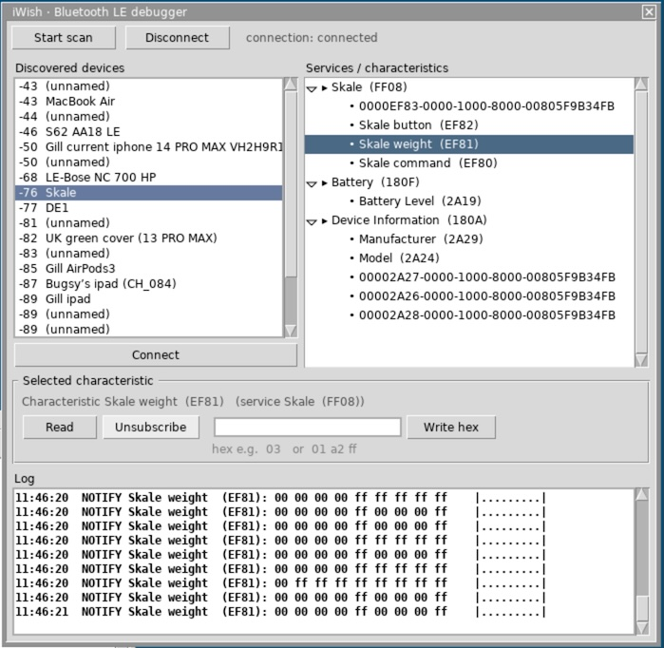
RADIOS
BLE, the iOS way
connect.tcl
package require ble
ble scan start
ble connect $de1_mac
ble subscribe $uuid on_notify
proc on_notify {char data} {
decode_shot $data
}
# CoreBluetooth under the hood —
# the same ble API as desktop
EuroTcl 2026 iWish for iOS
9

Slide 12
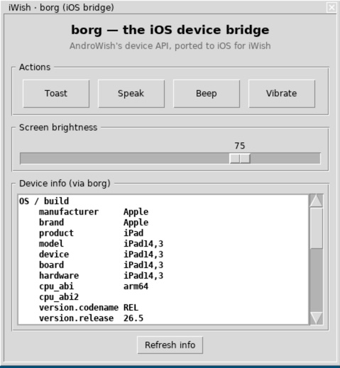
DEVICE API
The borg command
AndroWish's borg command — one Tcl call into the native device, now on iOS.
Toast, speak, beep, vibrate — instant user feedback
Read and set screen brightness
Device info: model, board, CPU ABI, OS version
The same borg your AndroWish code already calls
Native iOS frameworks behind a familiar Tcl API
EuroTcl 2026 iWish for iOS
10

Slide 13
BY THE NUMBERS
What iWish covers today
iOS 9 → 18
armv7 + arm64
1 .ipa
Supported OS range, one codebase
32- and 64-bit device slices
App, Tk, extensions and demos bundled
EuroTcl 2026 iWish for iOS
11

Slide 14
02
Running & shipping your own apps
Getting a tcl/Tk app onto real iPads — and living with Apple's rules

Slide 15


CODE-SIGNING
Seven days free, or a year for $99
Free Apple ID
Paid — $99 / year
7 days
1 year
The signed app stops launching after a week
Re-sign and re-deploy every 7 days
Only three sideloaded apps at a time
Fine for yourself and for development
Provisioning stays valid a full year
Install on up to 100 registered devices
Unlocks TestFlight and the App Store
The practical choice for real distribution
EuroTcl 2026 iWish for iOS
12

Slide 16



DISTRIBUTION
Getting your IPA onto other phones
Ad Hoc
TestFlight (beta)
Up to 100 devices a year, by UDID. One-year profile, paid account.
Up to 10,000 testers, but a beta review first; builds expire in 90 days.
Enterprise · $299/yr
App Store
Internal apps for your own staff only — never the public, or Apple revokes it.
Widest reach, but full review — every guideline applies to you.
EuroTcl 2026 iWish for iOS
13

Slide 17
INSTALLING IT
Five ways onto your iPad
Route | What you need | Validity
iSideload (USB) | Mac + USB + free Apple ID | 7 days free · 1 year paid
Sideloadly | Mac or Windows + Apple ID | 7 days free · 1 year paid
SideStore | iPad + one-time pairing | Renews on-device
Build from source | Mac + Xcode toolchain | 7 days free · 1 year paid
EU web distribution | An EU device — no computer | Permanent
Full step-by-step guide: github.com/johnbuckman/iwish/blob/main/INSTALL.md
EuroTcl 2026 iWish for iOS
14

Slide 18
METHOD 1 · ISIDELOAD
The one-click installer I built
1
Sign in with a free Apple ID
Straight into the menu-bar app
2
Drop in the .ipa
zsign signs it with your Apple ID
3
Signed inside-out
Every nested dylib, not just the wrapper — the bit AltStore skips
4
Plug in over USB
Bundled libimobiledevice installs it — no Xcode, no Python
5
Leave it running
Re-signs iWish every 7 days, automatically
Free · open source · works today — github.com/johnbuckman/iSideload
EuroTcl 2026 iWish for iOS
15

Slide 19

ISIDELOAD · ROADMAP
Toward a cable-free install
1
Registered-device QR — works today
Scan → the signed app installs over the air
2
QR reports the device’s ID
Sends its UDID back for ad-hoc registration
Over-the-air
The Mac shows a QR of one-tap install links; the iPad pulls the signed app over HTTPS — no cable. Needs Developer Mode on once.
3
NaviServer + zsign, fully hosted
Nothing on your Mac — just scan a QR
EuroTcl 2026 iWish for iOS
16

Slide 20
METHOD 2 · SIDELOADLY
The simple one-time install
1
Download Sideloadly
Grab it free from sideloadly.io
2
Windows only: add Apple's iTunes + iCloud
The versions from apple.com — not the Microsoft Store
3
Connect the iPad over USB
Unlock it and trust the computer
4
Drag in the .ipa and sign in
Sideloadly signs it with your Apple ID
5
Trust the certificate
Settings → General → VPN & Device Management
Free Apple ID → every 7 days · paid → yearly. Its wireless (VPN) mode was finicky for me — USB is the reliable path.
EuroTcl 2026 iWish for iOS
17

Slide 21
CAUTION · ALTSTORE
AltStore can’t sign for modern iOS
1
Its signer is obsolete
Signs via an Apple ID flow Apple has retired
2
iWish breaks it anyway
~64 native dylibs live outside Frameworks/
What replaced it?
SideStore re-signs on-device — no computer after the first pairing. It should be the successor, but its VPN config defeated me too.
3
installd rejects the bundle
Mismatched team signatures → 0xe8008001
EuroTcl 2026 iWish for iOS
18

Slide 22

METHOD 3 · FROM SOURCE
Build it yourself
1
Clone the sources
iWish, AndroWish and SDL2
2
Apply the patches
AndroWish + SDL2, patched for iOS
Scripted end to end
3
Run the provided build scripts
Patch, build and sign with the scripts in the repo — the exact commands live in INSTALL.md.
The whole toolchain is scripted
4
Sign and deploy
7 days free, or a year paid
EuroTcl 2026 iWish for iOS
19

Slide 23

EUROPEAN UNION
The DMA cracked sideloading open
Since iOS 17.4, EU users can install apps from outside the App Store
Via alternative marketplaces or web distribution
No 7-day expiry, no 100-device cap — a real download
But it needs an EU-based developer entity + Apple's alternative terms
And every app is still Notarized by Apple before it ships
Notarization
An automated security + functionality check — not a content review. But a broken or interpreter-shaped app can still be turned away here.
EuroTcl 2026 iWish for iOS
20

Slide 24
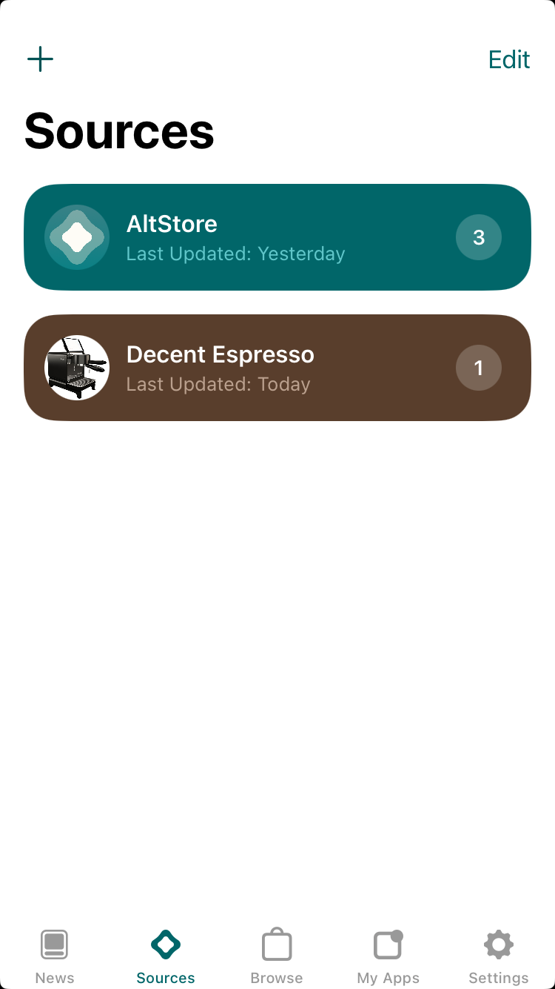
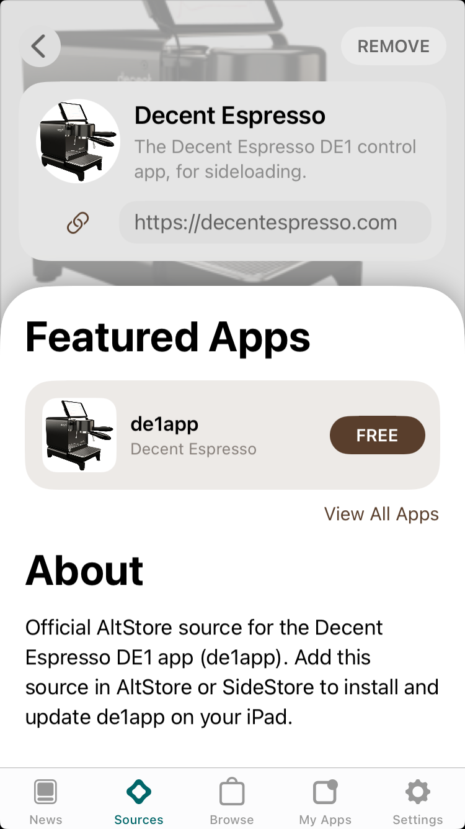
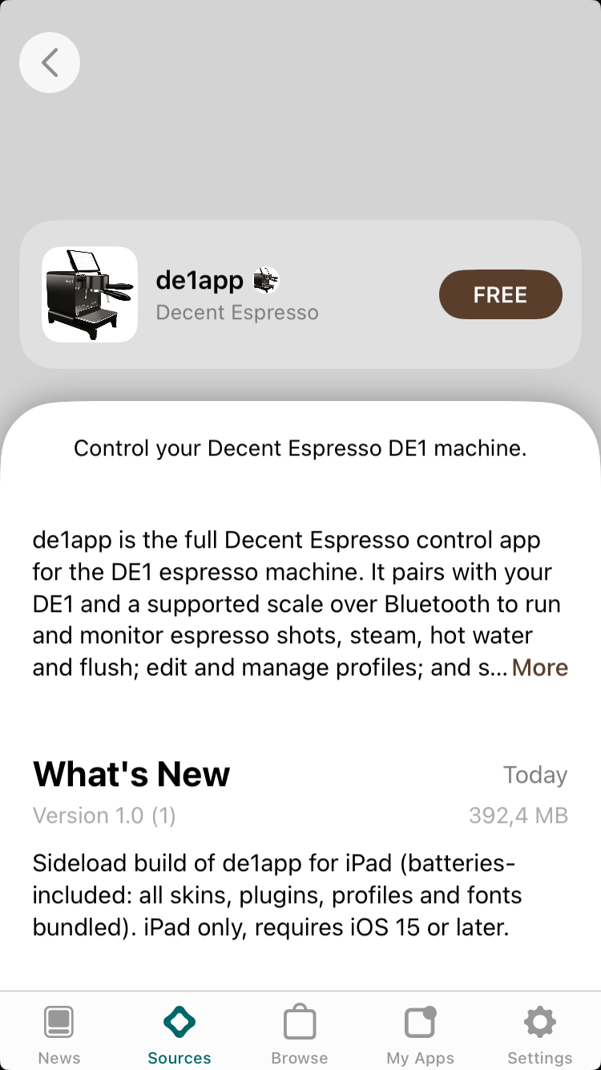
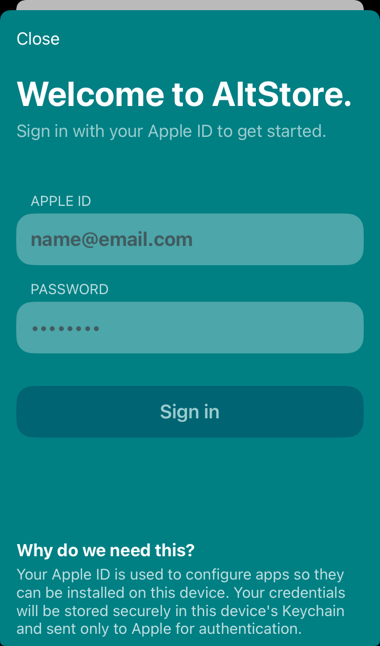
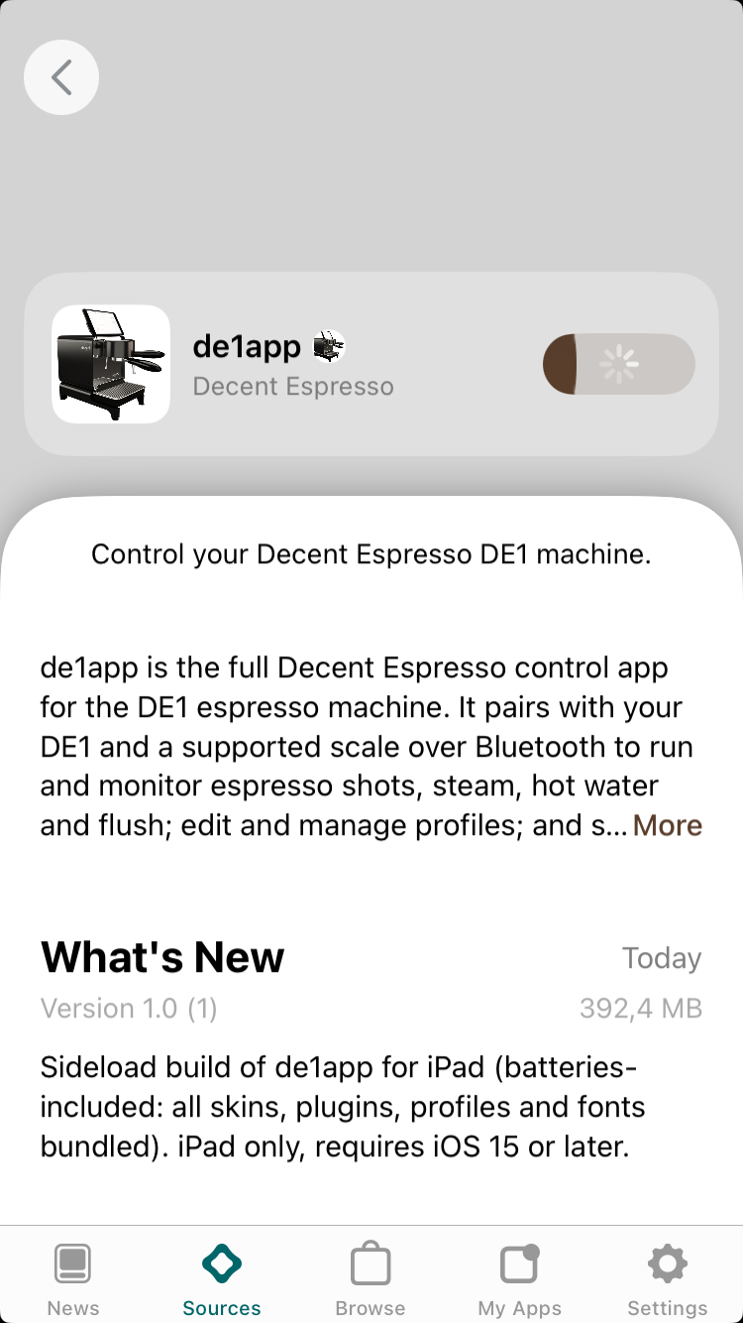
CAUTION · ALTSTORE
How AltStore used to install it
1
2
3
4
5
Add source
Open source
de1app page
Sign in
Install
SideStore — the on-device successor (no computer after pairing) should work, but its VPN setup defeated me too. iSideload is the path that works today.
These screenshots are historical — this flow no longer signs for current iOS. github.com/johnbuckman/iSideload
EuroTcl 2026 iWish for iOS
21

Slide 25

CALL FOR COLLABORATORS
Wanted: an EU Company (or Org) to help distribute a free Tcl/Tk without limitations
I'm looking for a partner with an EU-registered company
…willing to sign Apple's distribution paperwork
Then we ship a notarized IPA for open sideloading
Europeans get iWish + the DE1 app — no 7-day expiry, no device cap
You're the EU entity of record; I bring the app and the work
Let's talk
Find me at EuroTcl — during the break or after the talk.
EuroTcl 2026 iWish for iOS
22

Slide 26
Your Tcl/Tk app already runs on iOS
github.com/johnbuckman/iwish — source and the ios9-armv7 branch
Bring your wish app; iWish supplies the runtime
Have an EU company? Let's ship a sideloadable IPA together
John Buckman github.com/johnbuckman/iwish

