Slide 1
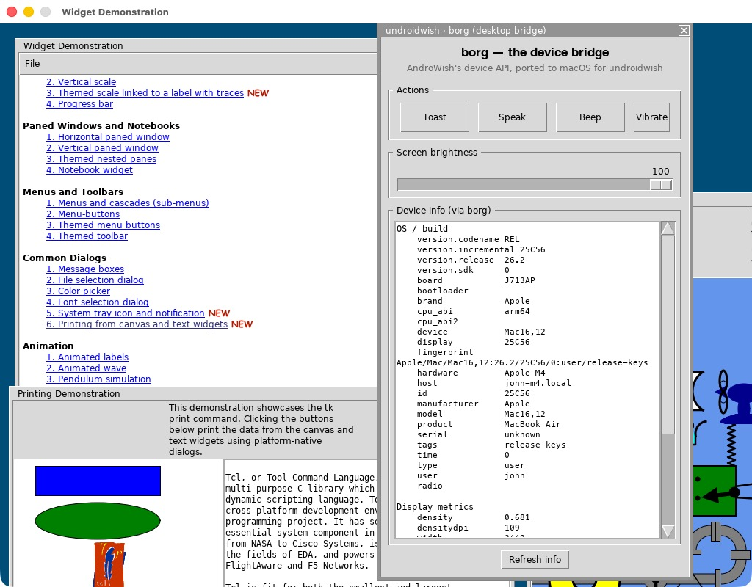
EUROTCL 2026
undroidwish for Apple Silicon Macs
Now with bluetooth and borg compatibility
github.com/johnbuckman/undroidwish-arm64-batteries-included · under the Tcl/Tk license
John Buckman EuroTcl 2026 · Vienna

Slide 2

WHY NOW
Rosetta 2 is being retired
Jun 2020
WWDC: the Apple Silicon switch begins. Rosetta 2 is billed as transitional.
Nov 2020
First M1 Macs. Intel apps run only via Rosetta 2 translation.
Jun 2025
WWDC: Rosetta 2 promised for only two more releases — through macOS 27.
Living on borrowed time
Feb 2026
macOS 26.4 starts warning users about Rosetta-dependent apps.
An x86 undroidwish only runs through a translation layer Apple is deleting. A native arm64 build is the only way de1app keeps running on macOS 27 and beyond.
Fall 2026
macOS 27 “Golden Gate” — last release with full Rosetta 2.
Fall 2027
macOS 28 removes Rosetta 2 — x86 apps stop launching.
EuroTcl 2026 undroidwish · Apple Silicon
2

Slide 3
BENCHMARKS
Native arm64 vs x86 under Rosetta 2
1.46×
Startup
1.25× 20%
Math
1.47× 47%
faster overall
General Tcl
1.53× 53%
geometric mean of all micro-benchmarks
median of 5 runs · M4 MacBook Air
Tk
1.31× 31%
Two caveats: the builds also differ by a Tcl minor bump (8.6.9 → 8.6.10), so this is a real-world build-to-build comparison, not pure arch isolation. Tk gains are smallest because much of that work is SDL surface blitting on the GPU — CPU-heavy math and list work shows the biggest native win.
EuroTcl 2026 undroidwish · Apple Silicon
3

Slide 4
BENCHMARKS
Every metric — x86 vs arm64 (ms)
metric | x86 | arm64 | faster | metric | x86 | arm64 | faster
startup | 531.7 | 425.0 | 1.25× | list.build_sort | 137.7 | 83.1 | 1.66×
math.int | 954.1 | 583.4 | 1.64× | list.foreach_search | 125.3 | 59.2 | 2.12×
math.float | 894.7 | 623.0 | 1.44× | dict.set_get | 396.5 | 265.7 | 1.49×
math.trig | 519.7 | 336.4 | 1.54× | regexp.match | 1258.9 | 982.5 | 1.28×
math.fib_recursion | 422.6 | 281.4 | 1.50× | array.set_get | 157.7 | 110.0 | 1.43×
math.bignum | 44.6 | 34.9 | 1.28× | binary.format_scan | 167.7 | 109.1 | 1.54×
str.append | 47.4 | 28.9 | 1.64× | tk.widget_create | 20.6 | 15.5 | 1.33×
str.map_regsub | 320.2 | 260.0 | 1.23× | tk.canvas_items | 12.0 | 9.5 | 1.26×
str.format | 284.0 | 184.1 | 1.54× | tk.canvas_redraw | 124.3 | 95.4 | 1.30×
 |  |  |  | tk.text_insert | 4.3 | 3.2 | 1.34×
EuroTcl 2026 undroidwish · Apple Silicon
4

Slide 5
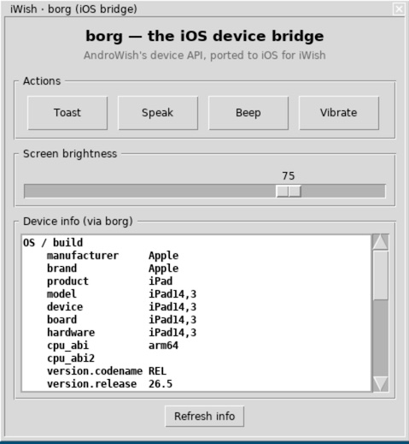
01
The borg command
AndroWish's platform bridge — reintroduced on the Mac desktop

Slide 6

BACKGROUND
What borg does
On AndroWish, borg exposes the Android platform to Tcl
Notifications, speech, USB, preferences, device info
One command, dozens of subcommands — a native API in Tcl
de1app is written against borg, assuming Android underneath
But undroidwish ships “sans the borg” — it's missing
borg
The platform bridge de1app expects — so we bring it back on the Mac.
EuroTcl 2026 undroidwish · Apple Silicon
6

Slide 7

IMPLEMENTATION
tkBorgOSX.c — a clean-room port
Not an #ifdef-shred of the 6,900-line Android JNI file
A self-contained reimplementation guarded by __APPLE__
Exposes the same subcommand surface — code runs unmodified
Never errors on a well-formed call; absent features no-op
Built only on libc, Tcl, CoreFoundation, IOKit, CoreGraphics
package require Borg
Ships as a loadable Tcl stubs package, bundled into assets.zip — the same way undroidwish carries all its batteries.
EuroTcl 2026 undroidwish · Apple Silicon
7

Slide 8
THE API
The same calls, native backends
borg.tcl
Native backends, Android-shaped output
say for speech, afplay for beep
An always-foreground SDL panel for toast
IOKit enumerates USB; DisplayServices sets brightness
# the same de1app code, unmodified
borg speak "Shot ready"
borg toast "Saved"
borg beep
set bi [borg osbuildinfo]
# manufacturer -> Apple
# model -> Mac16,12
borg usbdevices
EuroTcl 2026 undroidwish · Apple Silicon
8

Slide 9




COVERAGE
What works natively on the Mac
Speech & sound
Device & display
speak · stopspeak · beep · toast — via say, afplay and an always-foreground SDL overlay.
osbuildinfo · displaymetrics · brightness · networkinfo — real values from sysctl & CoreGraphics.
Storage & prefs
USB & app control
sharedpreferences · osenvironment — a typed KV store under ~/Library/Application Support.
usbdevices · withdraw · spinner · log · locale — IOKit enumeration and native window control.
EuroTcl 2026 undroidwish · Apple Silicon
9

Slide 10


REALITY CHECK
Graceful where macOS differs
Partial — common case covered
Stub — accepted, never errors
activity → open a URL or file
notification → osascript banners
bluetooth state via system_profiler
permissions report granted
vibrate · sms · NFC — no hardware
camera · location · sensors — future work
Return Android-shaped empty values
So de1app runs without a single crash
EuroTcl 2026 undroidwish · Apple Silicon
10

Slide 11
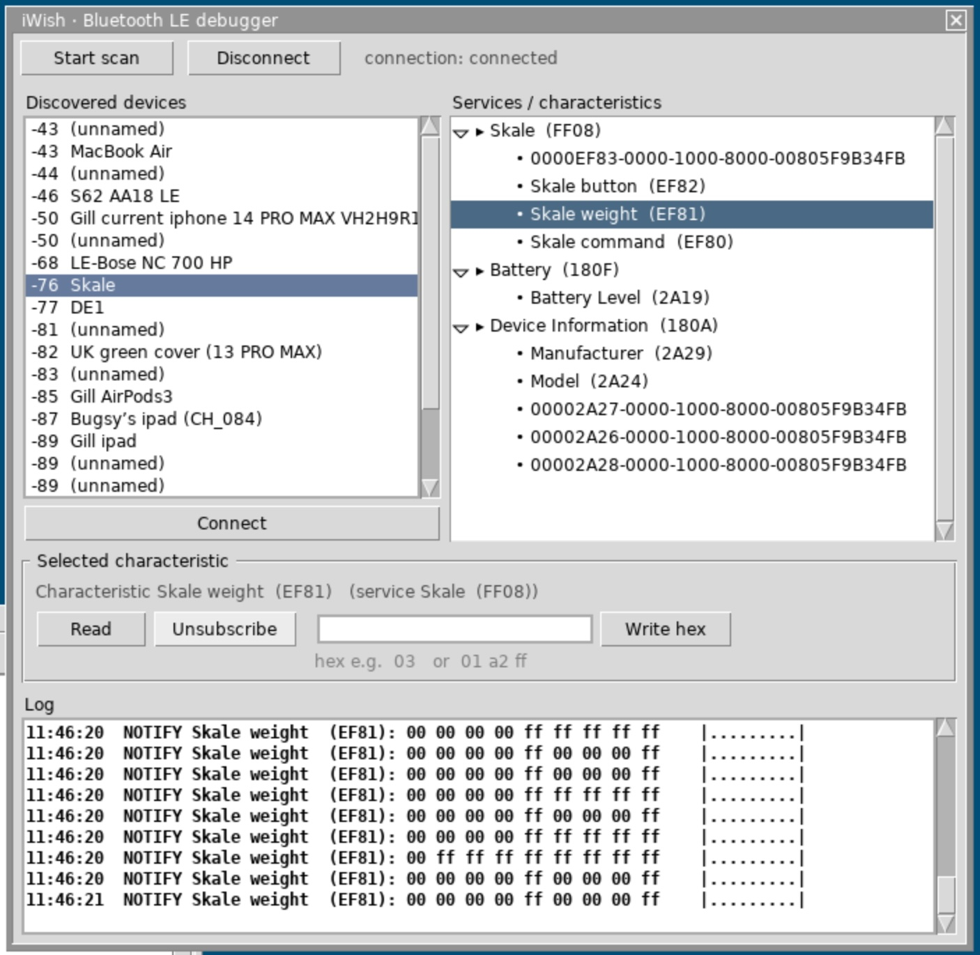
02
Bluetooth LE on the Mac
The Android ble command set, now driven by CoreBluetooth

Slide 12

BLUETOOTH
One ble API, CoreBluetooth underneath
undroidwish now bundles a native BLE driver for macOS
It exposes the exact same ble command set as AndroWish
scan · connect · discover · read · write · subscribe
Built on CoreBluetooth, marshalled onto the Tcl event loop
de1app's Android BLE code runs unchanged on the Mac
package require ble
Completely compatible with the Android ble command set — write the BLE code once, run it on both.
EuroTcl 2026 undroidwish · Apple Silicon
12

Slide 13
One Tcl/Tk code base running on Mac, iPad and Android
Native arm64 on Apple Silicon — signed and notarized
borg and ble reintroduced, with native Apple backends
Mac Desktop, iOS and Android from a single Tcl script
John Buckman github.com/johnbuckman

