Slide 1
Stable isotope dilution approach to measuring mineral replacement rates at high P-T conditions: Replacement of metamict zircon by hydrothermal zircon
John C. Ayers, Pan Hu, and Blake Wallrich, Vanderbilt University
Chen Zhu, Indiana University Bloomington
Keewook Yi, Korea Basic Science Institute

Slide 2
Introduction
Radiation damage can convert crystalline zircon to metamict (amorphous) ZrSiO₄
Metamict ZrSiO₄ is more soluble than crystalline zircon in hydrothermal fluids
Hypothesis: coupled dissolution-precipitation drives the replacement of metamict ZrSiO4 with crystalline zircon
Objective: measure the rate of replacement of metamict ZrSiO₄ by crystalline zircon
  Dope fluid of known ¹⁸O with rare stable isotope ²⁹Si
  Conduct cold seal pressure vessel experiments at 0.2 GPa and 600-800°C
  Measure isotope compositions of run product solids and fluids
  Calculate percent replacement from isotopic mass balance

Slide 3
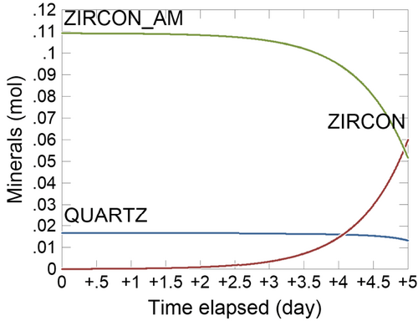
Previous Research
Several papers by Thorsten Geisler in the early 2000s reported partial replacement of partially metamict ZrSiO₄, with the thickness of replacement rims increasing with degree of radiation damage.
Ayers and Zhu (2025 G^3 26, e2024GC011925) used photomicrographs in Geisler et al. (2003, Am. Min. 88, p. 1496) to estimate rate constants for replacement of metamict ZrSiO₄ by crystalline zircon.

Slide 4
Zirconium phase solubilities: the driving force for replacement
At 0.2 GPa and quartz saturation
In a closed system, hydrothermal zircon may form by replacement of radiation-damaged zircon
Ayers and Zhu, G^3, 2025
Notes:
Activity-activity diagram comparing the pH-dependent solubilities of zirconium phases at conditions of quartz saturation at 0.2 GPa and 600°C. The fluid is undersaturated in the blue fields that are labeled with the dominant aqueous species and oversaturated in the yellow fields. Diagram of each mineral constructed using the GWB program Act2. The activities on the y-axis are for the dominant Zr species at the specified pH.

Slide 5
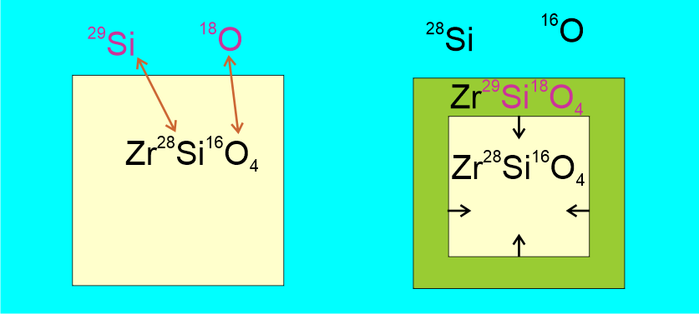
How we aim to better characterize the replacement of metamict zircon
Add silicon isotope and oxygen isotope tracer to dope the solution and trace the reaction;
Use isotopic compositions of starting materials and run product solids and fluids to quantify the extent of replacement.
Notes:
Why isotopic tracing, compared to weight loss and image analysis.

Slide 6
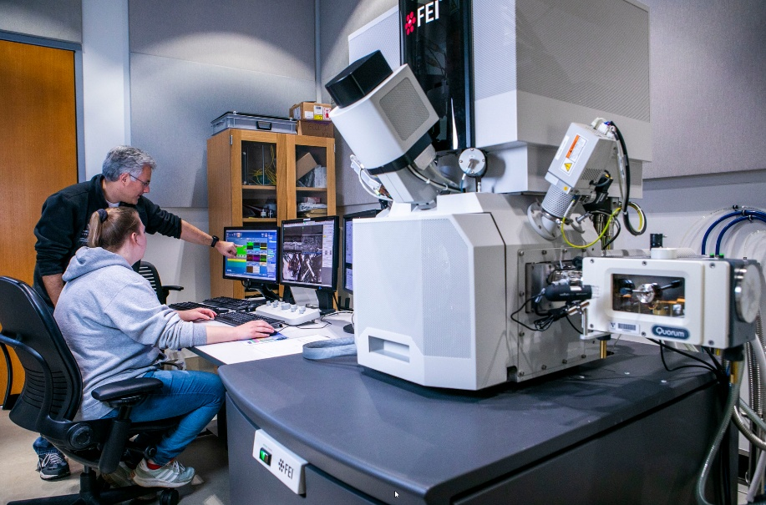
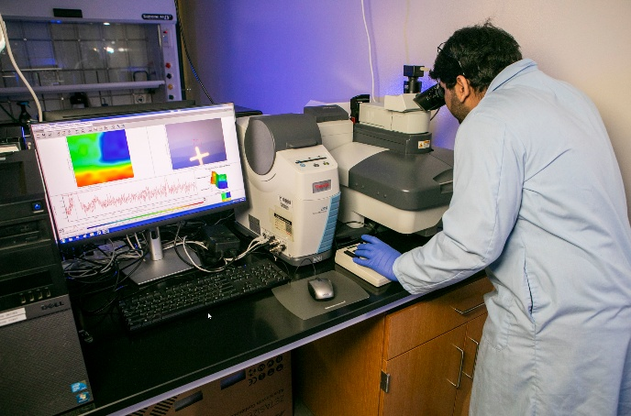
Solids characterization
EDS and CL imaging: FEI Helios NanoLab G3 CX SEM
Micro-Raman measurements: Thermo Scientific DXR Confocal Raman microscope

Slide 7
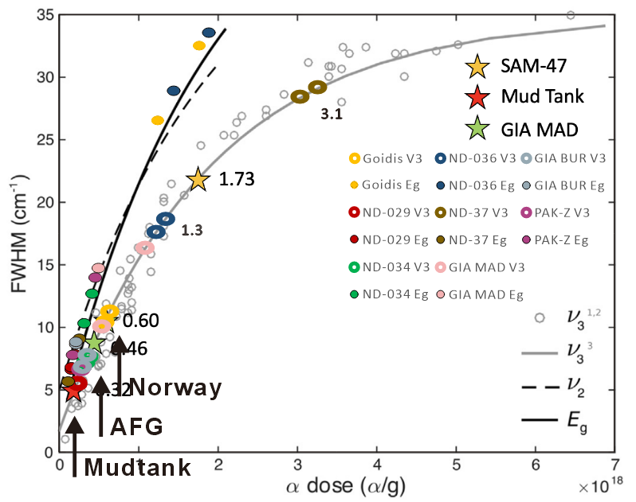
Degree of radiation damage from Raman spectroscopy

Slide 8
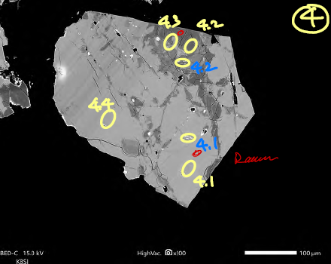
AFG metamict ZrSiO₄ heterogeneity
Bright zones in BEI have higher alpha doses and radiation damage than the dark zones.
Run products confirm that the bright radiation-damaged zones were preferentially replaced.

Slide 9
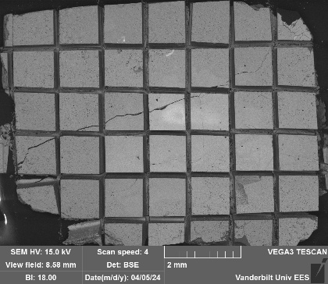
Starting Materials
Solids: zircon cubes
  AFG α-dose 0.46 α/g * 10¹⁸
  Norway α-dose 0.6 α/g * 10¹⁸
Fluid: USGS-49
  δ¹⁸O = -55‰
Solutes: ²⁹SiO₂ ± NaF

Slide 10
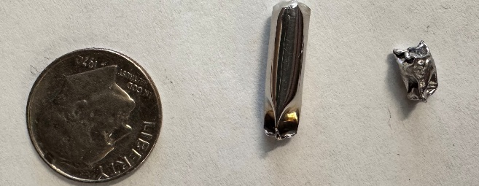
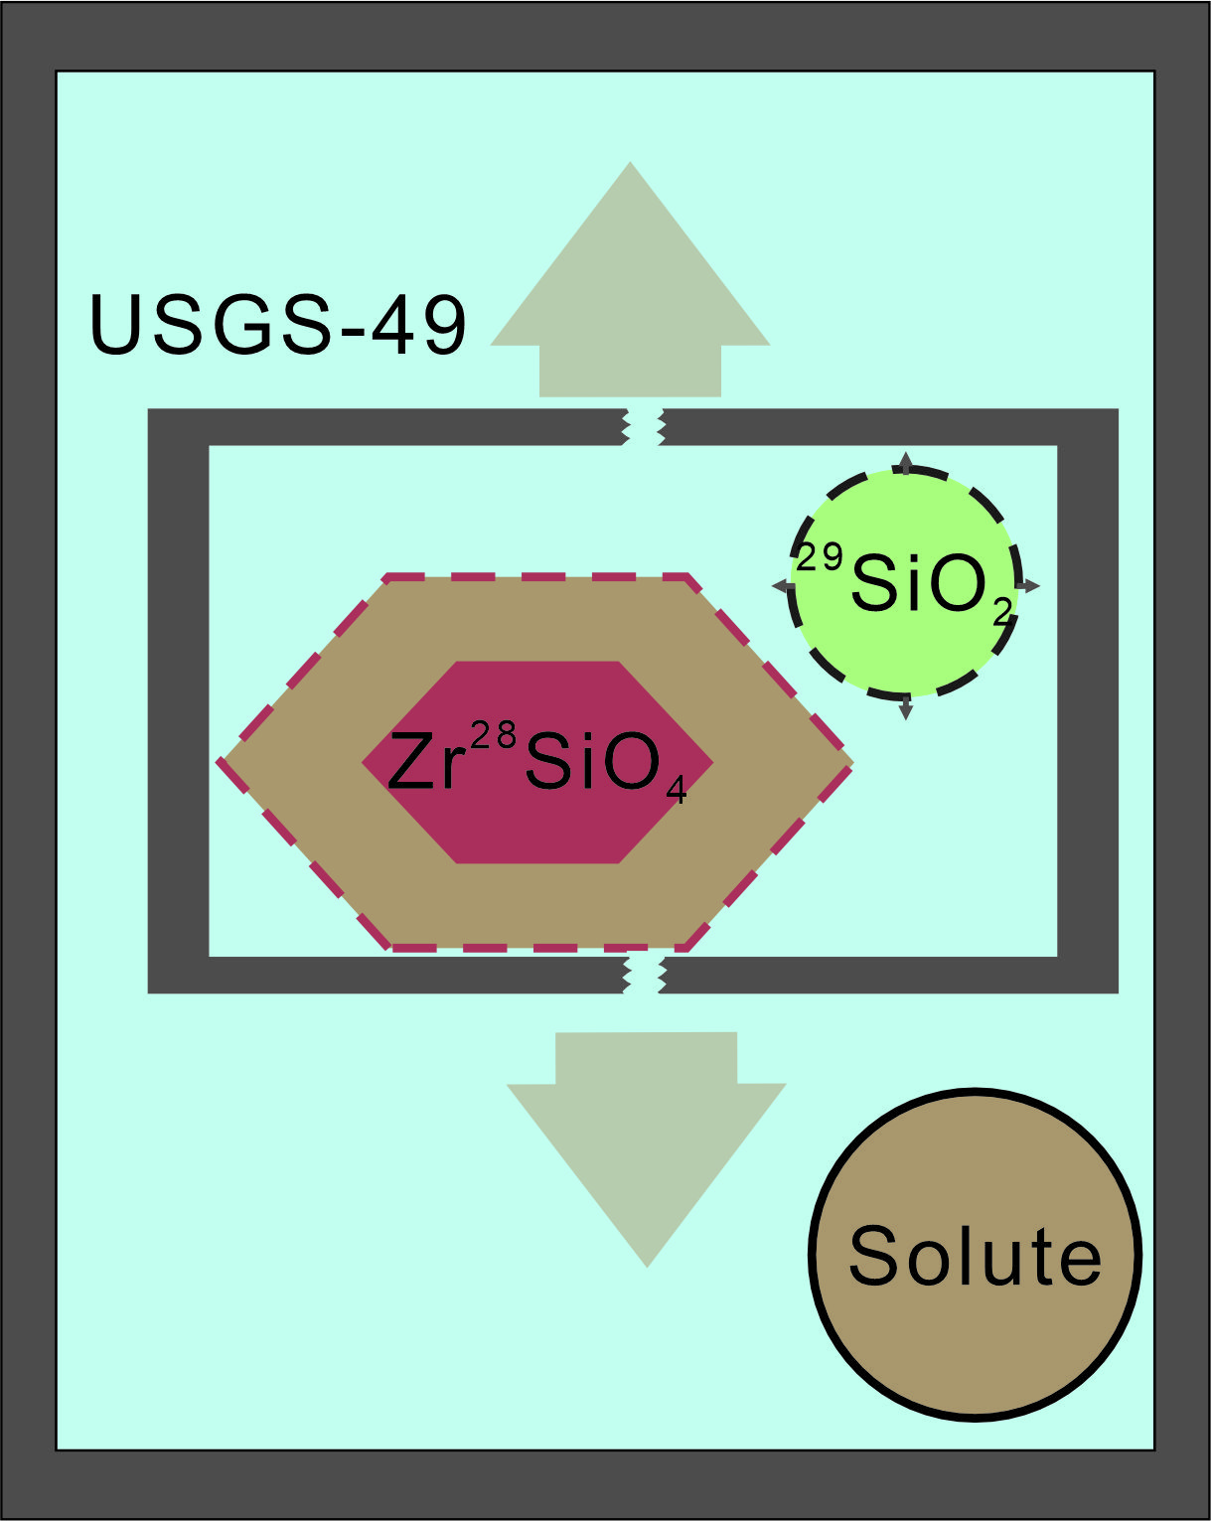
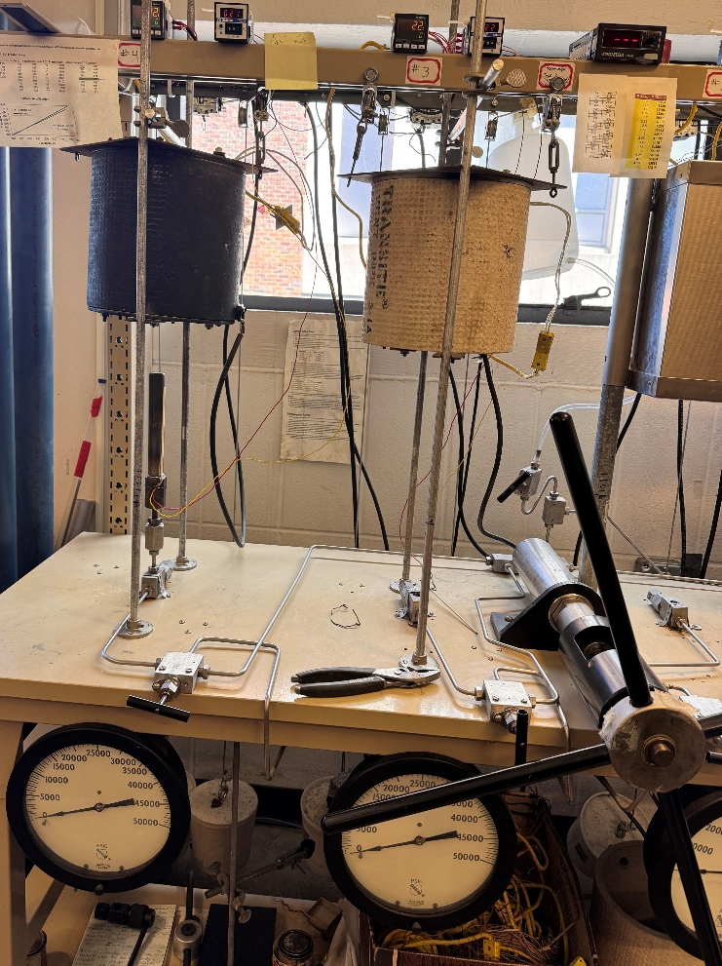
Double Capsule Cold Seal Pressure Vessel Experiments
Notes:
Picarro

Slide 11
List of experiments
Experiment | Run Time (d) | T (ºC) | P (GPa) | Starting material | Recrystallize?
Z_005 | 0.5 | 110 | 1 atm | AFG cubes + 0.5m NaF | No
Z_006 | 0.042 | 600 | 0.2 | AFG cubes + 0.5m NaF | No
Z_007 | 0.33 | 600 | 0.2 | AFG cubes + 0.5m NaF | Yes
Z_014 | 3 | 800 | 0.2 | AFG cubes + 1m NaF | Yes
Z_015 | 19 | 800 | 0.2 | AFG cubes + 1m NaF | Yes
Z_016 | 7 | 800 | 0.2 | AFG cubes + 1m NaF | Yes
Z_017 | 1 | 600 | 0.2 | Norway fragments + H2O | Yes
Z-018 | 1 | 600 | 0.2 | Norway fragments + 1m NaF
In all experiments starting fluid was USGS-49, and amorphous ²⁹SiO₂ dissolved in the fluid

Slide 12
Evidence for dissolution of metamict zircon
7 days at 800° C and 1m NaF

Slide 13
CL imaging of the replacement domain in run product grains
Replacement domain forms rim
Replacement occurs along cracks
Replacement domains are homogeneous and have porous texture.
7 days at 800° C and 1m NaF
Notes:
Porous
Crack rim

Slide 14
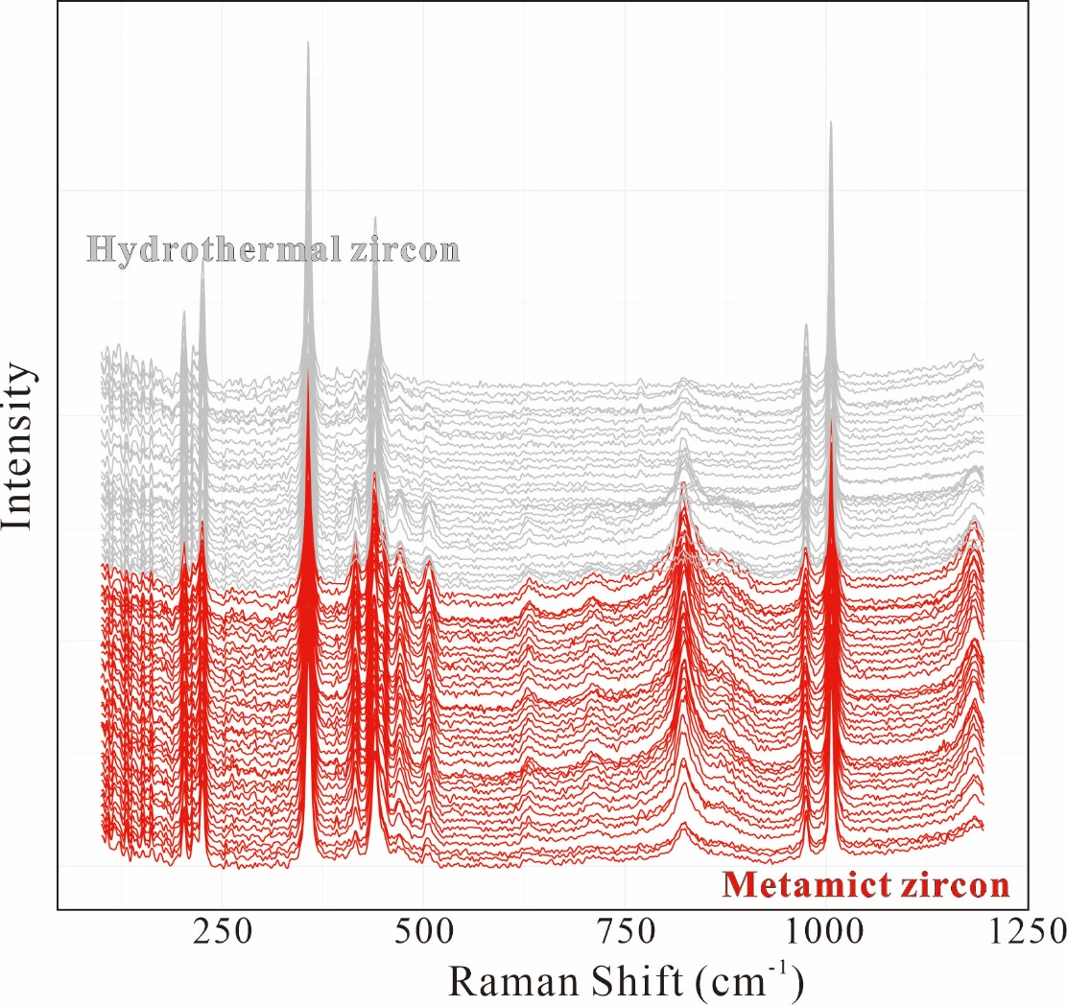
Raman spectroscopy of different domains
Replacement domain is perfectly crystalline!

Slide 15
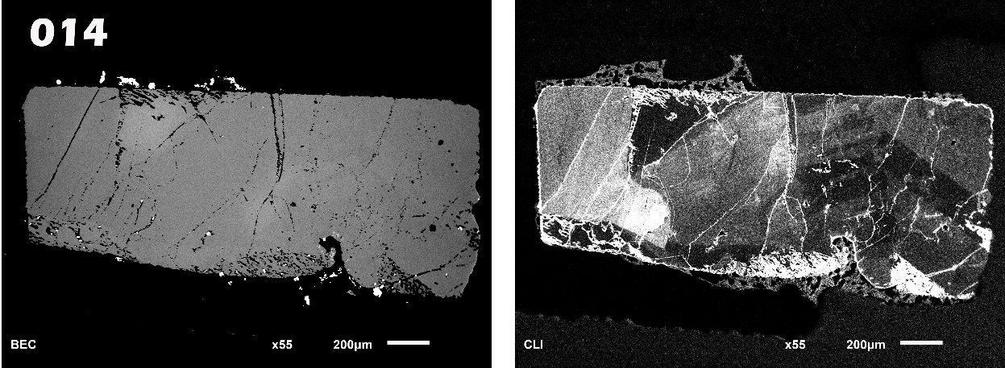
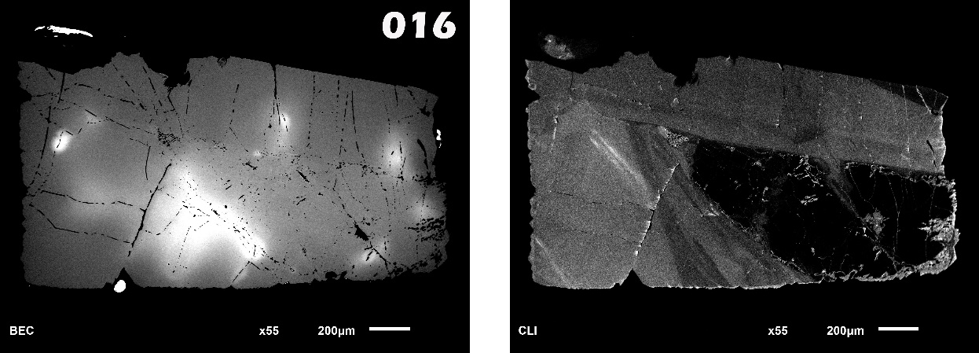
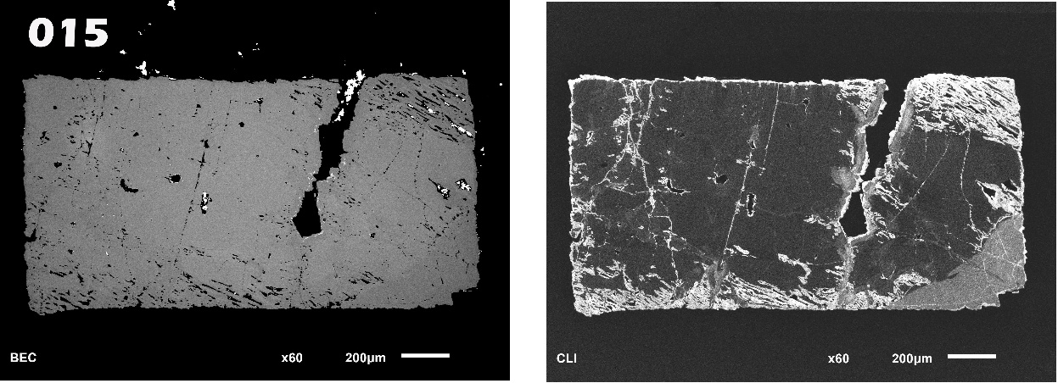
BSE
CL
The replacement occurs on mineral surface and cracks;
The replacement domain show porous texture;
Increase in the percentage of replacement through time.
3 days
7 days
19 days

Slide 16
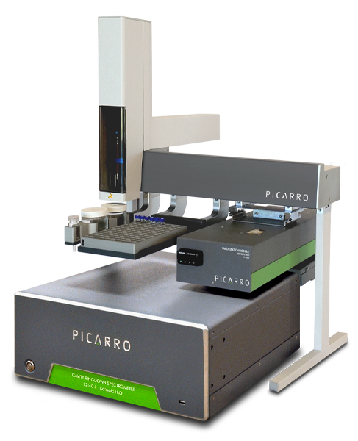
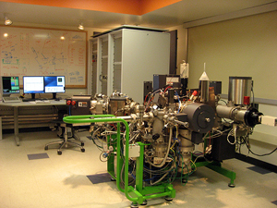
Stable Isotope Analysis
Picarro L2130-i: O and H isotopes of fluids
Cameca ims 7f at Caltech: Si and O isotope composition of solids and quenched solutes

Slide 17
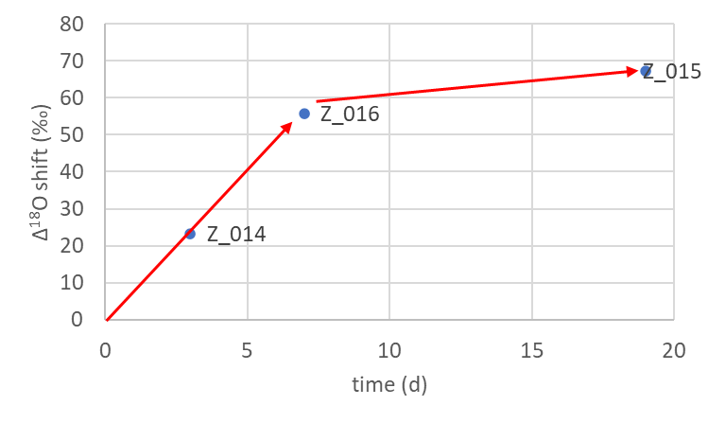
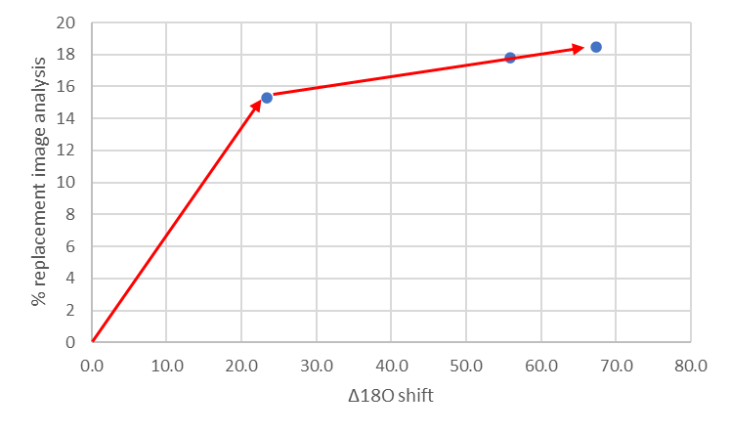
Oxygen isotope results from capsule fluid
Reaction rate is high and then levels off
Two measures of extent of reaction show good agreement

Slide 18
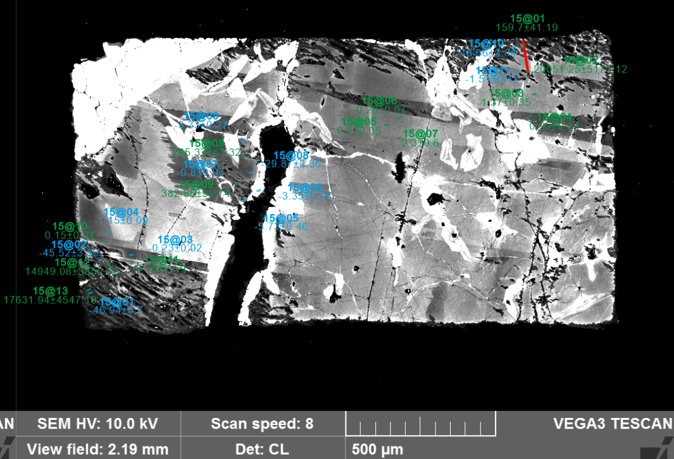
Experiment: Zircon_015
Temperature: 800 ºC
Pressure: 2 kbar
Time: 19 days
Solute: NaF + ²⁹Si
Solvent: USGS49
SIMS Si and O isotope data on run product solids
Kernel Density Estimation
δ¹⁸O ‰
Kernel Density Estimation
δ²⁹Si ‰
Notes:
Add Picarro after this

Slide 19
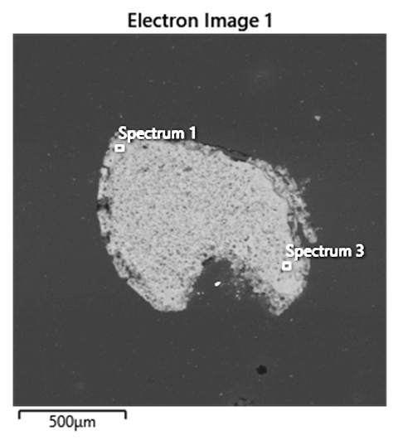
Quenched solutes
Zir-016 quenched solute
Avg. EDS composition
Element | Wt% | Wt% Sigma
O | 47.75
Na | 12.49 | 0.09
Mg | 0.02 | 0.04
Al | 2.74 | 0.05
Si | 35.01 | 0.12
K | 0.32 | 0.04
Ca | 0.37 | 0.05
Ti | 1.25 | 0.07
Mn | 0 | 0.08
Fe | 0.04 | 0.09
Total: | 100

Slide 20
Percent Replacement Results for AFG at 800°C
Duration (days) | δ29Si of solids | δ29Si of solutes | Image analysis
3 | 6.0 | 14.8 | 15.3
7 | 26.5 | 10.2 | 17.8
19 | 19.3 | 19.9 | 18.5
Calculation of % replacement from average δ²⁹Si assumes a homogeneous (batch equilibrium) model.
In experiments Zir-017 and Zir-018 Norway zircon was completely replaced after only one day at 600°C.

Slide 21
Replacement rates
Material | AFG | AFG | AFG | AFG | AFG | AFG | Norway | Norway
Method | Solids | Solutes | Solids | Solutes | Solids | Solutes | Solutes | Solutes
duration (s) | 259200 | 259200 | 1641600 | 1641600 | 604800 | 604800 | 86400 | 86400
replaced ZrSiO₄ (moles) | 9.4E-05 | 1.5E-05 | 3.3E-05 | 3.8E-05 | 3.9E-05 | 1.5E-05 | 2.2E+00 | 1.7E-01
Bulk rate (moles kg H2O⁻¹ s⁻¹) | 3.0E-06 | 4.7E-07 | 1.7E-07 | 1.9E-07 | 5.4E-07 | 2.1E-07 | 2.1E-01 | 1.7E-02
Replacement rate much higher for Norway due to higher alpha dose and higher surface area.
Norway was completely replaced, so rate estimate is a minimum.

Slide 22
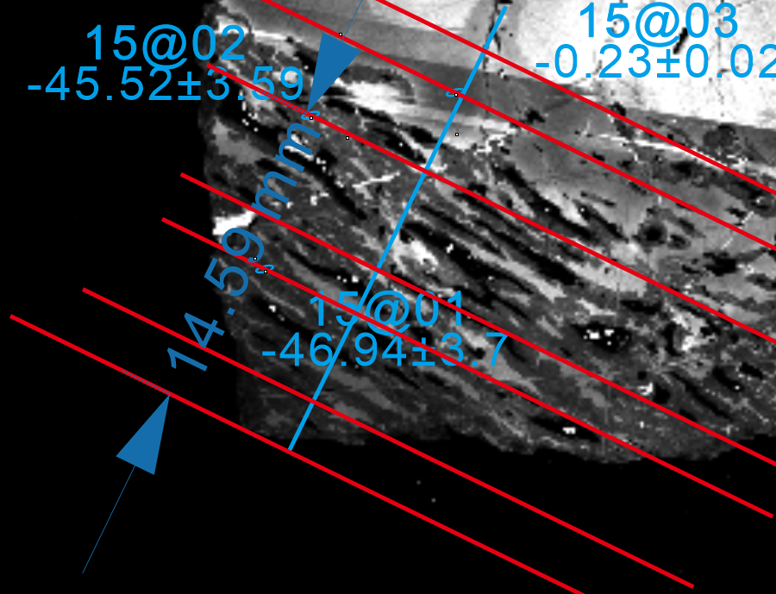
Reaction zone morphology: Zir-015
SE image shows parallel pore channels in replacement zone
CL image with showing how analysis points projected to blue line and distance from cube corner measured

Slide 23
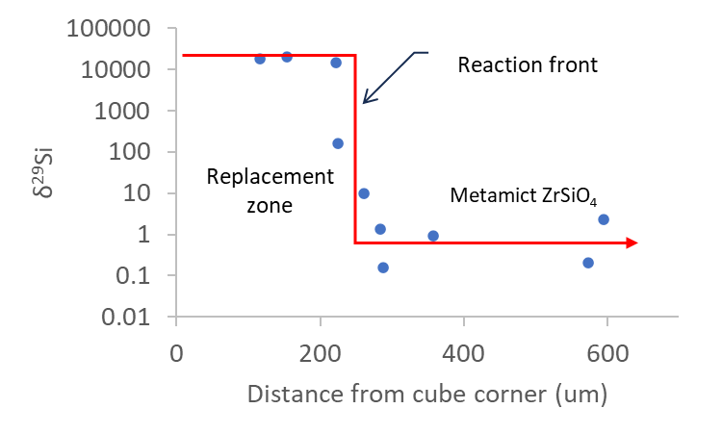
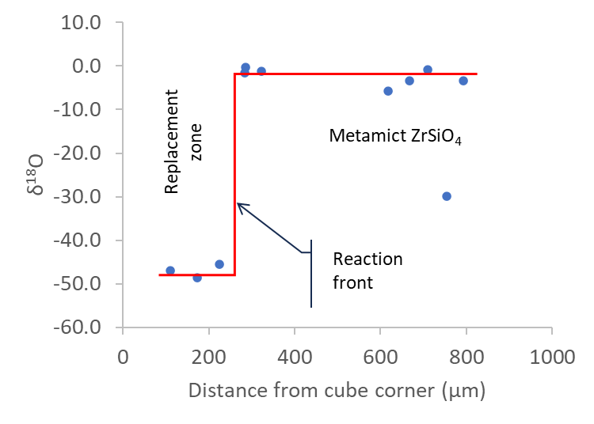
Homogeneous or heterogeneous model of replacement?
In a homogeneous model (batch equilibrium) the precipitated phases will continuously reequilibrate with the fluid as the isotopic composition of the fluid evolves.
In the heterogeneous model there is no back-reaction of precipitated minerals with fluid.
SIMS analysis of the Zir-015 run product cube shows the replacement zone is relatively flat at high δ²⁹Si, transitions to lower values across a ~50 um -wide reaction front, then plateaus at a low value in the unaltered zone.
Oxygen isotopes show a similar pattern.
The large isotopic shifts in our experiments can be explained using a homogeneous model.

Slide 24
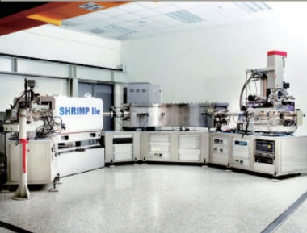
Trace element and U-Pb geochronology
EDS and results demonstrate the replacement of hydrothermal zircon is accompanied by the expulsion of trace elements.
Preliminary results from SIMS analysis show recrystallized domain have less U, Th, and Pb.
The replacement phase is more discordant.
Notes:
Change to keewooks results

Slide 25
Conclusions
Hydrothermal fluids can cause replacement of radiation-damaged zircon by crystalline hydrothermal zircon.
A new stable isotope method was used to measure the rate of replacement.
Replacement rate increases as degree of radiation damage increases.
Hydrothermal zircon may form through replacement of metamict ZrSiO₄.
Replacement zone U-Pb age = timing of fluid event.
Future work: use SIMS to measure oxygen isotope composition of quenched solutes and do depth profiling on thin rims.

Slide 26

Acknowledgements
Funding provided by funded by NSF EAR (2221906, 2221907) to Ayers and Zhu.
Thanks to Yunbin Guan at Caltech for help with SIMS analyses, James McBride at Vanderbilt Institute for Nanoscale Science and Engineering for SEM assistance, and Anthony Menicucci and Morgan Harris in Vanderbilt Earth and Environmental Sciences for SEM assistance.

