Slide 1
Mill Creek Water Quality
Dr. John C. Ayers

Slide 2
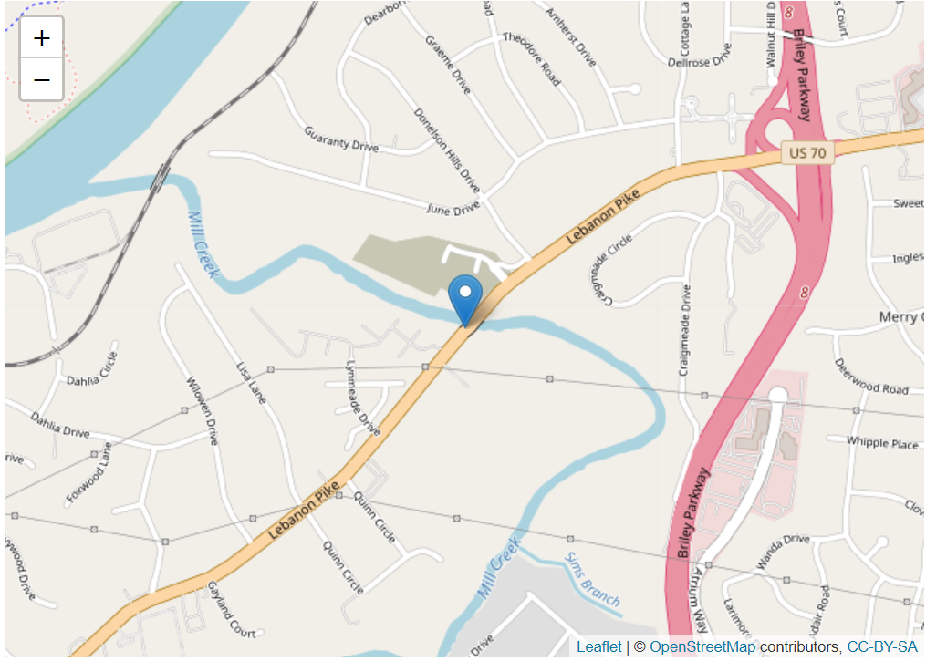
Mill Creek near Lebanon Pike USGS Gauging Station
https://waterdata.usgs.gov/nwis/inventory/?site_no=03431083&agency_cd=USGS

Slide 3
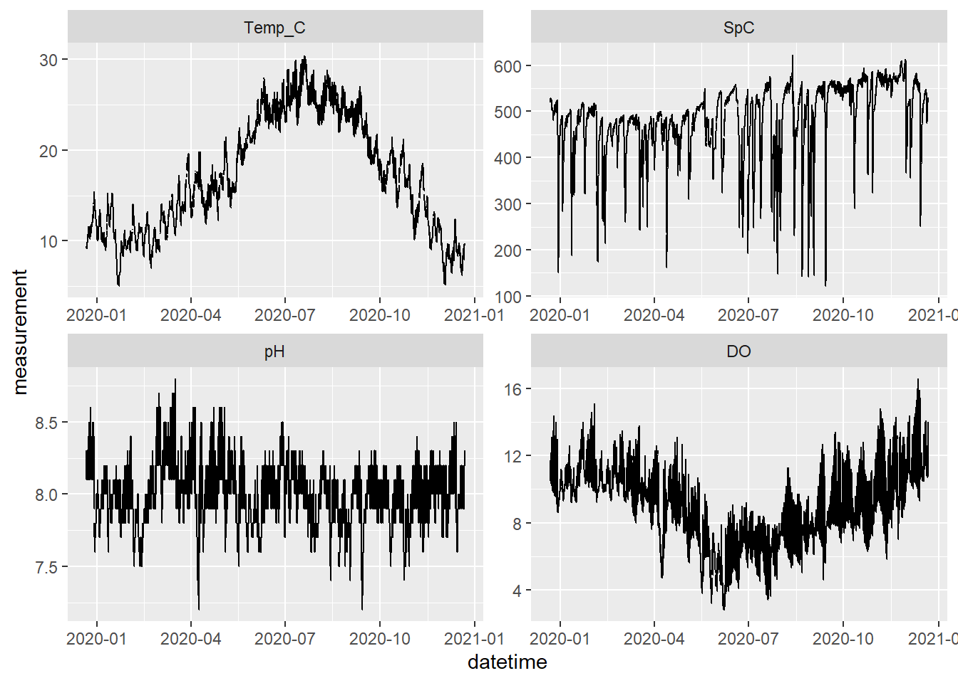
Water Quality Data 2019-12-22 to 2020-12-21

Slide 4
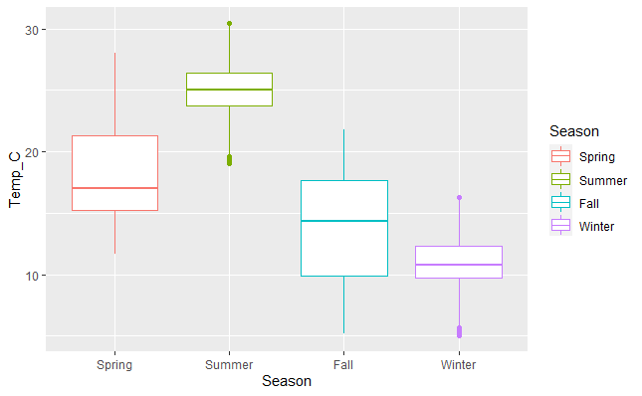
Seasonal changes in temperature

Slide 5
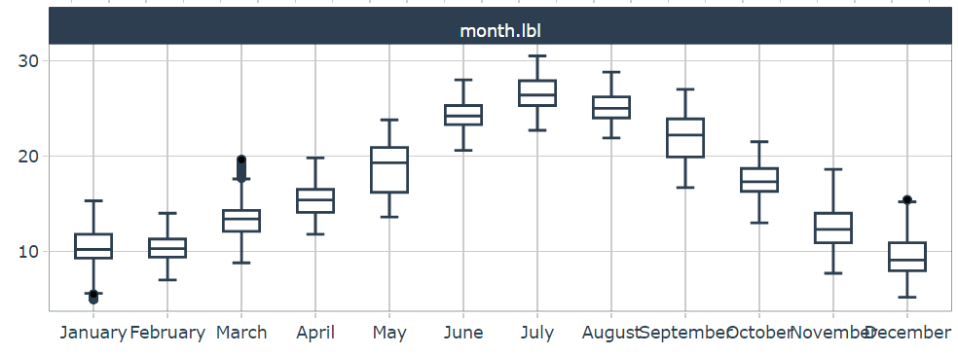
Monthly changes in temperature

Slide 6
Seasonal changes in conductivity/salinity

Slide 7
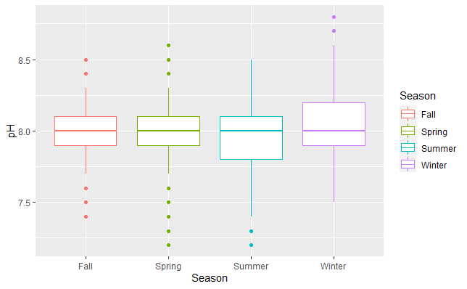
Seasonal changes in pH

Slide 8
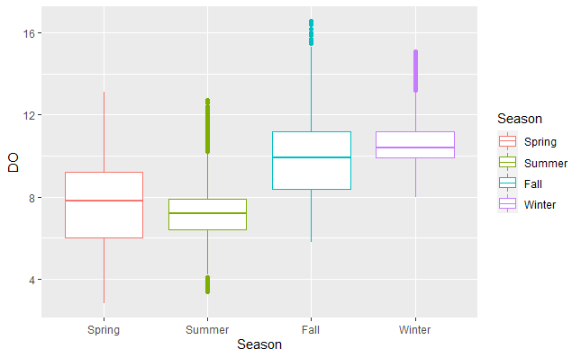
Seasonal changes in DO

Slide 9
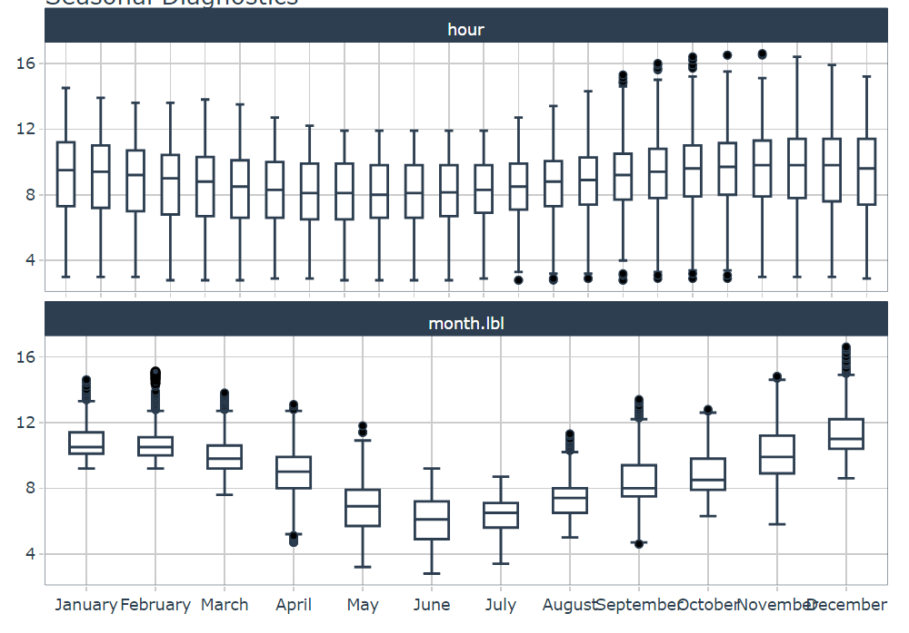
Hourly and monthly changes in DO

Slide 10
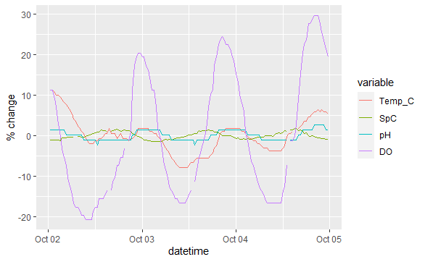
Comparison of diel cycles
Unpolluted East Fork Creek
Polluted Mill Creek

