Slide 1
Introduction to Mate
The 3rd thing I’d like if stranded on an island.

Slide 2
John C. Bland II
ActionScript Geek
ColdFusion Geek
.NET Geek
Java Geek
CEO/Chief Geek of Katapult Media, Inc.
(Occasional) PHP Geek

Slide 3
What is Mate and Why?
What?
Tag-based Flex framework
Why?
Dependency Injection
Event Handling keeps classes from being bound to each other.
Code IS NOT written to your framework (eg – Cairngorm)
Easy to remove and use another framework

Slide 4

DEMO
Before Mate

Slide 5
Downfalls
Code tied directly to each other
Not very reusable
Most of the time a ModelLocator, or other global/static class, sneaks in
Without building your own “Mate”, global event management can be a chore.

Slide 6
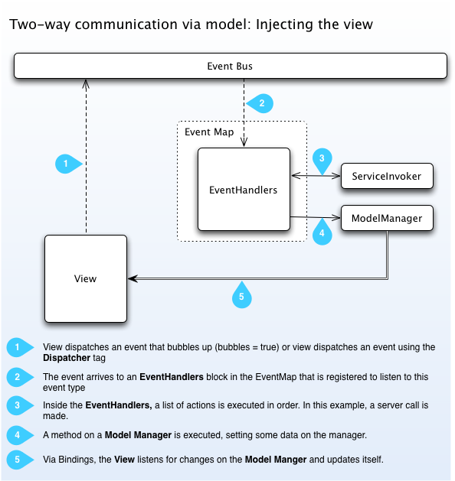
How Mate works:
Source: http://mate.asfusion.com/page/documentation/getting-started
Notes:
http://mate.asfusion.com/page/documentation/diagrams

Slide 7
Quick Example
<mate:EventHandler action=“{MyEvent.SOMETHING}”> <mate:MethodInvoker generator=“{DataGuy}” method=“saveIt” arguments=“{[event.data]}” /> </mate:EventHandler>
…method is called then a data update is dispatched…
<mate:Injectors targets=“{AccountView, AccountList, BlippidyBloo}”> <mate:PropertyInjector source=“{DataGuy}” sourceKey=“guys” targetKey=“guysList” /> </mate:Injectors>

Slide 8

DEMO
After With Mate (there is no “after”)

Slide 9
Why is this better?
Go back to slide 2. ;-)
Injectors allow for direct data access (vs through parent objects)
Removing Mate means managing your own events/data integration (ie – not tied directly to Mate)
Open and extendable (http://mate.asfusion.com/page/documentation/how-to/extend-mate)

Slide 10
What next?
READ UP!
http://mate.asfusion.com
Get Coding!
Donate
This is open source. Help those that help…you. ;-)

Slide 11

ONE HAPPY CODER!
Contact Information here:
http://www.johncblandii.com
Resources:
http://mate.asfusion.com
http://mate.riaforge.com
http://twitter.com/MateFramework

