Slide 1
Comparative Analysis of Predictive Maintenance Models for Turbofan Engines Using CNN, LSTM, and Reinforcement Learning.
ENGR 501 : Deep and Reinforcement Learning
Presentation by: Mjema Christina John

Slide 2
Introduction
Predictive maintenance:
    Preventing unexpected equipment failures
    Minimizing downtime in industrial settings.
Traditional Maintenance Practices:
    Reactive
    Based on fixed schedules
  Deep learning and reinforcement learning
    analyze complex data and optimize maintenance strategies.

Slide 3
Background: Maintenance Policies
Maintenance Policies:
    Run-to-failure (R2F),
    Preventive Maintenance (PM),
    Condition-Based Maintenance (CBM),
    Predictive Maintenance (PdM).
PdM and CBM: leverage DL and RL techniques to monitor equipment conditions and trigger maintenance based on specific indicators.
    Ensuring operational continuity and maximizing asset utilization, financial implications of downtime.

Slide 4
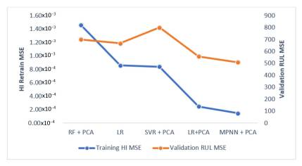
Review of Previous Research:
Kang et al. (2013) proposed a Multi-Layer Perceptron (MLP) for automating prediction of equipment failure in continuous production lines using NASA turbo engine datasets.

Slide 5
Data and Preprocessing
NASA's turbofan engine degradation dataset.
    Historical data including operational settings, sensor measurements, and remaining useful life (RUL) information.
Preprocessing Steps:
    Scaling the input features using MinMaxScaler to a range (0 to 1) for CNN and LSTM models.
Data Formatting:
    Structuring the dataset into suitable formats for CNN and LSTM analysis and model training.

Slide 6
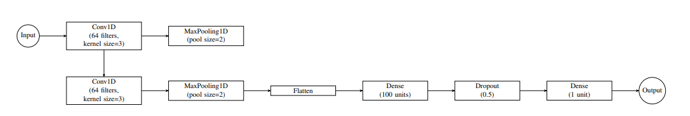
CNN Architecture
Commonly used for visual imagery, has been adapted to sequential data, enabling the extraction of features and patterns from sensor data.

Slide 7
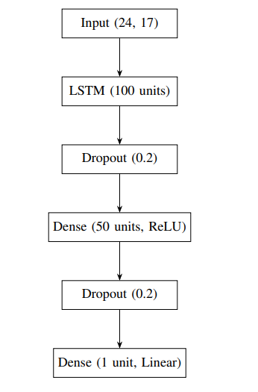
LSTM Architecture
Capable of learning long-term dependencies in sequential data, enabling the prediction of RUL of engines by analyzing temporal engine data, suitable for time series forecasting tasks.

Slide 8
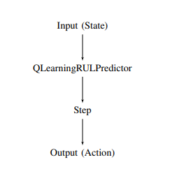
RL- based RUL Predictor
A subfield of machine learning where an agent learns to make sequential decisions by interacting with an environment.
The agent learns to maximize cumulative rewards over time through a trial-and-error.

Slide 9
RL- based RUL Predictive Maintenance Environment
State representation: operational settings, sensor measurements, and the current time cycle, forming the state space.
Action space: two actions
    Performing maintenance
    Continuing operation without maintenance.
  Reward Scheme:
    +1 Each time step that the model performs maintenance when the current state shows a degradation in the RUL
    Reward is inversely proportional to the RUL.

Slide 10
Results: CNN and LSTM
Performance Comparison of Deep Learning Models: Comparison of evaluation metrics including MSE, MAE, and R-squared for CNN and LSTM models.
Model/metric | MSE | MAE | R2
CNN | 0.000154 | 0.0114 | 0.9935
LSTM | 0.000012 | 0.0027 | 0.9995

Slide 11
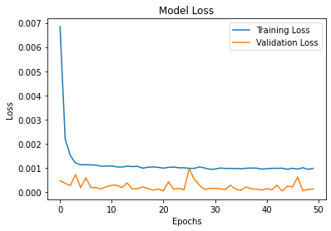
Results: Training and Validation Losses for the CNN

Slide 12
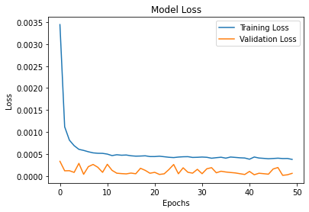
Results: Training and Validation Losses for the LSTM Model

Slide 13
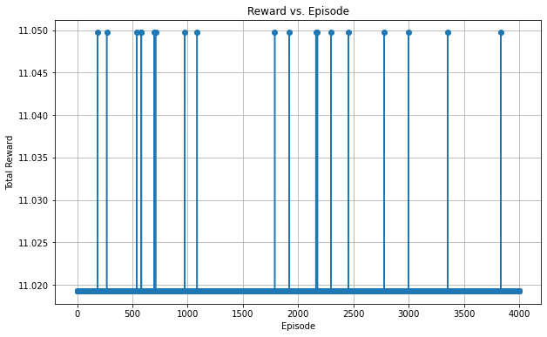
Results: Relationship between Episodes and Total Rewards during Training

Slide 14
Limitations with the RL-Based RUL Predictor
    Translating the predictive maintenance problem into a reinforcement learning (RL) environment
    Interpreting the results
      Deeper understanding of the RL framework, including the environment, state space, action space, and reward structure.
      Using standard evaluation metrics such as Mean Squared Error (MSE), Mean Absolute Error (MAE), and R-squared (R2) value.

Slide 15
Future Research Directions
Potential Extension to Oil Well Maintenance Prediction:
Adapt RL evaluation
    Compare predictions with actual RUL values using standard evaluation metrics (MSE, MAE, R2).
Scalability and Deployment of models to large-scale industrial datasets.
Evaluate deployment in real-world scenarios to understand effectiveness in different environments.

Slide 16
Thank You

