Slide 1
Comp1920-Shopping Cart
Bill Yu, Chun Wai Chan, Patrick Kowalski, Sahra Dilmaghanyan, Sami Jashromi
http://code.google.com/p/comp1920-shoppingcart/

Slide 2
Agenda
Demo (3 mins)
Technology Overview (7 mins)
Session Shopping Cart (10 mins)
Class Exercise (10 mins)
Q&A

Slide 3
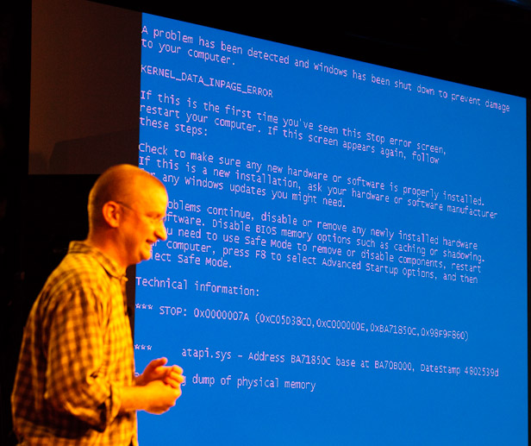
Demo Time

Slide 4
Technology Overview
CSS
MySQL
JQuery & Ajex & JSON & PHP

Slide 5
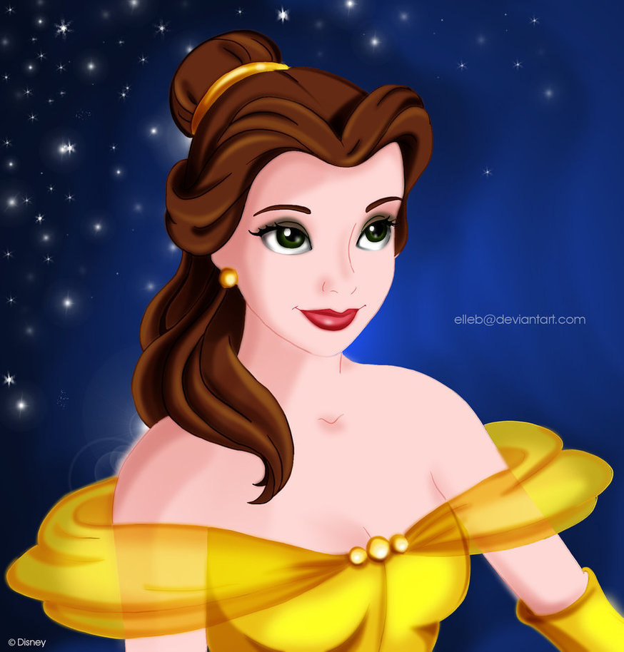
CSS

Slide 6
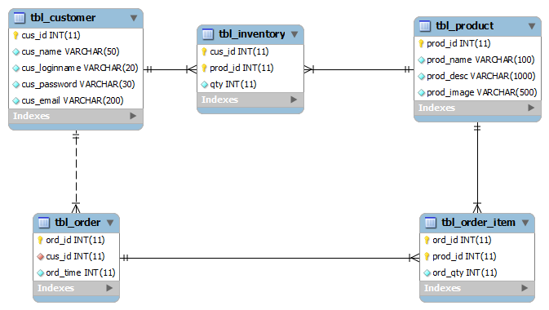
Schema

Slide 7
Ajax & JQuery
This:
$(“#age”).load(“./getage.php”);
Or:
$.getJson(‘./getageJson.php’), function(resp) {
$(“#age”).html(resp)
});

Slide 8
VS:
function ajaxFunction(){ var ajaxRequest; // The variable that makes Ajax possible! try{ // Opera 8.0+, Firefox, Safari ajaxRequest = new XMLHttpRequest(); } catch (e){ // Internet Explorer Browsers try{ ajaxRequest = new ActiveXObject("Msxml2.XMLHTTP"); } catch (e) { try{ ajaxRequest = new ActiveXObject("Microsoft.XMLHTTP"); } catch (e){ // Something went wrong alert("Your browser broke!"); return false; } } } // Create a function that will receive data sent from the server ajaxRequest.onreadystatechange = function(){ if(ajaxRequest.readyState == 4){ var ajaxDisplay = document.getElementById('ajaxDiv'); ajaxDisplay.innerHTML = ajaxRequest.responseText; } } var age = document.getElementById('age').value; var wpm = document.getElementById('wpm').value; var sex = document.getElementById('sex').value; var queryString = "?age=" + age + "&wpm=" + wpm + "&sex=" + sex; ajaxRequest.open("GET", "ajax-example.php" + queryString, true); ajaxRequest.send(null); }

Slide 9
JSON – Javascript Object Notation
{
“products” : [
{
“id” : 1,
“name” : “handbag”,
“imgUrl” : “./img/handbag.jpg”
},
{
“id” : 2,
“name” : “handgun”,...

Slide 10
XML
<products>
<entry>
<id>1</id>
<name>handbag</name>
<imgUrl>./img/handbag.jpg</imgUrl>
</entry>
<entry>
<id>2</id>
<name>handgun</name>

Slide 11
PHP
echo json_encode(
array(
array(‘prodId’ => 1, ‘name’ => ‘handbag’,
‘imgUrl’ => ‘./img/handbag.jpg’),
array(‘prodId’ => 2, ‘name’ => ‘handgun’,
‘imgUrl’ => ‘./img/handgun.jpg’)
));

Slide 12
Shopping Cart
It’s all about $_SESSION!
Don’t even need to use a DB.

Slide 13
Cart Item
Simply a key value pair:
productName => quantity
Add item/update quantity:
productName => (quantity +/- some count)

Slide 14
A bunch of Items?
Easy:
array( “prodName_01” => 100,
“prodName_02” => 13,
...);

Slide 15
How about the cart?
$_SESSION[‘cart’] = array();
That’s our cart.!

Slide 16
Cart Operations
Add new item:
$_SESSION[‘cart’][‘newItem’] = 10;
Add more:
$_ SESSION[‘cart’][‘newItem’] += 5;
Remove:
unset($_ SESSION[‘cart’][‘newItem’]);

Slide 17
Get Cart Content
foreach ($_SESSION[‘cart’] as $prodName => $quantity) {
...
}
That’s it!

Slide 18
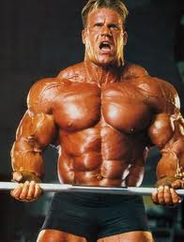
Class Exercise

Slide 19
Project Webpage
http://code.google.com/p/comp1920-shoppingcart/
Just search googlecode
-> Project Hosting
-> Search for comp1920
You can sync down the full source code or read it from the web ☺

Slide 20

Q & A

