Slide 1
Predicting tennis match outcomes
With neural networks

Slide 2
Why IS TENNIS GOOD FOR PREDICTION
Individual Sport
Tournament oriented
Round-based tournament
Well-documented results and betting lines
In-depth statistics available
visualize tennis matches using network graphs

Slide 3
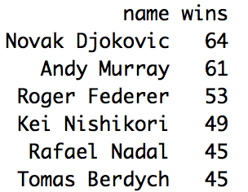
2015 BEST Performers

Slide 4
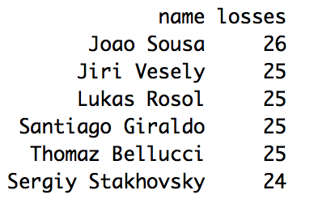
2015 Worst Performers

Slide 5
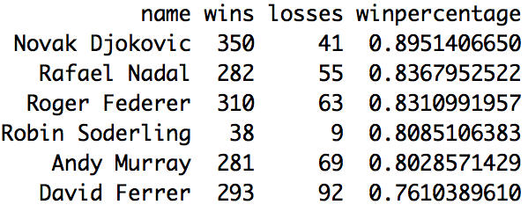
Best Win Percentage (Past 5 yrs)

Slide 6
Neural Network models
Calculate statistics from 2011-2014
Train and test model on 2015 matches
Evaluate models based on MSE

Slide 7
Model 1
Basic Model:
8 inputs:
1. Wins
2. Losses
3. Games Played
4. Win %
Hidden Layers: MSE:
10 .35
20 .31
10,5 .31
20,5 .31

Slide 8
Additional Feature
3 main types of courts
Hard 55%
Clay 33%
Grass 11%
Only .1% of matches do not have a court type
Does this really matter?

Slide 9
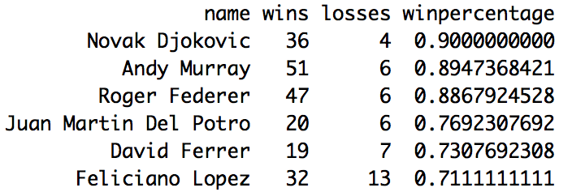
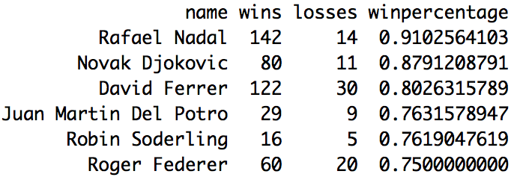
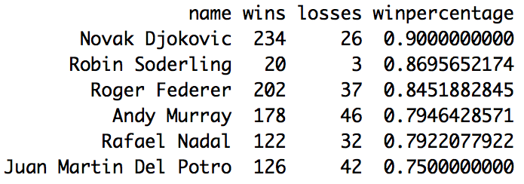
Hard
Grass
Clay

Slide 10
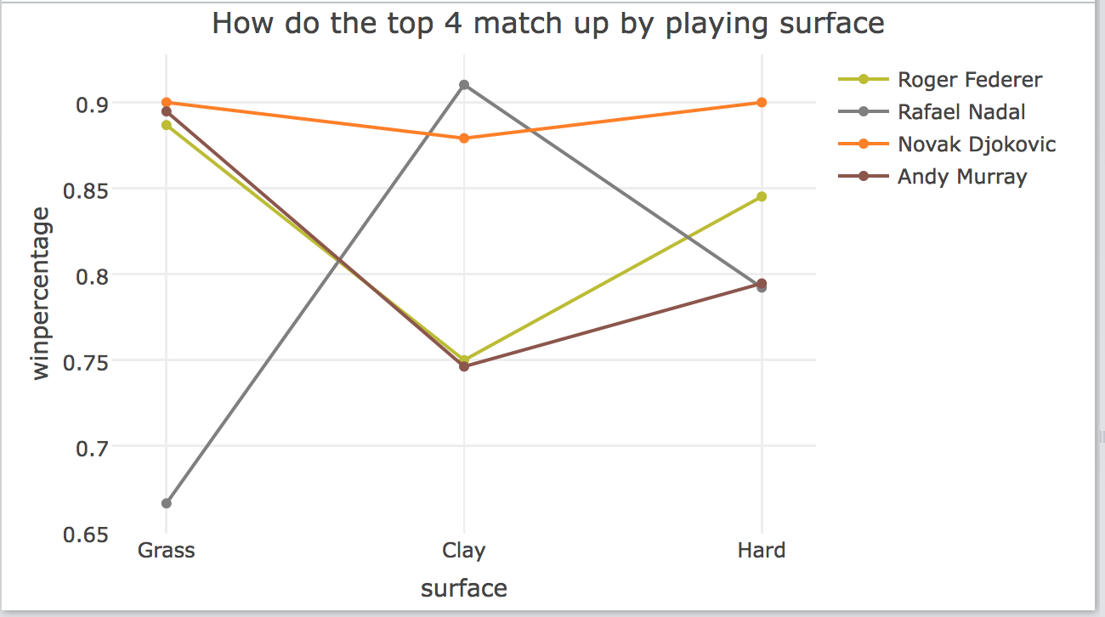
How do the top players stack up?

Slide 11
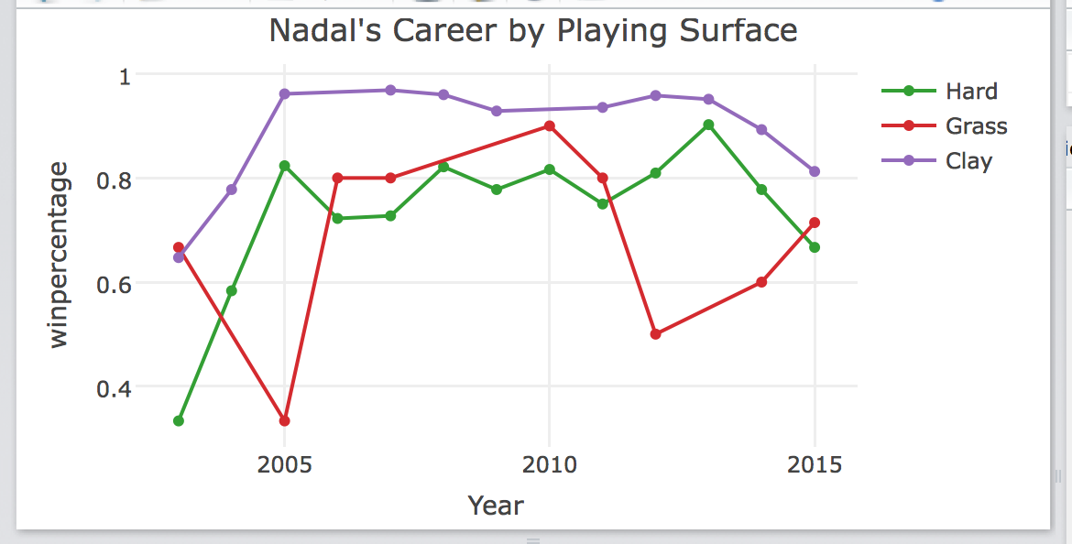

Slide 12
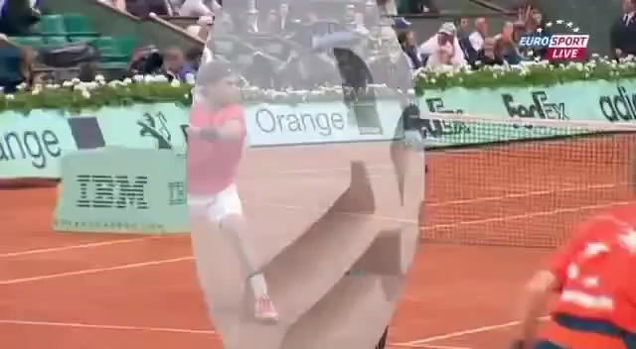

Slide 13
Model 2
15 Inputs:
All those of Model 1
# of games played on court type
win percentage on court type
Hidden Layers: MSE:
10 .15
20 .14
10,5 .14

Slide 14
Additional Features
4 In-Depth Statistics:
Winning % on first serve
Winning % on second serve
Winning % on return serve
Winning % on break point

Slide 15
Model 3
23 Inputs:
All those of Model 2
4 in-depth statistics for each player
Hidden Layers: MSE:
5 .16
10 .16
20 .15
30 .14
30,10 .11

Slide 16
FURTHER Evaluating Model 3
Calculate inputs from 2011-2014 period
Train neural network on 2015 matches before the 2015 US Open (which began August 31, 2015)
Get 2015 US Open betting lines from OddsShark
Calculate net profit if $100 bet on every predicted match

Slide 17
US Open test Results
127 matches
Only 35 matches had players of whom all inputs were known.
NN predicted:
31 Correct
4 Incorrect
A $100 bet on each of these matches would have led a net profit of $1,289.66

Slide 18
Highlights
Of the 35 predicted matches every upset was correctly predicted
For each of the 4 wrongly predicted matches the network predicted the underdog to win
The neural net predicted some large upsets:
+798
+503
+248

