Slide 1


BONF RE TERMINAL

Slide 2
“Getting work done used to cost salaries. Now I just pay the electricity bill and have AI do it. That’s power; act with immediacy.”
— John Crestani

Slide 3
THE UNTOLD STORY
OF COMPUTERS
Written by John Crestani

Slide 4
CHAPTER 01
CAN YOU STILL MAKE A LOT OF MONEY WITH AI?

Slide 5
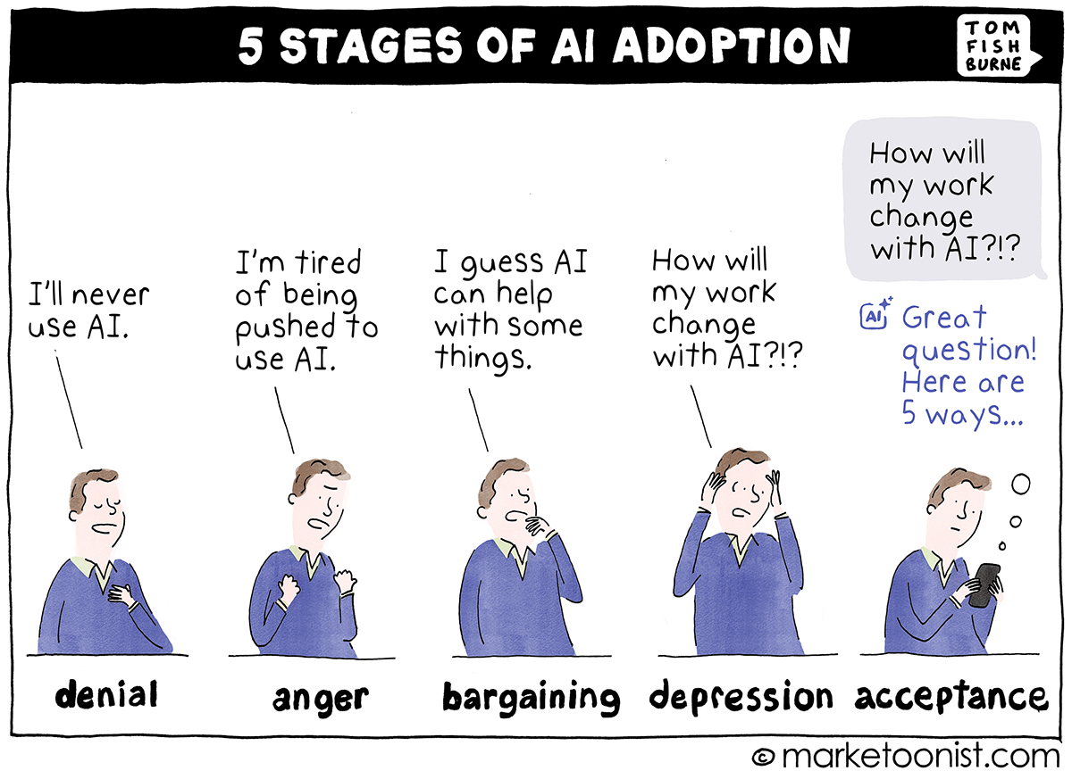

Slide 6

s artificial intelligence continues to break records in every industry on earth, is it too late to profit from the most transformative technology since electricity?
This is an enormous question on the minds of business owners, marketers, and entrepreneurs who are watching hundreds of billions of dollars flood into AI while wondering if the opportunity has already passed them by. Based on extensive research, I have concluded that AI has barely begun its real impact on small and mid-size businesses and this could possibly be one of the greatest wealth-building windows in modern history. What made me come to this conclusion? The actions of the smartest businesspeople alive and a pattern that has repeated itself for over two thousand years.

Slide 7
If you ever need an indication of where things are heading, look at what the largest companies on earth are doing with their own capital. In 2026, the combined AI capital expenditure of Amazon, Microsoft, Google, and Meta reached approximately $725 billion. That is a 77% increase from the prior year. Goldman Sachs projects these four companies alone will spend a combined $5.3 trillion on AI infrastructure between 2025 and 2030. These are not speculative bets. These are the most data-driven companies in history putting their money where their models are.
NVIDIA, the company that manufactures the chips powering AI, saw its market capitalization grow from approximately $750 billion in early 2023 to over $4.6 trillion by mid-2026. That is not a stock market bubble. That is the market pricing in a fundamental shift in how the world operates.

Slide 8
When Mark Cuban, who built his fortune by recognizing technology shifts before the mainstream, was asked about the AI opportunity, he stated: "The world's first trillionaire will be someone who masters AI. It could be just one dude in a basement." He went further: "There's going to be two types of companies in this world. Those who are great at AI, and everybody else that they put out of business."
The pattern we are witnessing is not new. In ancient Rome, Marcus Licinius Crassus became the wealthiest man in the Republic by building the first private fire brigade. When a building caught fire, Crassus would offer to buy the property at a fraction of its value. If the owner refused, he watched it burn.

Slide 9
He amassed a fortune equivalent to billions in modern currency, not because he was stronger or smarter, but because he held an information advantage no one else possessed.
The Rothschild family used carrier pigeons and private couriers to learn the outcome of the Battle of Waterloo a full day before the British government. Nathan Rothschild used that single day of advantage to execute trades on the London Stock Exchange that generated profits in the hundreds of millions in today’s dollars. One day. One piece of information. Generational wealth.
Benjamin Franklin understood that information was the ultimate form of leverage. As a printer, postmaster, and diplomat, he stood at the intersection of knowledge and commerce. He controlled its flow. His printing press and postal networks were tools of information advantage.

Slide 10
Larry Ellison built Oracle by recognizing that whoever controlled the database controlled the business. Every transaction, every customer record, every piece of corporate intelligence flowed through Oracle. The real product was not software. It was the information advantage.
The Allies won World War II because of Bletchley Park. Alan Turing cracked the Enigma code, giving Allied forces an information advantage that shortened the war by two years. That technology became the foundation for everything that followed.
The pattern is unmistakable. Those who hold an information advantage, and the tools to act on it, accumulate disproportionate wealth and influence. The question has never been whether information advantages create wealth. The question has always been whether you recognize the advantage while it still exists.

Slide 11
Right now, AI is creating the largest information advantage in human history. The business leaders listed above are not speculating. They are acting with their own capital, in amounts that dwarf any previous technology investment cycle. Sundar Pichai called AI “more profound than fire or electricity.” Bill Gates wrote: “AI will change society more than anything humans have ever created.” Sam Altman warned: “This is just the first inning of a long AI revolution.” Like investors who purchased gold at the right moment, those who act now on AI will not be disappointed. The only regret will be not acting fast enough. To speak with our team about getting a perpetual license to Bonfire Terminal, visit https://bonfireterminal.com/apply

Slide 12
CHAPTER 02
SUBSCRIPTION SLAVERY SYSTEM REVEALED

Slide 13
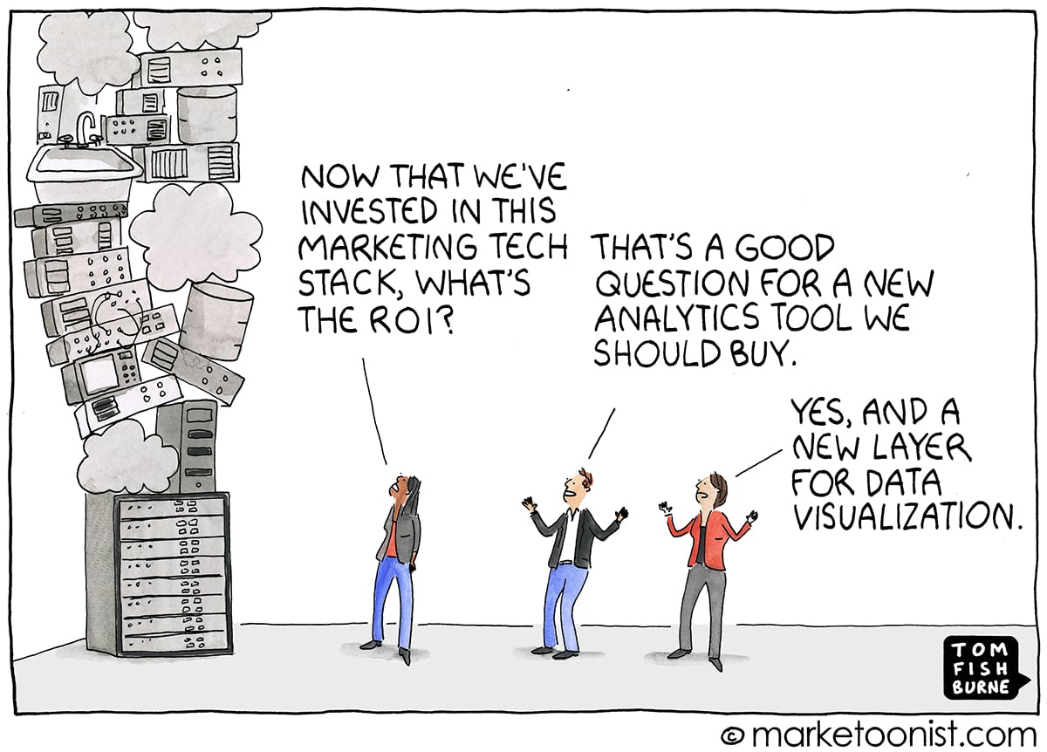

Slide 14

or over 3,000 years, two types of tools have ruled human productivity. One benefits the person who uses it. The other benefits the person who rents it out.
Civilization has alternated between these models for centuries, with great effort spent keeping the advantage with the renters. I have come to see that every productivity crisis facing knowledge workers today traces to the software model that nearly every business operates under.
These two systems break down simply: ownership tools and rental tools. An ownership tool is something you buy once and use as long as you want. A hammer. A printing press. A copy of Microsoft Office in 2005. Ownership tools have a clear cost, a clear benefit, and they become more valuable over time because your expertise compounds while your costs remain fixed.

Slide 15
A rental tool is exactly the opposite. A rental tool is something you never own, must continue paying for indefinitely, and lose access to the moment you stop paying. In the software world, this is called Software as a Service, or SaaS. In a SaaS system, you do not buy software. You subscribe to permission. The moment you stop paying, your files, your workflows, your history, and your capabilities disappear. With a rental system it is extremely difficult to build lasting competitive advantage because your tools can be taken away at any time and your costs increase every year while your capabilities remain dependent on someone else's decisions.
The turning point came in 2013 when Adobe abandoned perpetual licenses entirely. Before 2013, a professional could buy Adobe Photoshop for approximately $699 and use it for years.

Slide 16
After 2013, that same professional was required to pay $55 per month, every month, forever. Adobe's annual revenue before the switch was approximately $4 billion. By 2024, Adobe's annual revenue had grown to over $21 billion. That growth did not come from building better software. It came from converting millions of owners into permanent renters. The wealth was simply transferred from the users to the company. The software itself barely changed. The business model changed everything.
This is beyond faulty, and it has created massive instability in how businesses operate. When Adobe forced the subscription model, every other software company followed. Salesforce. Microsoft. Autodesk. Slack. Zoom. Canva. Notion. Figma. One by one, the tools that businesses depended on were converted from things you owned into things you rented.

Slide 17
The average company now uses over 100 separate SaaS applications. The average SaaS spend per employee has reached $9,100 per year and rising at nearly five times the general inflation rate. For a company with 10 employees, that is $91,000 per year flowing out of the business in perpetuity, with nothing to show for it if payments stop.
The numbers only get worse when you look at the details. Gartner estimates that roughly 30% of all SaaS spending is what they call toxic spend, unused licenses and redundant applications, amounting to approximately $90 billion wasted globally every year. The average enterprise loses $18 million per year on licenses nobody even touches. Among the top 500 SaaS companies, there were 339 pricing and packaging changes in 2024 and 2025 alone.

Slide 18
Seventy-eight percent of IT leaders reported unexpected charges tied to consumption-based or AI pricing models. SaaS inflation runs at nearly five times the general market inflation rate, with vendors raising prices 11% to 14% annually while consumer inflation sits at around 2.7%.
Let me show you what this means in real dollars. If your business spends $1,000 per month on SaaS subscriptions today, that is $12,000 per year. With average SaaS price inflation compounding at 12% annually, that $1,000 per month becomes approximately $1,762 per month by year five. By year ten, it reaches approximately $3,106 per month. Your ten-year total is not $120,000 as you might expect. It is over $230,000. And at the end of those ten years, you own nothing. Stop paying and everything disappears.

Slide 19
A one-time perpetual license purchase, even at $5,000, would have paid for itself within the first few months.
But the cost of subscriptions is only the surface problem. The deeper crisis is what researchers call context switching. Dr. Gloria Mark at UC Irvine found that knowledge workers switch tasks every three minutes and five seconds. After each interruption, it takes 23 minutes to return to the same level of focus. The average knowledge worker spends nearly half their day recovering from switching between applications. Not working. Recovering from trying to work.
Harvard Business Review found that workers toggle between applications 1,200 times per day, costing approximately 200 hours per year per employee. That is nine percent of total work time spent reorienting between tools.

Slide 20
Across the United States economy, context switching destroys an estimated $450 billion in productivity annually. Not from bad workers. From bad tools.
Think about what that means. You open Slack to check a message. You switch to Google Docs to update a document. You open Canva to resize an image. You switch to your email to send the document. You open your CRM to update a contact. You switch back to Slack because someone responded. Each switch costs you 23 minutes of cognitive recovery. Multiply that across an eight-hour day, multiply it across a ten-person team, and multiply it across a full year. The numbers are staggering. Fifty-six percent of workers now report that tool fatigue negatively impacts their work on a weekly basis. This is not an opinion. This is a measured epidemic.

Slide 21
The subscription model did not create better tools. It created more tools. Every new feature that could have been added to an existing application was instead spun off into a new subscription. Need to edit video? New subscription. Need to schedule social media? New subscription. Need to manage projects? New subscription. Need to transcribe a meeting? New subscription. Need to design a social media graphic? New subscription. Need to analyze your website traffic? New subscription. Need to send an email campaign? New subscription. Need to do what a single competent assistant could have done in 1995? Twelve subscriptions and a master's degree in app-switching.
The math speaks for itself.
For nearly fifty years, from the PC era through the early 2000s, software ownership was normal. You purchased Microsoft Office and Adobe.

Slide 22
The software lived on your computer. Your files lived on your computer. Nobody could take them away or change the interface without your permission. That era created the most productive period in knowledge work history. Workers learned their tools deeply and operated with real autonomy.
Now compare that to today. Features are moved behind higher-priced tiers. Interfaces change without warning. Companies that built workflows around specific software find themselves hostage to pricing decisions made by VC-funded startups. This is not a business model. It is a dependency system. Like all dependency systems, it benefits only the supplier.
The subscription fatigue is real and measurable. Active subscription cancellation rates rose from 31% in 2024 to 47% in 2026.

Slide 23
The average American household now spends $273 per month on subscriptions, yet 89% underestimate their actual monthly spending. Forty-two percent pay for at least one subscription they no longer use. Fifty-three percent of AI subscribers now cycle their subscriptions on and off as needed rather than maintaining them continuously. When SaaS companies can raise prices at five times inflation, remove features without notice, and hold your data hostage, you do not have a vendor relationship. You have a dependency.
It seems like Wall Street has become more important than the users of these products. While businesses are scrambling to adapt to constant changes, software companies are reporting record revenues and their executives are receiving billions in stock-based compensation. The incentives are fundamentally misaligned.

Slide 24
Your productivity is their revenue. Your dependency is their moat. Your data is their leverage. The Broadcom acquisition of VMware provided the starkest warning yet of what happens when a subscription vendor decides to extract maximum value: Broadcom eliminated perpetual licensing entirely and forced all customers onto subscriptions, with reported price increases of 150% to over 1,000%. The backlash was immediate, with 50% to 75% of VMware customers now exploring alternative platforms. But for many it was too late. They were already locked in.
Just as the fiat monetary system allowed banks to expand the money supply at the expense of ordinary citizens, the SaaS subscription system has allowed software companies to expand their revenue at the expense of ordinary businesses.

Slide 25
Both systems share the same flaw: they extract wealth from productive people and transfer it to intermediaries who produce nothing of lasting value.
But an alternative does exist. Just as gold provided a hedge against currency manipulation for centuries, software ownership provides a hedge against subscription manipulation today. The tools that will define the next era of computing will not be rented. They will be owned. They will run on your hardware, use your data, and answer to you — not to a quarterly earnings call.

Slide 26
CHAPTER 03
THE TRUTH BEHIND THE IMPORTANCE OF AI

Slide 27
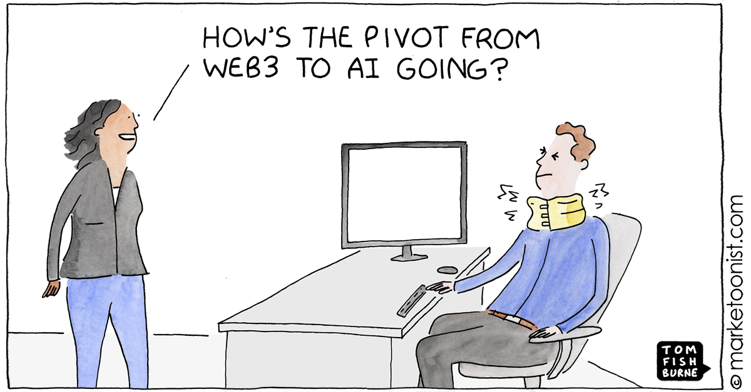

Slide 28

he price of intelligence has never been lower, yet most businesses operate as if it is still 2019. As much as the skeptics claim AI is overhyped,
the people running the largest companies on earth are making decisions that tell a very different story. I will spend more time with AI and less time with employees moving forward. This is the emerging consensus of the most powerful executives, expressed through their actions and their capital.
Mark Zuckerberg stated in January 2026 that projects which used to require big teams are now accomplished by a single talented person. He predicted AI would write 50% of Meta’s code by end of 2026. Meta cut 8,000 jobs and reassigned 7,000 employees to AI initiatives. Output per engineer rose 30% since early 2025, driven by AI coding agents.

Slide 29
Power users who embraced AI saw output increases of 80% year over year.
Satya Nadella revealed that 20% to 30% of code inside Microsoft is now written by AI. Sundar Pichai disclosed that over 30% of Google’s new code is AI-generated, with recent reports placing that figure at 75%. These are not startups generating hype. These are the largest technology companies on earth fundamentally restructuring how they operate.
Elon Musk has predicted that AI and robots will replace all human jobs, making work optional. Sam Altman warned: “Waiting until 2026 to react to 2026-level AI will be too late. The exponential curve waits for no one.” Micha Kaufman, CEO of Fiverr, told his workforce in March 2026: “AI is coming for your jobs. … Get better, get faster, or get left behind.”

Slide 30
He said no profession is immune, listing programmers, designers, product managers, data scientists, lawyers, and salespeople.
A landmark study by Harvard Business School and BCG tested 758 consultants on 18 tasks. Those using AI completed 12.2% more tasks, finished 25.1% faster, and produced 40% higher quality results. The lowest performers saw a 43% improvement. Klarna’s AI assistant handled 2.3 million conversations in its first month, doing the work of 853 employees and saving $60 million. The Federal Reserve found throughput increased 66% with AI tools.
The BCG AI Radar 2026 surveyed 2,400 executives including 640 CEOs and found three-quarters are now their company’s chief decision-maker on AI. Trailblazer CEOs, roughly 15% of those surveyed, dedicate over eight hours per week to AI training.

Slide 31
PwC analyzed over one billion job postings across 27 countries and found that workers with AI skills command a 62% wage premium on average. In consumer markets, that premium reaches 118%. AI-specific jobs have grown 69% since the technology emerged, eight times faster than the overall market. The message is clear: AI proficiency is no longer optional. It is the single most valuable skill a knowledge worker can possess. AI will not take your job. Someone using AI will.
Yet only 22% of companies have advanced beyond proof-of-concept with AI, and only 4% are creating substantial value. The field is wide open. The window is closing. Visit https://bonfireterminal.com/apply to get started.

Slide 32
CHAPTER 04
BANKRUPTCIES SETTING RECORD HIGHS

Slide 33
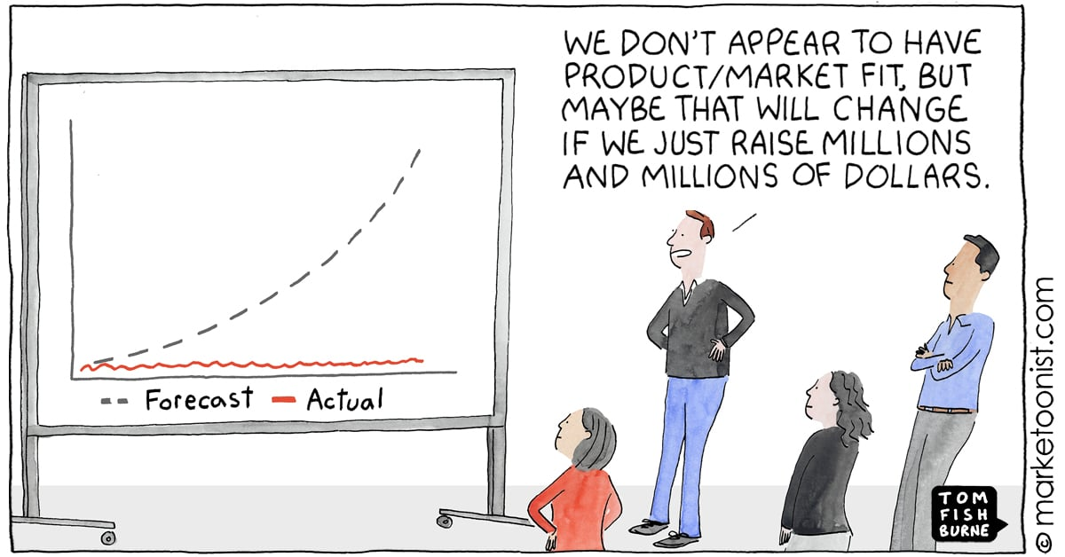

Slide 34

ith each passing year, the number of businesses filing for bankruptcy climbs higher. In 2024, 694 U.S. companies filed for bankruptcy protection,
the highest annual figure since 2010. In 2025, total bankruptcy filings hit 574,314, an 11% increase, with large company bankruptcies reaching 717 through November alone. Mega bankruptcies, companies with over $1 billion in assets, surged 44% above the historical average. The trajectory has been relentless: filings have increased every single quarter since mid-2022, four straight years of acceleration.
This is not without precedent. In 2001, the dot-com crash destroyed $5 trillion in market capitalization. At least 4,854 internet companies were acquired or shut down. Pets.com went from IPO to shutdown in nine months. Webvan burned through $830 million in venture capital.

Slide 35
The NASDAQ did not recover to its March 2000 peak until 2015, a full fifteen years later. In 2008, the financial crisis obliterated $10 trillion in global stock market value. Lehman Brothers filed the largest bankruptcy in U.S. history with $619 billion in debt, and 489 banks failed between 2008 and 2013. In 2020, roughly 400,000 businesses permanently closed within the first four months of the pandemic, including Brooks Brothers, which had outfitted 40 of the last 45 presidents.
Now the pattern is repeating with particular ferocity in the technology sector. WeWork, once valued at $47 billion, saw its stock drop 99% before filing Chapter 11 in November 2023. Olive AI raised $902 million, peaked at a $4 billion valuation, then shut down entirely when its vaunted AI turned out to be largely manual processes.

Slide 36
Convoy, backed by Bill Gates and Jeff Bezos at a $3.8 billion valuation, laid off a thousand employees and closed. Jasper AI raised $125 million at a $1.5 billion valuation just six weeks before ChatGPT launched and rendered its product redundant. In 2024 alone, 966 startups shut down, a 25.6% increase from the prior year, with enterprise SaaS companies making up 32% of all shutdowns. Venture capital funding has collapsed, with U.S. VC fundraising falling 35% to roughly $66 billion in 2025, the lowest in six years.
In every crisis, the same pattern emerges. Businesses that owned their tools, controlled their infrastructure, and maintained low recurring costs survived at significantly higher rates than those that rented everything and depended on external capital.

Slide 37
COVID proved this decisively: companies owning their digital channels thrived while those renting physical space and depending on third-party platforms collapsed. Do not risk your business on someone else's burn rate. To speak with our team about getting a perpetual license to Bonfire Terminal, visit https://bonfireterminal.com/apply

Slide 38
CHAPTER 05
AI BUSINESS SYSTEMS SET TO BOOM

Slide 39
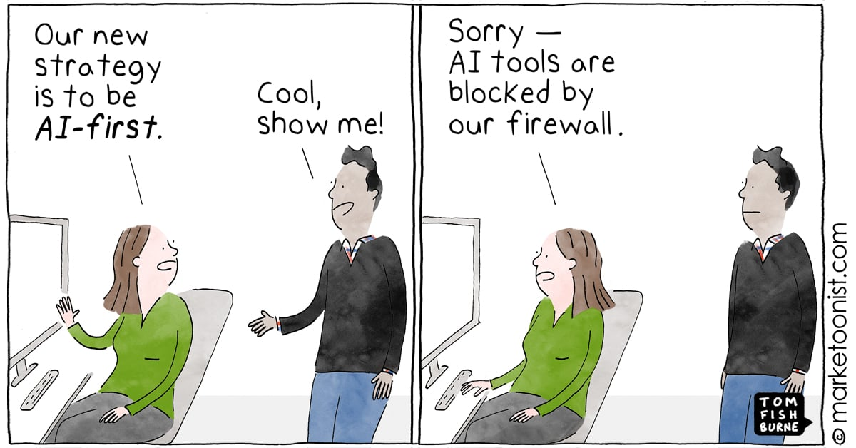

Slide 40

t is important for you to understand how the AI business systems market is currently structured and why it represents the single largest economic opportunity in human history.
The subscription model has created massive fragility in business operations. What is emerging to replace it is not a new software category — it is a fundamental restructuring of how work gets done, and the numbers are unlike anything seen before.
PwC projects AI will add $15.7 trillion to global GDP by 2030, exceeding China and India’s combined output. Goldman Sachs projects a 7% GDP boost and 1.5 percentage points of annual U.S. productivity growth. McKinsey estimates that generative AI alone could add $2.6 to $4.4 trillion annually to global corporate profits; the United Kingdom’s entire GDP is $3.1 trillion.

Slide 41
Total benefits could reach $6.1 to $7.9 trillion annually. Seventy-five percent of that value falls in four areas: customer operations, marketing and sales, software engineering, and research and development.
The AI market reached $638 billion in 2026 and is projected to exceed $3 trillion by 2030. Bloomberg Intelligence revised its generative AI projection to $2.3 trillion by 2032. These are not startup guesses — they are projections from the world’s most conservative financial institutions, revised upward repeatedly.
The AI agent revolution is where the real transformation begins. Gartner projects AI agents will handle $15 trillion in B2B purchases by 2028, with 90% of buying done autonomously. Forty percent of enterprise applications will embed AI agents by the end of the year.

Slide 42
The agents market is growing at 49.6% annually, from $7.6 billion to $183 billion by 2033. These agents execute workflows, make purchasing decisions, manage relationships, and coordinate operations autonomously.
Every major industry is being transformed simultaneously. Healthcare AI is projected to grow from $39 billion in 2025 to over $1 trillion by 2034. Financial services AI has reached $36.6 billion and is expected to save the industry $500 billion per year by 2030. Real estate AI is reaching $1.3 trillion by 2030. Marketing AI has hit $52.8 billion and is on track for $107.5 billion by 2028. These are not theoretical projections. These industries are actively transforming, with early AI adopters reporting extraordinary results.

Slide 43
Small business data is particularly compelling: 91% using AI report measurable revenue increases, and AI-using businesses are 2.3 times more likely to see revenue growth. Average ROI is 3.7 times the initial investment. Leaders investing in AI are nearly twice as likely to report year-over-year growth. Yet only 14% have AI fully embedded in core operations, and 72.5% rely on just one AI service. The gap between adoption and opportunity is enormous.
The comparison to the early internet is the most instructive data point of all. In 1998, the internet economy was worth approximately $301 billion. Today's digital economy is valued at $28 trillion. That is 56 times growth in 25 years. AI is adopting at roughly eight times the internet's speed. ChatGPT reached 100 million users in two months. It took the internet eight years to reach that milestone.

Slide 44
It took mobile phones six years. It took Instagram two and a half years. ChatGPT now processes over 1 billion queries daily with 800 million weekly active users, and those numbers doubled in just three months.
Jensen Huang, CEO of NVIDIA, called this "the largest infrastructure build-out in human history" during his CES 2025 keynote, adding: "One trillion dollars of AI infrastructure is coming. The entire installed base of data centers will be renewed." Jeff Bezos said the benefits to society from AI are going to be gigantic.

Slide 45
Bill Gates wrote in his 2026 essay: "Of all the things humans have ever created, AI will change society the most." He added: "There is no upper limit on how intelligent AIs will get or on how good robots will get, and I believe the advances will not plateau before exceeding human levels." Andrew Ng, the Stanford professor who co-founded Coursera, drew the clearest parallel: "About 100 years ago, electricity transformed every major industry. AI has advanced to the point where it has the power to transform every major sector of the economy."
McKinsey estimates that generative AI could automate 60% to 70% of current work activities. Goldman Sachs found that generative AI could automate tasks equivalent to 300 million full-time jobs worldwide. But this is not a story of job destruction.

Slide 46
The World Economic Forum's Future of Jobs Report 2025 projects that while 92 million jobs will be eliminated by 2030, 170 million new jobs will be created, a net gain of 78 million positions. The businesses that position themselves on the creation side of this equation will define the next decade of commerce. The individuals who develop AI deployment skills today will fill the roles that do not yet have names.
Companies are doubling their AI spending in 2026. The BCG AI Radar found that corporate AI budgets are doubling, from 0.8% to 1.7% of revenues. Ninety percent of CEOs surveyed believe AI agents will deliver measurable ROI by 2026. Ninety-four percent said they will maintain or increase AI spending regardless of near-term results. This is not hype. This is capital allocation on a scale that has no historical precedent.

Slide 47
When the smartest operators in the world are all moving in the same direction with this level of conviction, you do not want to be standing on the other side of the trade.
The local AI and edge computing market is accelerating this transformation even further. Businesses no longer need to send their data to cloud servers to access AI capability. Apple's M-series processors demonstrated that a personal laptop could handle workloads that previously required server farms. NVIDIA's consumer GPUs brought machine learning capability to desktop computers. Quantized language models proved that increasingly powerful AI could run on ordinary hardware. The computer sitting on your desk right now can run speech recognition, image generation, video editing, and large language model inference without sending a single byte to someone else's server.

Slide 48
The cloud was necessary when personal hardware was weak. Personal hardware is no longer weak.
Harvard Business Review reported in 2026 that organizations are pilot-rich but transformation-poor. Two-thirds report productivity gains from AI, but only one in five sees revenue growth. The obstacle is not model quality. It is the absence of a repeatable path from proof-of-concept to standard operations. Ninety-five percent of enterprise AI pilots fail to reach production because of integration complexity, not because the technology fails. This gap between AI capability and deployment is the single largest business opportunity of the decade.
For the first time in personal computing history, a single desktop machine can run AI models that match cloud-based services. Local speech recognition. Local image generation. Local language models.

Slide 49
Local video editing. Everything that was once only possible in the cloud is now possible on your desk. The hardware is ready. The models are ready. The only question is whether you are ready.
Countries around the world are recognizing this shift. The EU’s data sovereignty regulations are forcing businesses to reconsider where their data lives. India’s data localization requirements are pushing computing back to local infrastructure. China has built an entirely separate technology ecosystem based on domestic ownership. The global trend is clear: the era of renting everything from American cloud companies is ending. The era of owned, local, AI-powered business systems is beginning.
I am calling for business owners to recognize this moment for what it is. The AI business systems boom is not coming. It is here.

Slide 50
The only question is whether you will capture value from it — or pay someone else’s subscription fees while they capture it instead.

Slide 51
CHAPTER 06
THE AI REVOLUTION IS THE RECOVERY PLAN

Slide 52
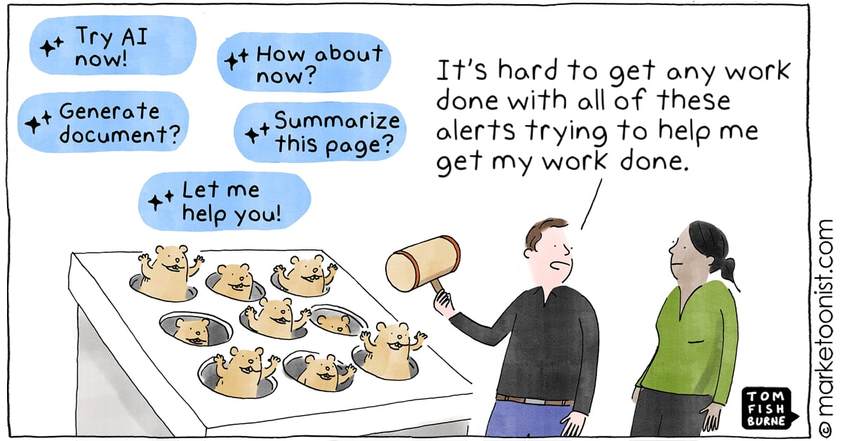

Slide 53

ince the Macintosh brought the mouse to the mainstream in 1984, the way humans interact with computers has not fundamentally improved. For over forty years,
every interface has followed the same formula: point, click, type, navigate menus, switch between applications. The graphical desktop made computers accessible to billions, but it never made them natural. We adapted to the machine. The machine never learned to adapt to us.
That is finally changing. Natural voice interaction through platforms like Telegram, Slack, and Discord — running on the phone in your pocket — is the interface breakthrough the industry has waited for. You simply speak. The computer listens and acts. Speech is three times faster than typing, with 20% fewer errors. The average person speaks at 130 words per minute but types at only 38. Voice is not just convenient.

Slide 54
It is measurably faster, more accurate, and more natural.
Google’s CEO admitted in May 2026 that they are replacing Search’s fundamental model for the first time in 25 years, transforming the search box into an AI conversation. ChatGPT has 800 million weekly active users interacting through natural language. Over 8.4 billion voice assistant devices are active worldwide. The era of speaking to your tools has begun.
Bonfire Terminal is the local, private interface layer that you own and control. It interfaces with your existing software through voice and text, replacing dozens of applications with a single conversation. It is not another app to learn. It is the app that learns you. And the technology that made it possible has a specific origin.

Slide 55
But behind all the headlines and hype about artificial intelligence, there is a single research paper that started everything. In June 2017, eight researchers at Google published "Attention Is All You Need," introducing the Transformer architecture. That paper now has over 250,000 citations and is the single most consequential technical document in computing history.
What it solved was deceptively simple. Previous AI processed information one word at a time. The Transformer introduced self-attention, allowing models to see entire contexts at once. This unlocked parallelization, then scale, then capability — an exponential curve that shows no sign of flattening.
The timeline: BERT in 2018, GPT-2 in 2019, GPT-3 in 2020, ChatGPT in November 2022 reaching 100m users in two months, GPT-4 in 2023.

Slide 56
By 2026, the technology spawned by that single paper had created a multi-trillion dollar industry. NVIDIA alone reached a market capitalization exceeding $4.6 trillion. Every major AI system in the world, every chatbot, every image generator like DALL-E and Midjourney, every coding assistant like GitHub Copilot, every speech recognition model like Whisper, every video generation system, runs on the Transformer architecture. Even DeepMind's AlphaFold, which predicted the structure of over 200 million proteins and won the 2024 Nobel Prize in Chemistry, is built on Transformers.
The irony is extraordinary. Google invented the Transformer but lost all eight original authors to startups. Ashish Vaswani co-founded Essential AI. Illia Polosukhin co-founded NEAR Protocol.

Slide 57
Google declared a “Code Red” when ChatGPT launched, botched the Bard release so badly it lost $100 billion in market capitalization in a single day, and spent two years catching up to a technology it created.
Claude Shannon’s 1948 paper on information theory solved a practical problem about telegraph noise and created the mathematical foundation for the digital age. The Transformer paper solved a practical problem about translating languages and created the foundation for artificial general intelligence. Both proved far more general than their creators intended. Both spawned trillion-dollar industries.
The implications for business are already visible.
Businesses that have adopted AI-powered workflows are reporting extraordinary results. Single-person operations produce output that previously required teams of five to ten.

Slide 58
Marketing agencies produce video content in minutes instead of days. Legal firms review contracts in seconds instead of hours. Klarna’s AI assistant handled 2.3 million conversations in its first month, doing the work of 853 full-time employees. The technology is democratized. Capable AI models run on laptops. The competitive advantage has shifted from having access to AI to knowing how to apply it. The critical question is not whether to adopt AI. It is whether you will own your AI or rent it. Visit https://bonfireterminal.com/apply to take the first step.

Slide 59
CHAPTER 07
BREACH, SPY, TRAIN, REPEAT

Slide 60
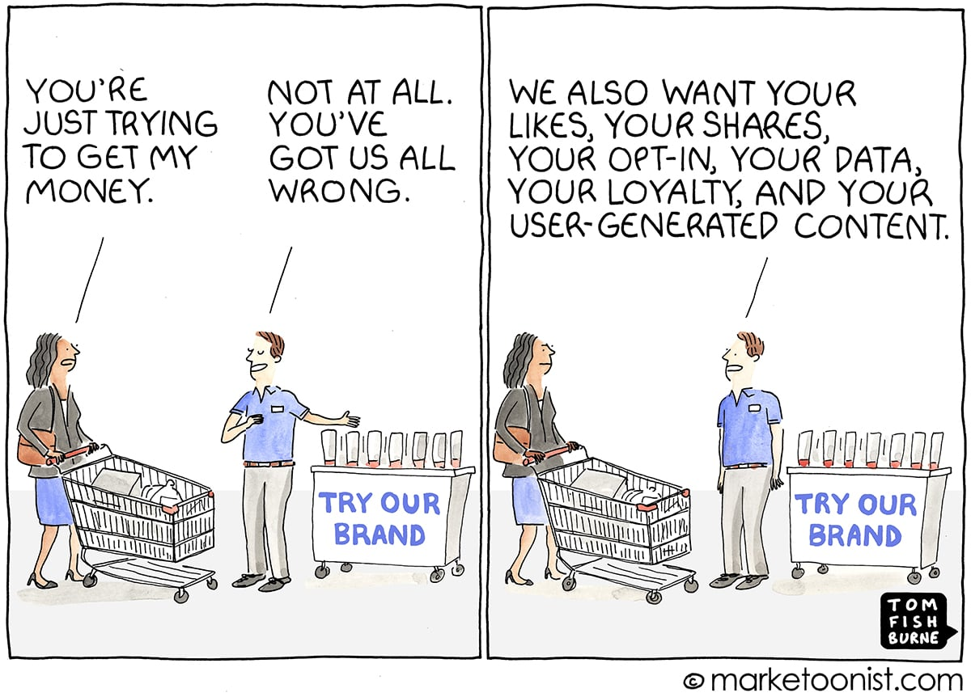

Slide 61
t is staggering how many business owners use cloud uptime statistics as a gauge for reliability. They look blindly at 99.9% uptime promises,
none the wiser to the reality that the real risk has nothing to do with uptime. Whether the cloud is available or not, these trusting business owners continue to dump their most valuable data, creative work, and customer information into someone else's infrastructure. They have no interest in confronting the truth. Allow me to confront it for them.
The list of high-profile cloud security disasters is long and growing longer every quarter. The Equifax breach of 2017 exposed 147.9 million Americans' Social Security numbers, resulting in a $575 million settlement. Facebook’s Cambridge Analytica scandal harvested 87 million users’ data without consent, leading to a $5 billion FTC fine.

Slide 62
The Marriott breach exposed 339 million guest records, with attackers living inside the company's databases undetected for over four years. The Capital One breach exposed 106 million credit card applicants and 140,000 Social Security numbers due to a misconfigured AWS setting. Total cost: $270 million.
Things have only accelerated. LastPass, the password manager trusted by millions, was breached in 2022 when attackers stole encrypted vaults and cracked enough to steal $438 million in cryptocurrency. The MOVEit breach in 2023 exposed data from 96 million individuals across 2,700 organizations, with damages reaching $12.15 billion.

Slide 63
The Snowflake breach in 2024 saw 165 customer environments accessed because the platform lacked multi-factor authentication, exposing AT&T call metadata for 110 million customers and Ticketmaster data for 560 million individuals. National Public Data lost 2.9 billion records containing Social Security numbers, then filed for bankruptcy.
The CrowdStrike incident in July 2024 was something else entirely. A single faulty software update crashed 8.5 million Windows systems worldwide, the largest IT outage in history. Five thousand flights were cancelled. Airlines, banks, hospitals, and emergency services went dark. Fortune 500 damages reached $5.4 billion; Delta sued for $500 million. This was not a cyberattack. It was an infrastructure dependency.

Slide 64
The SolarWinds attack in 2020 compromised 18,000 organizations through a poisoned software update, including the Pentagon and nuclear security agencies. Remediation costs reached $100 billion. T-Mobile breaches exposed 113 million customers’ data, costing $500 million in settlements.
But breaches and outages are the visible problems. The invisible problem is equally destructive: vendors using your data against your interests. In 2023, Zoom quietly updated its terms to grant itself a perpetual, royalty-free license to use customer content for AI training. The backlash forced a reversal, but the intent was clear. In 2024, Adobe updated its terms to allow access to customer creative work, sparking outrage from creators fearing their work would train Adobe’s AI.

Slide 65
LinkedIn opted all 930 million users into AI training by default without updating its privacy policy. Microsoft’s Recall feature, designed to screenshot everything on your screen for AI search, was called a privacy nightmare before redesign.
And it is not just hackers you need to worry about. Your own government is watching. In April 2024, the U.S. Senate approved the renewal and expansion of FISA Section 702, the surveillance authority that allows warrantless collection of communications stored on cloud servers. The Electronic Frontier Foundation called it an expansion of unconstitutional mass surveillance. Despite the FBI's own reforms, the Department of Justice discovered that the FBI had been using a querying tool that bypassed safeguards for months. Every document and customer record in the cloud is accessible under these authorities.

Slide 66
Every trade secret.
Three providers — AWS, Azure, and Google Cloud — control 63–71% of global cloud infrastructure. AWS’s US-EAST-1 region alone holds 41.5% of its infrastructure. When that region went down in October 2025, it triggered 17 million user reports across 60 countries. The Azure outage in 2025 lasted eight hours, taking down Slack, Atlassian, Barclays, and the UK tax authority.
Cloud dependency is as dangerous as any over-concentration. Businesses are so accustomed to cloud tools they have stopped considering what happens when that convenience disappears. The subscription model incentivizes constant changes — changes force upgrades, and upgrades increase revenue. Your stability as a customer is in direct conflict with their growth as a company.

Slide 67
Every breach, every outage, every terms-of-service change reinforces the same lesson: if you do not own your infrastructure, you do not control your business. The cloud was built to serve the provider, not the customer. The question is not whether you will be affected. It is whether you will have already moved to owned infrastructure when it happens. Visit https://bonfireterminal.com/apply to take back control.

Slide 68
CHAPTER 08
OWNED AI: A TRUE SAFE HAVEN

Slide 69
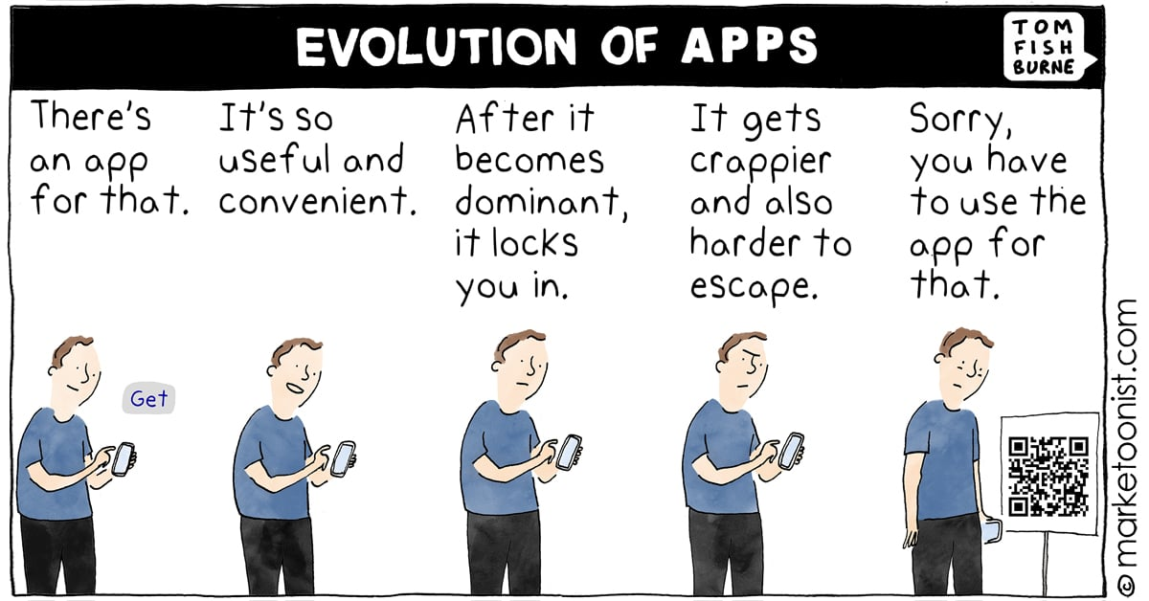

Slide 70
he rush for AI-powered business tools has not even begun according to leading technology analysts. The world’s largest companies have committed over a trillion dollars
to AI infrastructure. The leaders driving this shift have joined the ranks of history’s most decisive actors, those who recognized a paradigm shift before the majority understood what was happening.
The key to their strategy is not merely using AI. It is owning AI capability. As the gold rush unfolds, business owners are steered toward cloud-based AI services rather than locally-owned tools. Just as merchants once handed their gold to banks for promissory notes, today’s business owners hand their data and competitive intelligence to cloud providers for monthly access. This strategy faces the same problem that arose centuries ago.

Slide 71
Linus Torvalds, the creator of Linux, demonstrated decades ago that owned software could outperform anything created by a billion-dollar corporation. Linux now runs virtually every server on the internet, every Android phone, every supercomputer on the Top500 list, and the majority of cloud infrastructure worldwide. Richard Stallman, the founder of the free software movement, warned for decades that proprietary software was a trap. His predictions about vendor lock-in and user exploitation have been vindicated by every SaaS company that has ever raised prices or changed terms of service. The most successful software in history has been software that users could own, modify, and control.

Slide 72
Yann LeCun, Meta’s Chief AI Scientist, has been vocal that open-source AI is essential for the technology’s future, stating it would be dangerous to have a small number of companies control the most powerful AI systems. Marc Andreessen declared that software is eating the world. Now AI is eating software, and who owns the AI determines who captures the value. Tim Berners-Lee, inventor of the World Wide Web, has warned about centralized data and called for a redesign of the web to return data ownership to individuals. Cory Doctorow coined “enshittification” to describe what happens when platforms degrade products to extract revenue from captive users. The only defense against enshittification is ownership.
Gartner's cloud repatriation research shows that businesses are already moving back.

Slide 73
Companies in healthcare, finance, legal services, and government are pulling sensitive workloads off cloud infrastructure and returning them to local systems. The European Union's data sovereignty regulations are accelerating this trend. India's data localization requirements are pushing computing back to local infrastructure. The Broadcom acquisition of VMware provided the starkest warning yet: Broadcom eliminated perpetual licensing entirely and forced all customers onto subscriptions, with reported price increases of 150% to over 1,000%. The backlash was immediate and severe, with 50% to 75% of VMware customers now exploring alternative platforms.
The historical parallels are precise. Computing has always swung between centralized and decentralized models, and ownership has always won in the long run.

Slide 74
The mainframe era of the 1960s forced businesses to rent computing time from IBM at enormous cost. The personal computer revolution of the 1980s returned computing to the individual and created an explosion of productivity. The cloud era pulled it back to centralized data centers. Now local AI is swinging the pendulum back to ownership. The same cycle played out with the telephone. AT&T’s monopoly forced users to rent their telephones. The 1984 breakup returned ownership to consumers and unleashed decades of innovation. Each swing toward centralization creates dependency. Each swing toward ownership creates resilience and wealth.
Open-source models like Llama, Mistral, and Whisper have demonstrated that powerful AI can run entirely on personal hardware. No cloud dependency. No per-token costs. No data leaving your machine.

Slide 75
Shannon's information theory proved that information has measurable value. When you upload your business data to a cloud AI service, you are handing that value to someone else. Your usage patterns improve their algorithms. Your competitive intelligence becomes their training data. When you own your AI, your data trains your models, improves your workflows, and the value stays with you and no one else.
PwC found that 74% of AI’s economic value is captured by just 20% of organizations, those who have moved beyond proof-of-concept to full deployment. BCG research shows AI leaders achieve 50% higher revenue and 60% higher total shareholder returns. McKinsey found that AI high performers have maintained their lead over time. Early advantages compound. Late adoption leaves you further behind each quarter.

Slide 76
Centuries ago, when a bank realized nobody was cashing promissory notes for gold, it began issuing more notes than it had gold to back them. Once word got out, depositors would rush to claim their gold and the bank would become insolvent. The cloud AI model follows the same pattern. Your data trains their models. Your usage improves their algorithms. Your competitive intelligence becomes their training data. When you upload documents to a cloud AI service, you are handing your gold to a bank that will lend it to your competitors.
The smart money has already moved. The only question is whether you will act before or after the crowd. To speak with our team about getting a perpetual license to Bonfire Terminal, visit https://bonfireterminal.com/apply

Slide 77
CHAPTER 09
TIME TO OWN YOUR DIGITAL BUSINESS

Slide 78
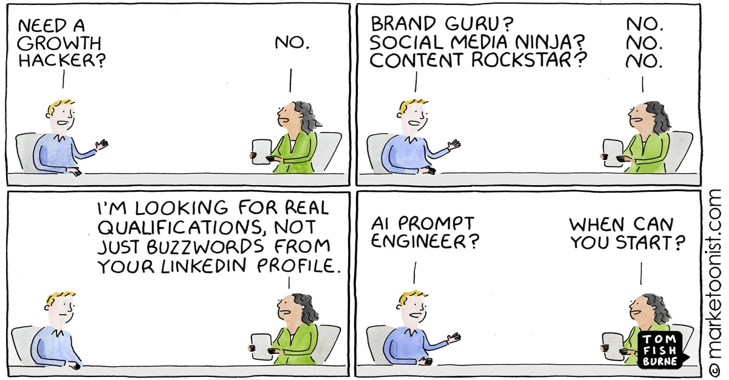

Slide 79
here has never been a better time to own your digital business tools. There are 29.8 million solopreneurs in the United States generating $1.7 trillion in annual revenue.
Eighty-two percent of U.S. small businesses operate with zero employees. Solo-founded startups surged from 23.7% in 2019 to 36.3% in 2025. The age of the one-person business is not coming. It is here.
And yet 96% of small business owners plan to adopt AI, but 62% lack understanding of how AI could help. Sixty percent have no expertise to implement it. Harvard Business Review reported in 2026 that organizations are pilot-rich but transformation-poor. The problem is rarely model quality. It is the absence of a repeatable path from pilot to daily operations. The technology exists. The know-how does not. That gap is the opportunity.

Slide 80
This is exactly what Bonfire Terminal was built to solve. Bonfire Terminal is a desktop AI terminal that runs entirely on your hardware. No cloud dependency. No API fees. No subscriptions. You purchase a perpetual license once and own it forever. The software includes local speech recognition powered by Whisper, local AI inference powered by open-source language models, local image and video processing powered by FFmpeg, and a unified natural language interface that lets you control everything by simply speaking.
Instead of switching between 100 different applications 1,200 times per day, you work in one terminal. Instead of paying $9,100 per employee per year in SaaS subscriptions, you pay once. Instead of sending your data to someone else's cloud, your data stays on your machine. You speak. The terminal acts.

Slide 81
Through our Certified AI Deployment Engineer program, you can become a licensed installer and consultant for Bonfire Terminal. The AI consulting market has reached $14.1 billion and is projected to exceed $90 billion by 2035. Forward Deployed Engineer job postings grew over 800% in 2025, the fastest-growing role in technology. The managed services industry has already proven this deployment model works at $267 billion globally. AIDE applies the same structure to AI.
An AIDE earns income in three ways. First, through direct perpetual license sales to businesses in their area. Second, through annual retainer fees for managing a business's AI infrastructure. A single client paying a $5,000 annual retainer for AI management represents recurring revenue that you own, not a SaaS company.

Slide 82
Third, through the AIDE community and training resources that help you build a client network and scale your operation. IT professionals who earn certifications see an average salary increase of $13,000 and a 25% earnings premium over uncertified peers. Certified professionals earn an average of $138,800 per year. Just as the Cisco CCNA created a career path for network engineers and AWS certifications created a career path for cloud engineers, AIDE creates a career path for the emerging AI deployment role.
If you have ever played musical chairs, you know the reality of limited windows. Someone is always left without a seat. The businesses that own their AI tools today will have an insurmountable advantage tomorrow. If you are sitting in a stack of SaaS subscriptions hoping things get cheaper, you will be disappointed.

Slide 83
It is time to exit the subscription economy and move into ownership. Your competitors are already doing it. To speak with our team about a perpetual license to Bonfire Terminal and AIDE certification, visit https://bonfireterminal.com/apply
OWN YOUR AI — BUILD YOUR INCOME
Everyone wants AI-powered tools, but not everyone knows where to start. Bonfire Terminal has designed a program that pays you while you help others adopt AI: build your consulting practice by deploying Bonfire Terminal for businesses in your area.

Slide 84
1. Visit https://bonfireterminal.com/apply to get your perpetual license. 2. Complete the AIDE certification program to learn AI deployment for businesses. 3. Start earning commissions and retainer income from every business you serve.
Visit https://bonfireterminal.com/apply today to speak with our team and start building your AI deployment business.
800 N King St Ste 304 Wilmington, DE, 19801 United States, Earth
*The Untold Story of Computers* — M3M3TIC LLC — 2026

Slide 85
OWN YOUR AI — BUILD YOUR INCOME

Slide 86
The opportunity to own AI-powered business tools is available right now. Bonfire Terminal gives you a perpetual license to a complete AI business system that runs entirely on your own hardware. No monthly fees. No data leaving your machine. No vendor lock-in.
Step 1: Visit https://bonfireterminal.com/apply
Step 2: Receive your perpetual license and install Bonfire Terminal on your own hardware. Your data stays on your machine. Your AI models run locally. Your competitive intelligence remains yours.
Step 3: Join the AI Marketers community and start building your AI-powered income stream as a Certified AI Deployment Engineer (AIDE).

Slide 87
M3M3TIC LLC
https://bonfireterminal.com/apply
bonfire@bonfireterminal.com
800 N King St Ste 304 Wilmington, DE, 19801 United States, Earth

