Slide 1
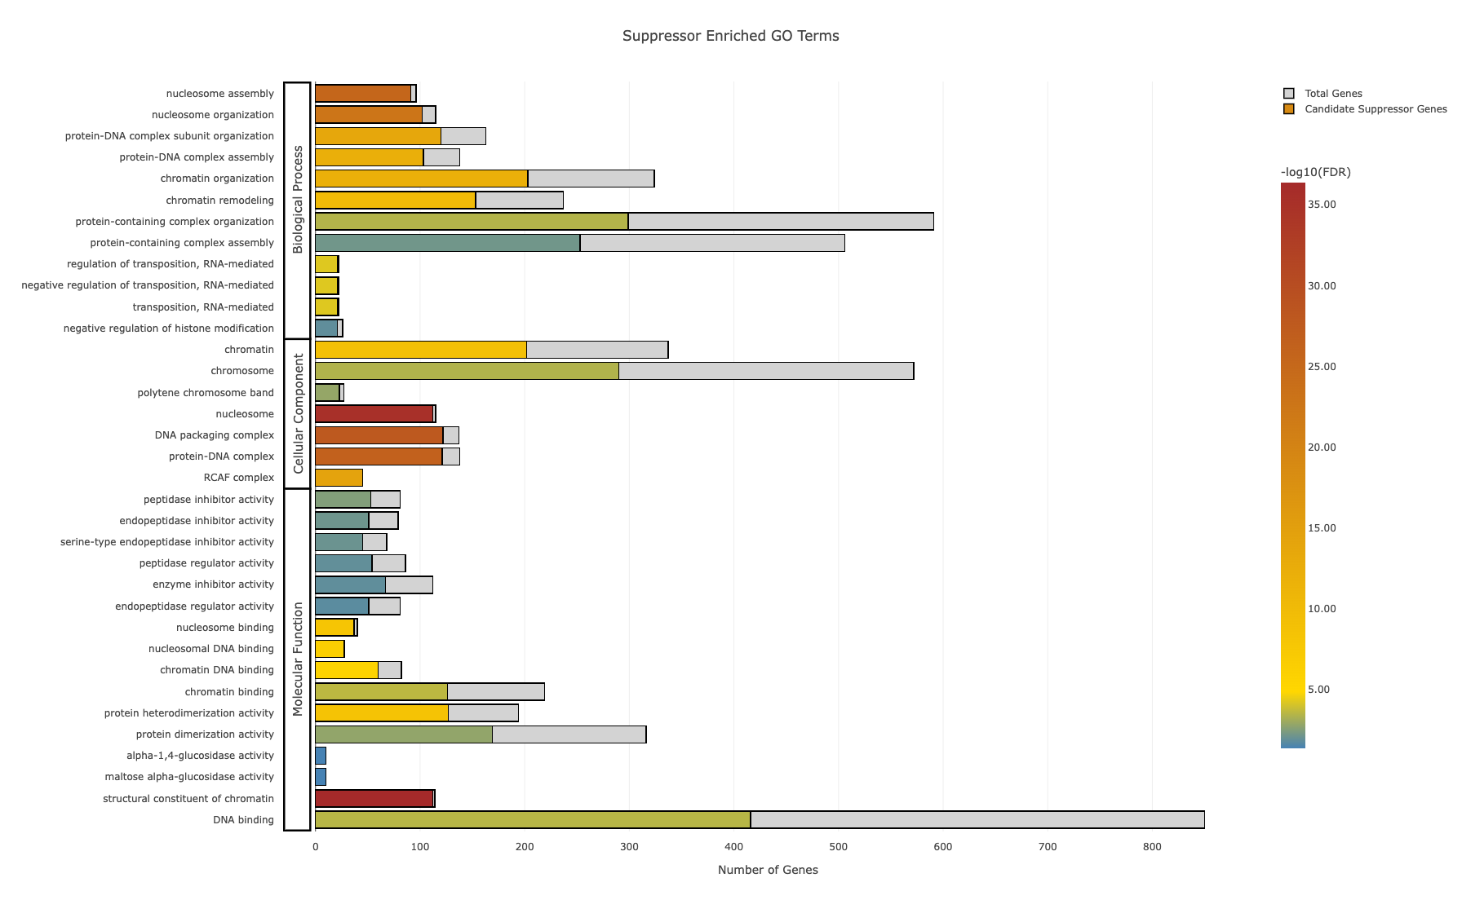
Nucleosome assembly
Regulation of transposition,
RNA-mediated
Chromatin
Nucleosome
Peptidase inhibitor activity
Nucleosome binding
Protein heterodimerization activity
Alpha-1, 4-glucosidase activity

Slide 2
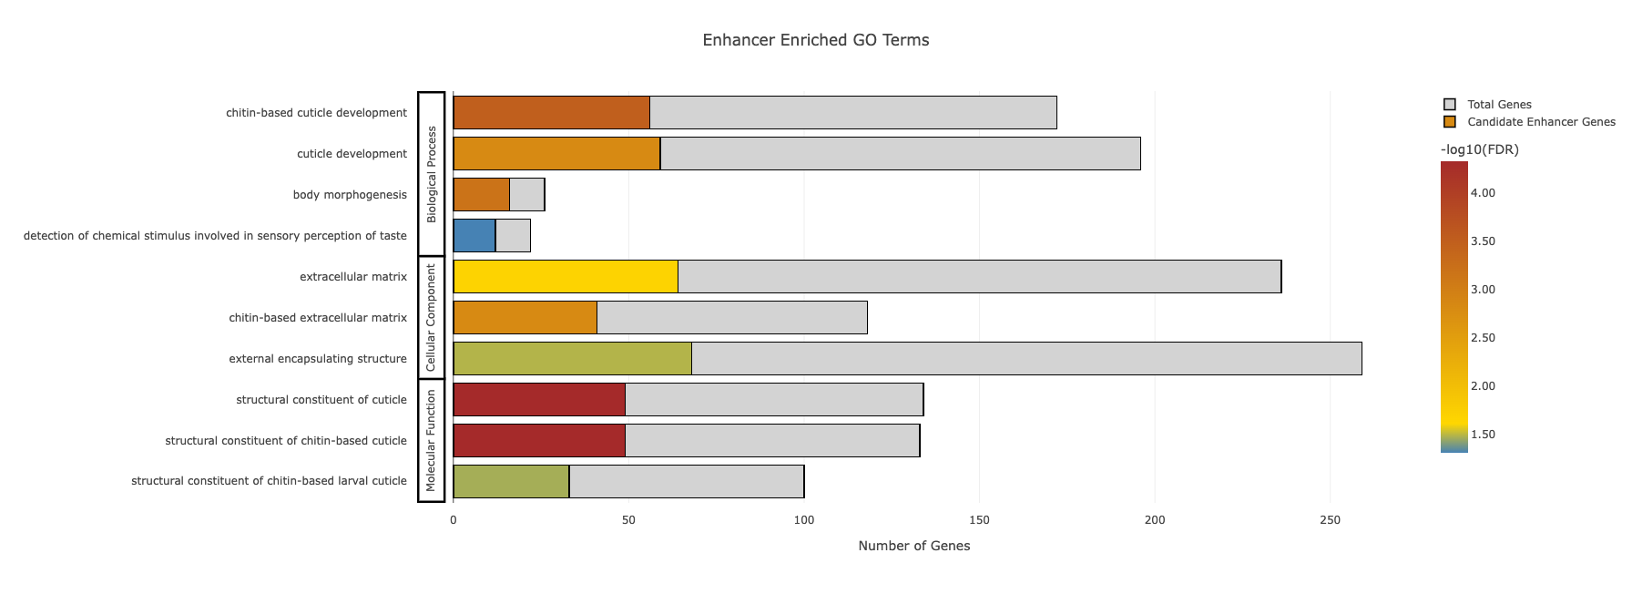
Chitin-based cuticle development
Extracellular matrix
Structural constituent of cuticle

