Slide 1
NEXT GENERATION Project
BARJA, JHON MICHAEL
GACILAN, JOHN JAMES
SAMSON, JOHN DAVID

Slide 2
audience
Millennials (Main – audience)
They came of age in the 1990’s when the technology revolution was exploding, and are extremely technologically sophisticated. Mosier further said they are able to process large amounts of visual information, posses advanced motor, spatial and strategy skills because of game technology (Mosier, 2001).
Newton (2000) in “The New Student”, said that Millennial students enter college having had greater exposure to, and more experimentation with “grown up” activities than any other generation. He also said they are part of the “home alone” generation, having spent many hours in the hands of television, the Internet, peer groups, and alternative parent figures. They received rapid exposure to a wide variety and ever increasing level of informational activity, which makes them the most informed generation in history.

Slide 3
How did you came up with the Project
Innovate
Promote
Enhance
Share
Provide
Earn

Slide 4
What it can do?
Provide new and realistic experience
Move animated objects
Character will move according to body movements and hand gestures
Provision of virtual keyboard
Interaction to other users through mic (provided in googles)
Connect to any modern computer through Bluetooth compatible apps only
Settings edit to be comfortable

Slide 5
What it can not do?
Feel the objects physically
Feel the atmosphere of the place
Communicate have a conversation with your created characters
Provision of the actual smell
Access to other apps that is not compatible

Slide 6

Existing
Tilt-brush google

Slide 7
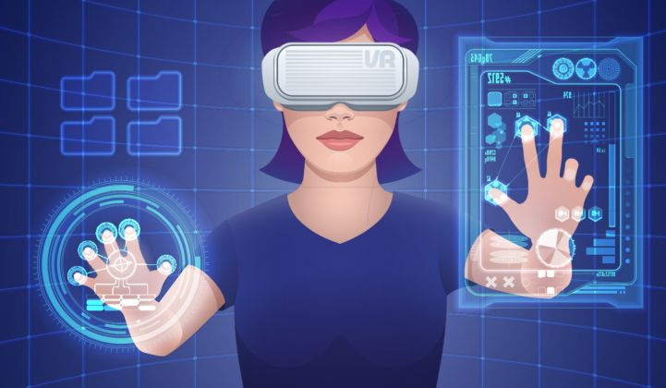
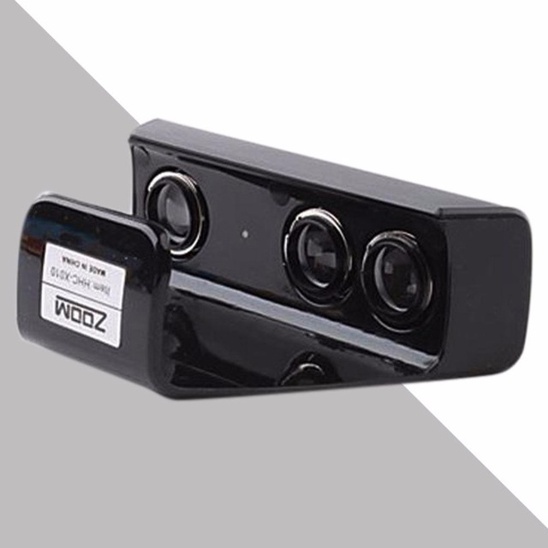
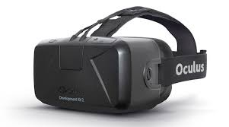
Proposed project
Next Generation

Slide 8
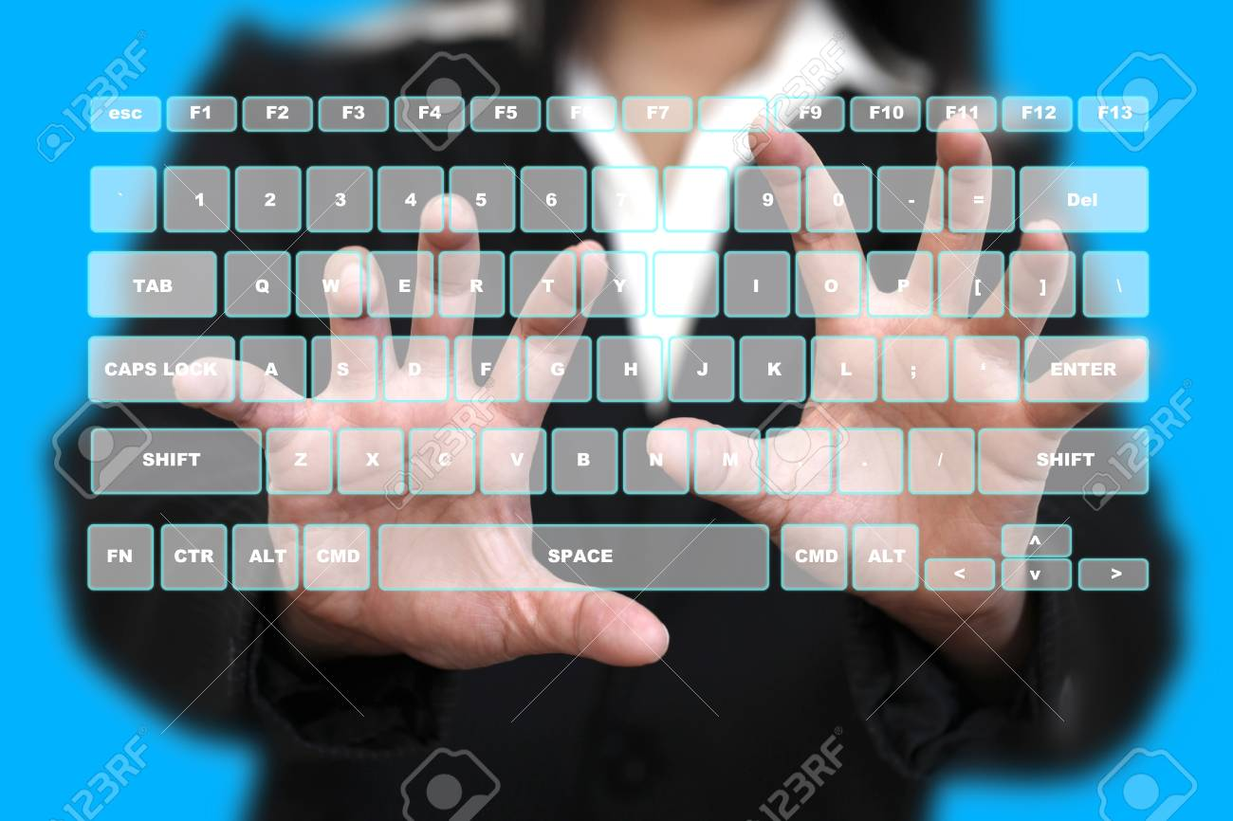
Demo

Slide 9
Usability
Animation and Designing
Sensor
Gears improvement
Use of “Blender App” for 3d animations
Use of “Adobe Audition”/ ”Audacity” for a better audio editing
Create and setup a server to connect clients (through internet and offline)
“Virtalis” for converting tools for creating virtual reality
Provides 3 camera sensors to have an accurate view for body movements and also to provide the view of the actual place you are in to avoid injury or accident
Motion Scan
Color differentiation to limbs, body and head to avoid misinterpretation of the computer
Lesser gears to have (goggles and Sensors only)
Provide goggles with protected/coated concrete lens for blue light and radiation protection to avoid vision problems
Goggles have everything in it microphone to communicate-- (Bluetooth, Internet, hotspot) if wanted to connect to any modern computers (compatible apps only)

Slide 10
Thank you!

