Slide 1

AMARINO
Android meets Arduino and a love story begins…

Slide 2

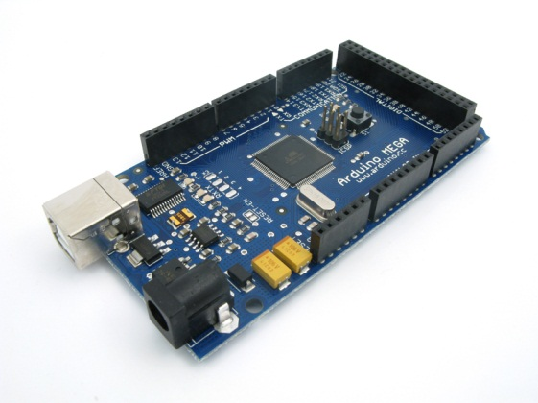


What is Amarino?

Slide 3

Steps to reach the honeymoon
Set hardware (Arduino & Bluesmirf)
Program Arduino
Download and setup Amarino on Android
Create Android Application
Test
Final Result:

Slide 4
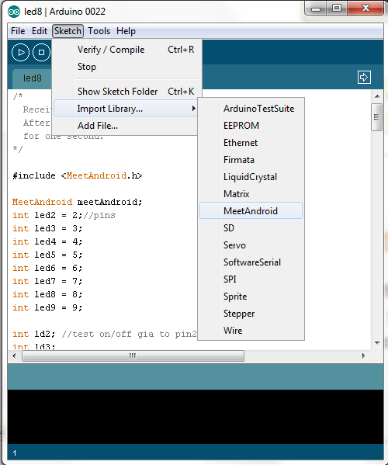
Program Arduino
Get your hands dirty 1
Connect PC to Arduino
Install Arduino Software
Download and import
Amarino Library to directory: your_arduino_sketches_dir/libraries/MeetAndroid
Check amarino installation,
start Arduino software and
go to
Sketch => Import Library
… => Meet Android

Slide 5
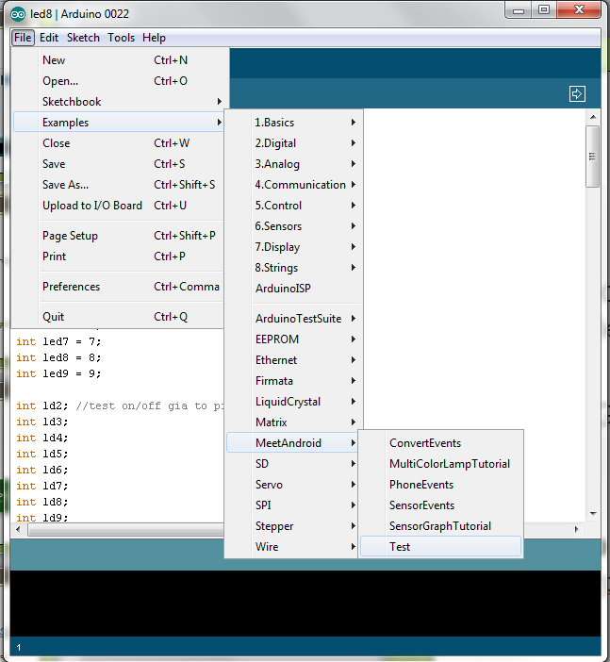
Program Arduino
Get your hands dirty 2
Upload the test program:
File => Examples => Meet Android
=> Test
Important Note!
When uploading program
to Arduino disconnect
TX & RX

Slide 6

Set Hardware
Set Baud Rate 1
Change baud rate of Bluesmirf to 57600
How to connect them:
  RX - RX of arduino
  TX -TX of arduino
  VCC- VCC of arduino
  GND-GND of arduino
  Connect CTS-I to RTS-O

Slide 7
Set Hardware
Set Baud Rate 2
Use Arduino’s terminal (tools => Serial Monitor) or another terminal program to change Baud Rate (we used Tera Term)
Type the following commands:
  $$$ (Initialize, bluesmirf led will turn on/off faster)
  d
  e
  su, 90
  --- (to exit)
  Instructional video for Tera Term http://www.youtube.com/watch?v=Qa-G0FvI98U

Slide 8
Set Hardware
Bluetooth Connection
Important Note! After setting the Baud Rate, remember to change TX and RX
How to connect them:
  RX - TX of arduino
  TX - RX of arduino
  VCC- VCC of arduino
  GND-GND of arduino
  Connect CTS-I to RTS-O

Slide 9
Install Amarino
Time to meet each other
Download Amarino and install .apk to Android http://code.google.com/p/amarino/downloads/detail?name=Amarino_2_v0_55.apk&can=2&q=
Open Amarino application and add new bluetooth device
(Important Note! If it takes too long, restart bluetooth on android or/and replug arduino)
Connect and enter pin (usually it is 1234 or 0000, BT device dependent, you can change it via Arduino terminal)
If a connection is established Bluesmirf’s led turns to green
First test passed
Congratulations!!!

Slide 10

Test connection
Is everything working?
Open Amarino
Choose Monitoring
Enable Monitoring, write something and send it
If everything is working led13 of Arduino will flush
Second test passed
Congratulations!!!

Slide 11
How Amarino works?
Signal Explanation
Amarino sends a flag which is a character (A-Z, a-z) along with an integer
Our application uses 8 LEDs
For each LED we set a flag from A to H along with 0 or 1.
Flags determines the LED (Arduino pin) and the number determines the LED state (ON / OFF)

Slide 12
Code Explanation 1
Import Amarino Library to Eclipse
Create an Android project
Download and import Amarino library as follow:
  In the Package Explorer panel, right-click on your project and select Properties.
  Select Java Build Path, then the tab Libraries.
  Press the Add External JARs... button and select the AmarinoLibrary_v0_55.jar

Slide 13
Code Explanation 2
Android gets naked
Get full source code here: http://www.johndel.gr/amarino.zip
private static final String DEVICE_ADDRESS = "00:06:66:06:BE:54";
Amarino.connect(this, DEVICE_ADDRESS);
if((sensorEvent.values[1] > -20 && sensorEvent.values[1] < 20) && (sensorEvent.values[2] > -20 && sensorEvent.values[2] < 20)) {
direction.setText("Stop");
  Amarino.sendDataToArduino(this, DEVICE_ADDRESS, 'A', '1');
  Amarino.sendDataToArduino(this, DEVICE_ADDRESS, 'B', '1');
  Amarino.sendDataToArduino(this, DEVICE_ADDRESS, 'C', '1');
  Amarino.sendDataToArduino(this, DEVICE_ADDRESS, 'D', '1');
  Amarino.sendDataToArduino(this, DEVICE_ADDRESS, 'E', '1');
  Amarino.sendDataToArduino(this, DEVICE_ADDRESS, 'F', '1');
  Amarino.sendDataToArduino(this, DEVICE_ADDRESS, 'G', '1');
  Amarino.sendDataToArduino(this, DEVICE_ADDRESS, 'H', '1');
}
else if((sensorEvent.values[1] > 20) && (sensorEvent.values[2] > -20 &&
sensorEvent.values[2] < 20)) {
direction.setText("Up");
Amarino.sendDataToArduino(this, DEVICE_ADDRESS, 'A', '0');
}

Slide 14
Code Explanation 3
Arduino / explain setup()
#include <MeetAndroid.h>
…
int led2 = 2; //pin2
…
int ld2; //check on/off
void setup() {
Serial.begin(57600);
meetAndroid.registerFunction(leda, 'A');
    pinMode(led2, OUTPUT);
}

Slide 15
Code Explanation 4
Arduino / explain loop()
void loop() {
meetAndroid.receive();
…
switch (ld2) {
case 0:
digitalWrite(led2, HIGH);
break;
case 1:
digitalWrite(led2, LOW);
break;
}
}
…
void leda(byte flag, byte numOfValues) { ld2 = meetAndroid.getInt(); }

Slide 16
Resources
Amarino: http://www.amarino-toolkit.net/
Arduino: http://www.arduino.cc/
Bluesmirf Gold: http://www.sparkfun.com/products/582
Code: http://www.johndel.gr/amarino.zip

Slide 17

Thank you!!!
istoselidas@gmail.com
eleni.chourouzidou@yahoo.gr

