Slide 1
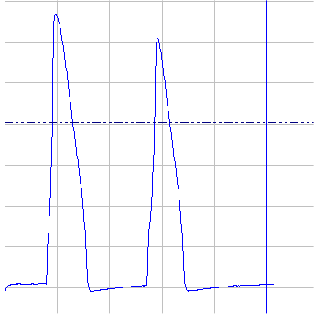
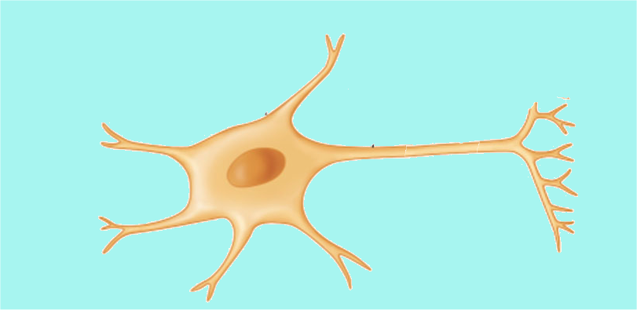
Salt Solns.
Amplifier
Drugs
Stimulator
Micro-
electrode
Soln.
Outflow
Neuron

