Slide 1
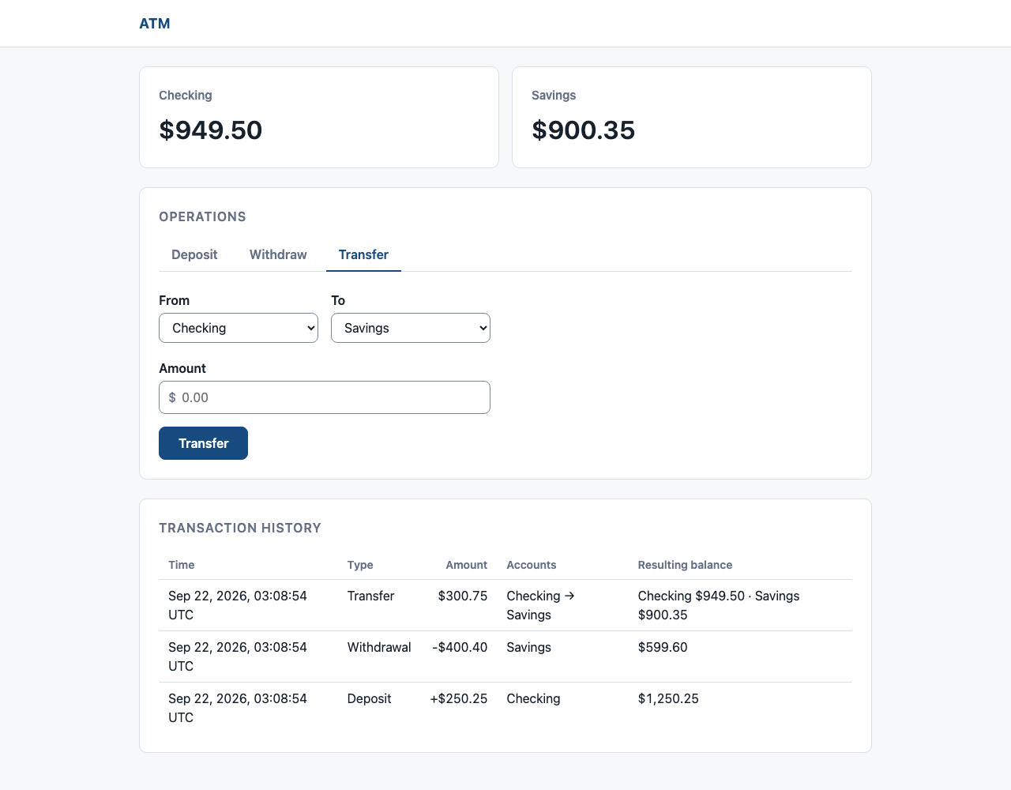
CASE STUDY
ATM
Coding Exercise
Two accounts, persisted locally,
covered by 143 tests.
Hint: try the Konami code.
Notes:
Open with the finished product, running against a scratch SQLite database. The intentionally narrow scope keeps the review on correctness, architectural boundaries, and evidence. The hint points at an opt-in easter egg: the Konami code (up, up, down, down, left, right, left, right, B, A) toggles a Matrix theme; Esc, the blue pill, or the code again exits it.

Slide 2
Technology stack
FRONTEND
Razor Pages, vanilla JavaScript, CSS
No client framework or packages
BACKEND
C# 14 on .NET 10
ASP.NET Core
DATABASE
SQLite via EF Core 10
Code-first migrations
TESTING
xUnit, WebApplicationFactory, coverlet
Notes:
No client-side framework or npm packages ship with the app.
Pages are server-rendered Razor Pages with a small amount of vanilla JavaScript and one “hand-written” stylesheet.
The solution is a modular monolith of four projects (Domain, Application, Infrastructure, Web) with dependencies pointing inward, recorded in ADR-0002.
EF Core and SQLite live only in the Infrastructure project.
Tests use xUnit, WebApplicationFactory for in-process HTTP, and coverlet for coverage.

Slide 3
Decisions and costs
DECISION | COST
Razor Pages | Full page reload per action
Modular monolith | One feature spans four projects
SQLite + EF Core | Single-writer ceiling
2-decimal USD | Single-currency support
Notes:
The ADRs explain why each choice fits the exercise.
Razor Pages (ADR-0001). Cost: a full page reload per action. The server renders HTML with minimal JavaScript, so the whole app is written in C# and ships as a single unit. A separate JavaScript front end (e.g., a React single-page app) would add its own npm build and a JSON API for the browser to call, because the browser would fetch data instead of receiving finished pages.
Modular monolith (ADR-0002). Cost: one feature spans four projects, so adding a transaction type touches Domain, Application, Infrastructure, and Web. The payoff is that business rules can be tested without the web host or the database. Microservices would add operational complexity with no payoff at this scope.
SQLite + EF Core (ADR-0003). Cost: single-writer ceiling. A server database is the upgrade path if concurrent load ever matters. The next slide covers the datastore choice.
2-decimal USD (ADR-0005). Cost: single-currency support. Amounts are decimal with at most two fractional digits, which rules out floating-point error. The two-digit rule fits USD only, and there is no currency field, so supporting another currency (e.g., JPY with 0 places or KWD with 3) would change the Money type.

Slide 4
Datastore choice
In-memory would suffice.
CHOSEN
SQLite file
Survives restarts
CONSIDERED
SQLite in-memory
Lost on restart
Hand-written store
Owns atomicity
EF Core InMemory
No transactions
Redis
Extra process
Notes:
An in-memory store would have been enough. I chose a persistent one so balances and history survive restarts (ADR-0003).
• SQLite – single-file DB with near-zero setup.
• EF Core – the ORM (the .NET counterpart to Hibernate).
– Transactions: saves a transfer's debit, credit, and history rows in a single DB transaction, so they either commit or roll back as a unit.
– Optimistic concurrency: rejects a write based on an outdated balance, e.g., two tabs withdrawing against the same $1,000 and overdrawing it. Doesn't lock account rows; assumes conflicts are rare.
Every option sits behind the same Application ports, so switching is an Infrastructure-only change.
• SQLite in-memory – an in-memory connection string with one connection held open. Keeps EF Core, migrations, transactions, and constraints, but data is lost on restart. The best in-memory choice, e.g., for a demo mode.
• Hand-written store – dictionaries behind a single lock. No dependencies, but the code itself must commit balance and history together instead of relying on a database transaction.
• EF Core InMemory provider – discouraged by Microsoft. It isn't relational, ignores transactions, and enforces no constraints, so it can't prove the invariants.
• Redis – a separate server process to install and run, and atomic transfers need MULTI/EXEC or Lua scripts. More operational machinery than this exercise needs, and still volatile unless its persistence is configured.

Slide 5
How I AI'ed
FRAME
GPT-5.6 Sol
I approved spec, plan, ADRs
BUILD
Fable 5.1
Six phases, tests green per commit
Chose to minimize rework over tokens
REFINE
Opus 5.5, GPT-6 Sol
Docs, deck, fixes
Notes:
Frame: GPT-5.6 Sol in Codex with my architect agent
• Architetto is my open-source architect agent: it bootstraps new repositories and records every foundational decision.
• Interviewed me on four open questions: time box, persistence, seed accounts, repo visibility.
• The model proposed the stack; I approved it.
• Scaffolded before any feature code: SPEC.md, PLAN.md, six ADRs, AGENTS.md.
– AGENTS.md lists the rules for this repo: money is decimal, balances never go negative, etc.
Build: Fable 5.1 in Claude Code
• Why Fable 5.1: I know the best approach is to plan with the strongest model and execute with cheaper ones, but when I reached the implementation phase, I was running short on time. Therefore, I chose the strongest end-to-end model at the time (a whopping week ago, before Opus 5.5 shipped).
• Six phases in order: domain, application, persistence, web, HTTP tests and accessibility, deck.
• Each phase committed only with the build and every test green; domain tests written first.
Refine: Opus 5.5 and GPT-6 Sol in Codex
• Windows setup steps in README.md, a Dependabot fix, the deck redesign, slide wording.
• The design direction came from jony-vibe, my design-consultation agent; the first deck skipped that consultation and was redone.
• c4po, my workspace-admin agent, moved the deck's visual checks from Keynote to PowerPoint after Keynote passed a deck that PowerPoint had to repair.

Slide 6
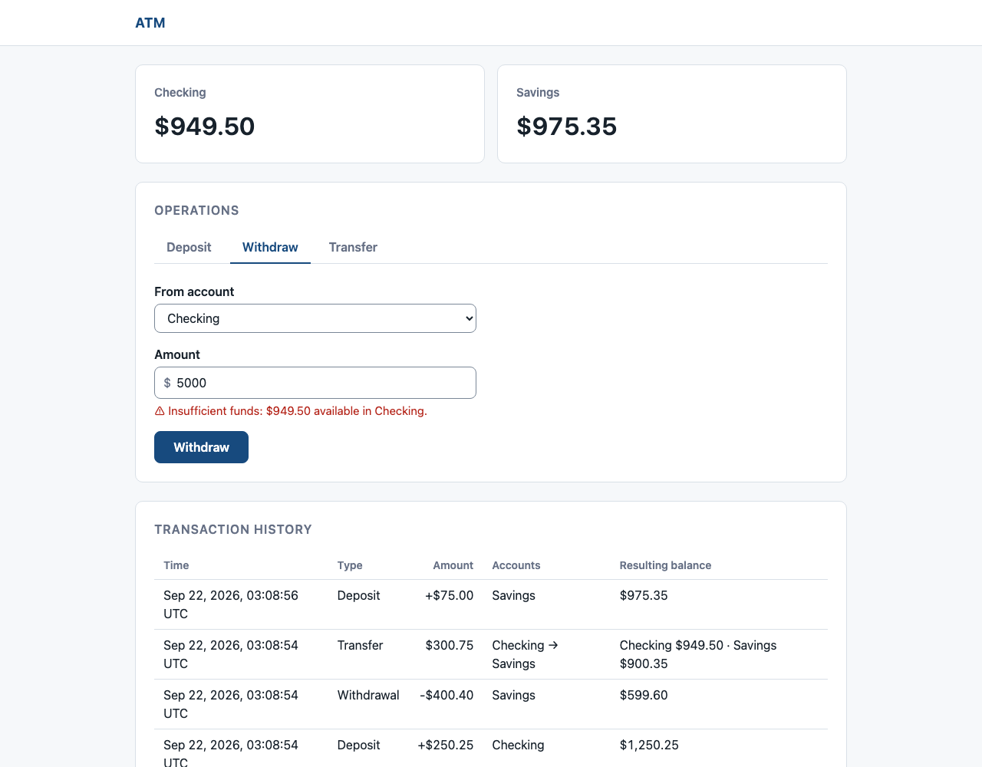
Failure leaves no partial state
01
Validate before mutation
02
Commit balance and history together
03
Reject stale writes
Rejected overdraft. Persisted state stays unchanged.
Notes:
The screenshot is a real rejected overdraft. The typed value stays visible, the error names the available balance, and persisted state is unchanged. Account versions turn stale writes into a safe retry instead of lost data.

Slide 7
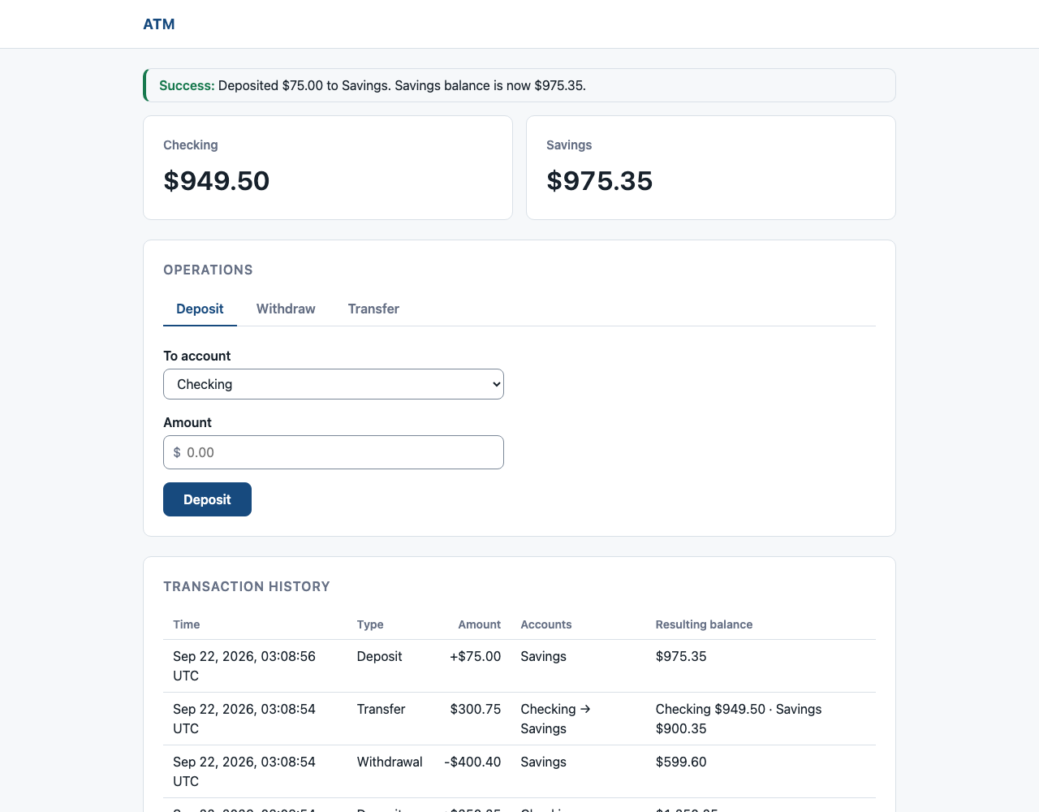
143 tests by layer
75
Domain
Invariants
33
Application
Orchestration
35
Integration + HTTP
Persistence and HTTP
Success receipt after Post/Redirect/Get.
Notes:
Domain tests are pure. Application tests use hand-written fakes. Integration and HTTP tests exercise the real host with an isolated SQLite file per test, including concurrency conflicts, atomic rollback, Post/Redirect/Get, security, and accessibility structure. Commands: dotnet restore Atm.sln; dotnet build Atm.sln --no-restore; dotnet test Atm.sln --no-build.

Slide 8
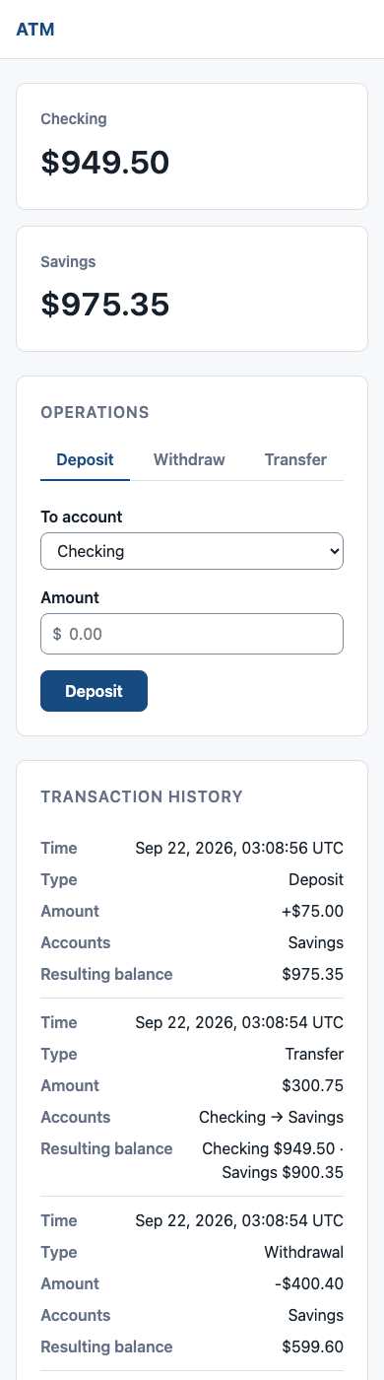
Tradeoffs and roadmap
OMITTED
NEXT
Identity
Double-submit protection, auditing, authentication
THEN
Banking breadth
Accessibility, observability, load tests
Distributed operations
LATER
Deployment, browser coverage
Responsive at 380 px.
Notes:
The omissions are conscious. The roadmap begins with the correctness gap that Post/Redirect/Get does not solve: a retried network request. The phone capture proves the existing presentation adapter already reflows at 380 pixels.
In a real bank, the Domain and Application layers would become a backend service behind an API that every channel (ATM, mobile, web, branch) shares, so the rules live in one place. This ATM would be one thin client. Splitting that backend into microservices becomes worthwhile once separate teams own accounts, transfers, and fraud and need to deploy independently. The inward dependencies here are what make that extraction straightforward.

