Slide 1
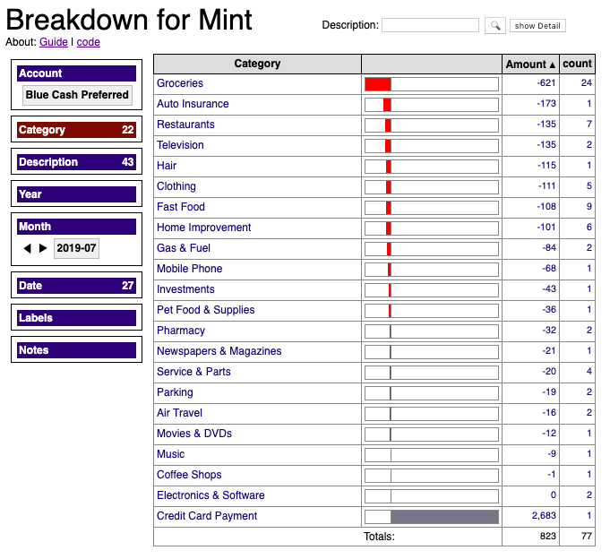

Slide 2
Breakdown slices and dices financial transactions you download from your Mint account. In a few clicks, it can answer questions like:
Where did all my money go?
When did I start shopping more at Trader Joe's than Vons?
Why did I spend more on vacation this year than usual?
Have my favorite restaurants changed over the months and years?

Slide 3
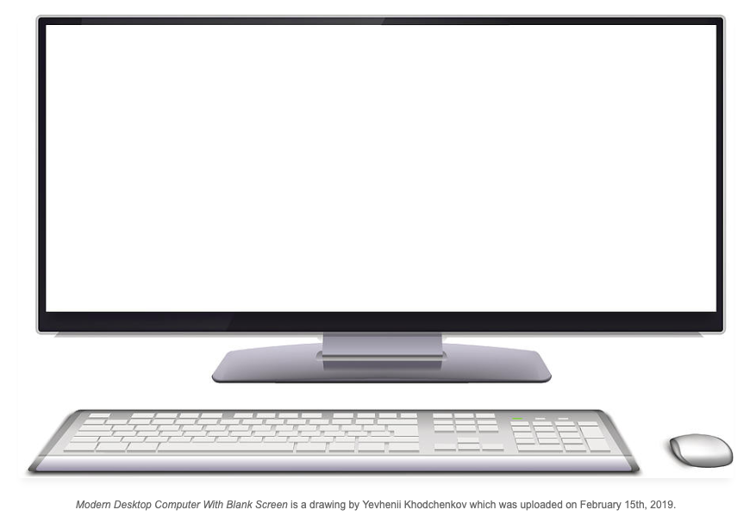
Mint Website
Breakdown works by loading your Mint data into Lovefield, the browser-based local database written in javascript by a team at Google.
Your data stays on your machine.
transactions.csv
Lovefield
database

Slide 4
How to use the chrome extension
Step 1:
In Mint, scroll down on the Accounts tab and click the Export link. Save the transactions.csv file to your hard drive.
Step 2:
A new tab will appear. Click the Import button. Select the transactions.csv file you just downloaded.

Slide 5
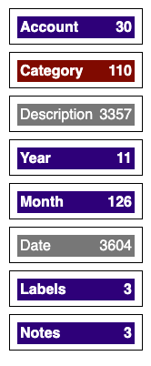
break down
Click to break down your current selection of data.
Account, Category, Year, and Month have a small number of distinct values. Categorical features of low cardinality make the best dimensions.
Description and Date are gray because at the top level there are too many. Once you drill down far enough to bring the number under 1000, they become active.

Slide 6
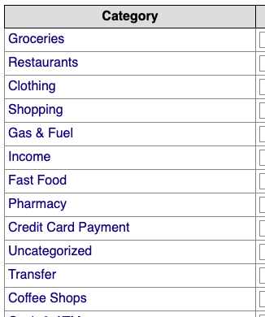
drill down
Click to drill down by selecting a value for the currently selected dimension.
Select values for other dimensions to further reduce the working dataset.

Slide 7
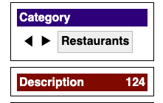
slide
Click the arrows to “scroll” through the values of a dimension without switching to it.
Here we're viewing Descriptions while moving sequentially through the Categories.
The order for previous and next is determined by the order in the list when the first value was selected.

