Slide 1

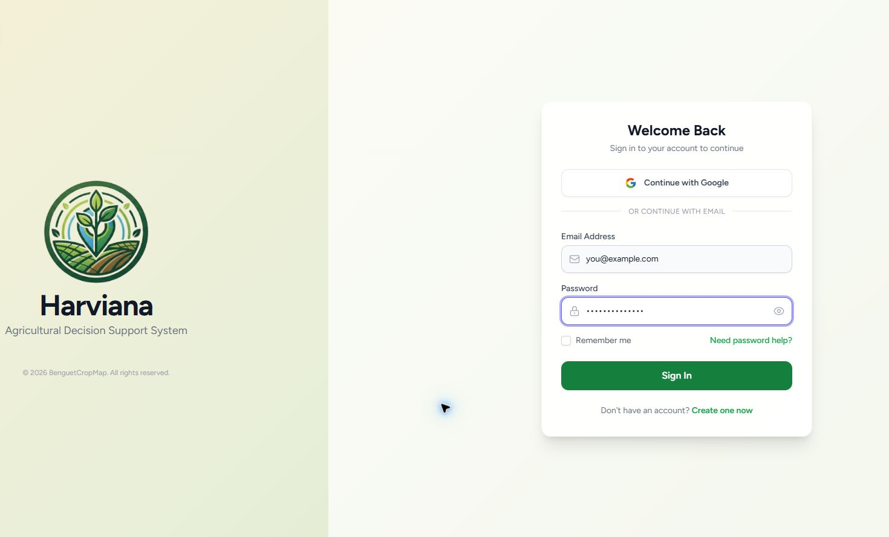
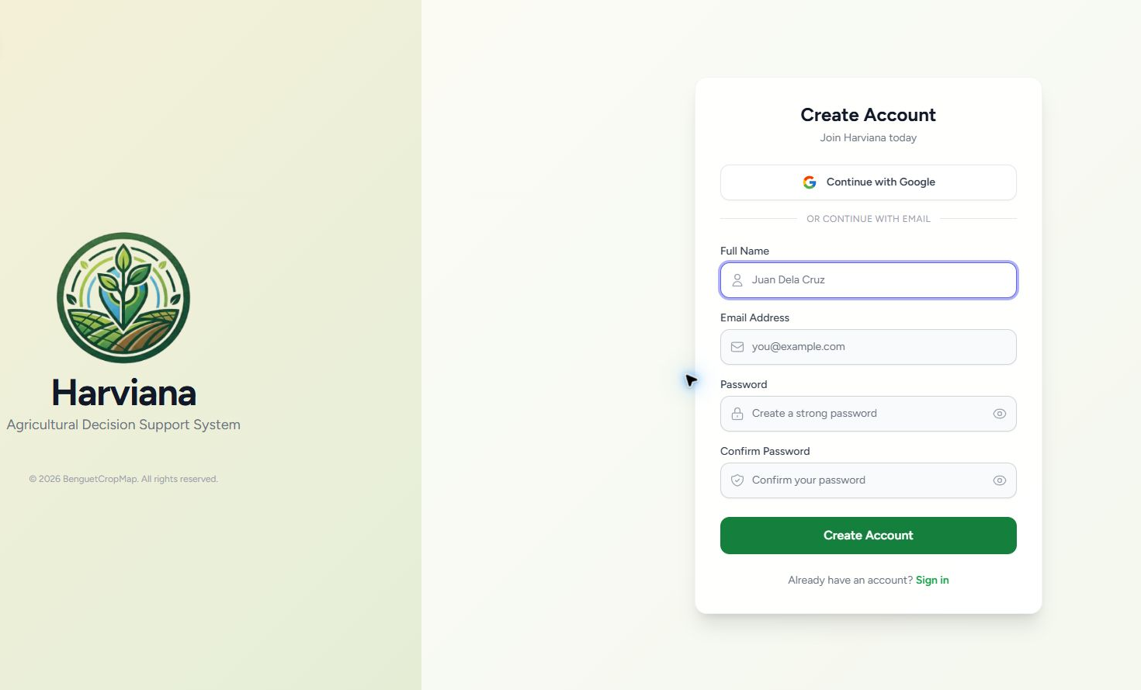
GETTING STARTED
Access Harviana in three steps
Open the platform, sign in with an authorized account, or register as a new Farmer.
01
Open Harviana
02
Sign in
03
Create an account
Visit harviana.app and select the login or registration option.
Enter the registered email address and password, then select Sign In.
New Farmers may enter the required information and submit the registration form.
After authentication, Harviana opens the interface assigned to the Farmer, LGU Validator, or DA Administrator role.
HARVIANA USER MANUAL • 01

Slide 2
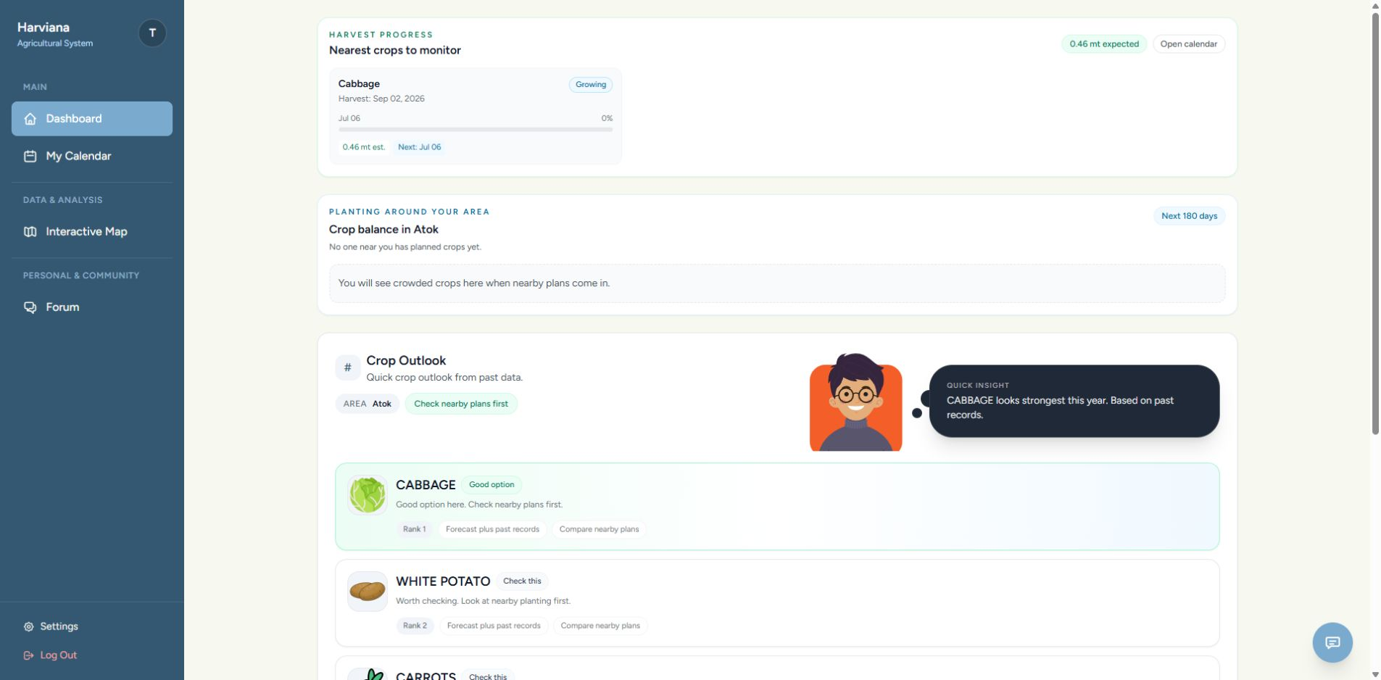
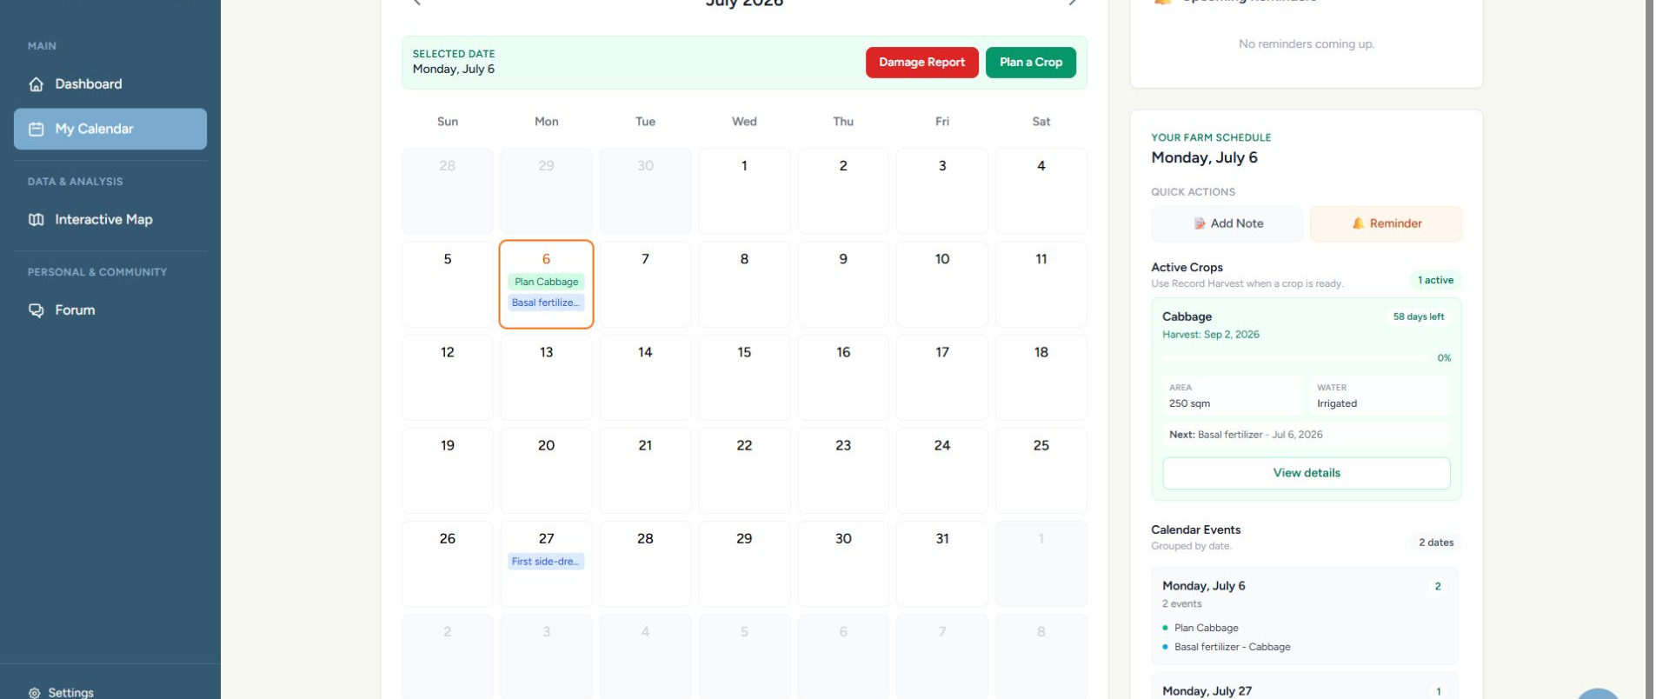
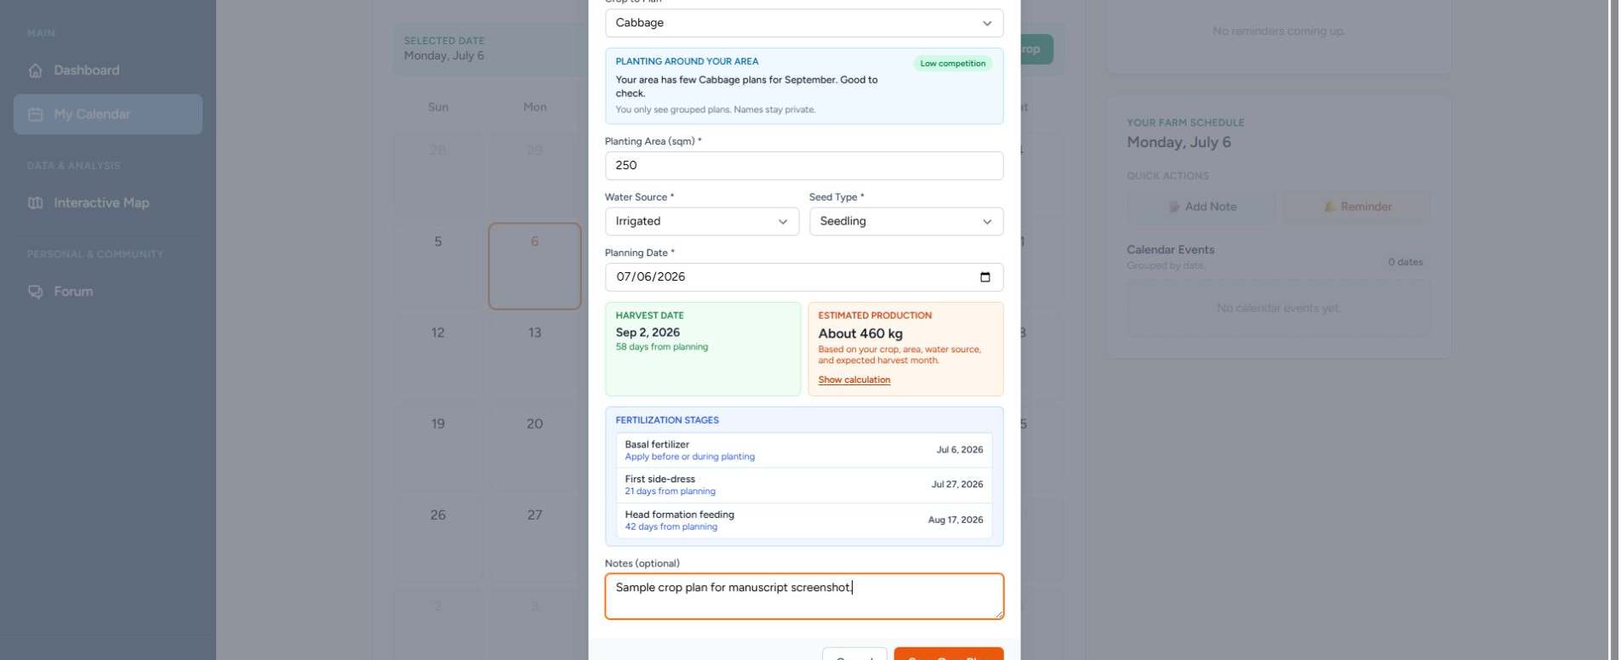
FARMER
Plan a crop and review its production estimate
The Farmer Dashboard, calendar, and prediction result work together during crop planning.
Calendar and crop-planning form
01
Review the dashboard
Check active plans, reminders, crop recommendations, and upcoming activities.
02
Create a crop plan
Open the Farmer Calendar and enter the crop, area, water source, planting material, and planning date.
Review the estimated harvest date and ML-based production result before saving the plan.
HARVIANA USER MANUAL • 02

Slide 3
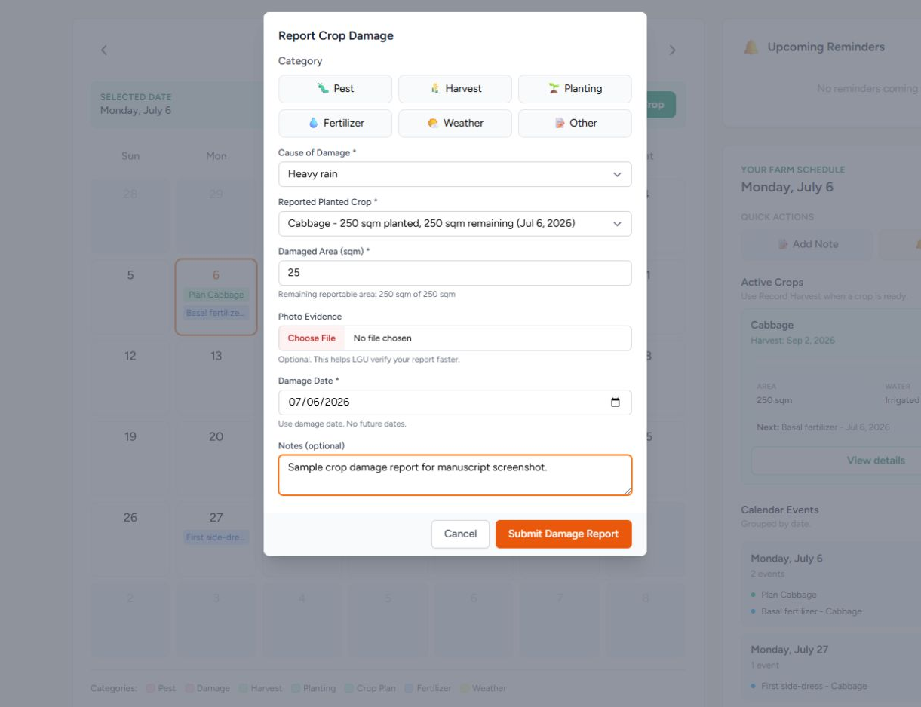
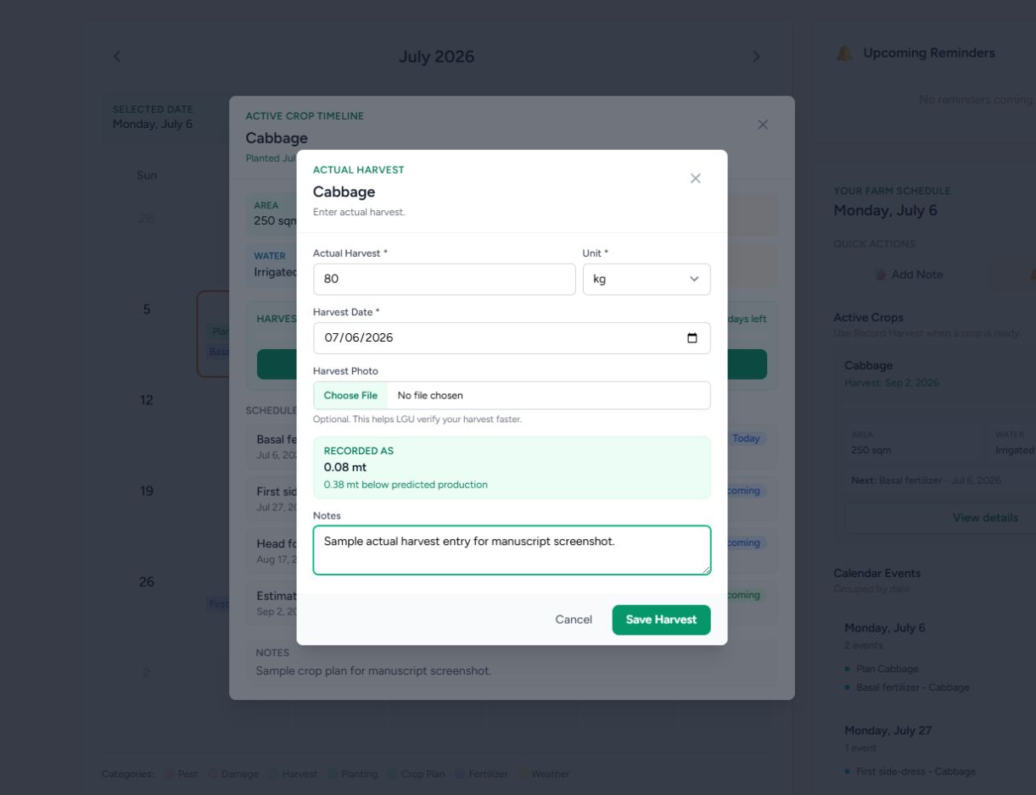
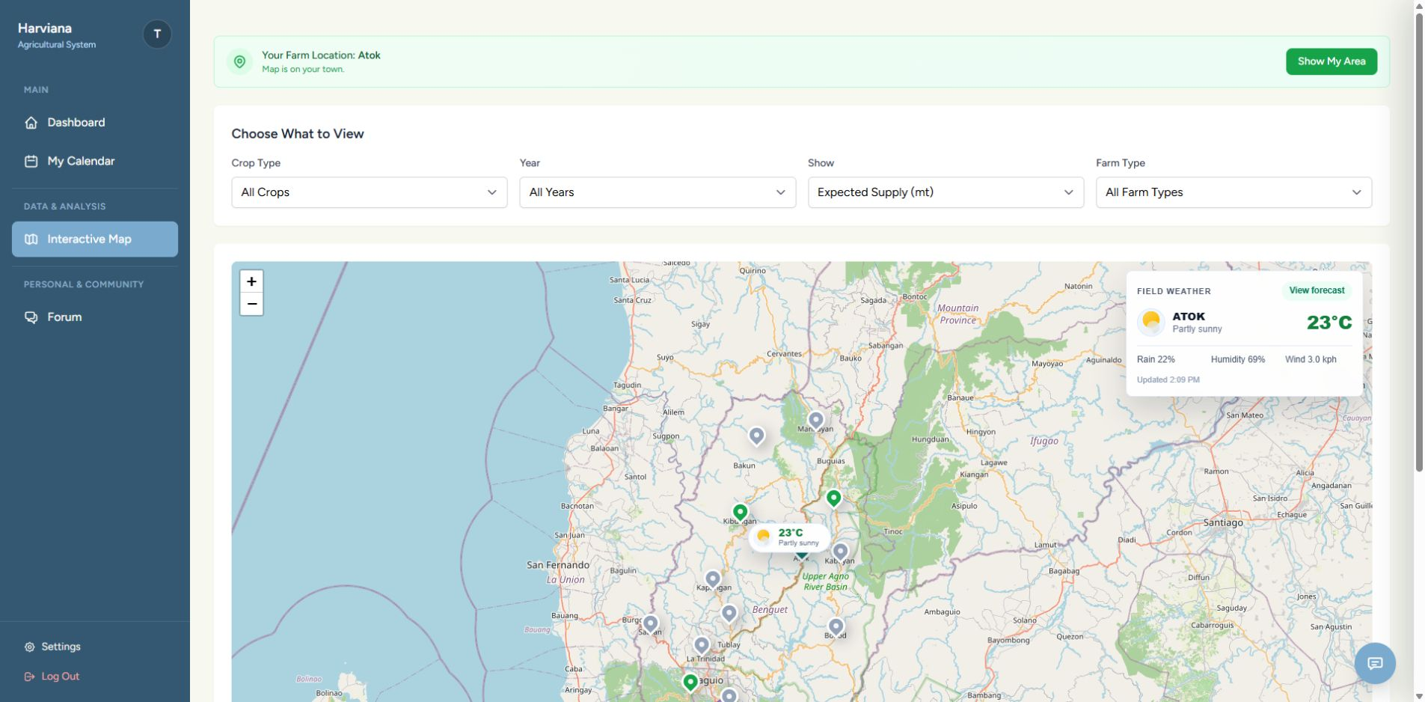
FARMER
Record field outcomes and check local conditions
Damage and harvest records strengthen monitoring, while the map connects crop information with location and weather.
01
Submit a damage report
02
Record the actual harvest
03
View map and weather
Select the affected crop plan, enter the damaged area and cause, then attach optional evidence.
Enter the harvest date, amount, unit, notes, and optional photo evidence.
Filter agricultural information and review the weather details of a selected municipality.
Damage and actual-harvest submissions remain pending until they are reviewed by the appropriate LGU Validator.
HARVIANA USER MANUAL • 03

Slide 4
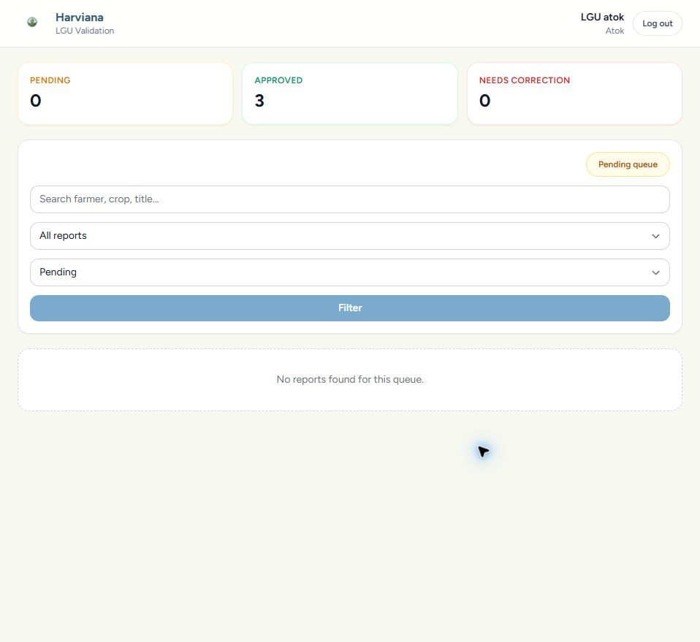
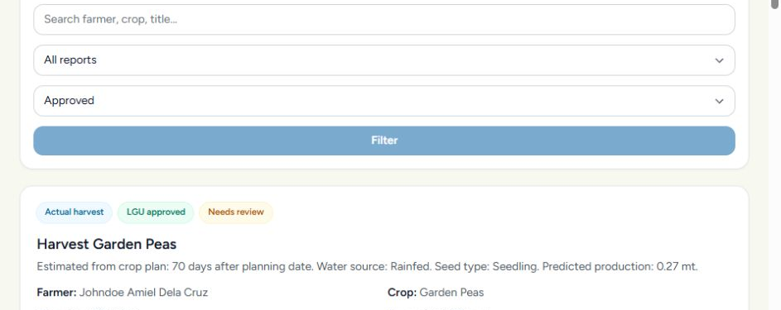
LGU VALIDATOR
Review and decide on Farmer-submitted reports
The validation queue is limited to the LGU Validator's assigned municipality.
01
Open the queue
02
Review the evidence
Filter reports by status or type and open the record that requires review.
Check the Farmer's information, attached photo, captured location, and authenticity indicators.
03
Record the decision
04
Confirm its status
Approve an acceptable report or return it with a required correction note.
The system records the validator, date, notes, revision, and audit history.
HARVIANA USER MANUAL • 04

Slide 5
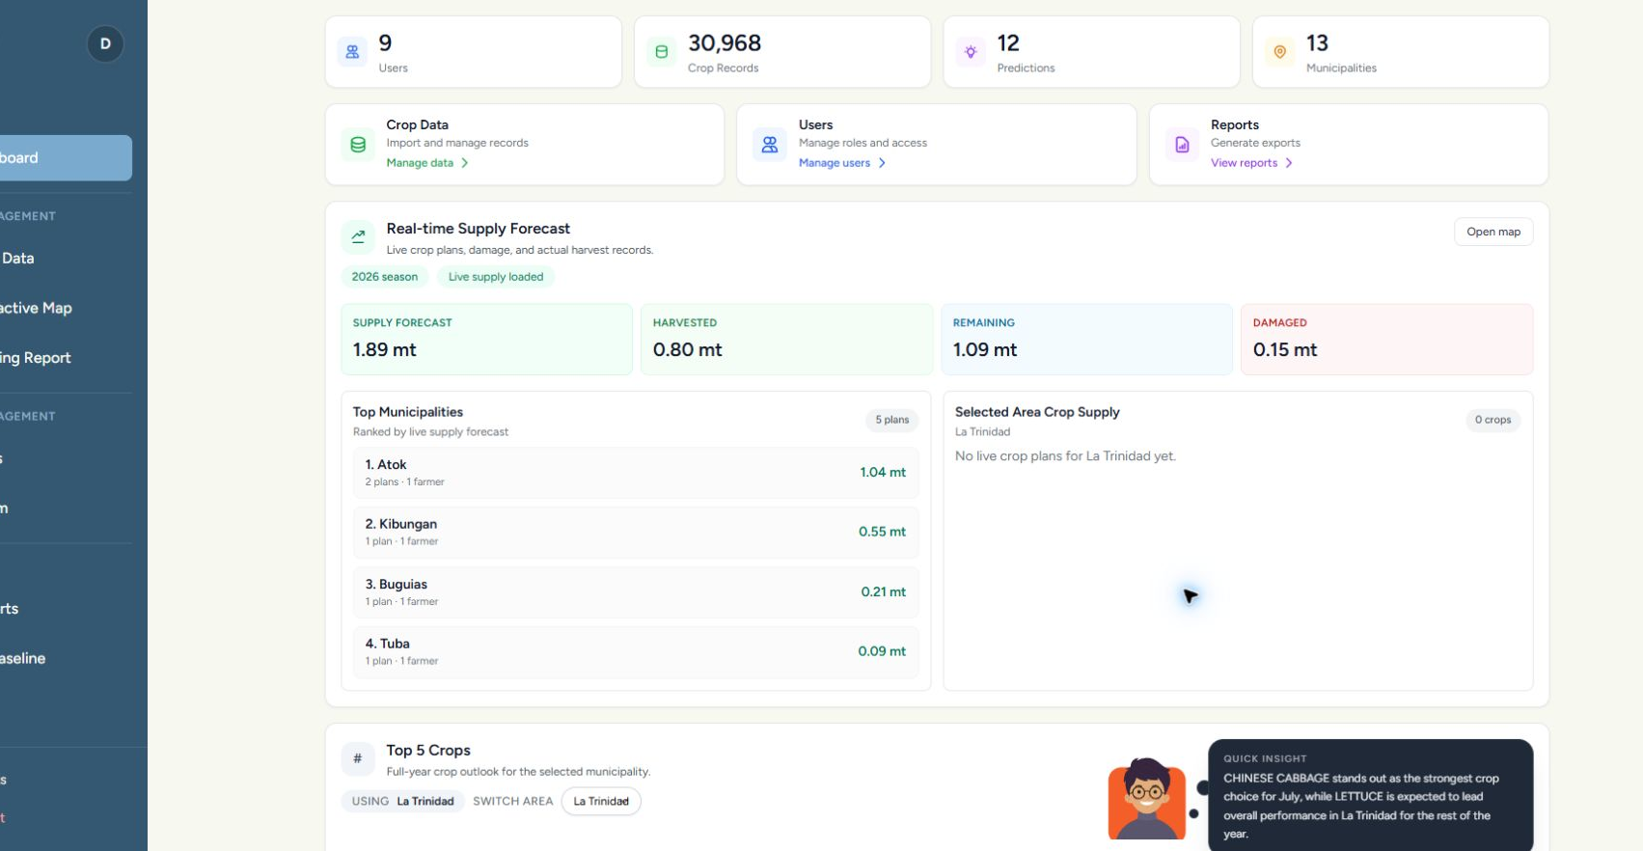
DA ADMINISTRATOR
Monitor municipal supply and location-based information
Validated records and Farmer crop plans support administrative monitoring across Benguet municipalities.
01
Review the dashboard
02
Select an area
Check record totals, municipal supply information, and the current administrative overview.
Use the municipality, crop, year, view, and farm-type filters to focus the displayed information.
Weather information may be viewed together with agricultural map records to support area-based monitoring.
HARVIANA USER MANUAL • 05

Slide 6
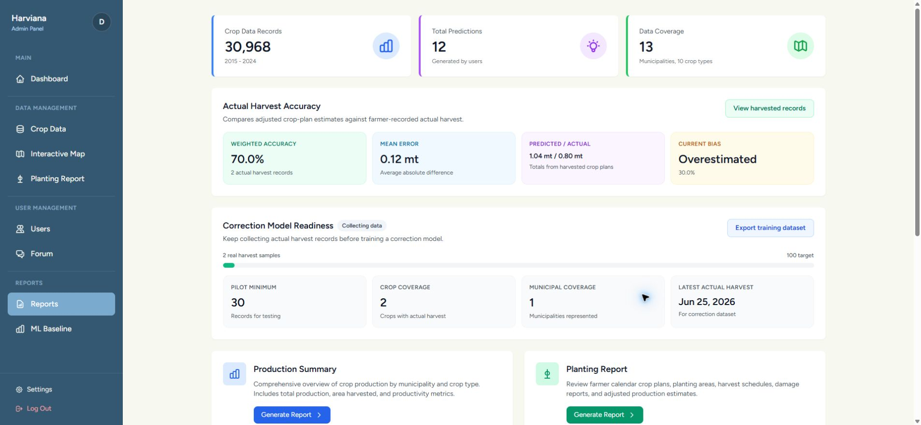
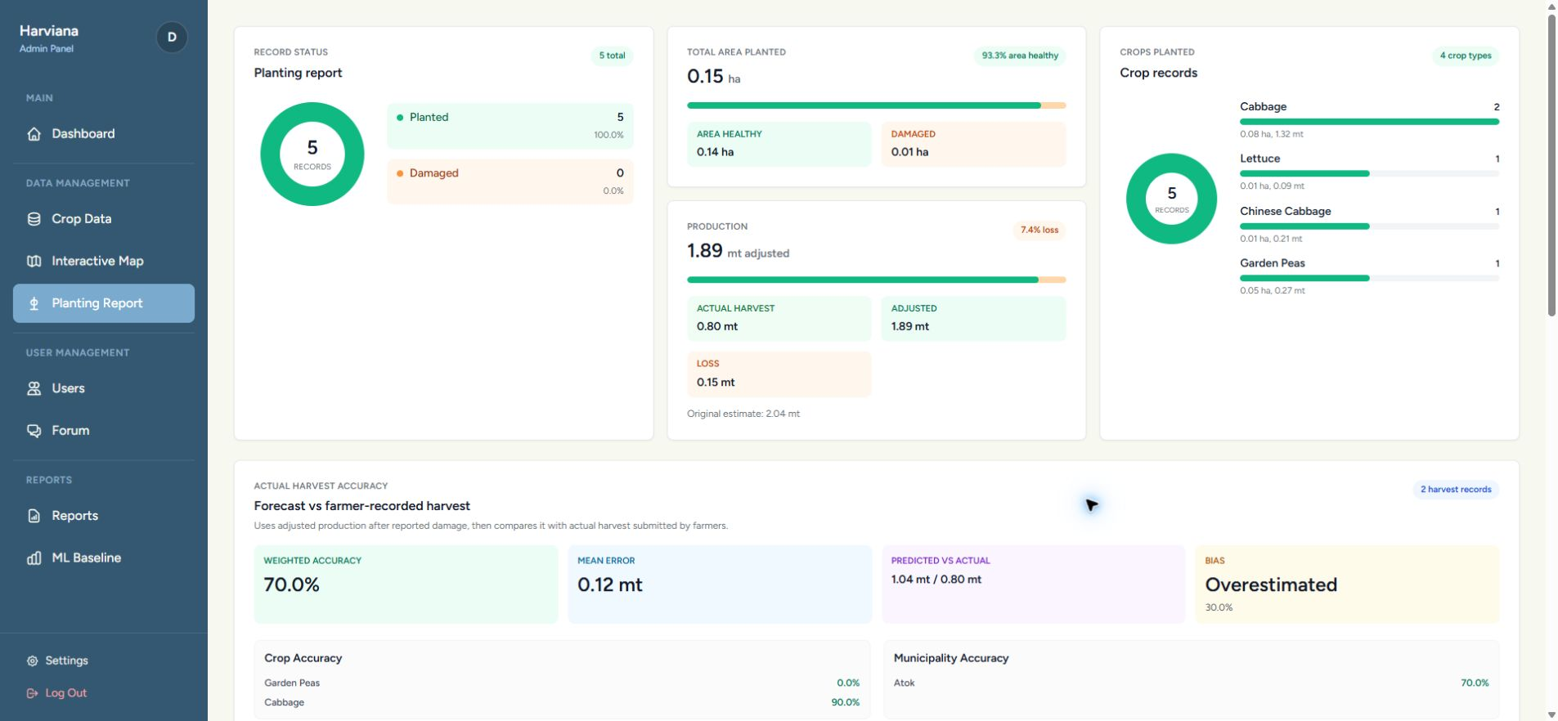
DA ADMINISTRATOR
Generate and export agricultural reports
The report pages summarize validated records and prepare them for documentation and administrative analysis.
01
Open Reports
02
Set the filters
03
Review the records
04
Export the report
Review harvest accuracy, crop production, damage, and report summaries.
Select the municipality, crop, date, status, or other available criteria.
Confirm the planting, production, damage, validation, and actual-harvest information.
Download the prepared report in PDF or CSV format when required.
Exported reports may be used for documentation, further analysis, and administrative decision-making.
HARVIANA USER MANUAL • 06

