Slide 1

Azure Key Vault capabilities on Azure
John Dohoney, Jr
Sr. Cloud CSA

Slide 2
Agenda
Update on Blue Yonder Azure Key Vault Requirements
Feedback on Vault Pricing
Key Vault Capabilities
Key Vault in Action
Demo
Questions

Slide 3
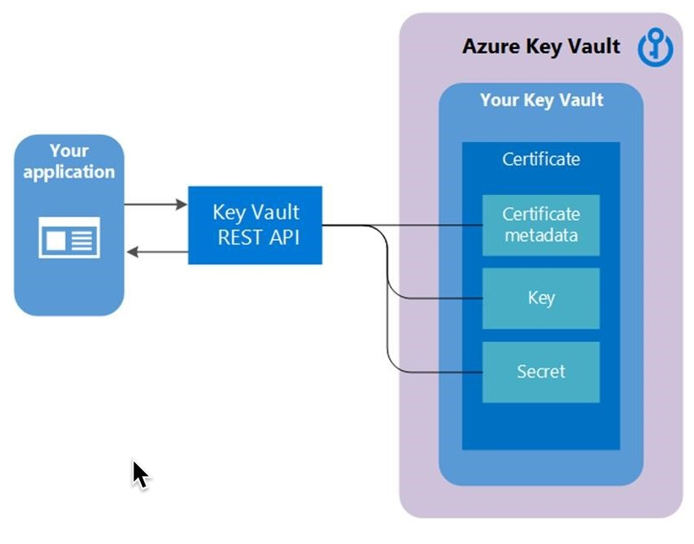
Azure Key vault capabilities
Securely store and manage cryptographic keys, secrets, and certificates.
Control access to keys, secrets, and certificates using granular access policies.
Audit access and usage of keys, secrets, and certificates.
Integrate with other Azure services and applications to provide secure access to cryptographic materials.

Slide 4
Azure Key Vault – Best Practices
Use Role-Based Access Control (RBAC) – Use Azure RBAC to control access to the Key Vault resources. This ensures that only authorized users or services have access to secrets and keys. You can assign permissions at the Key Vault level or at the secret and key level.
Limit Access to Secrets and Keys – Only grant access to secrets and keys to users or services that need it. This reduces the risk of accidental exposure or misuse of secrets and keys. Use Azure Key Vault’s access policies to control who can manage and access secrets and keys.
Use Azure Private Endpoints – Use Azure Private Endpoints to access Key Vault securely over a private connection. This reduces the exposure of the Key Vault to the public internet and improves the security of your application.
Monitor Access to Secrets and Keys – Monitor access to your secrets and keys to detect any unauthorized access. Azure Key Vault provides detailed logging and monitoring capabilities that enable you to track access to secrets and keys.
Rotate Keys Regularly – Rotate keys regularly to reduce the risk of exposure in case of a breach. Azure Key Vault provides automated key rotation capabilities for some key types.
Enable Soft Delete – Enable soft delete for Key Vault objects such as keys and secrets. This ensures that you can recover deleted objects in case of accidental deletion or malicious activity.
Use Managed Identities – Use Azure Managed Identities to access Key Vault from your Azure services. This eliminates the need for managing credentials or storing secrets in your application code.
Enable Azure Key Vault Firewall – Use Azure Key Vault Firewall to restrict access to your Key Vault resources to a specific set of IP addresses or Azure Virtual Networks.
Use Azure Policy – Use Azure Policy to enforce compliance and security policies for your Key Vault resources. This ensures that your Key Vault configuration is consistent and compliant with industry standards.

Slide 5
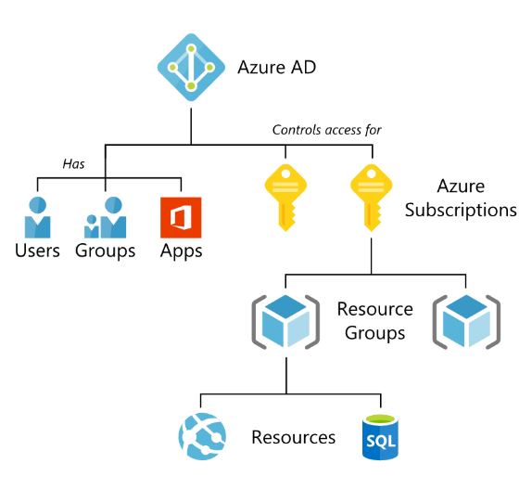
Security Granularity with RBAC
Big Ideas
Limit the scope of access when creating access for service principals
Scope can be limited to the resource itself
Many assign the scope to the Resource group, then assign very specific Azure Roles that preclude access to other resources in the group

Slide 6
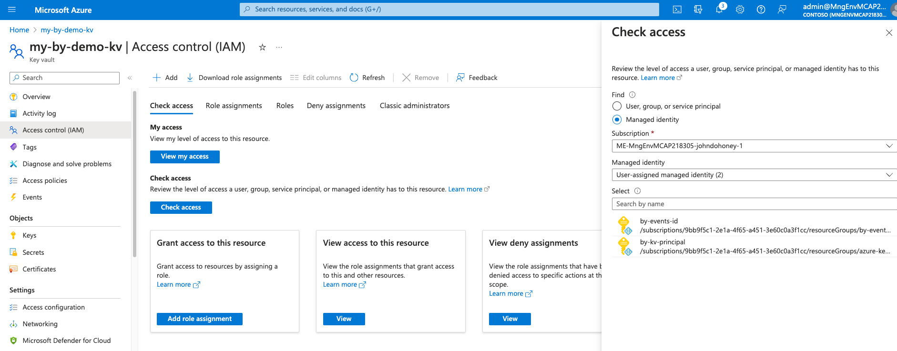
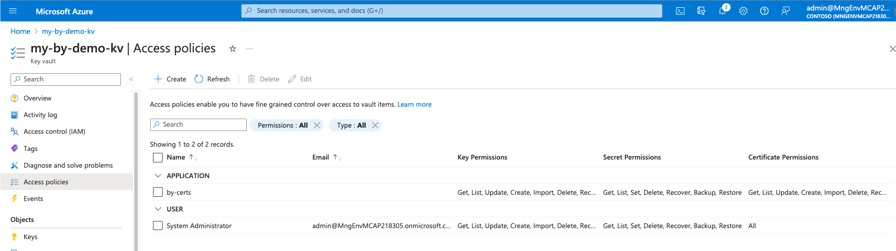
Key Vault access with Users and Managed Identities
Every Azure Resource has “Access Control”
Roles can be granted to users, groups and Managed Identities
Managed Identities, when granted access by the resource in question requires no further authentication
Key Vaults have very specific “Access Policies” that can be assigned to Service Principals “Applications” or Users

Slide 7
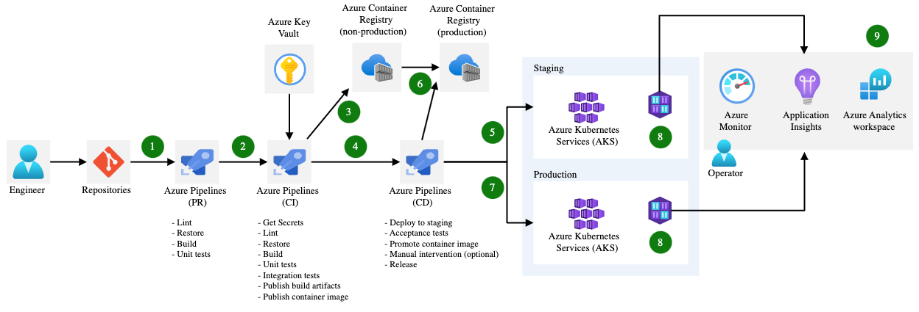
Key Vault in Action – Provide Secrets in CI/CD Operations
Secrets/Keys/Certs can be accessed as part of CI/CD operations with:
Github Actions
AzDo Pipelines

Slide 8
Key Vault in Action – Provide Secrets in CI/CD Operations
name: Azure Login and Key Vault Access
on:
push:
branches:
- main
jobs:
build:
runs-on: ubuntu-latest
steps:
- name: Checkout code
uses: actions/checkout@v2
- name: Login to Azure
uses: azure/login@v1
with:
creds: ${{ secrets.AZURE_CREDENTIALS }}
- name: Get secrets from Azure Key Vault
id: getsecrets
uses: azure/get-keyvault-secrets@v1.2
with:
keyvault-name: my-by-demo-kv
secrets: 'sql-connection-string'
- name: Set Connection String in Web App
run: |
az webapp config connection-string set \
--resource-group azure-key-vault-demo-BY \
--name Blue-Yonder-Luminate \
--connection-string-type SQLAzure \
--settings DefaultConnection=${{ steps.getsecrets.outputs.sql-connection-string }}
Sample GitHub Actions secret access for database configuration in an Application Deployment

Slide 9
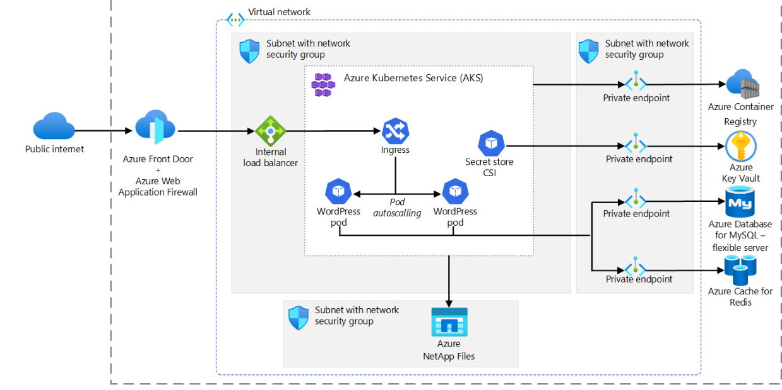
Key Vault in Action – Provide Secrets through AKS CSI Driver to AKS Container Apps
Azure Key Vault can be access from AKS with Container Storage Interface (CSI) Drivers
Reference: Use the Azure Key Vault Provider for Secrets Store CSI Driver for Azure Kubernetes Service (AKS) secrets - Azure Kubernetes Service | Microsoft Learn

Slide 10
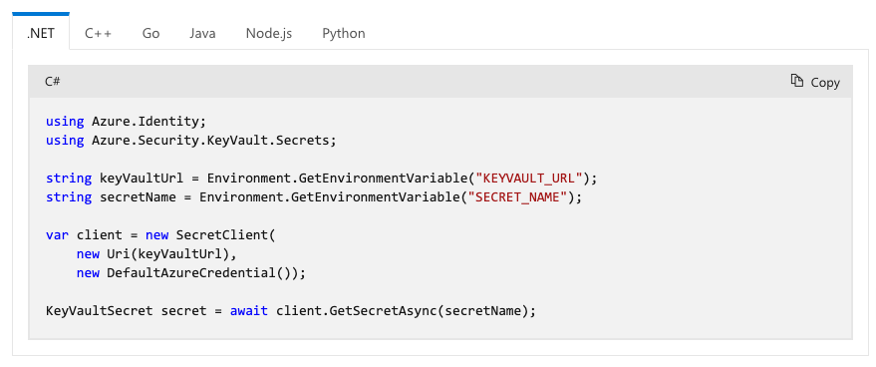
Key Vault in Action – Development Level SDK support
Six (6) Language Level Azure Key Vault Clients
Similar support for Microsoft Authentication Library (MSAL)

Slide 11
Demo – Azure Portal
Add a Secret: To add a secret, click on the “Secrets” tab in your Key Vault instance and click on the “+ Generate/Import” button. You can then provide a name and value for your secret and choose the secret type. You can also configure the secret’s activation and expiration dates and define who can access the secret.
Add a Key: To add a key, click on the “Keys” tab in your Key Vault instance and click on the “+ Generate/Import” button. You can then choose the key type and provide a name for your key. You can also configure the key’s activation and expiration dates, and define who can access the key.

