Slide 1
Azure API Management
Focus on Policies, Authorization, and Products
Presented By
John Dohoney, Sr CSA

Slide 2
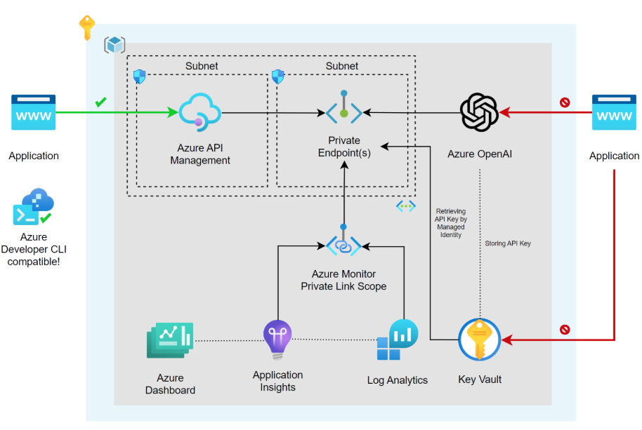

Slide 3
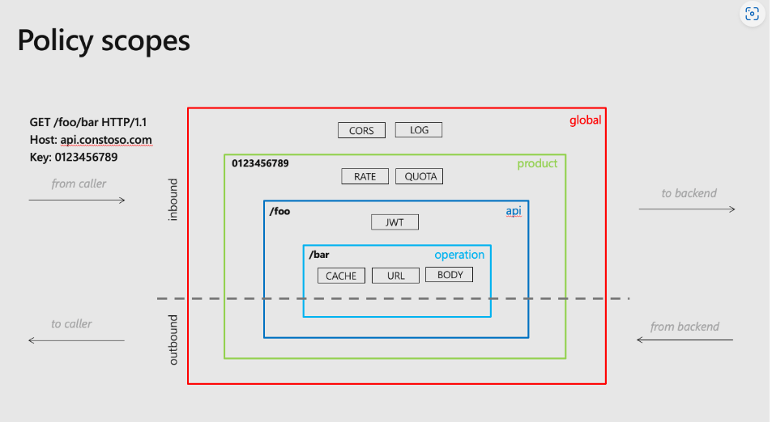
API Policies
Does not affect your code
Should Be under configuration management
  Revision/Version Points
Upstream of API’s
  Processed
    Just before API Invocation
    Right after API Invocation
4 Scopes with APIM Policies
  Global
  Product
  API
  Operation

Slide 4
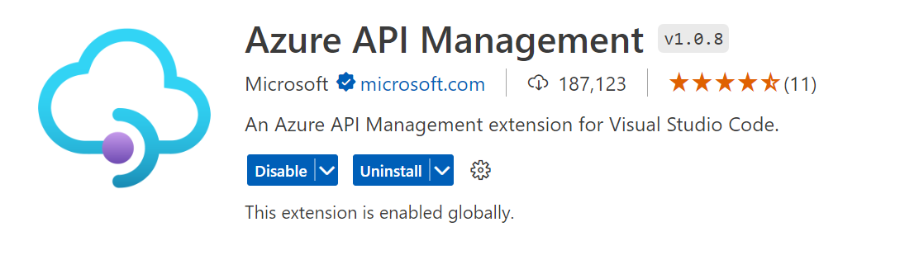
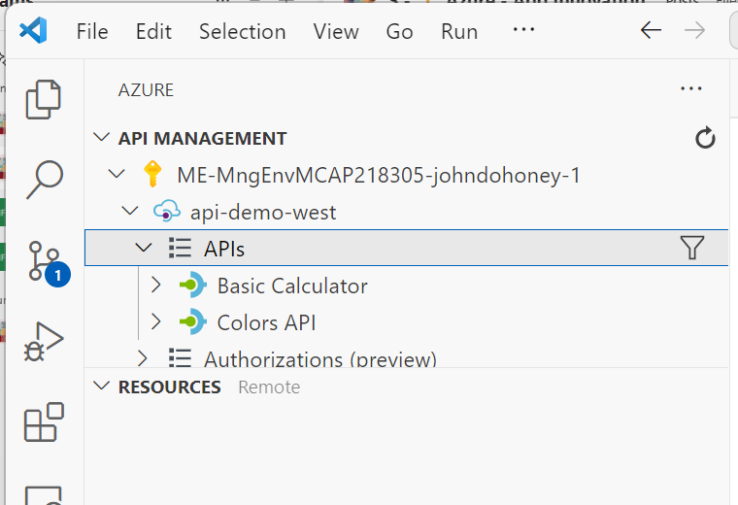
Policy Development
Visual Studio Extensions for Azure APIM
  Performs common management operations on your Azure API Management service instances without switching away from Visual Studio Code.

Slide 5
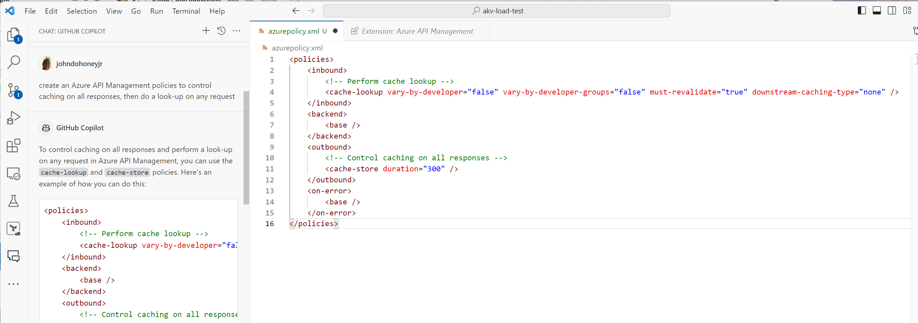
Policy Development – GitHub CoPilot
CoPilot Knows Azure APIM Policies
Custom policies are C# Code
CoPilot Chat is great with Novice Users to APIM Policy

Slide 6
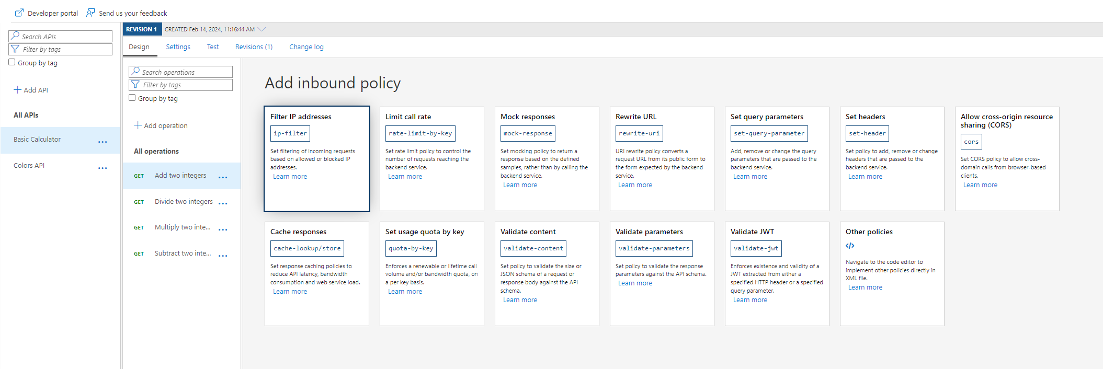
Policy Development – Built-in Policies
Built-In Policies are Ready to go
Github Repo - Azure/api-management-policy-snippets: Re-usable examples of Azure API Management policies (github.com)

Slide 7
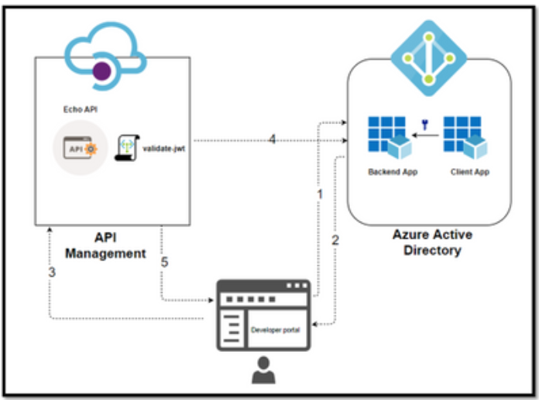
AUTHN/AUTHZ in APIM – Front End
Open API – No Authentication
  API Key (Subscription Key)
    Option to add key on a “Per API” Basis
Client Certificates
  Policy expressions can test for valid certificates
IP Filtering
  Restrict IP/Ranges using IP Filter Policy
OAuth2 – JWT tokens
  Built-In JWT Policy
    Allows designer to select claims to validate against
Notes:
OAUTH 2.0 is the open standard for access delegation which provides client a secure delegated access to the resources on behalf of the resource owner
1. The Developer Portal requests a token from Azure AD using app registration client id and client secret.
2. In the second step, the user is challenged to prove their identity by supplying User Credentials.
3. After successful validation, Azure AD issues the access/refresh token.
4. User makes an API call with the authorization header and the token gets validated by using validate-jwt policy in Azure API Management by Azure AD.
5. Based on the validation result, the user will receive the response in the developer portal.
Different OAuth Grant Types​:
Authorization Code
Implicit
Client Credentials
Resource Owner password Credentials
Authorization Code
It is the most used grant type to authorize the Client to access protected data from a Resource Server.
Used by the secure client like a web server.
Implicit
It is intended for user-based clients who can’t keep a client secret because all the application code and storage is easily accessible.
Used by the client that can’t protect a client secret/token, such as a mobile app or single page application.
Client Credentials
This grant type is non interactive way for obtaining an access token outside of the context of a user.
It is suitable for machine-to-machine authentication where a specific user’s permission to access data is not required.
Resource Owner password Credentials
It uses the username and the password credentials of a Resource Owner (user) to authorize and access protected data from a Resource Server.
For logging in with a username and password (only for first-party apps)

Slide 8
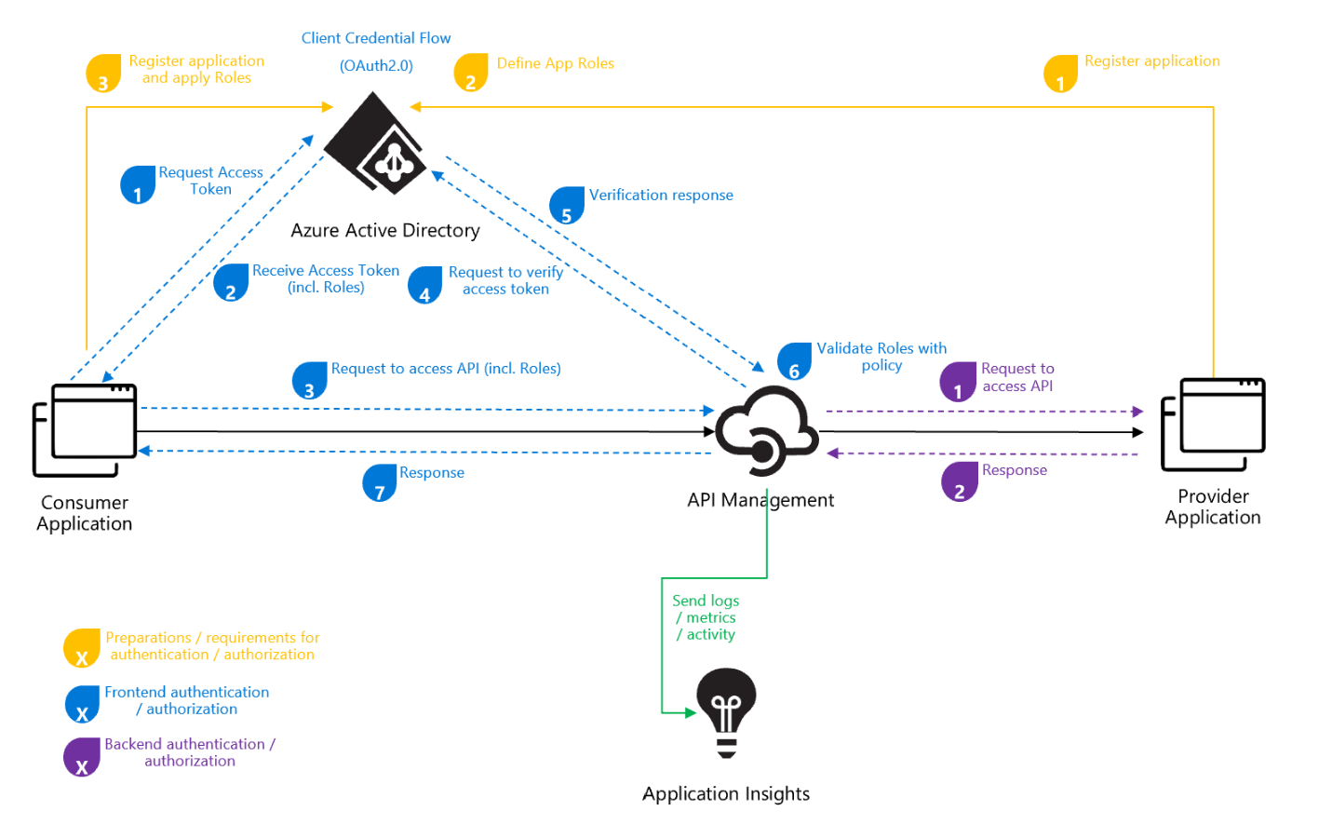
OAUTH – Client Credential Grant

Slide 9
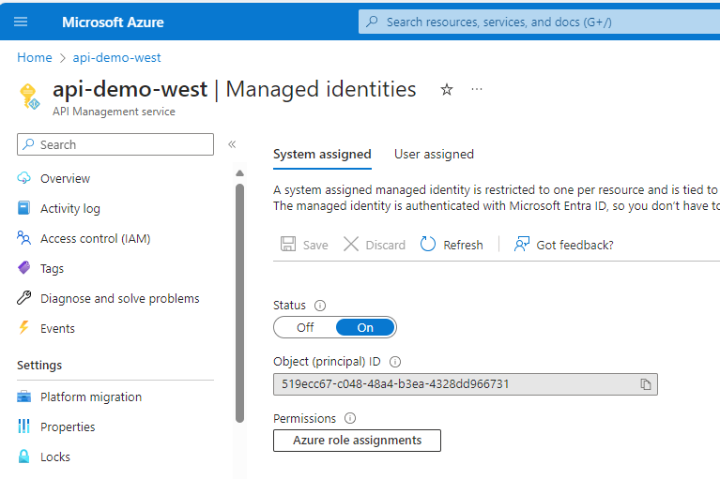
AUTHN/AUTHZ in APIM - Backend
Managed Identity
  Azure Resources can enable Managed Identity
  Access controlled with RBAC
  Password less
2-Way SSL (mTLS)
  Can be used for your own microservices in private AKS cluster

Slide 10
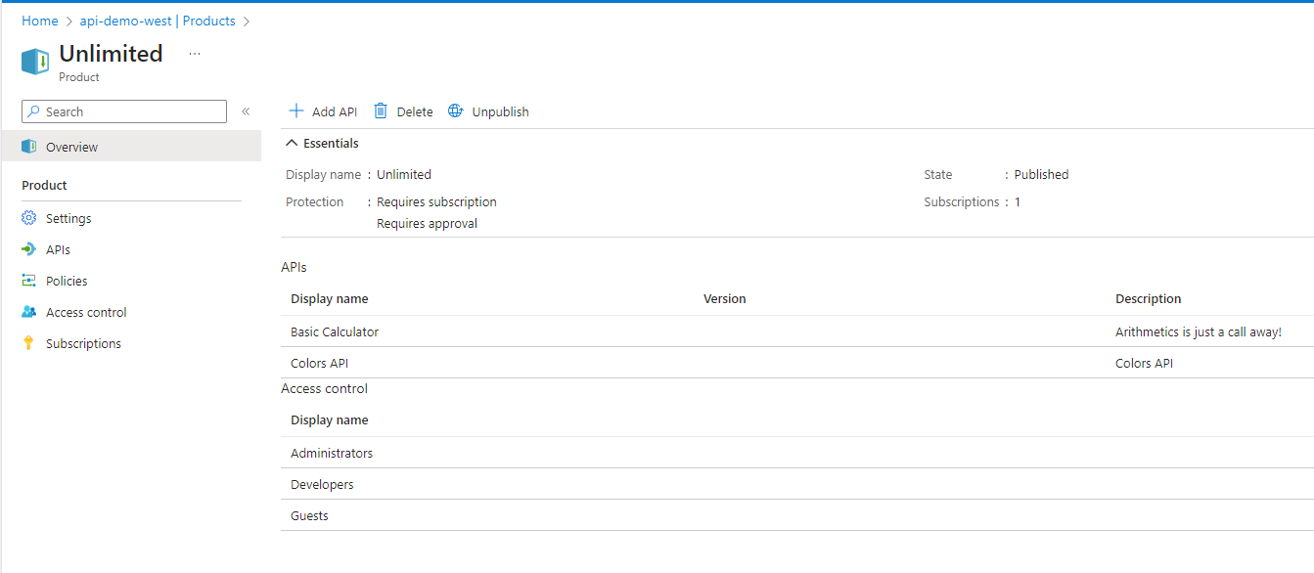
APIM Products
Azure API Management (APIM) products are collections of APIs that are grouped together and surfaced to developers
API Collection: Products in Azure APIM contain one or more APIs
  This allows for a logical grouping of APIs that can be managed and published together.
Usage Quota & Terms of Use: Each product can have a usage quota and terms of use
  This allows for control over how the APIs within a product are used.
Subscription: Developers can subscribe to a product and begin to use the product’s APIs.
  This subscription can be open (free to consume) or protected (requires a subscription key)
Publication: When a product is ready for use by developers, it can be published.
  This makes the APIs within the product available for consumption.
API Access: If a product is open, a subscription key isn’t required to access the product’s APIs
  If a product is protected, a subscription key is required

Slide 11
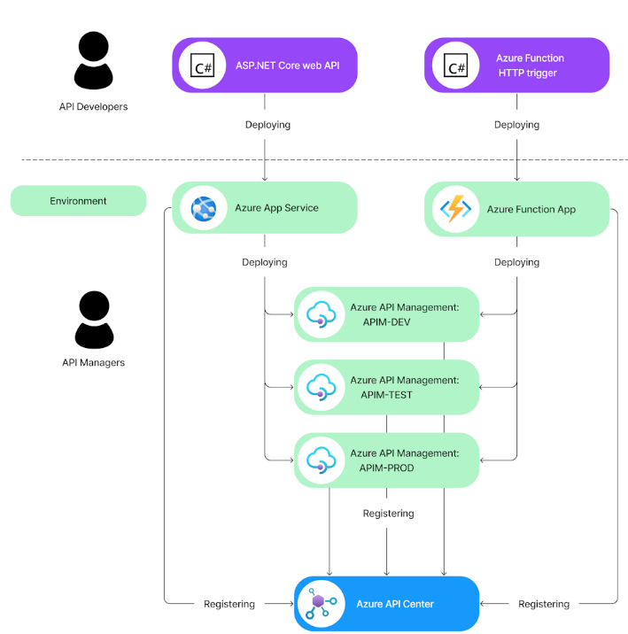
Azure API Center
API Center is a solution for organizations to catalog and manage their API inventory
Create and maintain an organizational inventory
  Organizations can build a complete inventory of APIs available in their organization. Foster communication and let API program managers and developers collaborate for increased API reuse, quality, security, compliance, and developer productivity.
Govern your organization's APIs
  With more complete visibility into the APIs being produced and used within an organization, API program managers and IT administrators can govern this inventory to ensure it meets organizational standards by defining custom metadata to enforce governance.
Easy API discovery
  Organizations want to promote API reuse to maximize developer productivity and ensure developers are using the right APIs. API Center helps program managers and developers discover the API inventory and filter using built-in and custom metadata properties.
Accelerate API consumption
  Maximize developer productivity when consuming APIs and ensure they are consumed in a secure manner consistent with organizational standards.

