Slide 1
Stock price prediction using Artificial Neural Networks
GroupID: 22
Supervisor: Jagdish Patra
Student: Ngoc Khanh Nguyen - 4957059

Slide 2
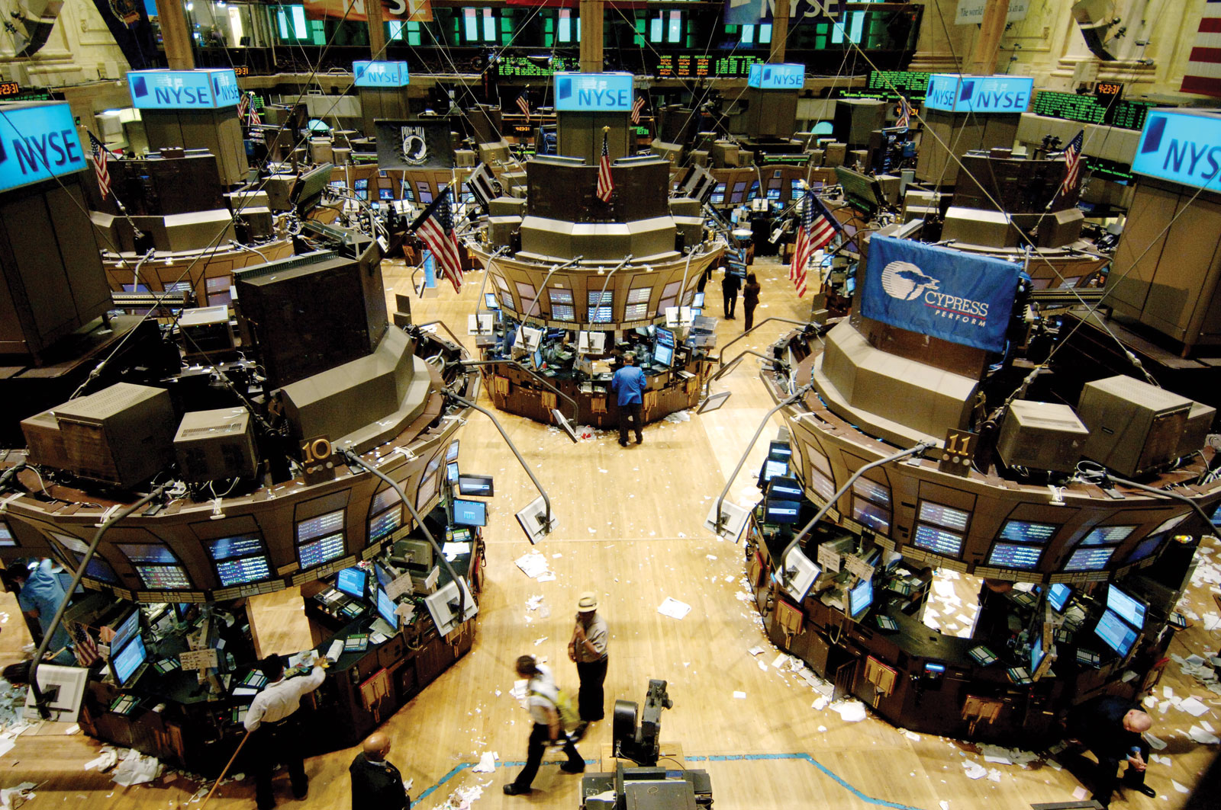
Stock Market
An pivotal part of the economy
Attract and allocate resources
Fuel productivity of industry
A great place to earn money
Notes:
How this can be improved: Creating a module which can read the numbers remotely
Other options: Flow water meter or replace a new smart water meter which will disturb the design of the current water meter. Our plan is to design a device which is mounted on top of the current water meter => lower cost...

Slide 3

Motivation
Make wiser decision
Make profitable investment
Plan trading strategy
When to buy?
When to sell?
When to hold?
Earn tons of money in stock market

Slide 4
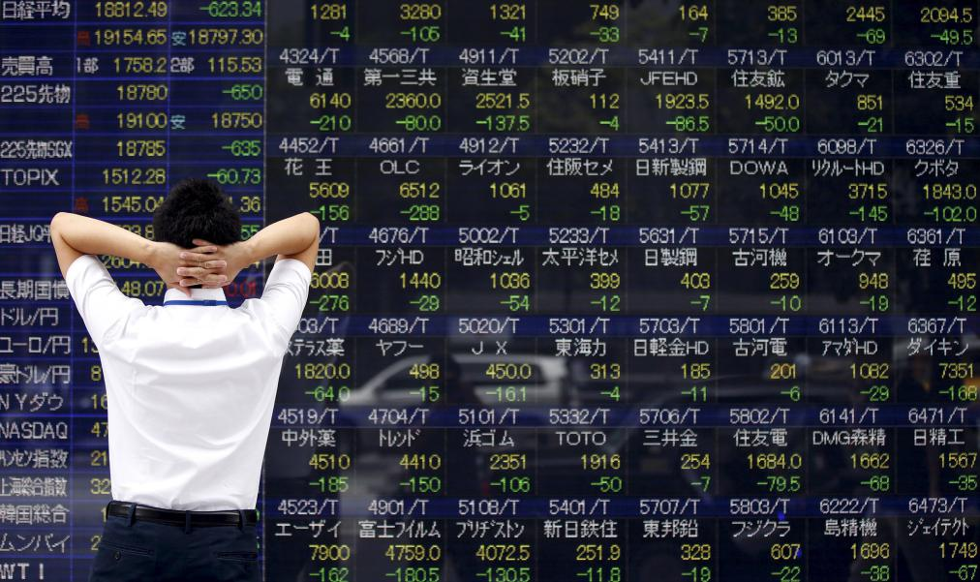
Difficulties
Involve many factors
Macroeconomic:
Bank rate
Inflation rate
Government policies
……….
Microeconomic:
Supply and demand.
Investor sentiments
Company growth and performances
……..
Unexpected events
Many factors are not qualitative

Slide 5
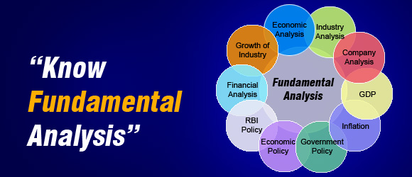
Fundamentals Analysis
Evaluate company conditions, performance and credibility
Study related economic, financial factor
Notes:
My task for this project is based around the housing design and securing the device from tampering and theft. My plan is to take something like the image in the top left, and with the aid of solidworks 3D print an enclosure similar to that shown in the bottom two images how house a camera, the microprocessor and energy control and storage particulars. The case needs to be weatherproof, with a design that fits on many different meters and is tamper proof as the device is being placed outside and may interest naughty parties

Slide 6
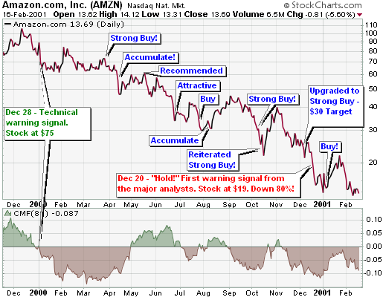
Time series forecasting
Study stock trend movements
Analyse past time series of stock price

Slide 7
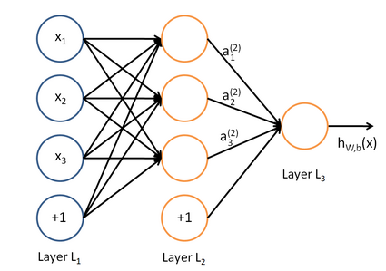
Machine learning and Data mining
Analyse both company performance and past stock price
Discover and extract hidden pattern in data

Slide 8
Objectives
Goal: construct a neural network based model to predict future closing price of companies in retail and technology sector over specific time horizons with high accuracy
Objective 1: Understand the characteristics of the target stocks
Objective 2: Construct the appropriate neural network architectures
Objective 3: Specify evaluation metrics to determine the performance of the model

Slide 9


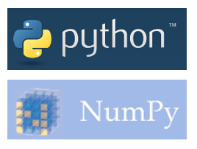
Methodology
Toolbox: Python and Tensorflow
Data collection: Yahoo finance
Model development
Functional link artificial neural network (FLANN)
Multilayer perceptron (MLP)
Recurrent neural network (RNN)
Performance evaluation
Root mean squared error (RMSE)
Mean absolute error (MAE)

Slide 10
Future Work and Extension
Real-time prediction model
Automatic trading strategy planner

Slide 11
Thank you for listening

