Slide 1





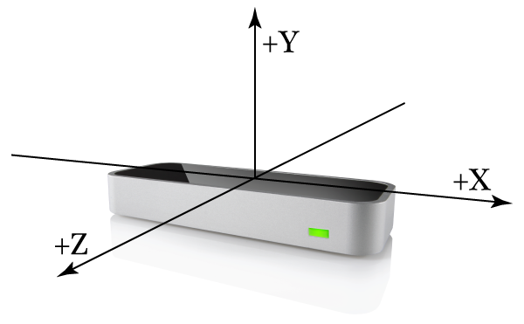
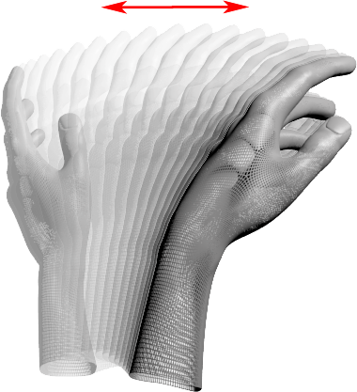
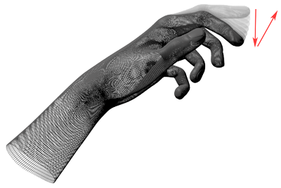

uper
onductor
Sound Capstone
Winter 2014
Usage
Goal
SuperConductor allows the interaction and manipulation of MIDI music with motion gestures through the leap motion controller in real time.
This allows people with little to no musical background to play with their music – without needing to learn complex audio editing software.
Change Control
Description
Pitch
Screenshot
Volume
Tempo
Precise Control Edit
Conduct Tempo
Special Control
(Hold)
Edit Control
(Hold)
Future Work
Additional features that would be interesting to add in the future are:
Ability to save changes to a song so users can share their creations with others.
Support for standard audio formats like mp3
Ability to create music from scratch, or add to existing songs.
Control Change:
W – Up, S - Down
Track Change:
A – Down, D - Up
Restore Default

