Slide 1
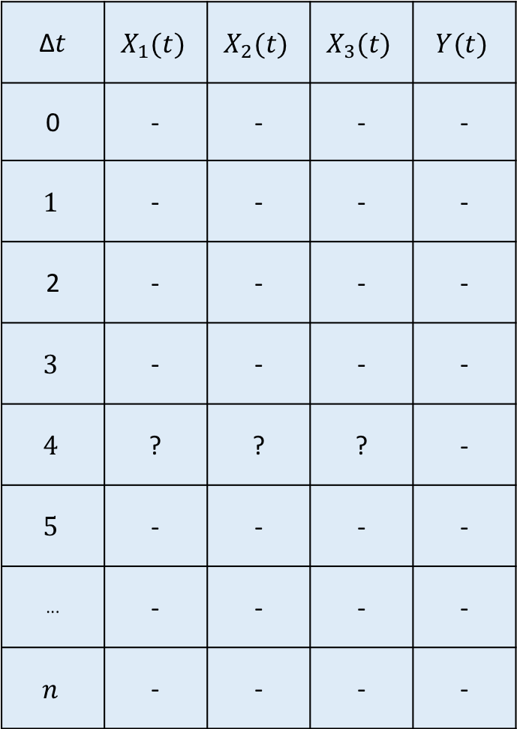
∆$t$ | $$X_{1}(t)$$ | $$X_{2}(t)$$ | $$X_{3}(t)$$ | $$Y(t)$$
0 | - | - | - | -
$$1$$ | - | - | - | -
2 | - | - | - | -
$$3$$ | - | - | - | -
$$4$$ | ? | ? | ? | -
$$5$$ | - | - | - | -
··· | - | - | - | -
$$n$$ | - | - | - | -
This is the window for the prediction of T(t + window)
These are the timestamp where the prediction will be done. This is how we give the information of irregular time series to our models.
W
$$y\left(w+r\right)=f(t_{0},…,t_{w},X_{i,0}, …,X_{i,w},t_{w+r},Y_{w+r})$$
(1)
r
$$y\left(w+r\right)=f(t_{0},…,t_{w},X_{i,0}, …,X_{i,w},Y_{0}, …,Y_{w},t_{w+r},Y_{w+r})$$
(2)

