Slide 1
w
r
Y(t)
Window
sliding
t-4
t-3
t-2
t-1
t
t+1
t+2
w
r
Y(t)
t-4
t-3
t-2
t-1
t
t+1
t+2

Slide 2
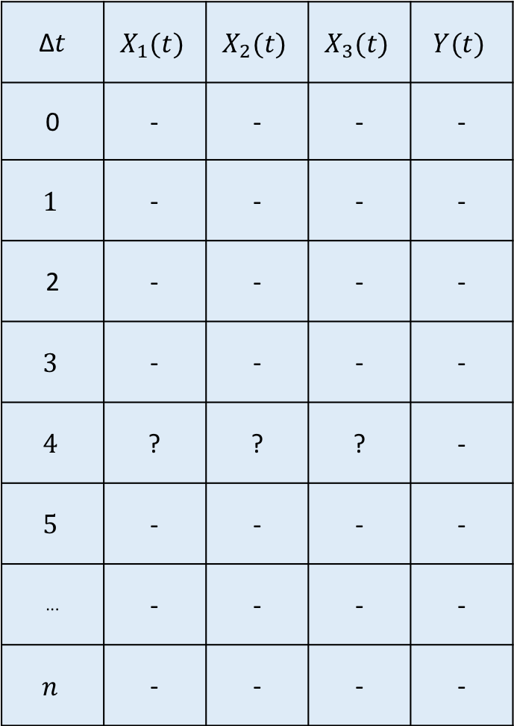
∆$t$ | $$X_{1}(t)$$ | $$X_{2}(t)$$ | $$X_{3}(t)$$ | $$Y(t)$$
0 | - | - | - | -
$$1$$ | - | - | - | -
2 | - | - | - | -
$$3$$ | - | - | - | -
$$4$$ | ? | ? | ? | -
$$5$$ | - | - | - | -
··· | - | - | - | -
$$n$$ | - | - | - | -
This is the window for the prediction of T(t + window)
These are the timestamp where the prediction will be done. This is how we give the information of irregular time series to our models.
W
$$y\left(w+r\right)=f(t_{0},…,t_{w},X_{i,0}, …,X_{i,w},t_{w+r},Y_{w+r})$$
(1)
r
$$y\left(w+r\right)=f(t_{0},…,t_{w},X_{i,0}, …,X_{i,w},Y_{0}, …,Y_{w},t_{w+r},Y_{w+r})$$
(2)

Slide 3
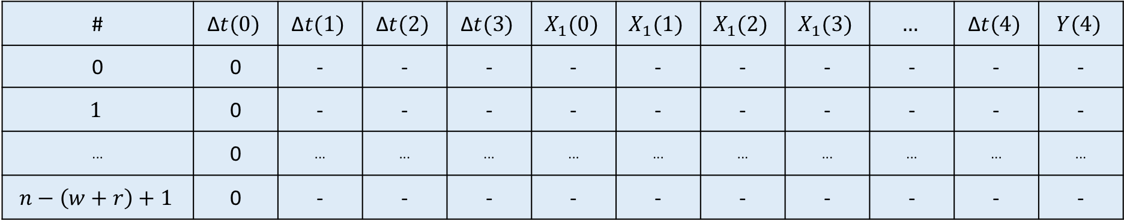
# | $$\text{∆}t(0)$$ | $$\text{∆}t(1)$$ | $$\text{∆}t(2)$$ | $$\text{∆}t(3)$$ | $$X_{1}(0)$$ | $$X_{1}(1)$$ | $$X_{1}(2)$$ | $$X_{1}(3)$$ | $$…$$ | $$\text{∆}t(4)$$ | $$Y(4)$$
0 | 0 | - | - | - | - | - | - | - | - | - | -
$$1$$ | 0 | - | - | - | - | - | - | - | - | - | -
··· | 0 | ··· | ··· | ··· | ··· | ··· | ··· | ··· | ··· | ··· | ···
$$n−\left(w+r\right)+1$$ | 0 | - | - | - | - | - | - | - | - | - | -

