Slide 1
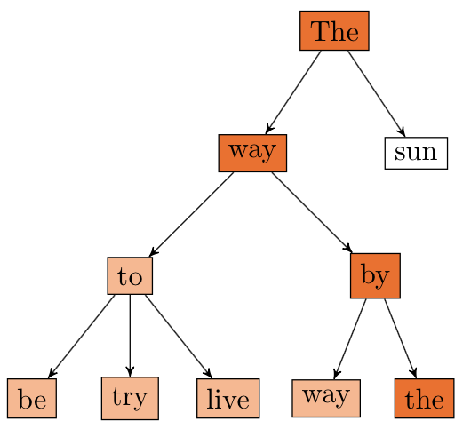
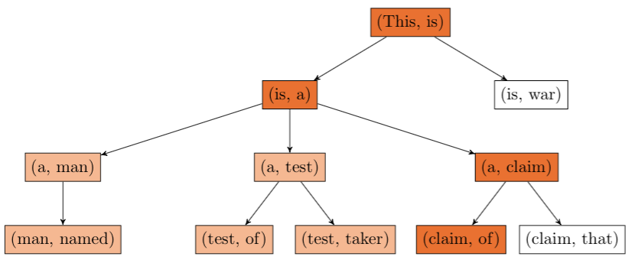
POETWRITER:
A CORPUS-BASED GENERATIVE MODEL
Mathieu Rolfo, Shalom Rottman-Yang, Nathan Tindall
CS221 Final Project, Fall 2014
PROBLEM DEFINITION
Our goal is to develop a framework designed to generate novel poetry based upon corpus data.
APPROACHES: CONTENT & FORM
For content production, we have relied on a n-gram model in order to find dependencies between words. The n-gram model has been tweaked in order to capitalize on corpus data.
For form congruency, our working algorithm performs a state based depth first search over the n-gram model. The state of the model is a (poem, seed) tuple representing the current state of the form and content of the poem, respectively. Syllabic and rhyming constraints, as well as the corpus to be used for generation are defined at runtime. Our algorithm performs action pruning in order to disregard states that break syllabic and rhyme constraints, and breaks ties among successors by choosing the more frequent successor. Rhyming constraints are imposed by a propagator-receiver framework in which end-line constraints are imposed in the forwards direction after a rhyme-propagating rhyme is completed. For example, if lines 0 and 1 are designated to rhyme, then after the search has completed line 0, the rhyming constraint is propagated forwards onto line 1 (the receiver). This facilitates forward motion but also allows the algorithm to backtrack when it gets stuck.
MOTIVATION
Poetry is one of the most expressive ways to use verbal language. It is notoriously difficult for humans to produce, and the study of what delineates “good” and “bad” poetry has been a vibrant academic field for most of recent history. Poetry is unique in that both content and form contribute to its aesthetic value.
CHALLENGES
How to impose rhyming constraints during generation
How to impose syllabic constraints during generation
How to determine if two words rhyme
How to determine the number of syllables in the word
Improving runtime (directing generation)
RESULTS
See below for two example poems produced.
ANALYSIS
n = 1
n = 2

