Slide 1
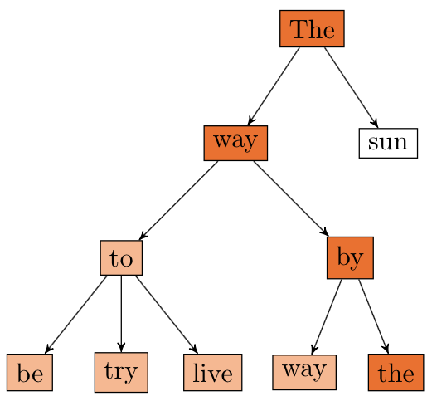
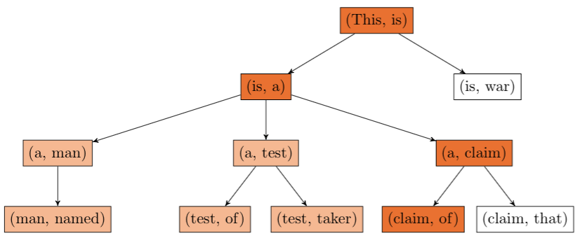
POETWRITER:
A CORPUS-BASED GENERATIVE MODEL
Mathieu Rolfo, Shalom Rottman-Yang, Nathan Tindall
CS221 Final Project, Fall 2014
PROBLEM DEFINITION
Our working goal throughout the duration of the project has been to develop a framework designed to generate novel poetry based upon corpus data.
CHALLENGES
Principal among challenges we faced during development were formalizing the rhyme and syllabic constraints on two fronts (1) how to incorporate these constraints into the model in order to prune away invalid branches, (2) how to evaluate the number of syllables in a word, (3) how to determine if two words rhyme, and (4) limitations of corpora.
is solved by a propagator-receiver framework in which end-line constraints are imposed in the forwards direction after a rhyme-propagating rhyme is completed. For example, if lines 0 and 1 are designated to rhyme, then after the search has completed line 0, the rhyming constraint is propagated forwards onto line 1 (the receiver). This facilitates forward motion but also allows the algorithm to backtrack when it gets stuck.
Remains an open question in NLP that is auxiliary to the goal of our project, though somewhat limiting in our solution. We have experimented with a number of syllable-estimation techniques.
Similar to (2), though rhyme detection is crucial to the success of our model, its development is auxiliary to the success of our model. We have experimented with a number of syllable-estimation techniques, including the usage of an imported dictionary.
Unfortunately, the model does not always produce results, and this is primarily a result of corpora that do not feature rhyming pairs in their n-gram model. In order to solve this problem, we may be able to relax the way that words are selected in order to favor the selection of rhyming nouns, for instance, though it would detract from the character of the corpora used for generation.
MOTIVATION
Our project was motivated by a desire to use corpus data in order to produce novel text under systematic constraints. Poetry is one of the most expressive ways to use verbal language. It is notoriously difficult for humans to produce, and the study of what delineates “good” and “bad” poetry has been a vibrant academic field for most of recent history. Poetry is unique in that both content and form contribute to its aesthetic value. Creative computation researchers have performed word substitution on existing poems with the view that the syntactic structure of sentences contribute very little to the poem’s quality or meaning. Under these models, the topic of Shakespeare’s soliloquys can be transformed from “roses” to “water” using a semantic network to facilitate intelligent substitution, though these models have been unable to impose rhyming constraints on the poems. With the knowledge that other researchers were interested in poetry generation, we were very excited to instantiate our project, with particular interest in testing our model on unusual corpora, such as the aggregation of all lyrics from musical artists and legal documents, in an effort to see if the essence of these corpora could be distilled into some poetic form
n = 1
n = 2
RESULTS
See below for two example poems produced.
APPROACHES: CONTENT & FORM
For content production, we have relied on a n-gram model in order to find dependencies between words. The n-gram model has been tweaked in order to capitalize on corpus data.
For form congruency, our working algorithm performs a state based depth first search over the n-gram model. The state of the model is a (poem, seed) tuple representing the current state of the form and content of the poem, respectively. Syllabic and rhyming constraints, as well as the corpus to be used for generation are defined at runtime. Our algorithm performs action pruning in order to disregard states that break syllabic and rhyme constraints, and breaks ties among successors by choosing the more frequent successor. Examples of tree search over the n-gram model are above.
ANALYSIS
%HoW OFTEN DOES IT WORK? –n 2, -n 3? MAKE A TABLE HERE

