Slide 1
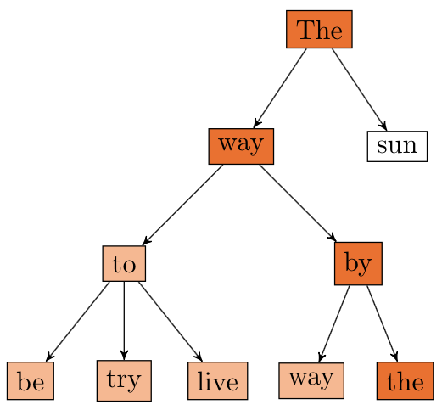
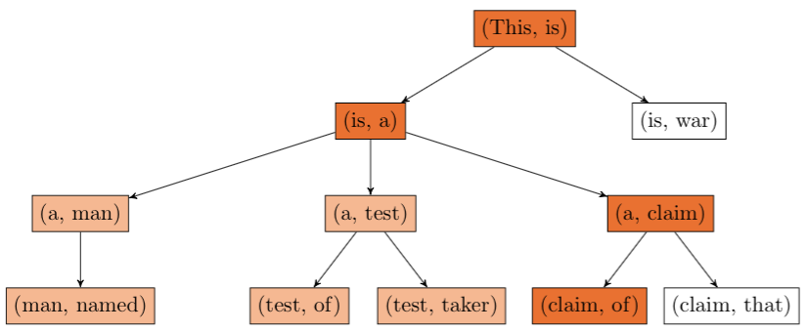
POETWRITER
:
A CONSTRAINT-BASED TEXT GENERATOR
Mathieu Rolfo, Shalom Rottman-Yang, Nathan Tindall
CS221 Final Project, Fall 2014
MOTIVATION
Poetry is one of the most expressive ways to use verbal language. Poems are notoriously difficult to produce, even for humans, and a poem’s content and form is highly dependent on its writer. It is an interesting challenge to produce original poetry that matches the qualitative constraints of style and the formal constraints of rhyme and meter.
PROBLEM DEFINITION
Our goal is to develop a text generator that produces original poetry given a body of previous work and constraints on poetic form.
CHALLENGES
Impose rhyming and syllabic constraints on output
Impart semantic meaning on output
Determine rhyming pairs
Determine syllabic structure
Minimize search space to improve runtime
RESULTS
See below for two example poems produced.
ANALYSIS
APPROACHES
Algorithm
The generation is represented as a depth-first search problem where search backtracks upon constraint violation.
Model
Our model is backed by a Poetry object, storing:
A list of Line objects, which store:
Number of completed syllables in the line
Other lines which it will rhyme with
The current Line
The number of completed Lines
Generation
The search problem is represented thus:
State: a (Poem, seed) tuple where the seed is the n-gram sequence
Goal state: any state with a fully completed Poem
Action: adding another word to the Poem
Successors: all states with a legitimate n-gram-generated word added to the Poem’s current Line
Cost: zero
Constraint
Within Line:
Each Line must contain a given number of syllables. This was imposed by a heuristic function that maps words to their IPA representation.
Between Lines:
Given pairs of Lines must end with rhyming words. This was imposed by a heuristic function that matches IPA suffixes.
n = 1
n = 2

