Slide 1
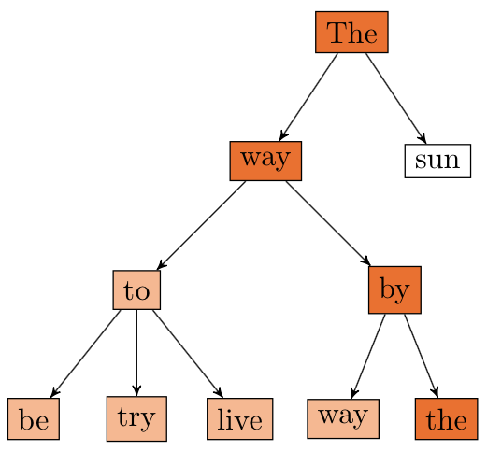
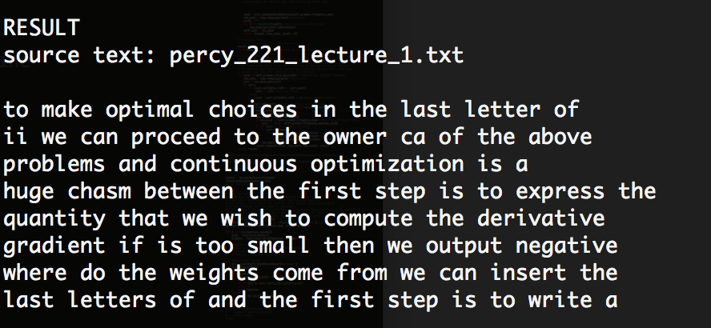
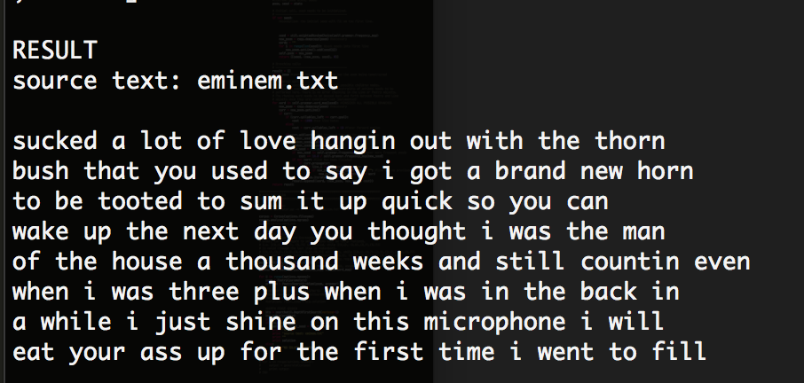
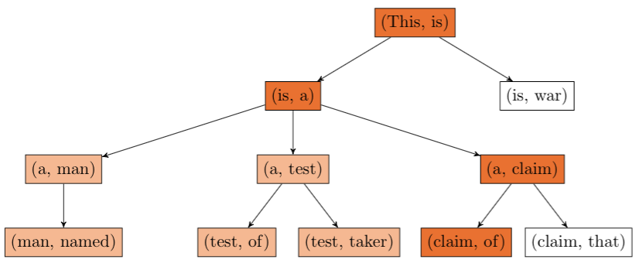

POETWRITER
:
A CONSTRAINT-BASED TEXT GENERATOR
Mathieu Rolfo, Shalom Rottman-Yang, Nathan Tindall
CS221 Final Project, Fall 2014
PROBLEM DEFINITION
Our goal is to develop a text generator that produces original poetry given a body of previous work and constraints on poetic form.
MOTIVATION
Poetry is one of the most expressive and notoriously difficult ways to use language. It is an interesting challenge to produce poetry that matches the qualitative constraints of style and the formal constraints of rhyme and meter.
CHALLENGES
Impose rhyming and syllabic constraints on output
Impart semantic meaning on output
Determine rhyming pairs
Determine syllabic structure
Minimize search space to improve runtime
n = 1
RESULTS
The corpora for these poems were the CS221 lecture note text outlines and Kanye West’s lyrics, scraped from rapgenius.com. Both utilize 3-grams.
APPROACHES
Algorithm
The generation is represented as a depth-first search problem where search backtracks upon constraint violation, where constraints are enforced within lines (syllables) and between lines (rhyming).
n = 2, Example Search Tree
ANALYSIS
Generation
The search problem is represented thus:
State: a (Poem, seed) tuple,
where seed is the n-gram sequence
Goal state: any state with a fully completed Poem
Action: adding another word to the Poem
Successors: all states with a legitimate n-gram-generated word added to the Poem’s current Line
Cost: zero
Model
Our Poetry object stores:
A list of Line objects, which store:
- Number of completed syllables
in the line
- Other lines it will rhyme with
The current Line
The number of completed Lines
Notes: Poems had 8 lines, 8 syllables, every two lines rhyme. Used simplified heuristics for rhyme and syllable count. Kanye has 47273 lines; Chance has 8678 lines. Scraped from RapGenius. Percent completed is percent w/ solution found. Semantic score was from 1-5. 1 is “no semantic meaning whatsoever”. 5 is “fully semantically meaningful”. Scores evaluated by current Stanford students.

