Slide 1
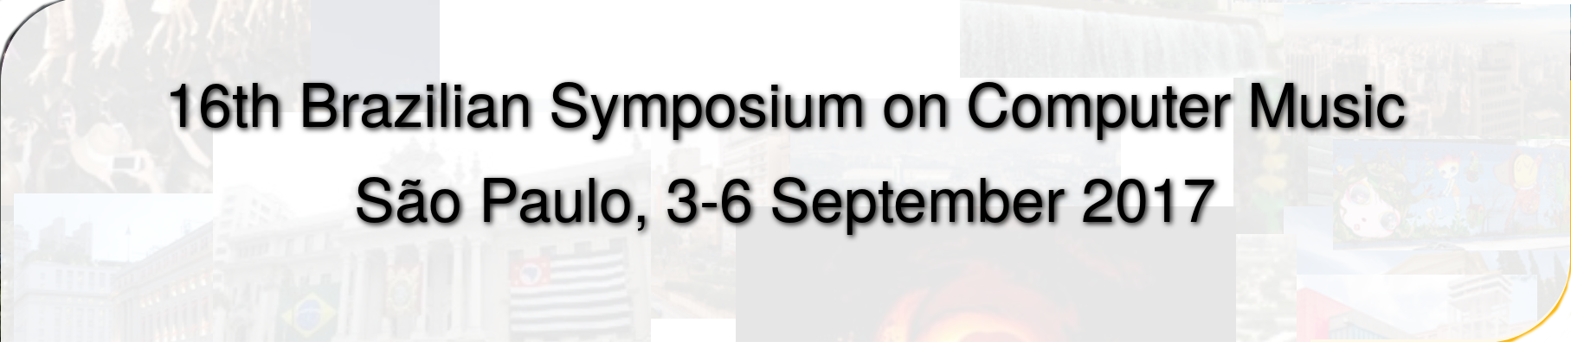

Cloning a physical modeling sound synthesizer using adversarial conditional autoencoders
Stephen Sinclair

Slide 2
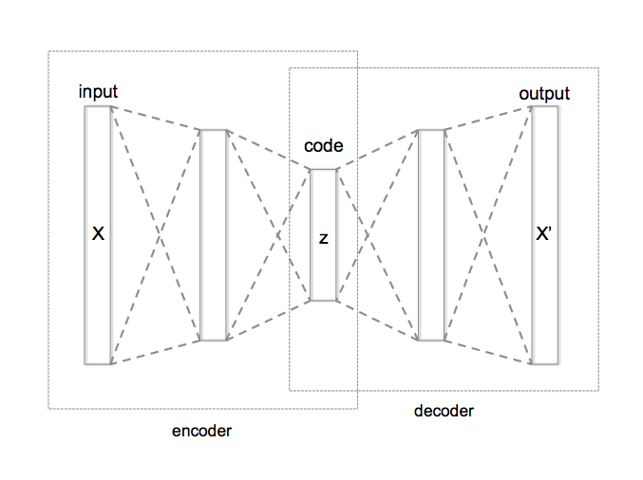
Autoencoder
A neural network that learns to recreate its input.
Data -> Code -> Data
Code = Latent parameter space
The bottleneck forces a compressed representation.

Slide 3
Conditional Autoencoder
Data+Parameters -> Code+Parameters -> Data
y
y

Slide 4
Conditional Autoencoder as Estimator
Data+Parameters -> Code+Parameters -> Data
y

Slide 5
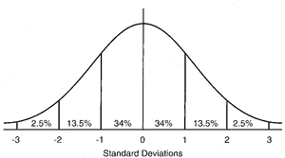
Adversarial Conditional Autoencoder
Data+Parameters -> Regularized Code+Parameters -> Data
y
such that z ~

Slide 6
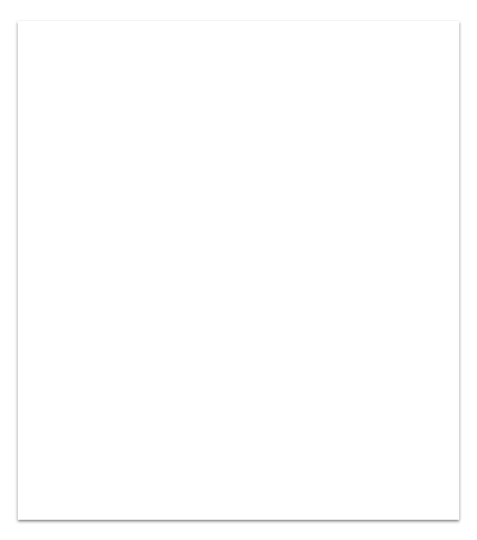
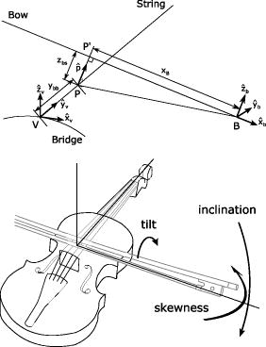
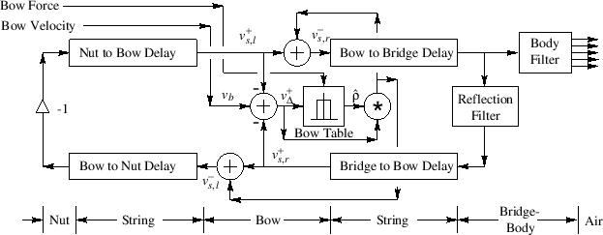
The Dataset
Needed a complex model with simple parameters: physical modeling audio synthesizer, e.g. the bowed string.
Restricted to two parameters
Position & pressure of bow; held constant: velocity, frequency.
Complex waveforms
Used 2 periods raw audio as input.
Stationary vs. Dynamic state
Some variance only explained by latent parameters. 2 datasets.
https://ccrma.stanford.edu/~jos/pasp/Digital_Waveguide_Bowed_String.html
btw, used in my thesis work: https://vimeo.com/29273593

Slide 7
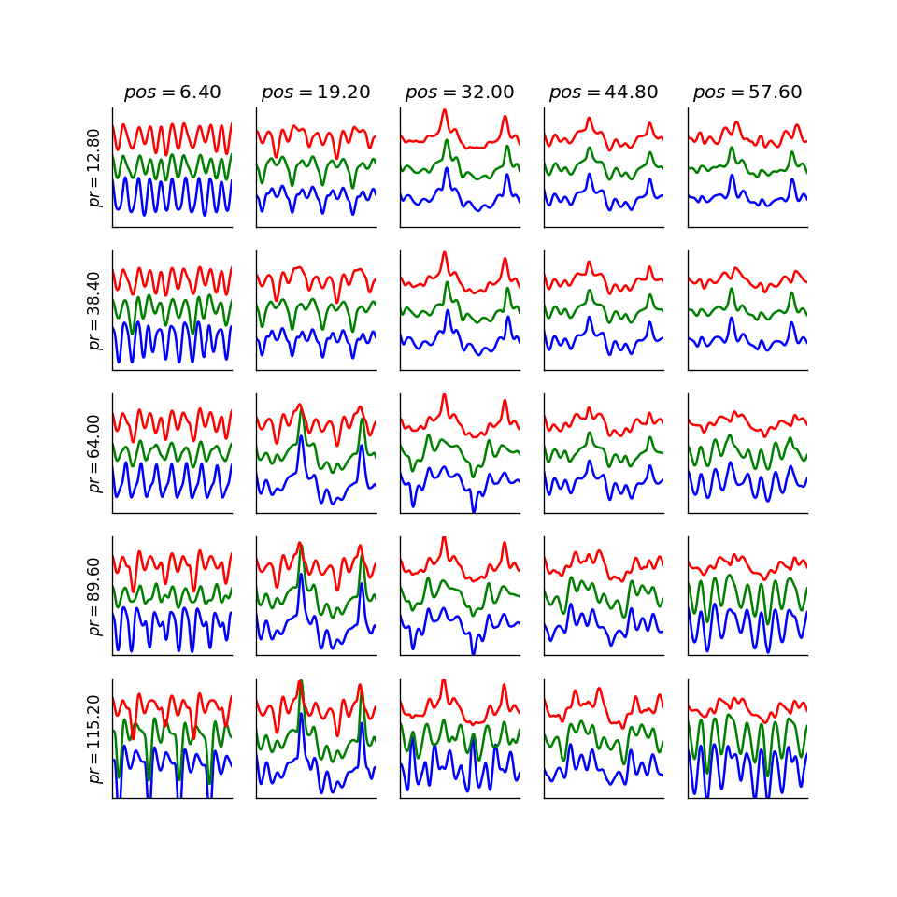
Resynthesis performance

Slide 8
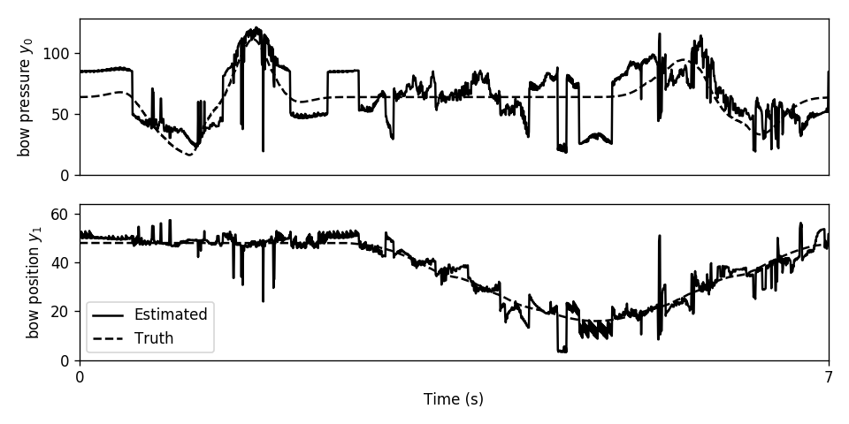
Copying the parameter-data relationship

Slide 9
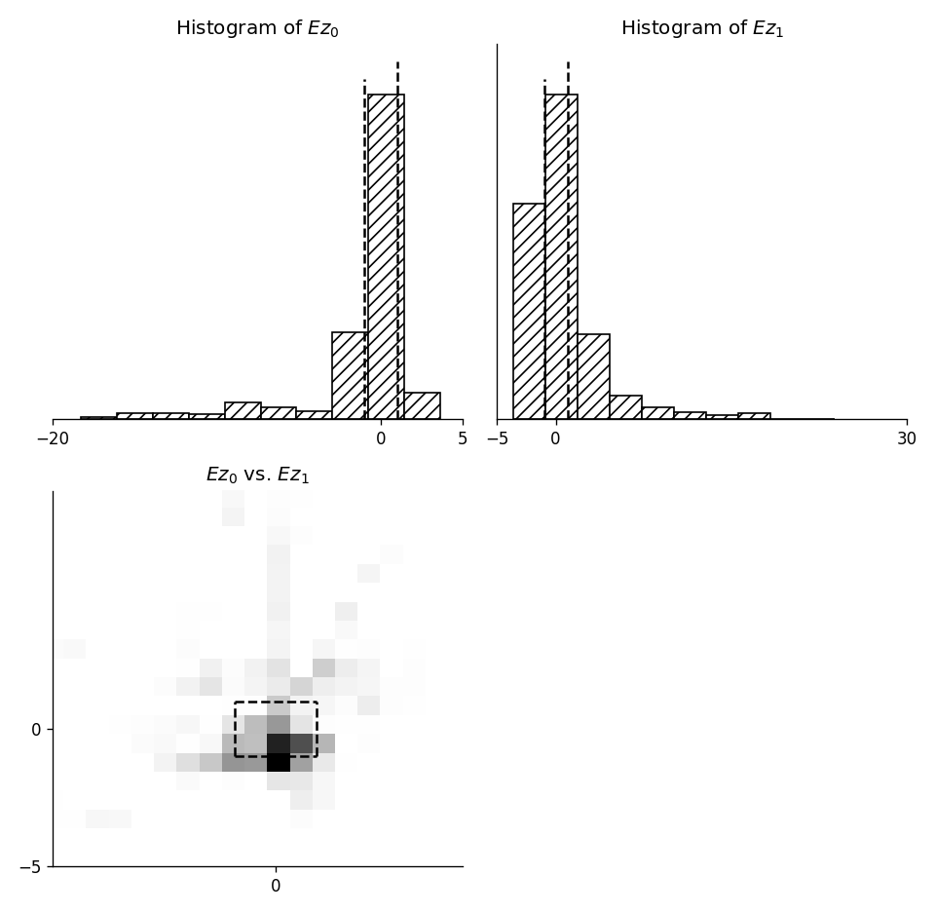
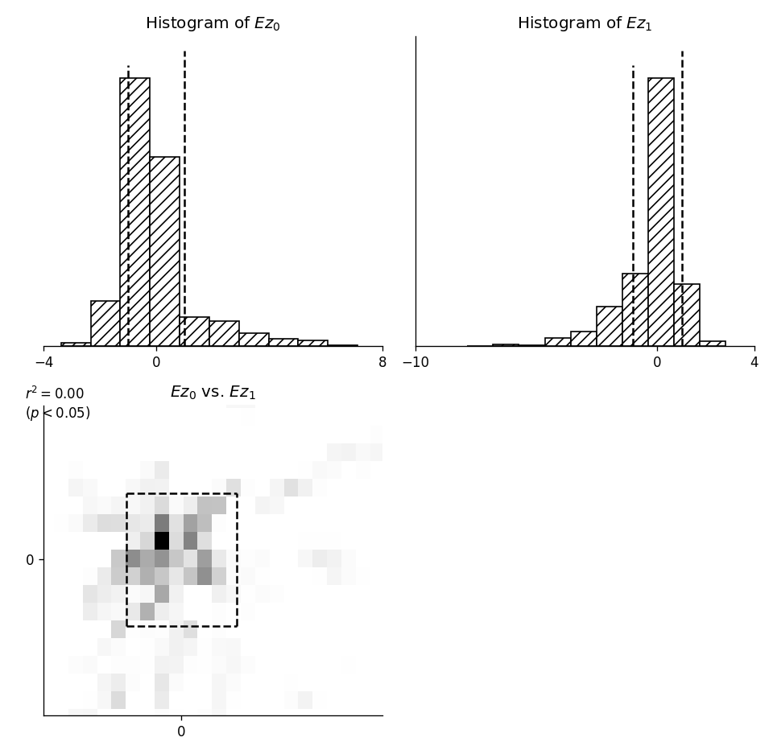
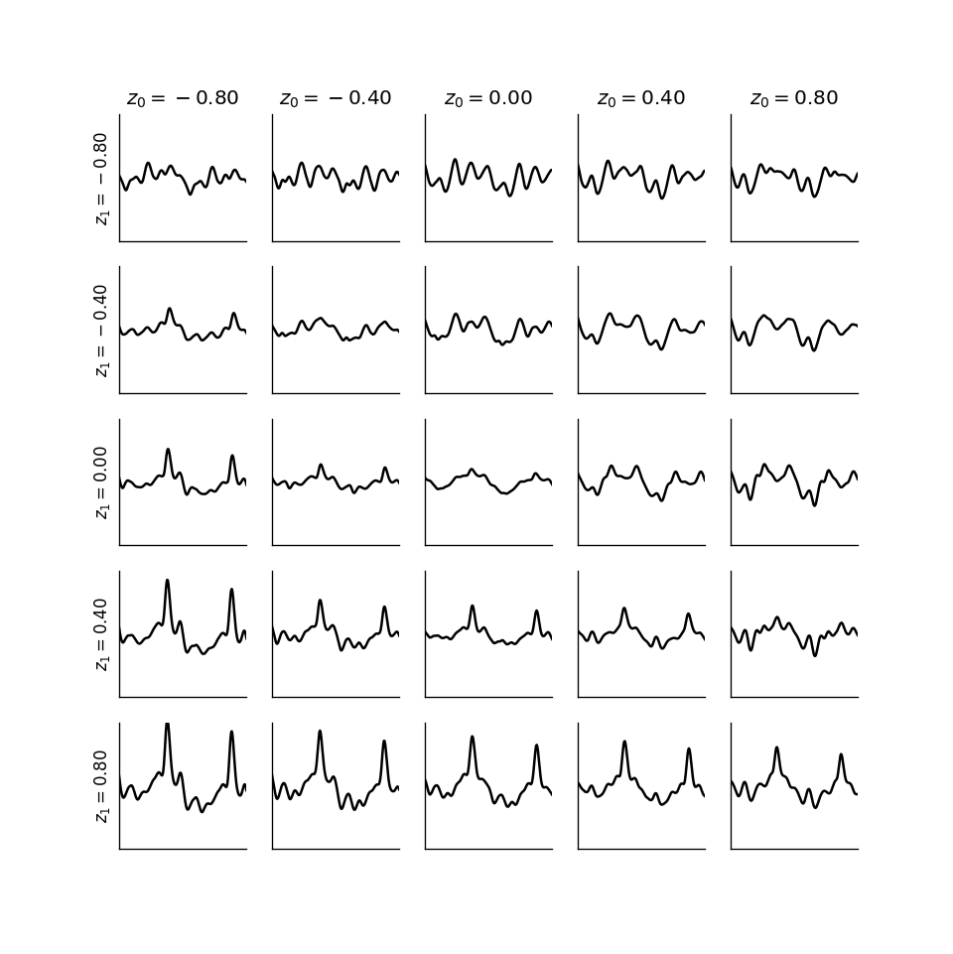
Regularization Interpolable z
The effect of regularization: restrict range, reducing “holes” and “arms” in the latent parameter space.

Slide 10
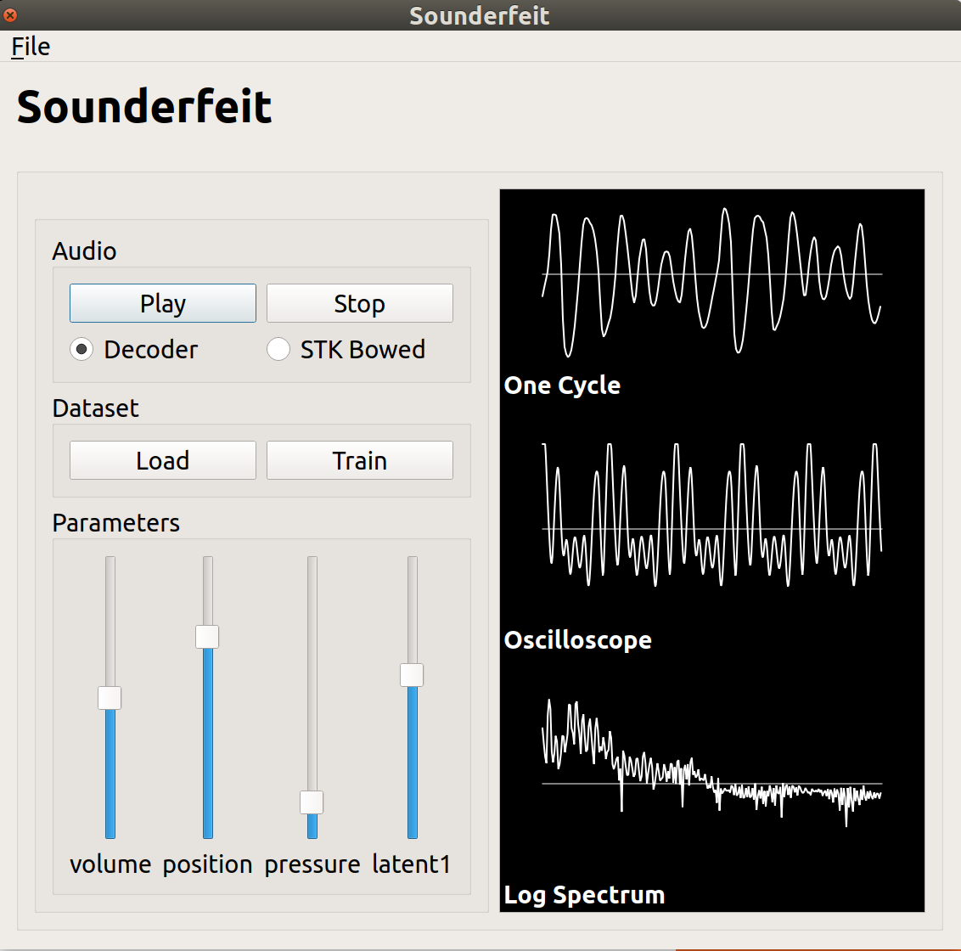
Real-time sound synthesis using a neural network:
2 periods = 200 samples decoder = 100×3 multiplies + 100 adds synthesis = half-window overlap-add
= No problem on current laptop.
In general this depends on the complexity of your dataset.
Demo time

Slide 11
Conclusion
Some final questions I will address:
Why?
Why use a black-box model when we have a perfectly good physical model?
Data-driven synthesis: capture real-life datasets, capture arbitrary synthesizers.
Drawbacks
Imperfect model, could be improved; does not capture dynamics except as latent parameters.
Difficulties: hyperparams, phase alignment

Slide 12
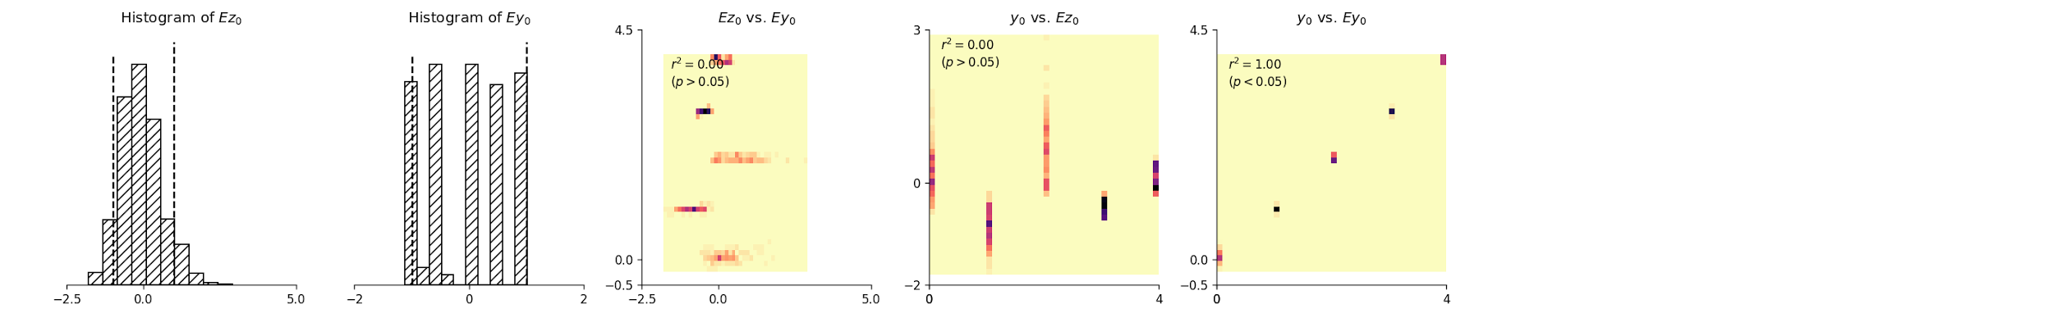
Thank you
¿Questions?
Code available at https://gitlab.com/sinclairs/sounderfeit
Vowel dataset

