Slide 1
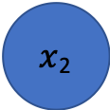
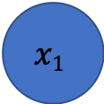
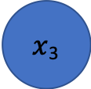
Question 2(h) – Dropout Regularisation
$$x1$$
$x$₂
$x$₃
0 output from dropped node

