Slide 1

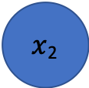
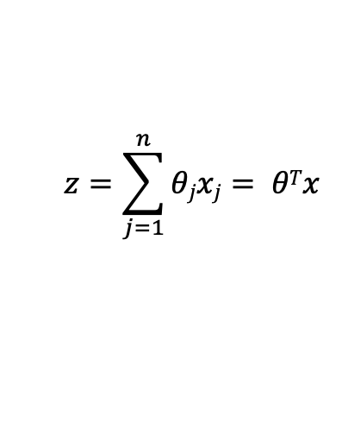
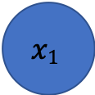


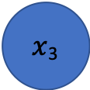
Question 1(a) – Basic Logistic Unit
$$x1$$
$x$₂
$$hθ(x)$$
$x$₃
$$z=\sum_{j=1}^{n}{θjxj}= θTx$$
Weighted Sum:
Activations:
$$a=h(z)$$
non-linear activation function $h$

