Slide 1

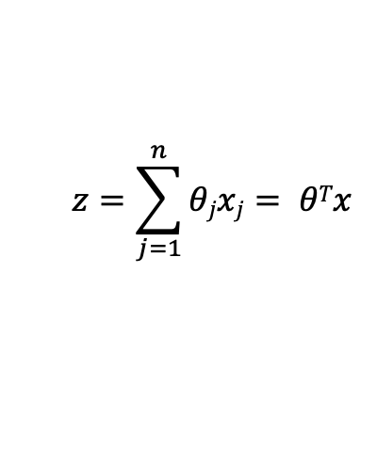
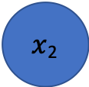

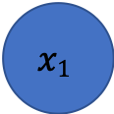




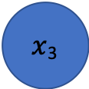


Question 1(a) – Basic Logistic Unit
$$x1$$
$$θ1$$
$x$₂
$$a$$
$$θ2$$
$$hθ(x)$$
$$θ3$$
$x$₃
$xi:$ Input
$θi:$Weight
$$z=\sum_{j=1}^{n}{θjxj}= θTx$$
Weighted Sum:
Activation:
$$a=h(z)$$

