Slide 1


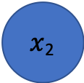
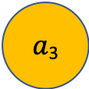

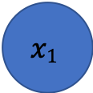
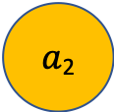

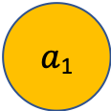

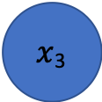
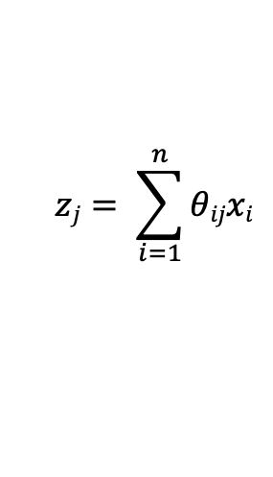

Question 1(c) – Fully Connected, Feed Forward, Artificial Neural Network
$$x1$$
$$θ11$$
$a$₁
$x$₂
$a$₂
$$hΘ (x)$$
$x$₃
$a$₃
$$θ33$$
$xi:$Input
$θij:$ Weight, e.g. $θ11 θ33$
Input Layer Logistic Units
$$zj= \sum_{i=1}^{n}{θijxi}$$
Hidden Layer Logistic Units
Weighted Sums:
Output Node
Activations:
$$aj=h(zj)$$

