Slide 1
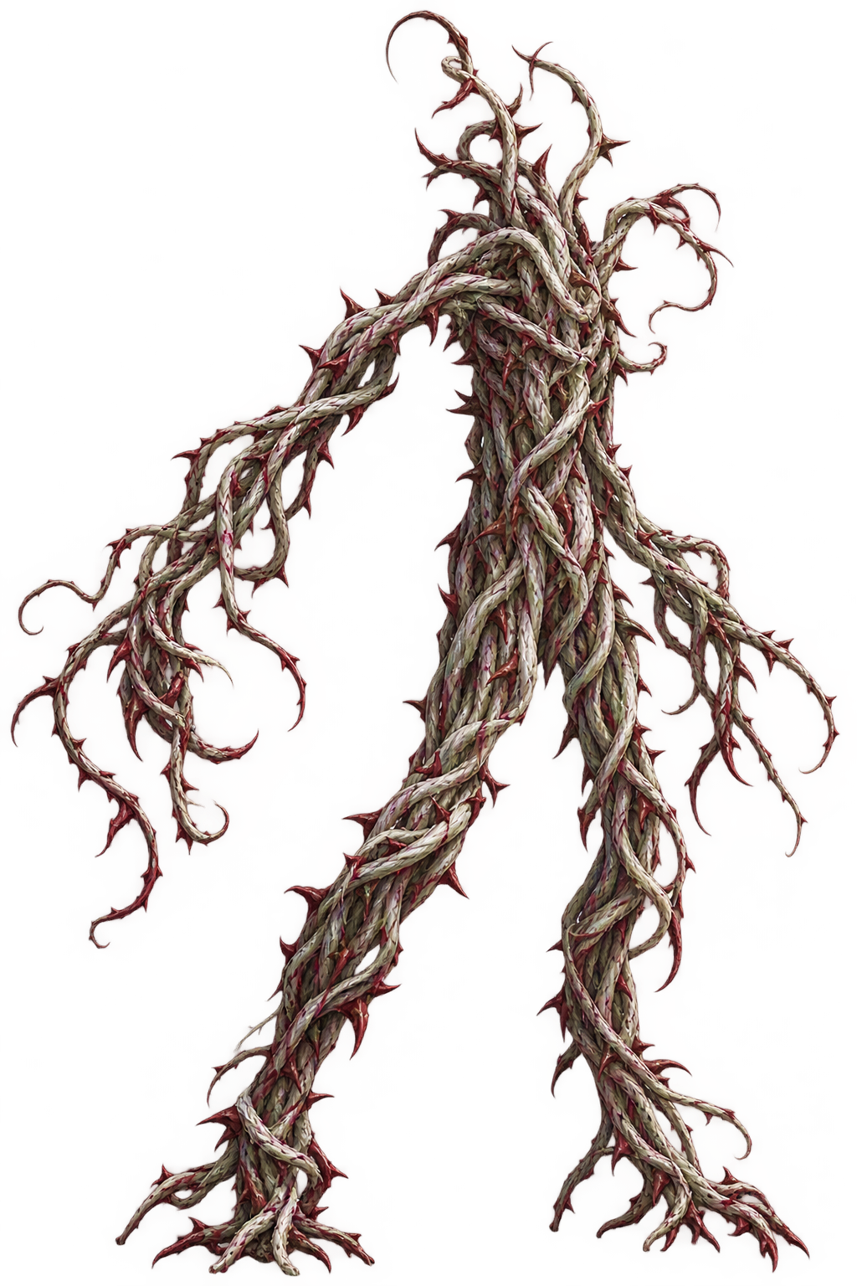

Slide 3
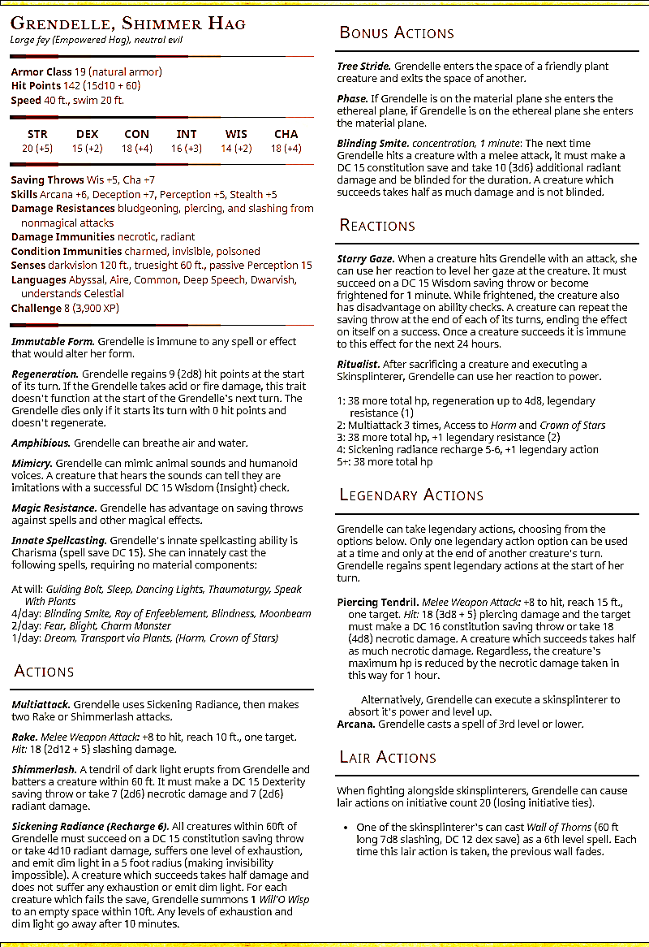

Slide 4
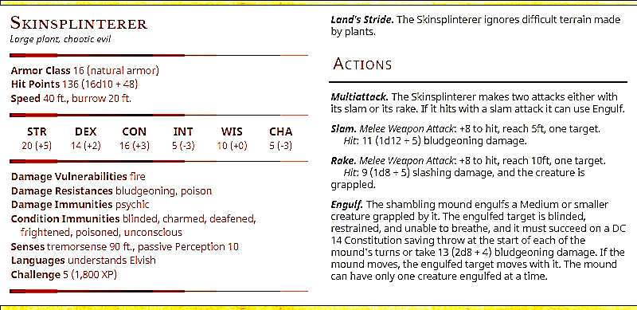
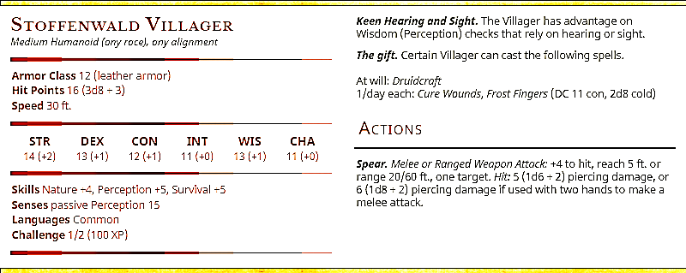
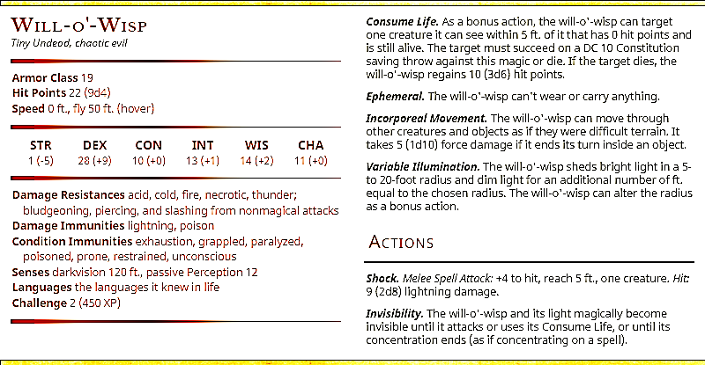

Slide 5
Combat 1 Reminders
90 sec to declare intent.
Roll 1d6 for Skinsplinterers at Shimmer Grove
(12 total, the rest are here).
Vauric and Velchar are there!
Initiative 20: Wall of thorns Lair Action
  Hits a tent, 3 villagers run out
  (4+ on d6 for a “gifted”)
Initiative 10: Villagers retaliate,
deal 5 (10) fire damage to 1d6 skinsplinterers
Preferential Engulf order
1. Rivka 2. Bart 3. Gil 4. Lemm
Combat 2 Reminders
(pretend) roll for Grendelle-Zop fight
Campaign loss condition:
  Shimmer tree takes damage 3 times
  (needs Grendelle’s action and LA)
  Grendelle slays the sphinx.
  First Tree Damage -> Describe Pan’s Disc.

Slide 6
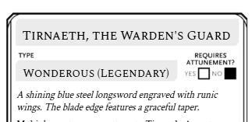

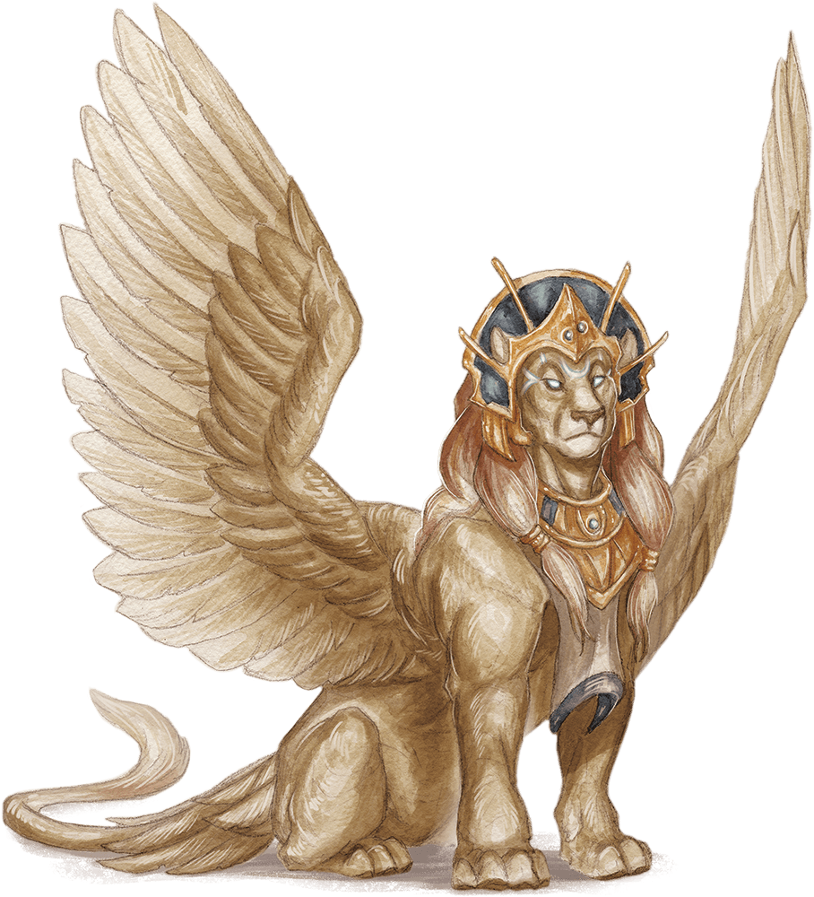
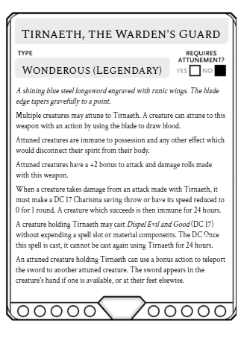
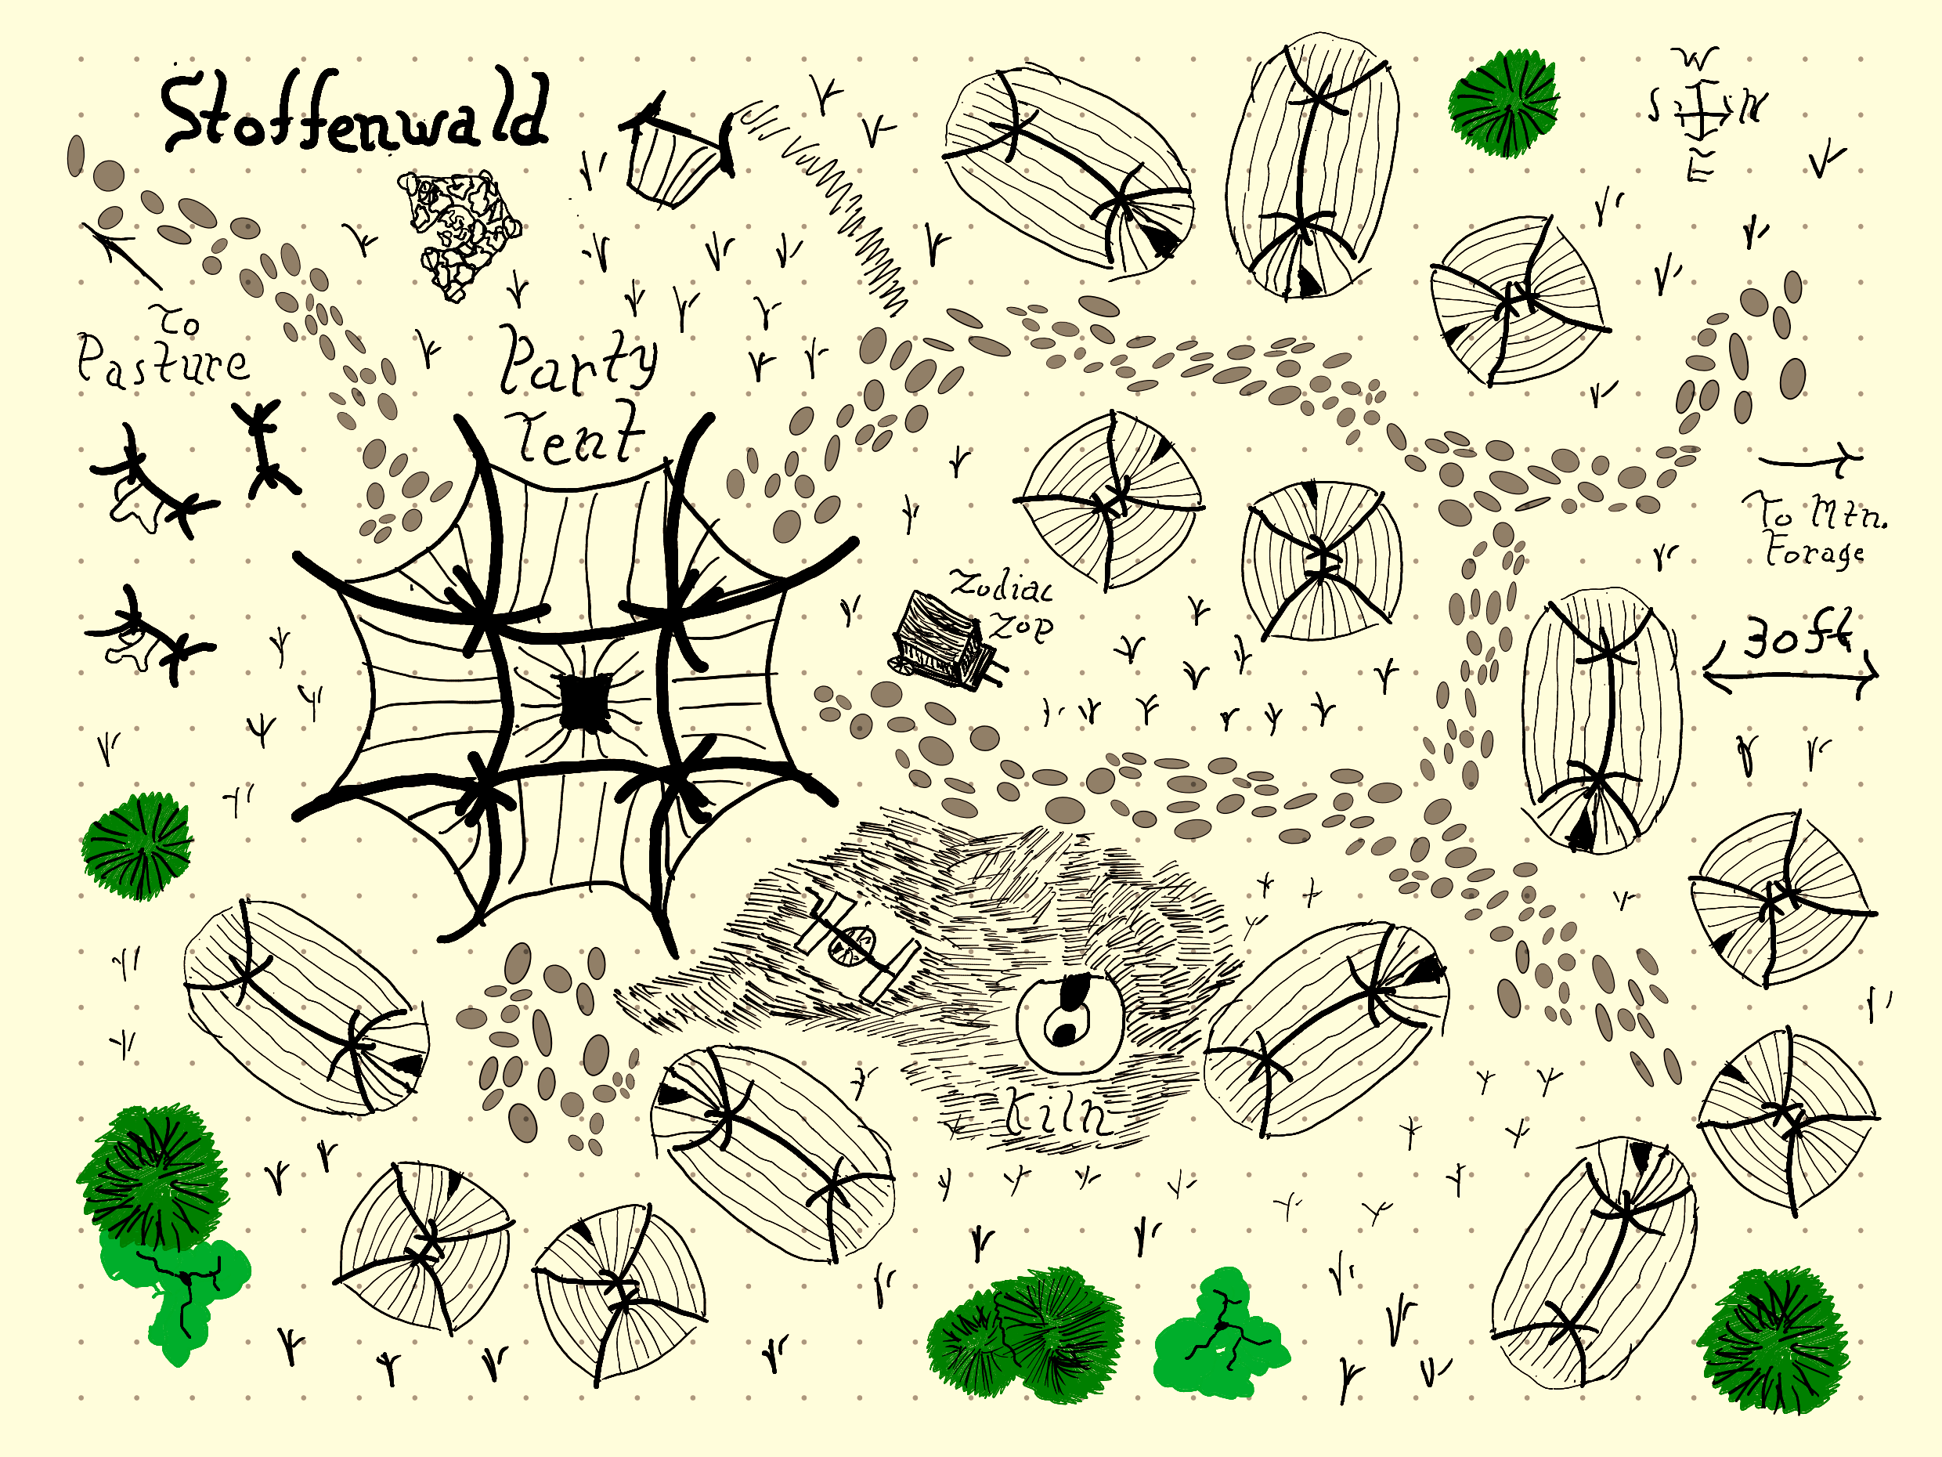

Slide 8
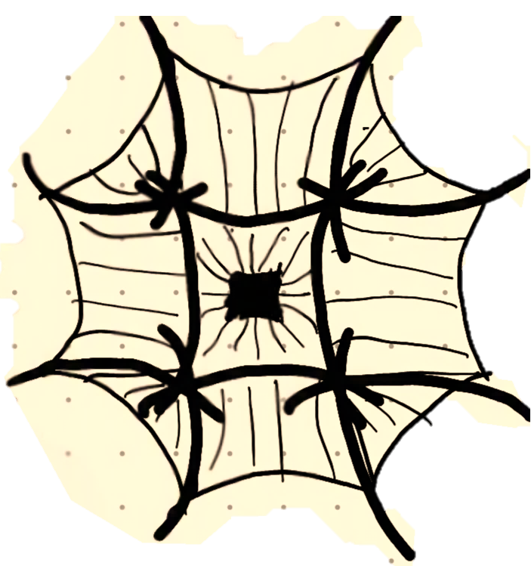

Slide 9


