Slide 1
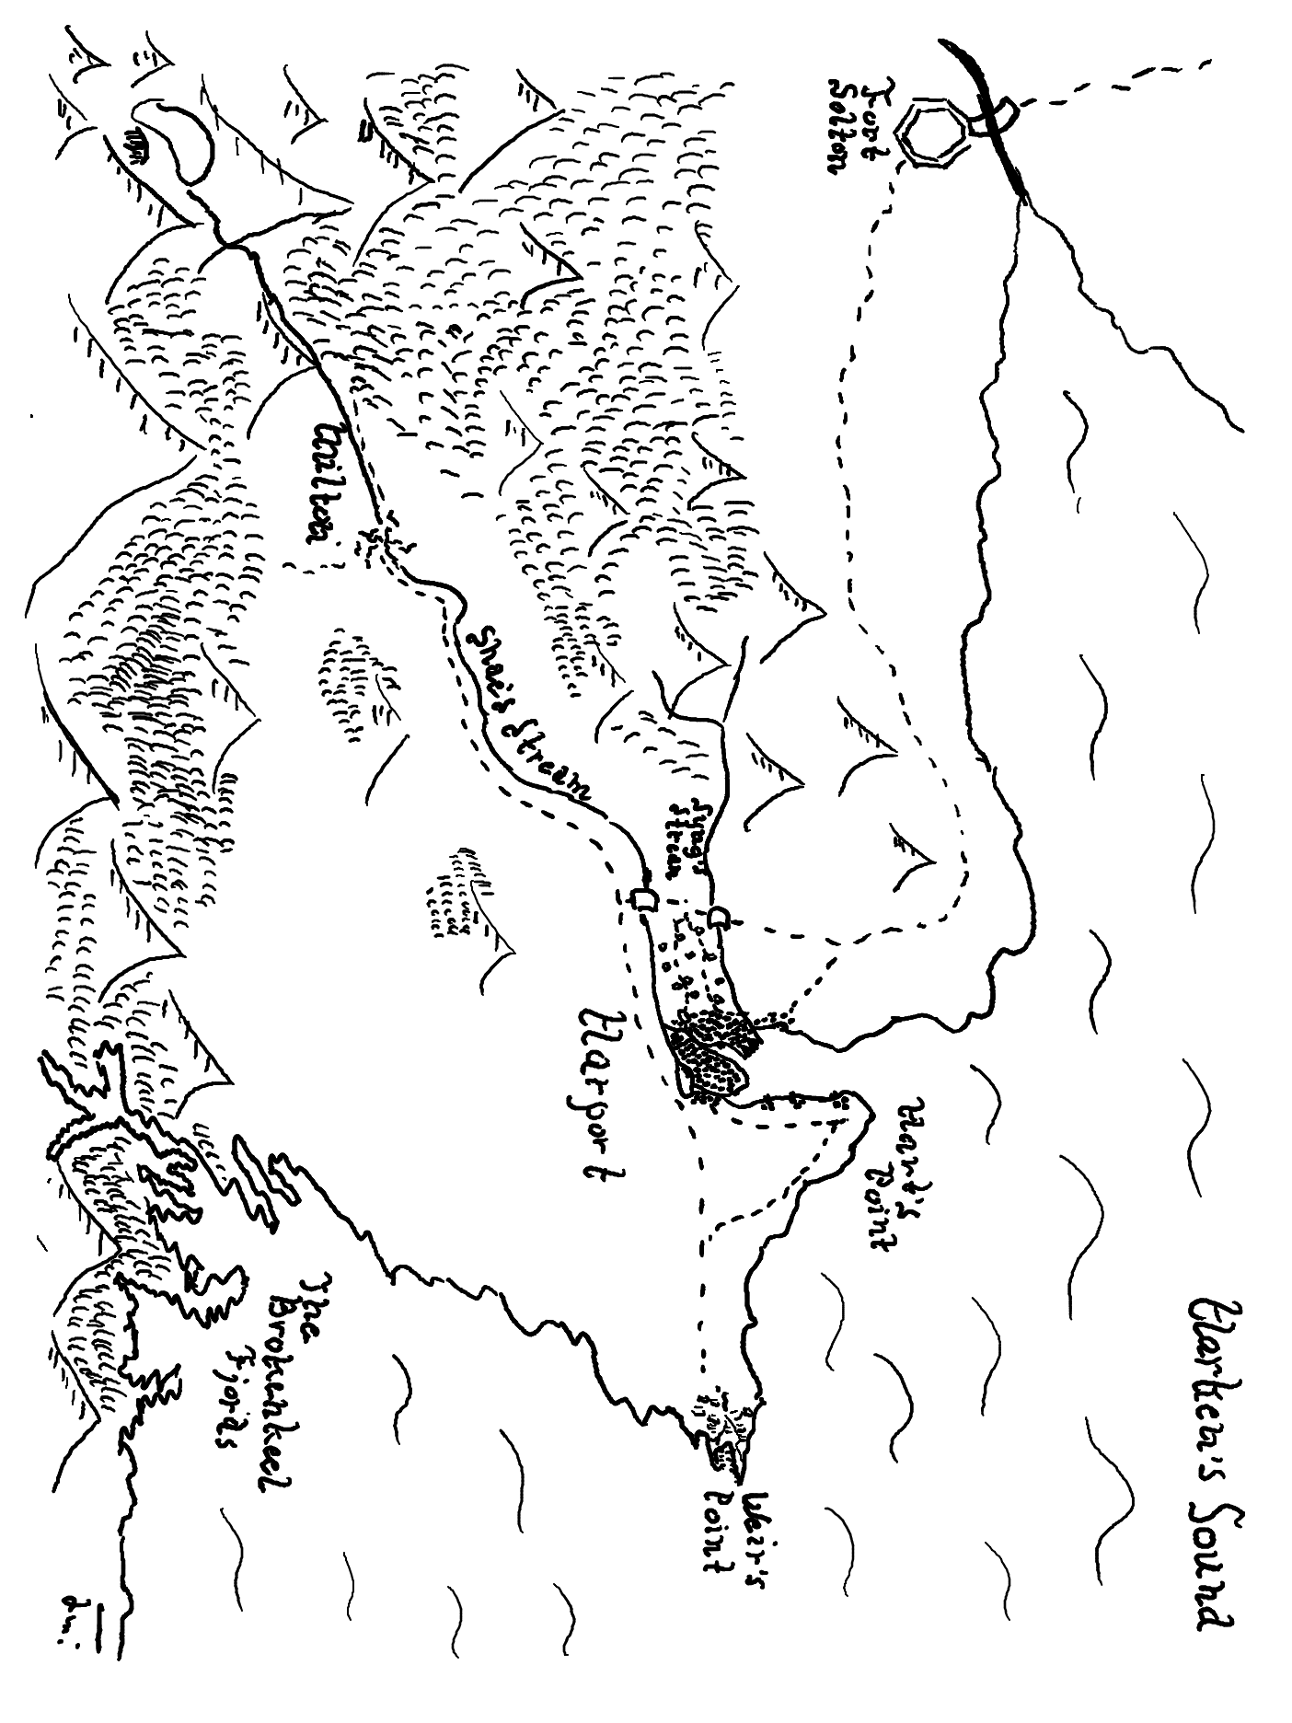

Slide 2
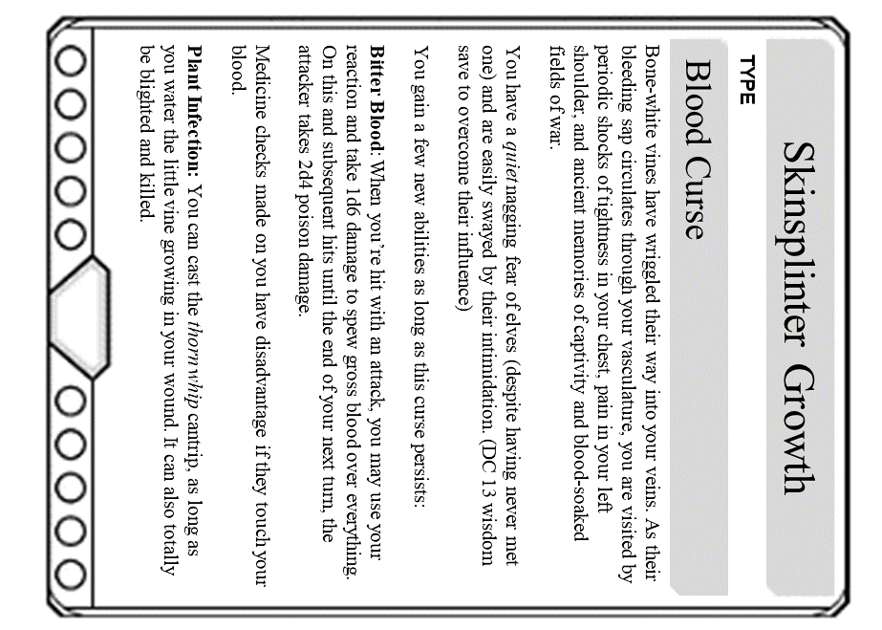
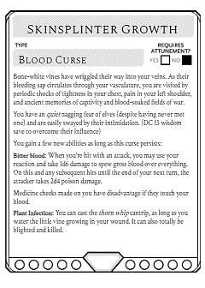
Skinsplinter Growth
TYPE
Blood Curse
Bone-white vines have wriggled their way into your veins. As their bleeding sap circulates through your vasculature, you are visited by periodic shocks of tightness in your chest, pain in your left shoulder, and ancient memories of captivity and blood-soaked fields of war.
You have a quiet nagging fear of elves (despite having never met one) and are easily swayed by their intimidation. (DC 13 wisdom save to overcome their influence)
You gain a few new abilities as long as this curse persists:
Bitter Blood: When you’re hit with an attack, you may use your reaction and take 1d6 damage to spew gross blood over everything. On this and subsequent hits until the end of your next turn, the attacker takes 2d4 poison damage.
Medicine checks made on you have disadvantage if they touch your blood.
Plant Infection: You can cast the thorn whip cantrip, as long as you water the little vine growing in your wound. It can also totally be blighted and killed.

