Slide 1
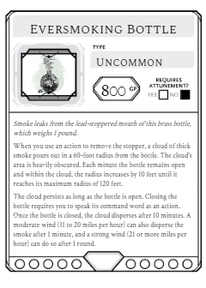
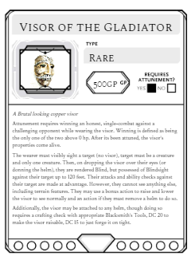
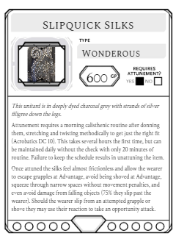
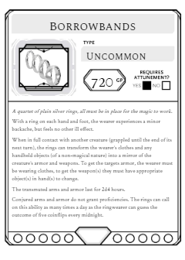
Smoke leaks from the lead-stoppered mouth of this brass bottle, which weighs 1 pound.
When you use an action to remove the stopper, a cloud of thick smoke pours out in a 60-foot radius from the bottle. The cloud's area is heavily obscured. Each minute the bottle remains open and within the cloud, the radius increases by 10 feet until it reaches its maximum radius of 120 feet.
The cloud persists as long as the bottle is open. Closing the bottle requires you to speak its command word as an action. Once the bottle is closed, the cloud disperses after 10 minutes. A moderate wind (11 to 20 miles per hour) can also disperse the smoke after 1 minute, and a strong wind (21 or more miles per hour) can do so after 1 round.
A Brutal looking copper visor
Attunement requires winning an honest, single-combat against a challenging opponent while wearing the visor. Winning is defined as being the only one of the two above 0 hp. After its been attuned, the visor’s properties come alive.
The wearer must visibly sight a target (no visor), target must be a creature and only one creature. Then, on dropping the visor over their eyes (or donning the helm), they are rendered Blind, but possessed of Blindsight against their target up to 120 feet. Their attacks and ability checks against their target are made at advantage. However, they cannot see anything else, including terrain features. They may use a bonus action to raise and lower the visor to see normally and an action if they must remove a helm to do so.
Additionally, the visor may be attached to any helm, though doing so requires a crafting check with appropriate Blacksmith’s Tools, DC 20 to make the visor raisable, DC 15 to just forge it on tight.
This unitard is in deeply dyed charcoal grey with strands of silver filigree down the legs.
Attunement requires a morning calisthenic routine after donning them, stretching and twisting methodically to get just the right fit (Acrobatics DC 10). This takes several hours the first time, but can be maintained daily without the check with only 20 minutes of routine. Failure to keep the schedule results in unattuning the item.
Once attuned the silks feel almost frictionless and allow the wearer to escape grapples at Advantage, avoid being shoved at Advantage, squeeze through narrow spaces without movement penalties, and even avoid damage from falling objects (75% they slip past the wearer). Should the wearer slip from an attempted grapple or shove they may use their reaction to take an opportunity attack.
A quartet of plain silver rings, all must be in place for the magic to work.
With a ring on each hand and foot, the wearer experiences a minor backache, but feels no other ill effect.
When in full contact with another creature (grappled until the end of its next turn), the rings can transform the wearer’s clothes and any handheld objects (of a non-magical nature) into a mirror of the creature’s armor and weapons. To get the targets armor, the wearer must be wearing clothes, to get the weapon(s) they must have appropriate object(s) in hand(s) to change.
The transmuted arms and armor last for 2d4 hours.
Conjured arms and armor do not grant proficiencies. The rings can call on this ability as many times a day as the ringwearer can guess the outcome of five coinflips every midnight.

Slide 2
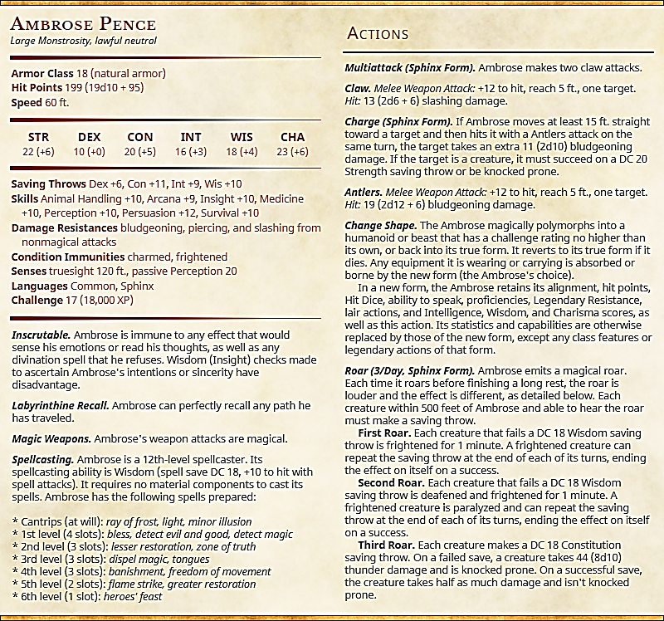

Slide 3
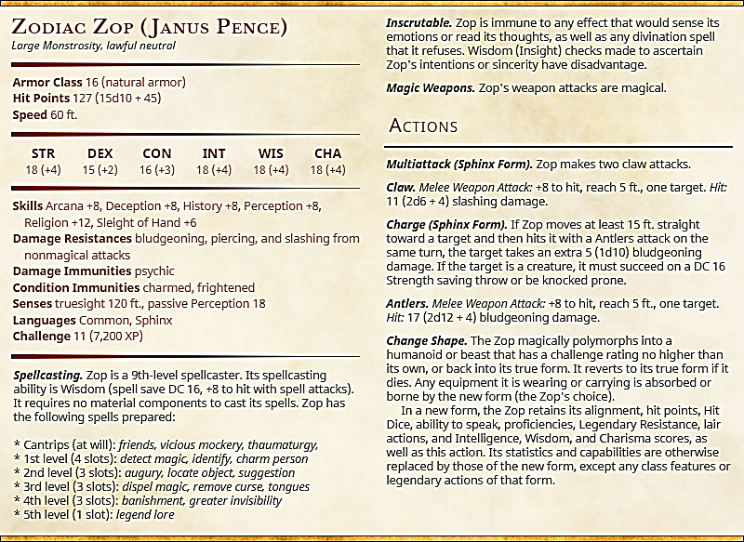
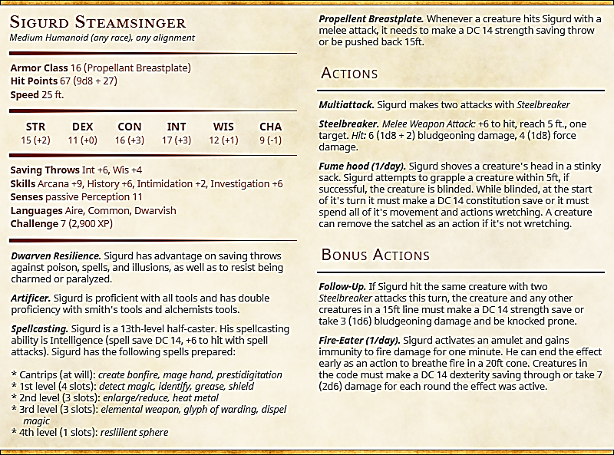

Slide 4
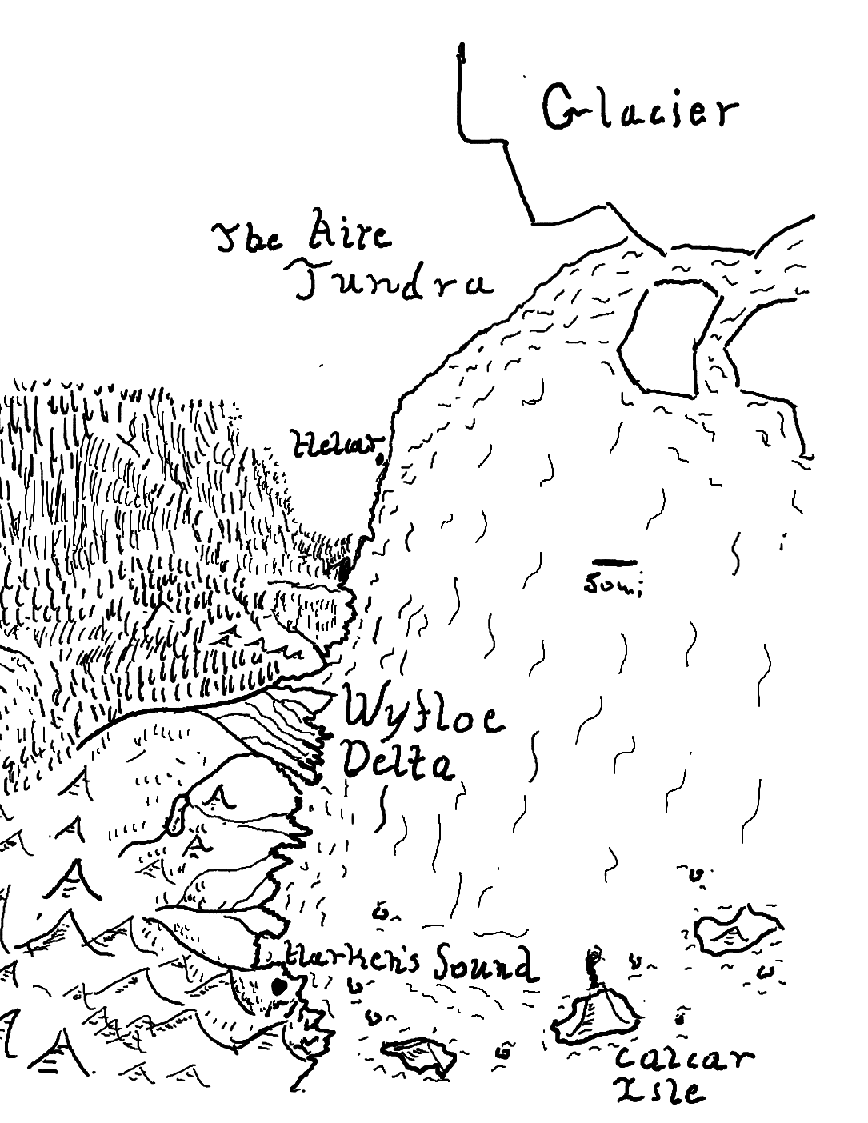

Slide 5
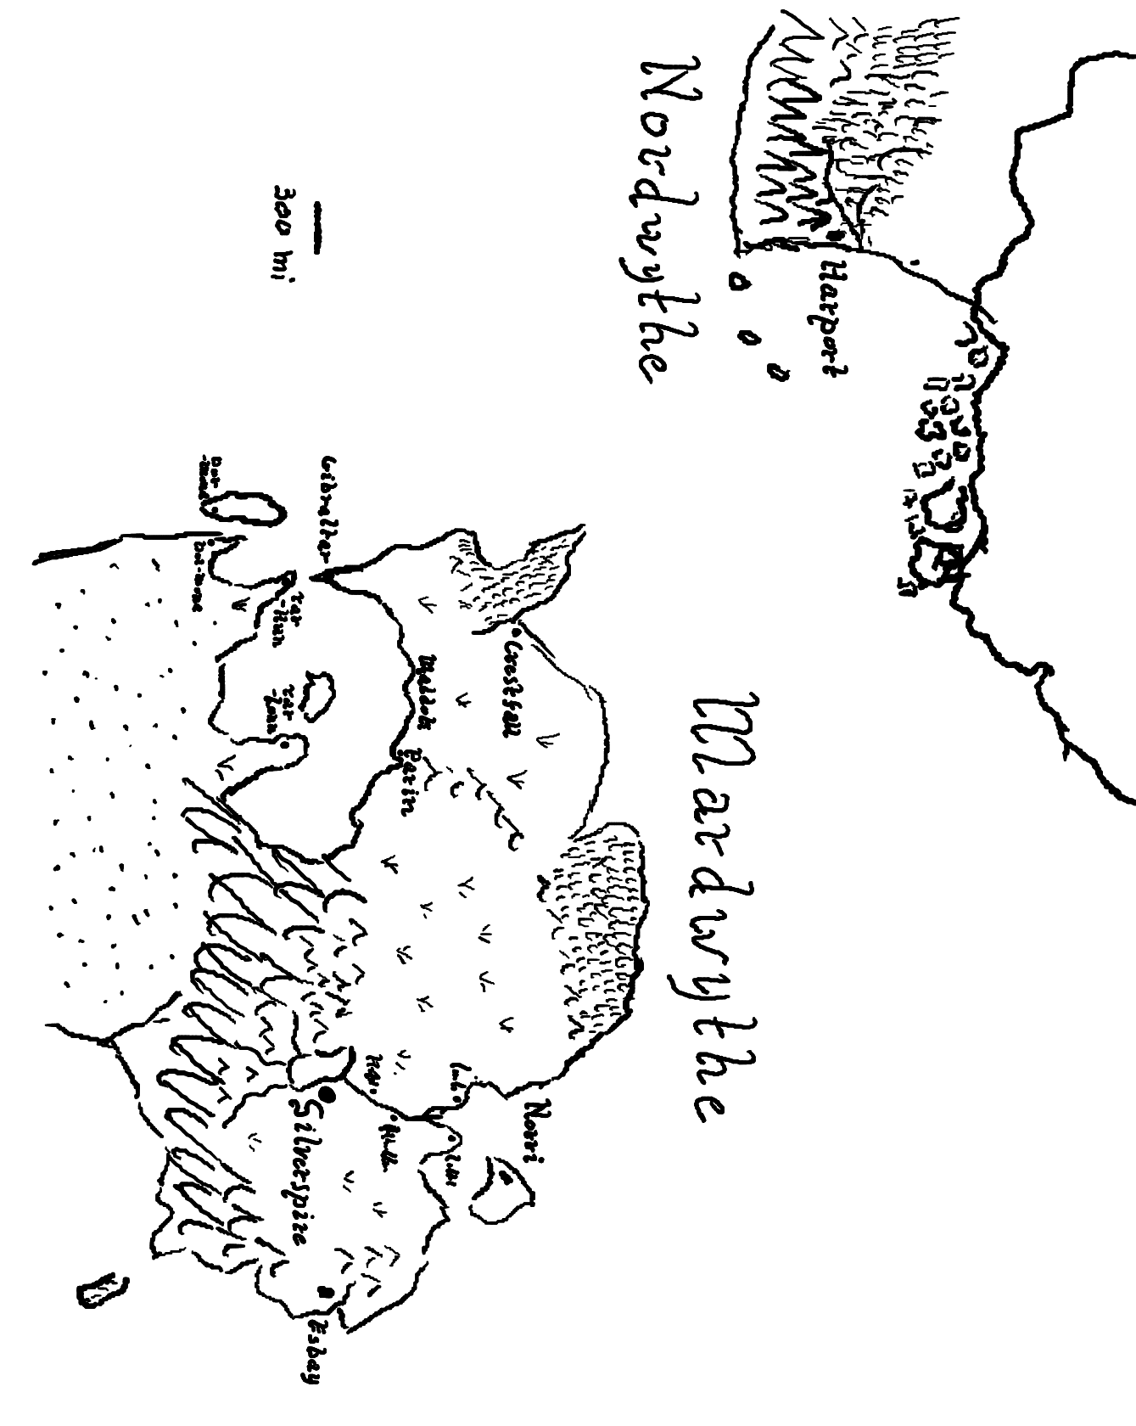

Slide 6
