Slide 1
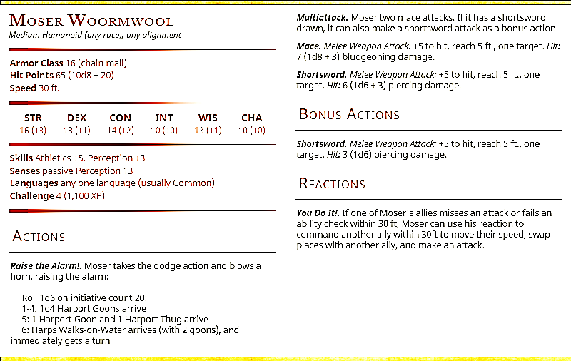
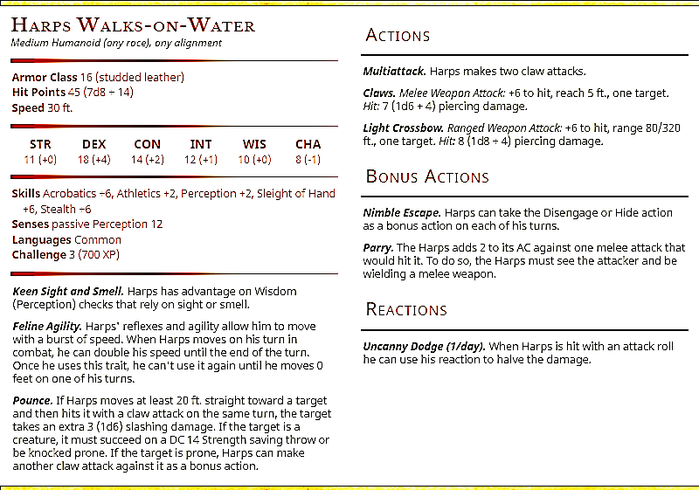

Slide 2

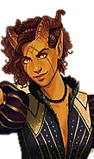
MISSING
Lady Esme Landros
REWARD
10,000 gp upon safe return to Silverspire
payable by order of House Vespera of Steelcry Hold

