Slide 1
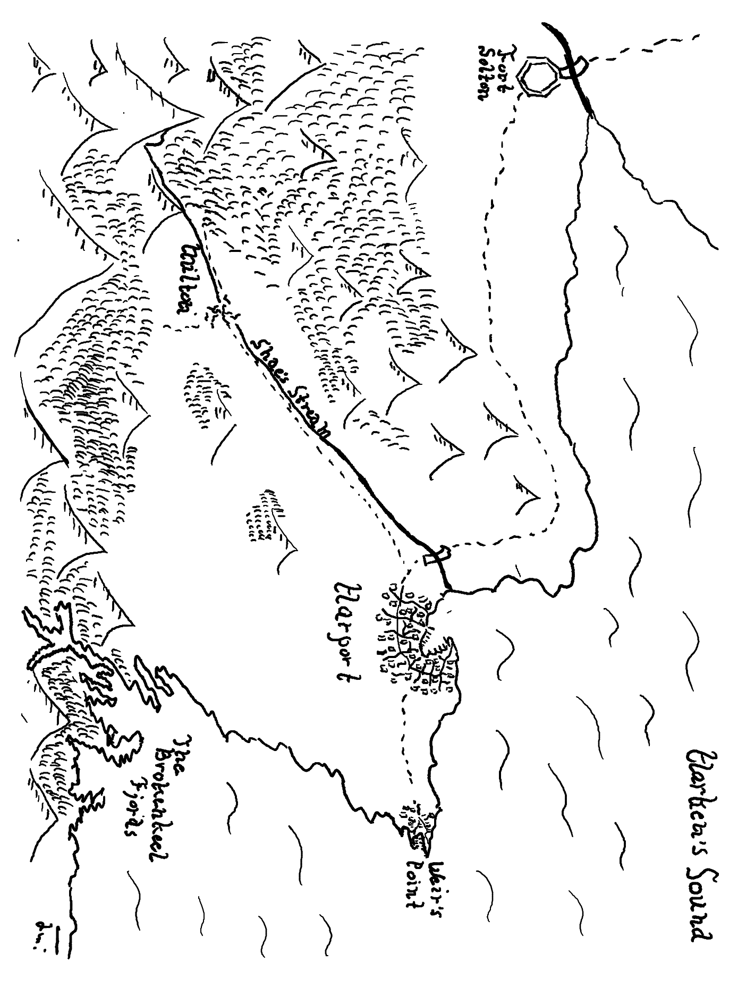

Slide 2
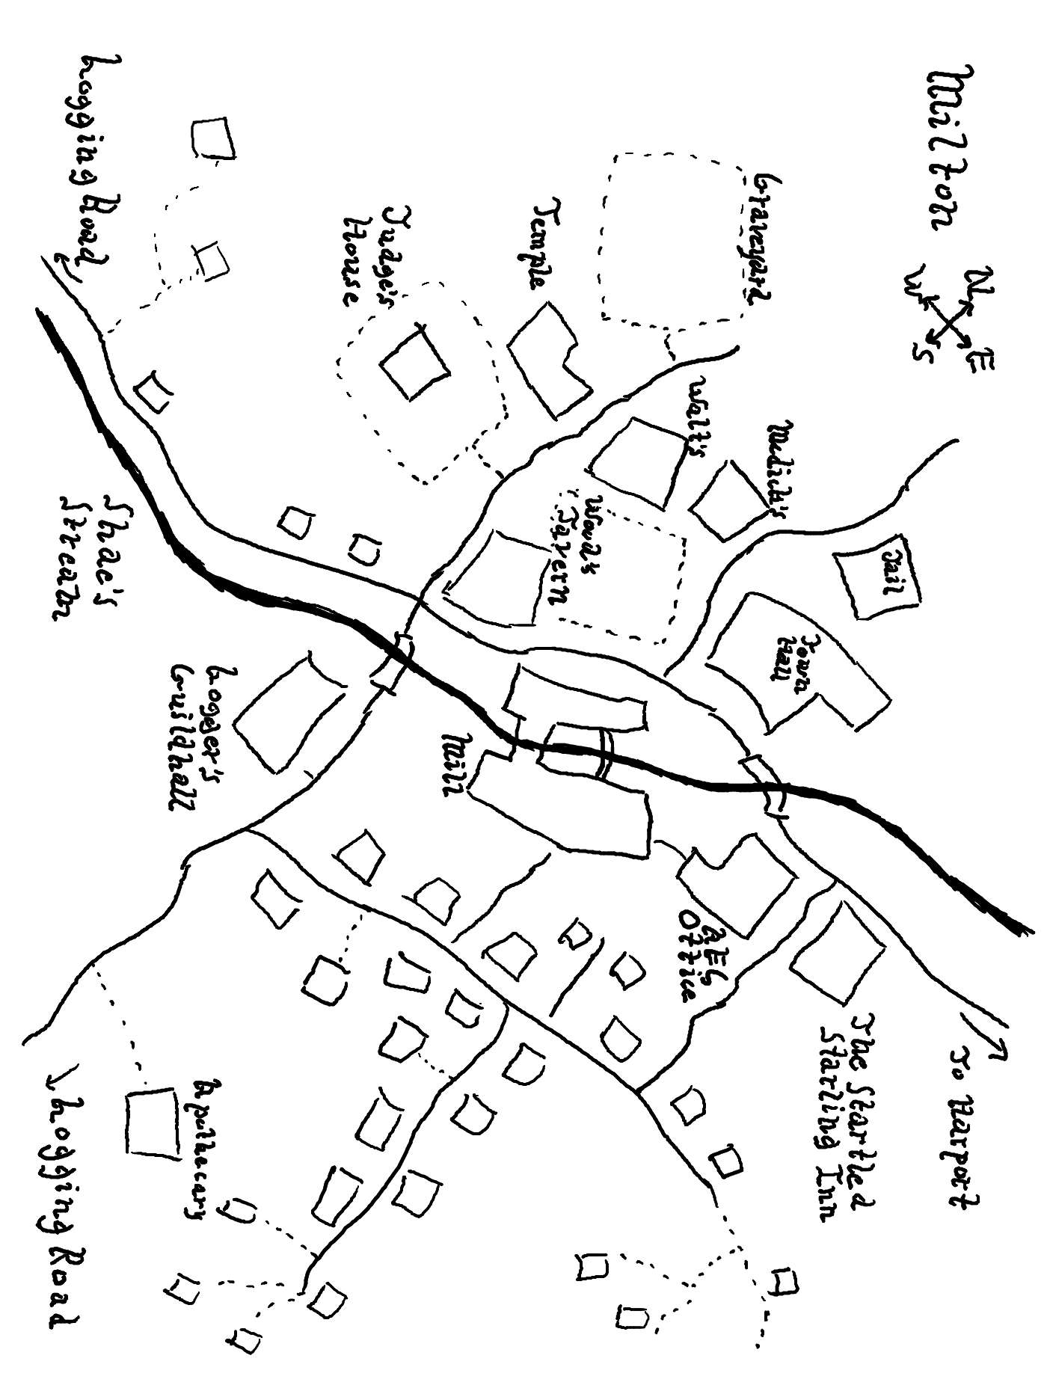

Slide 3
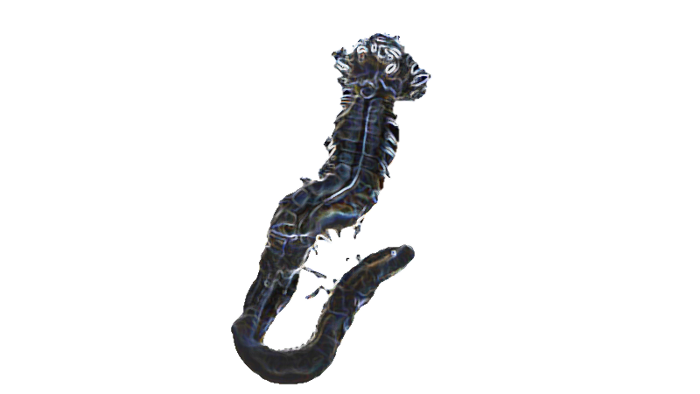
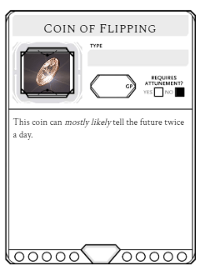

Slide 4

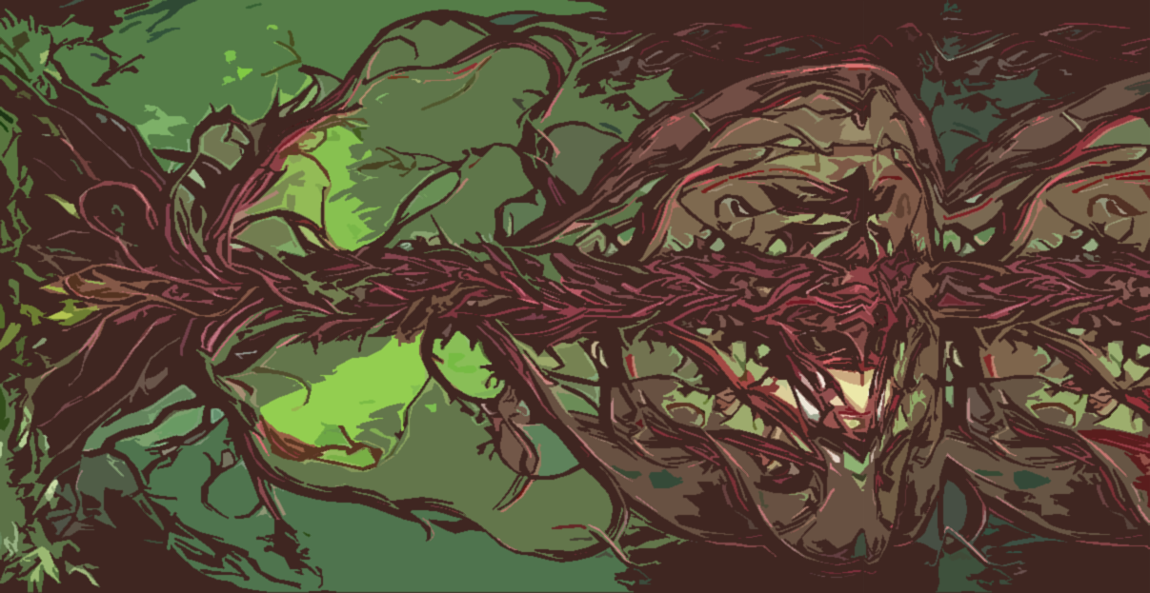
Skinsplinter Vines
“Come united light, shine on sanguine ripples, lay bare my enemies’ bones,” reads a cursed verse stolen from the tomes of Elven blood mages. It is an apt description of Skinsplinter vines. Our enemies created these vicious constructs to rend the flesh from the armies of my people, and to “liberate” the villages of our slaves. In all my correspondence I have heard said that only the servile spiritualists possess the ability to gentle these verdant horrors. Though fire and blight have also proven effective in times of war. Mercifully, Skinsplinter seeds are magically inert unless watered with the blood of a Shay-Luuq, a kind as rare as they are dangerous.

Slide 5
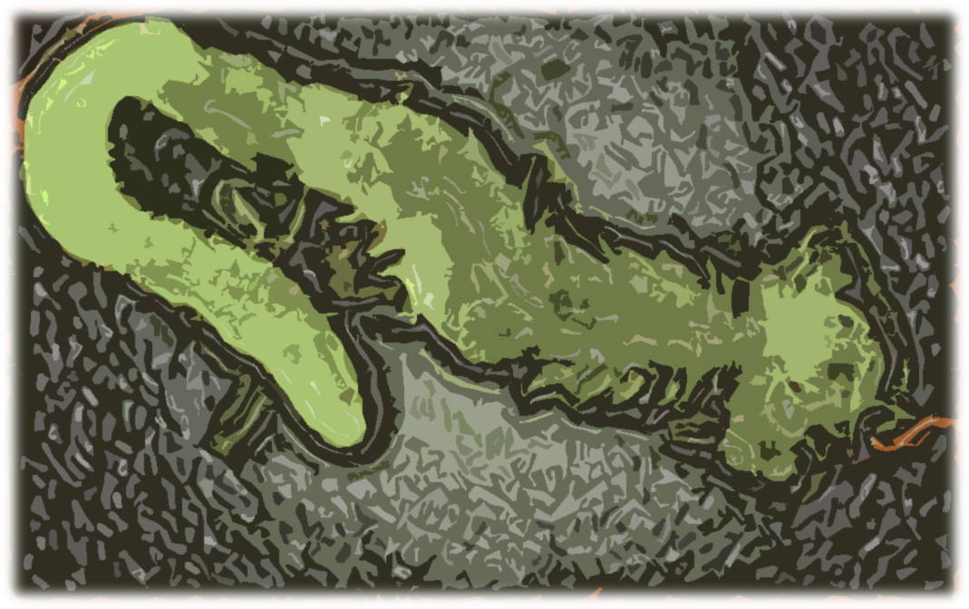
Lurid Worm
Despite its rather… colloquial, name, these sinister creatures are responsible for the death and digestion of many an adventurous Mer. Endemic to the deep caves and culverts which interweave beneath the Floes and alpine lakes, their usual strategy is to mesmerize prey using a glowing lure before dropping down and burrowing through their skull. While an individual worm is hardly a threat, they live in colonies, and so together they demonstrate surprising levels of tactical awareness. Once slain, their slime is a valuable magical component, and so our explorers’ guilds still routinely loose teams to these worms every year.

Slide 6
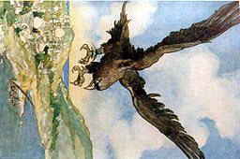
Mountain Roc
These majestic avians are the undisputed rulers of the Friggian Peaks which benevolently fence in the Elven nation. As a voracious predator, a Roc sees little distinction between a Mer, Elf, or Dwarf, and its usual prey. Their presence alone makes the mountain passes too dangerous for any caravan smaller than a few dozen Mer. There are, however, limited accounts of individuals surviving Roc encounters, and their stories insist that these creatures are intelligent, able to be bargained with, and, most interestingly, compelled to return any honor afforded to them. I shudder to think what would happen should the Elves ally with these beasts.

