Slide 1
TEAM UFO
ISTE 612: Information Retrieval and Text Mining
…Exploring the World Of
Declassified Government Documents…
Cory Maclauchlan, John Myers, Arivirku Thirugnanam

Slide 2
Agenda
01
02
03
04
PROBLEM Description
The data
Tool Needs and Software Design
Exploration, Preprocessing, and Representations
MODELS used
results
Indexing and Clustering Techniques
Parameter Customization Metrics
2

Slide 3
01
The Problem
Tool Needs and Software Design
3

Slide 4
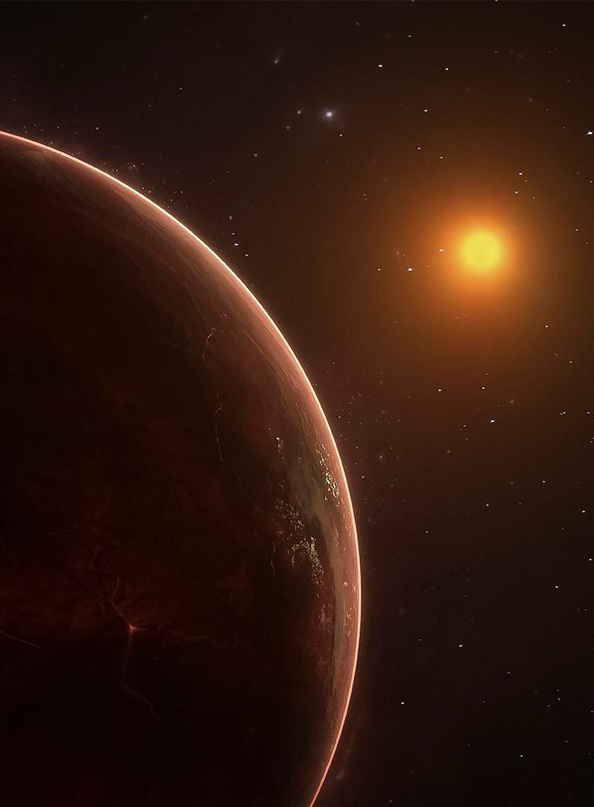
Why develop this?
Information Here
4

Slide 5
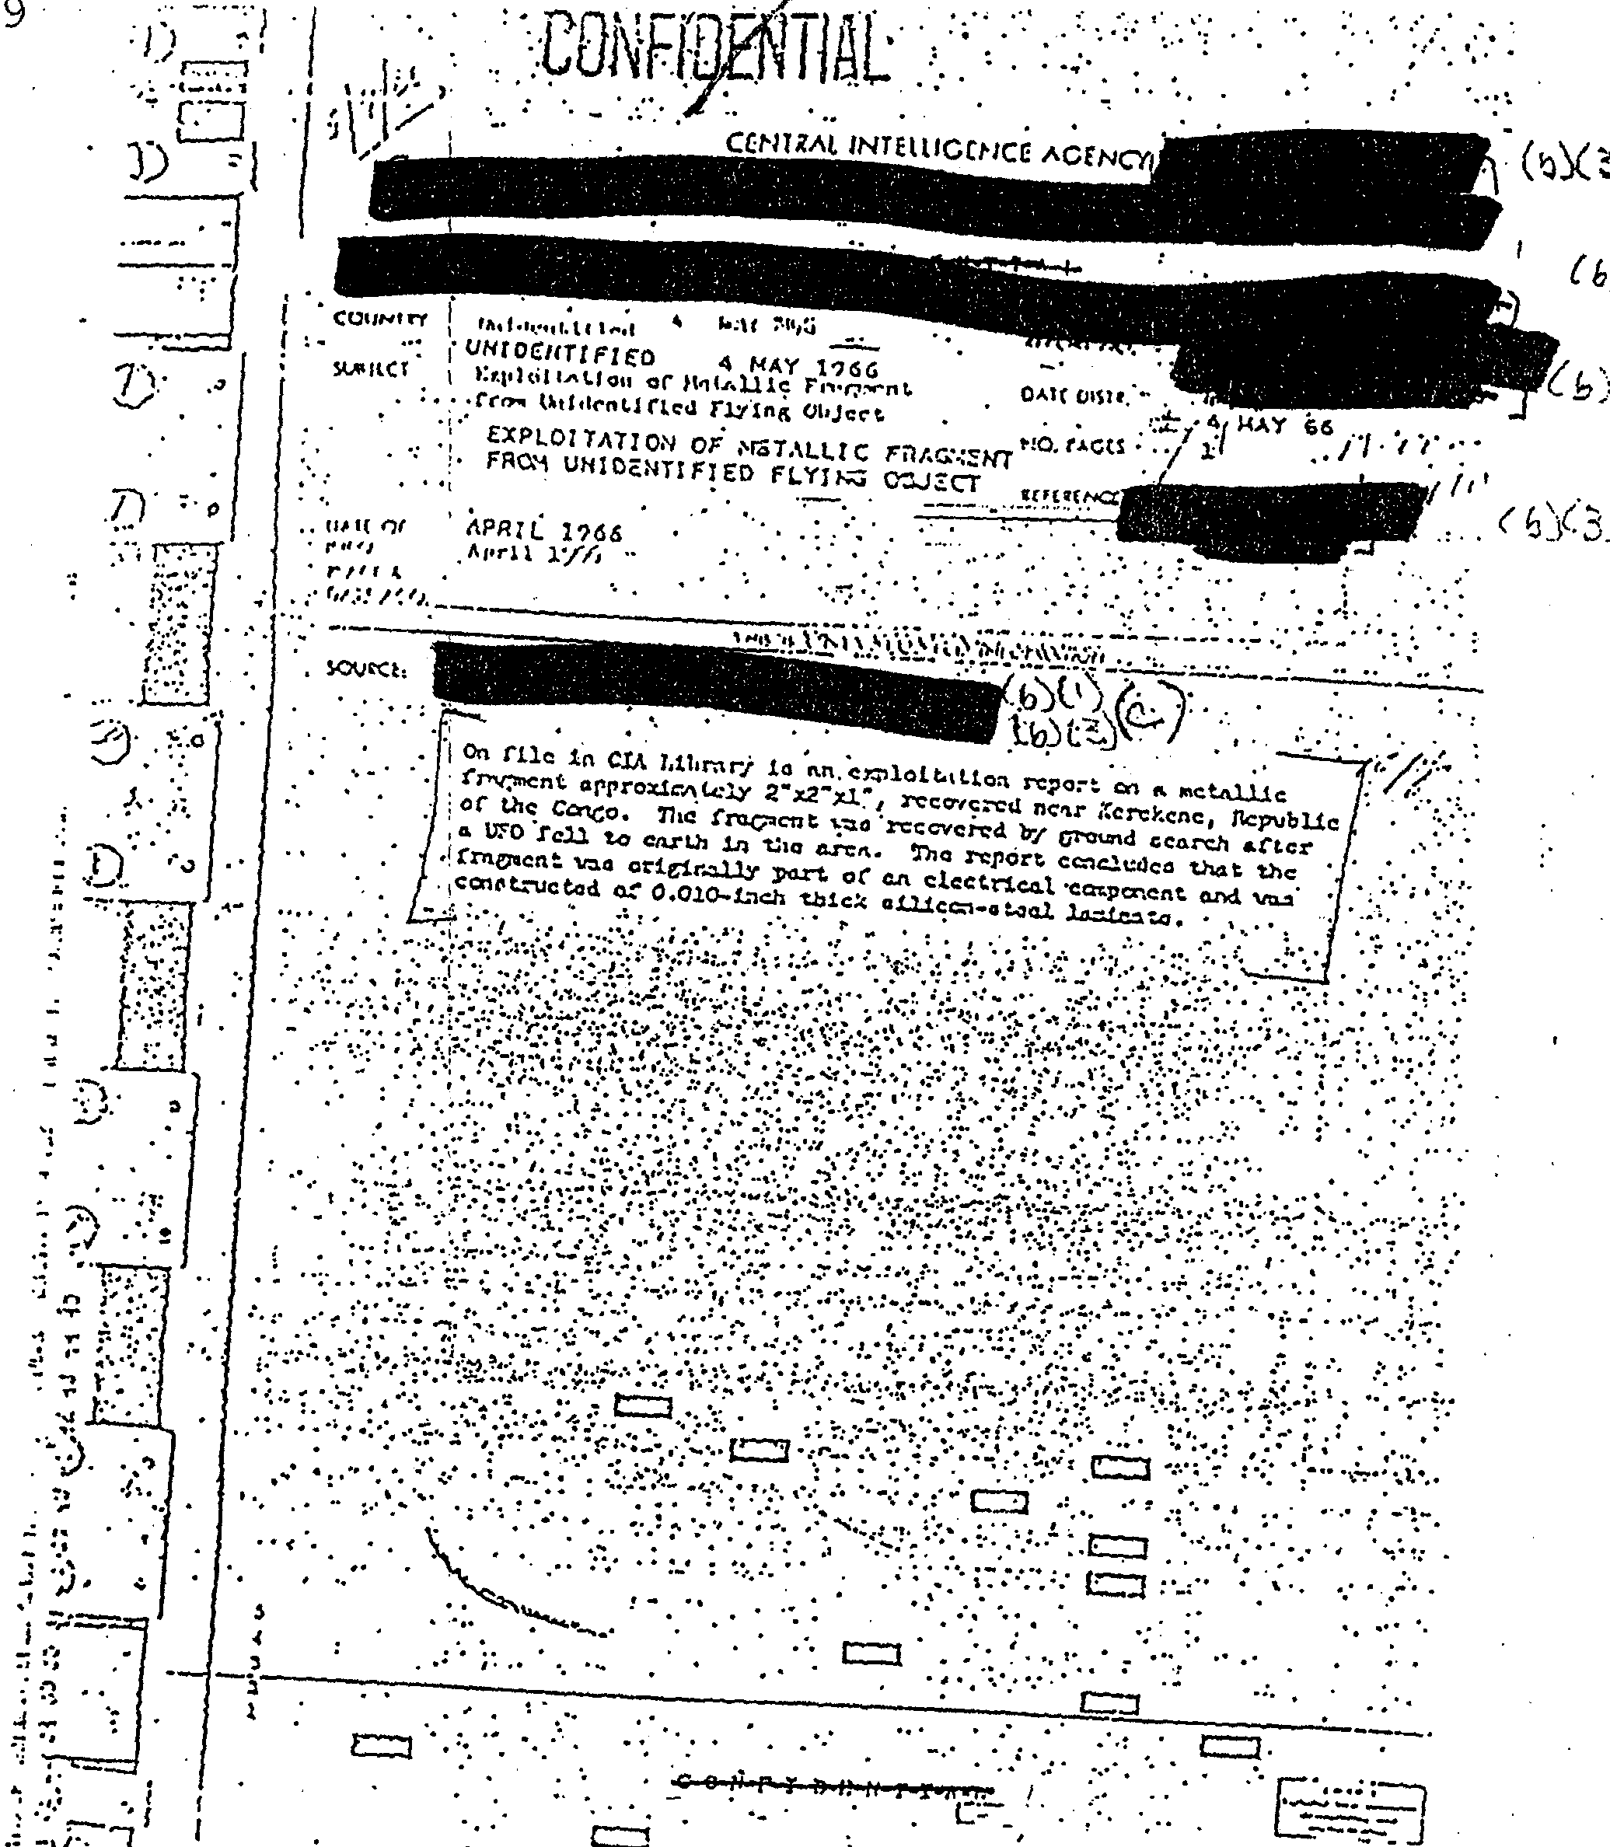
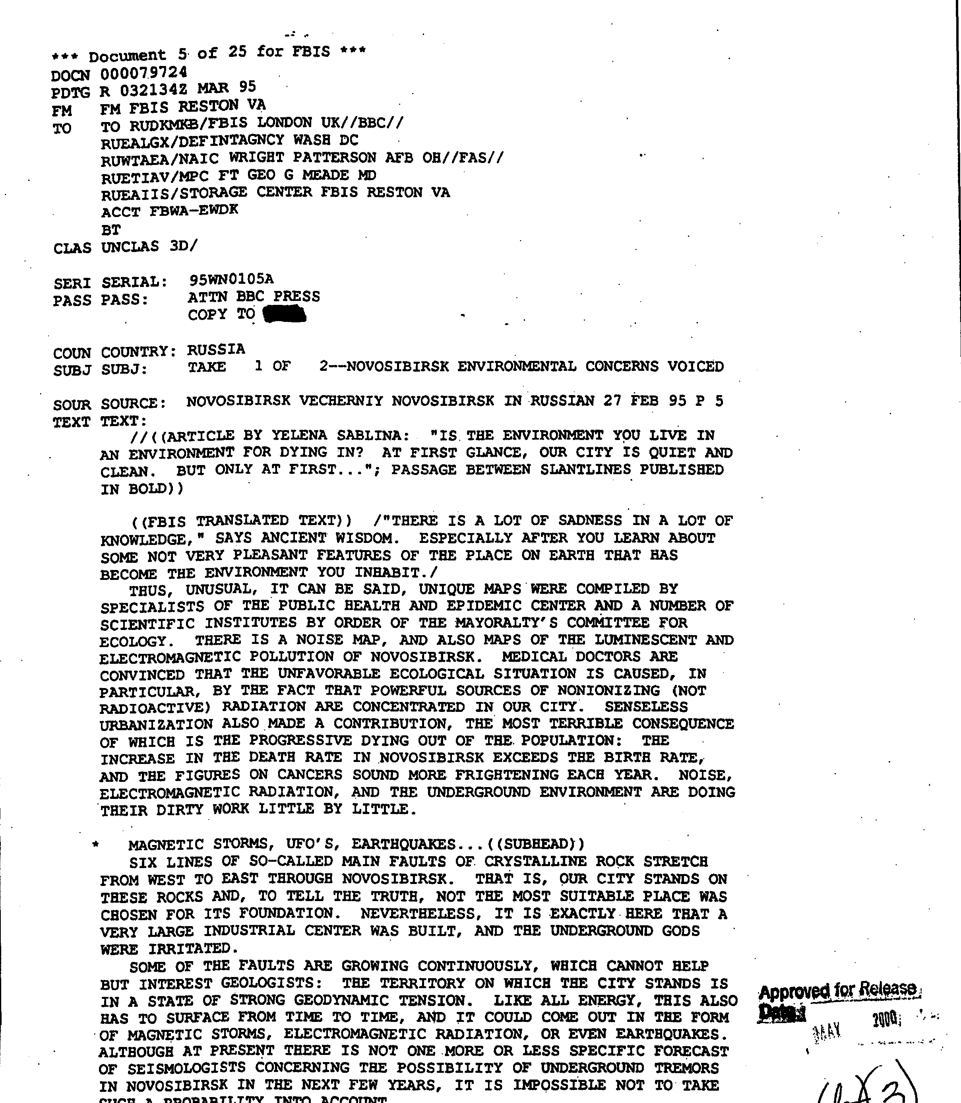
The Data
713 PDFs, of varying quality. All scans of paper documents.
5

Slide 6
Data Preprocessing and representation
Here’s an assortment of alternative resources whose style fits the one of this template
6

Slide 7
Learning Models Used
Learning Model 1
Learning Model 2
Stuff Here
Stuff here
7

Slide 8
RESULTS!
This can be the part of the presentation where you introduce yourself, write your email…
8

Slide 9
Timing metrics
MEASURES | DISTANCE | GRAVITY | DIAMETER
VENUS | 0,11 | 0,45 | 0,17
MERCURY | 0,44 | 0,70 | 0,18
SATURN | 0,75 | 0,32 | 0,47
9

Slide 10
SOFTWARE ARCHITECTURE and Implementation
10

Slide 11
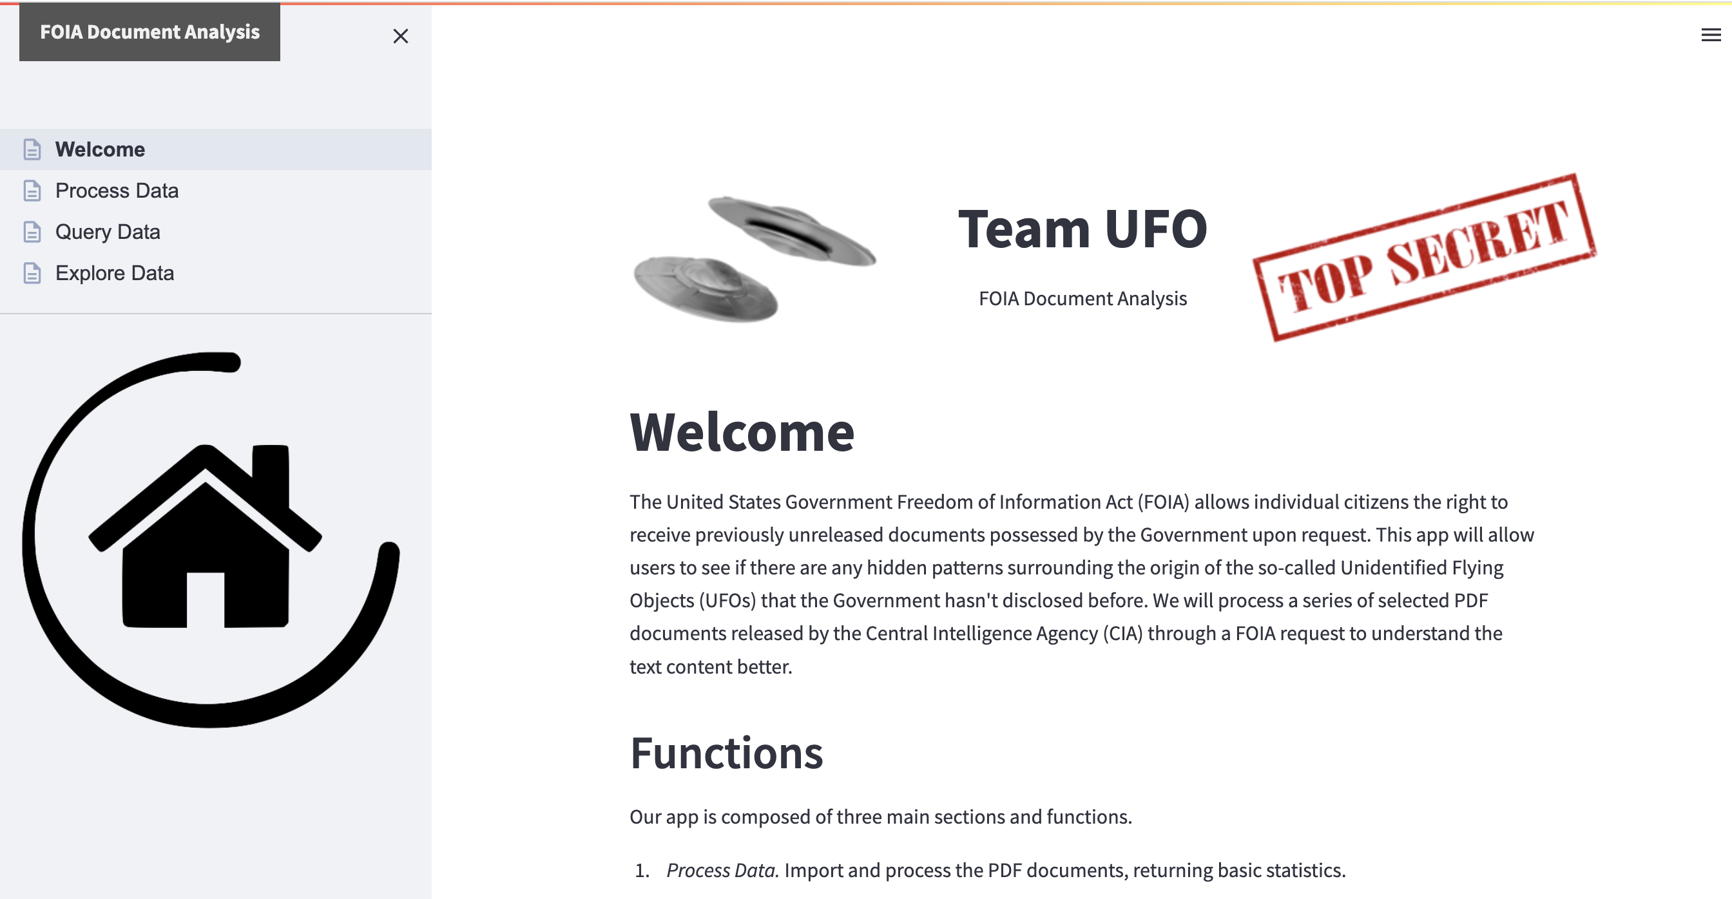
SOFTWARE DEMO
You can replace the image on the screen with your own work. Just right-click on it and select “Replace image”
11

Slide 12
THANK YOU! QUESTIONS?
12

