Slide 1
TEAM UFO
ISTE 612: Information Retrieval and Text Mining
…Exploring the World Of
Declassified Government Documents…
Cory Maclauchlan, John Myers, Arivirku Thirugnanam

Slide 2
Agenda
01
02
03
04
PROBLEM Description
The data
Tool Needs and Software Design
Exploration, Preprocessing, and Representations
MODELS used
results
Indexing and Clustering Techniques
Parameter Customization Metrics
2

Slide 3
01
The Problem
Tool Needs and Software Design
3

Slide 4
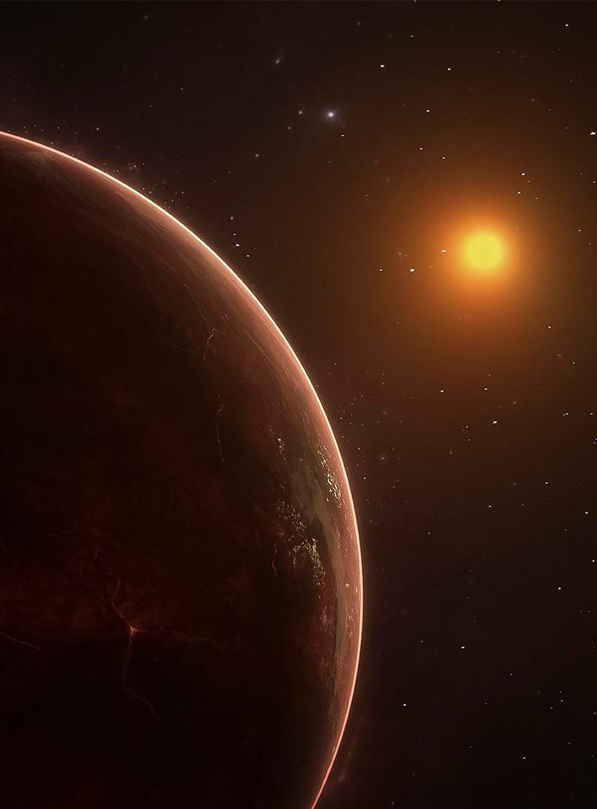
Why develop this?
A total of 712 pdf documents comprising 3493 pages related to UFO was released by CIA to “The Black Vault” upon a FOIA(Freedom of Information Act) request.
The document collection consists of a mixture of scans of printed materials with redactions, Memo posts and high-quality documents.
The documents are released without labeling or categorization of any kind.
Owing to data quality, classifying or extracting any useful information from the documents would be a tedious process.
4

Slide 5
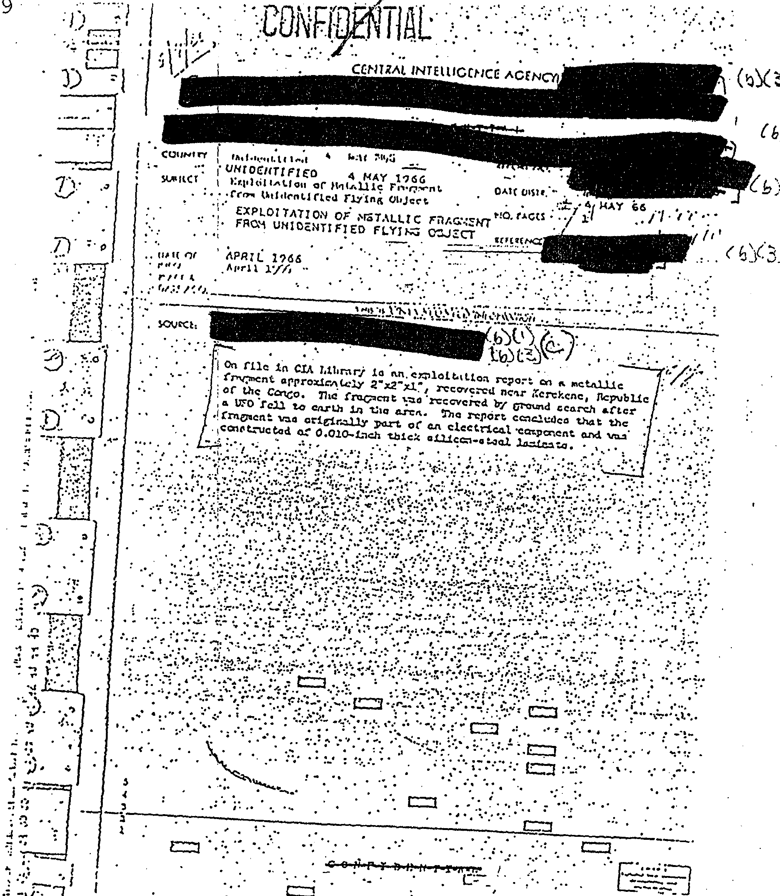
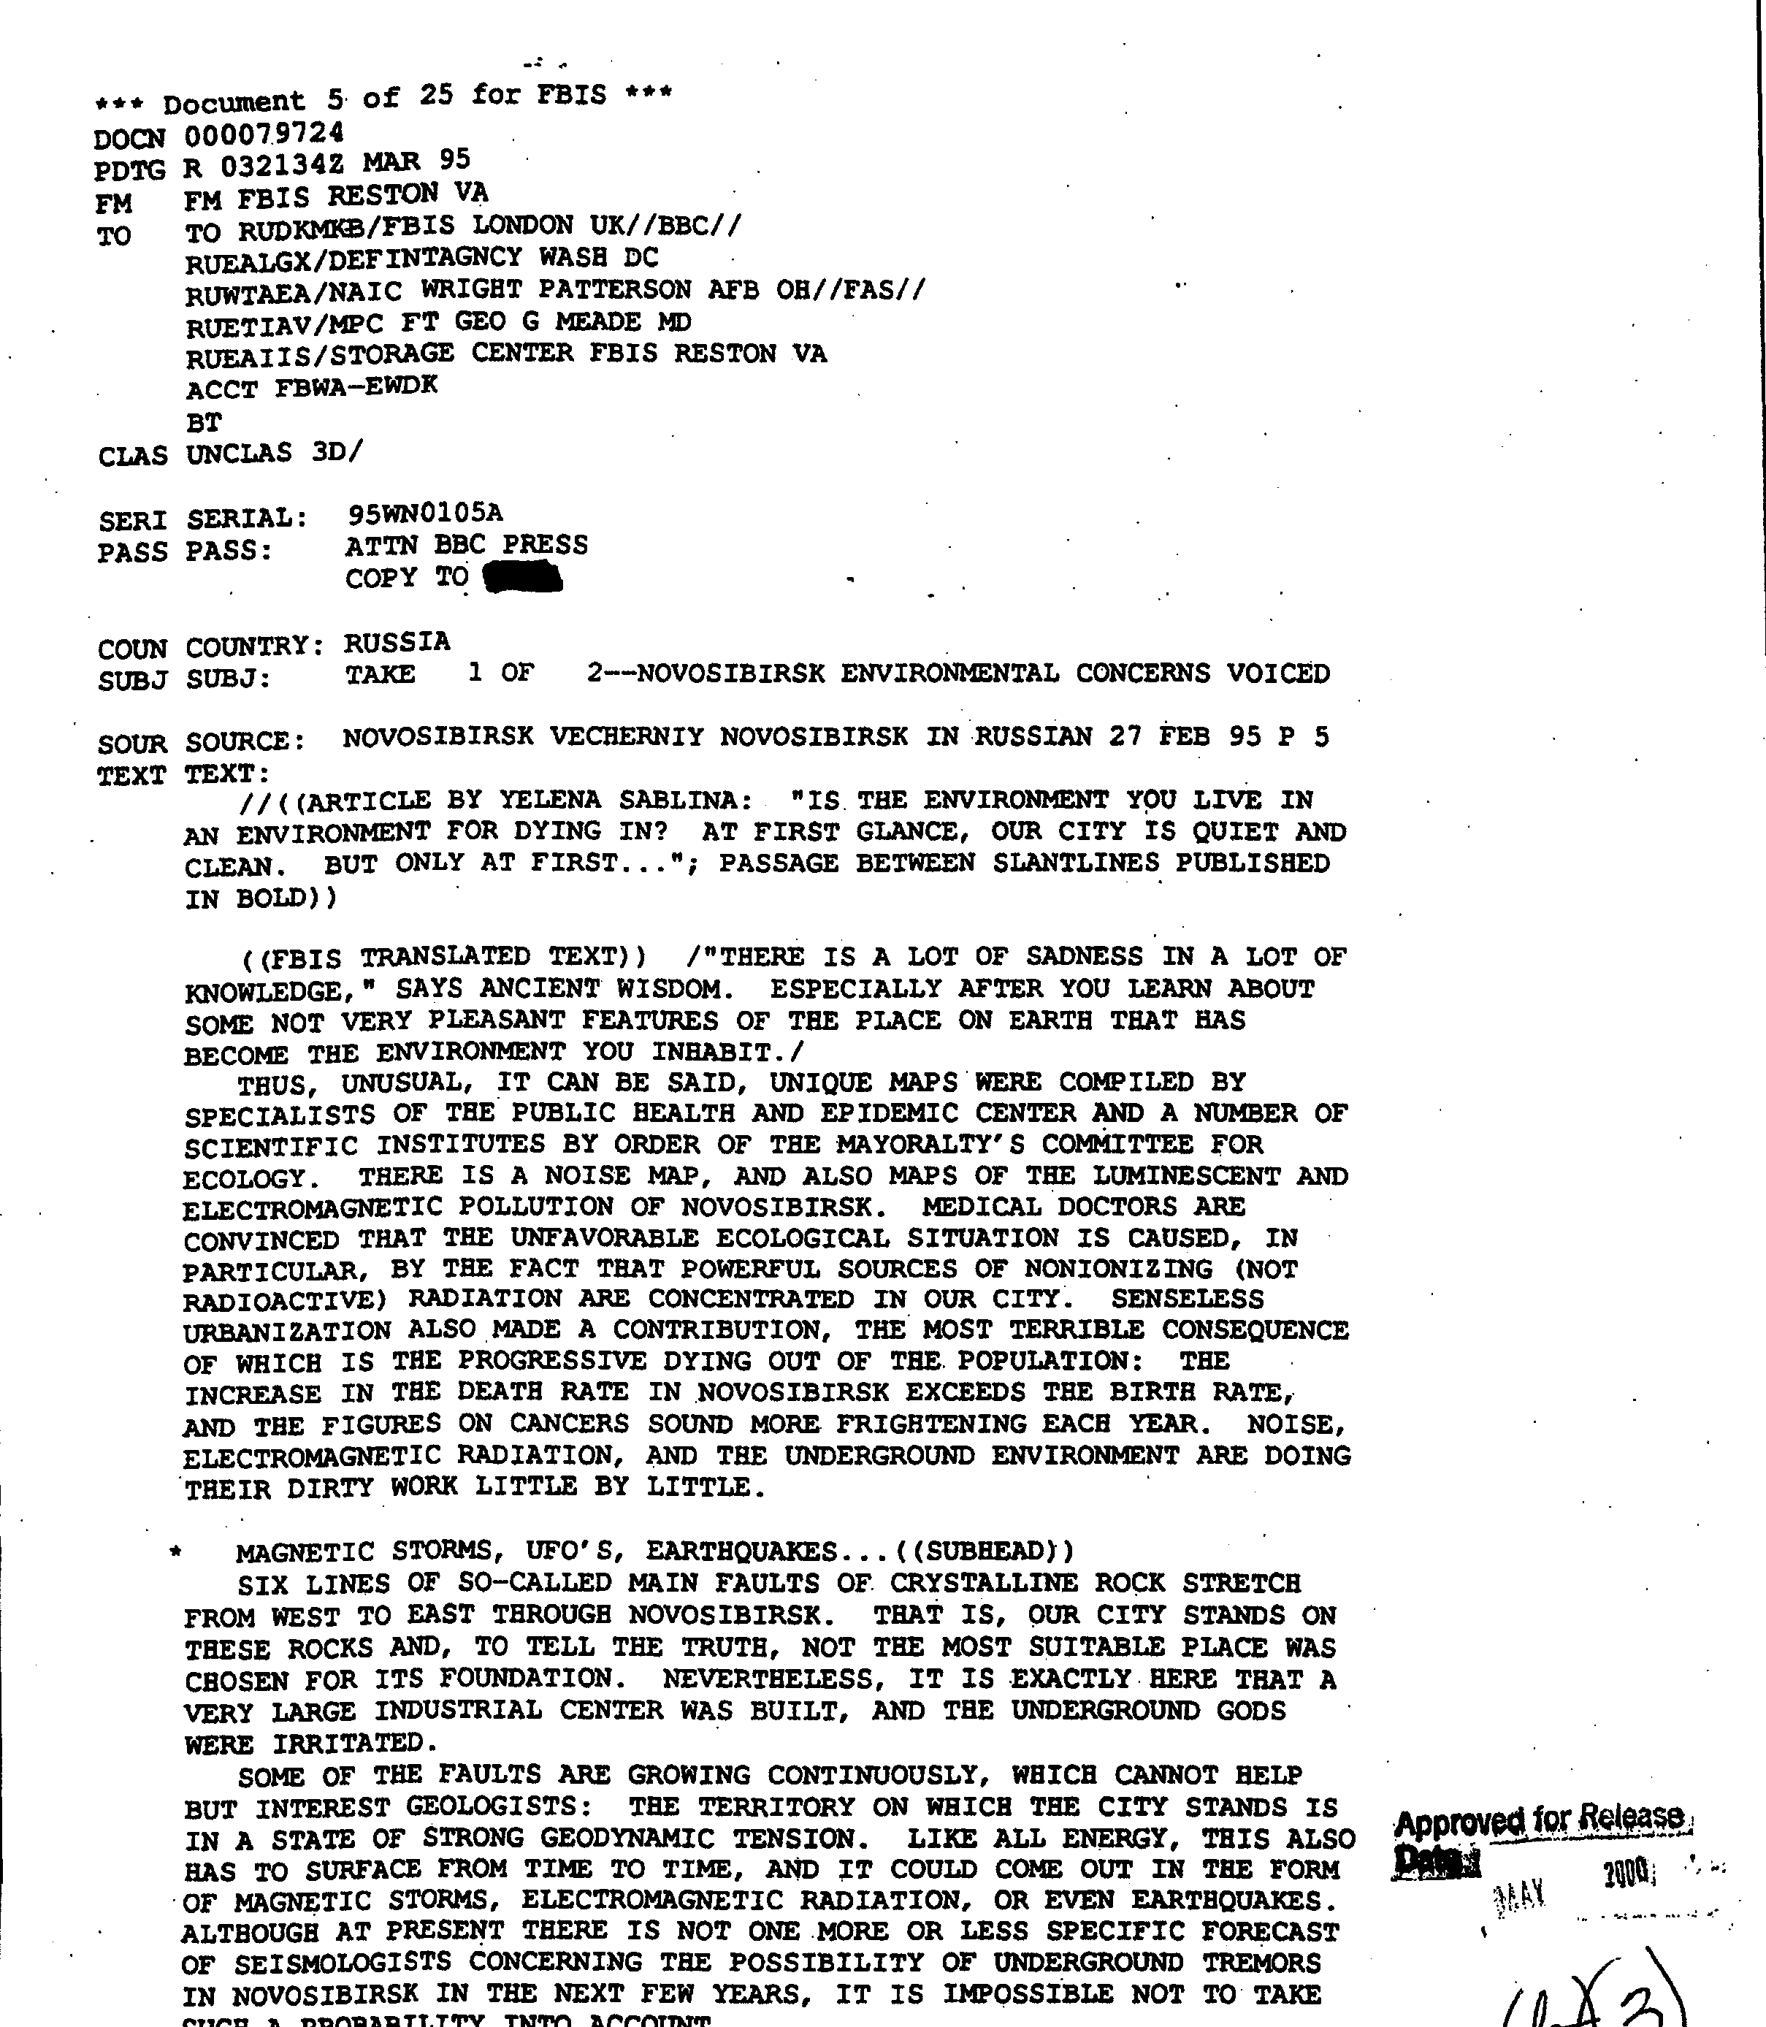
The Data
713 PDFs, of varying quality. All scans of paper documents.
5

Slide 6
Data Preprocessing and representation
To analyze the documents, we needed to extract as much text as possible from the scanned pdf documents.
We compared the extracted text from pypdf2 and pdfminer and found out that pdfminer has better efficiency and extracted better words than pypdf2.
Each pdf documents are opened, texts are extracted using pdfminer, tokenized, and imported into memory.
All tokenized words are compared to a Wordnet, and only words with semantics are indexed.
Only the documents that has at least 3 words are considered for further analysis.
6

Slide 7
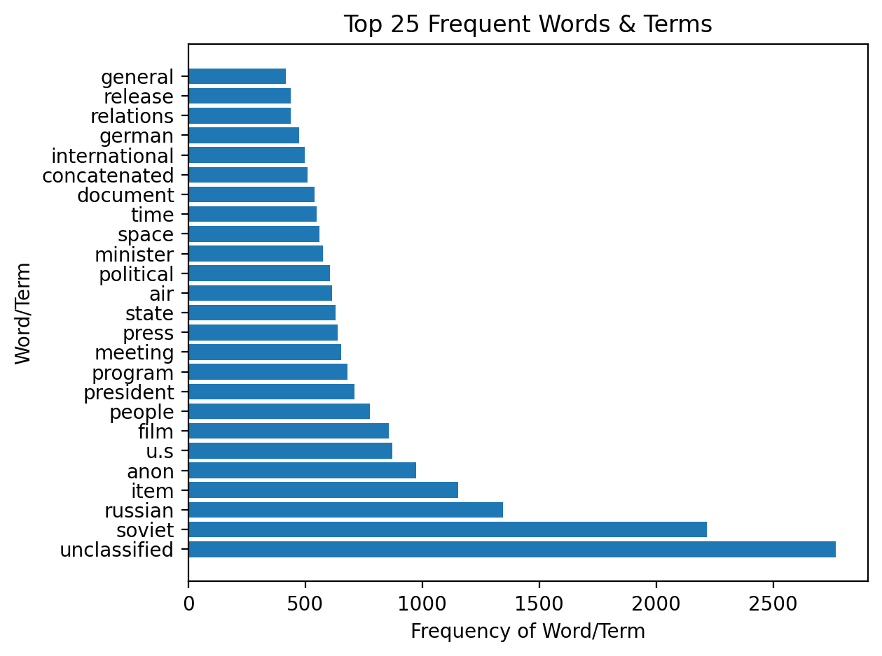
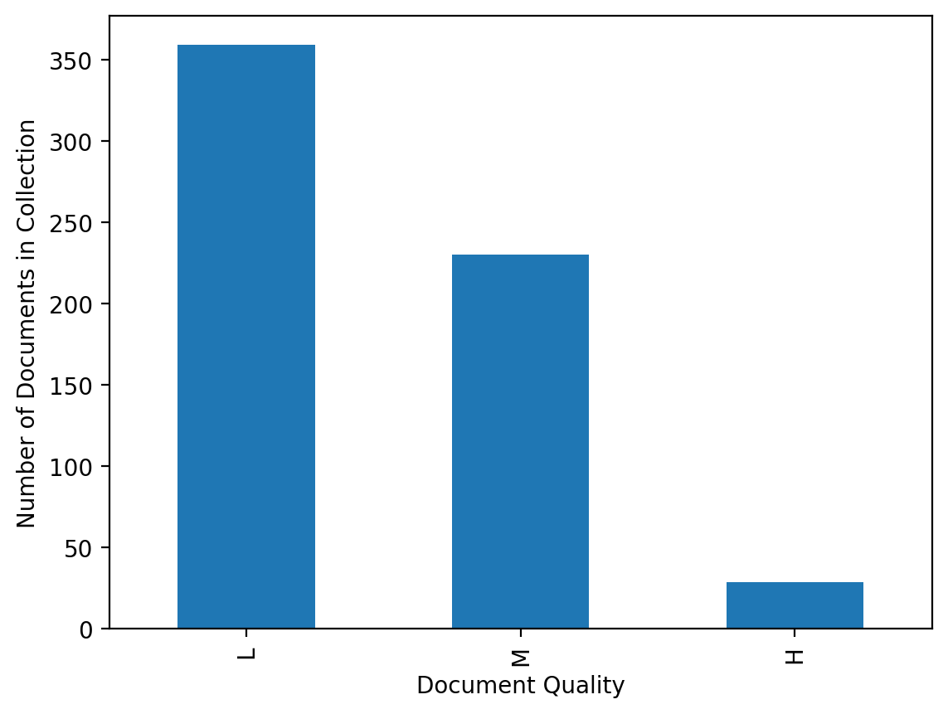
Document set Attributes

Slide 8
Learning Models Used
K-Means
Vector Space Model
K-Means Limitations:
K-means Clustering algorithm is an unsupervised learning method that requires lots of fine-tuning and one should keep in mind its limitations and drawbacks.
As per my analysis, it doesn’t work well with small size datasets.
It doesn’t perform well on datasets which has uniform Distribution.
It needs to find some optimal value of k using some external methods before feeding it to the algorithm’s parameter.
A Vector Space model with tf-idf as score parameter is used to build a search engine to rank-order the documents matching the input query.
Cosine similarity is used to determine the closeness against the documents.
The importance of using tf-idf is to increase the weightage of uncommon/important terms and decreasing the weightage for more common words.
Cosine similarity helps to reduce the impact of size of the document in determining th closeness.
One of the limitations of vector space is that the search word must precisely match document text.
8

Slide 9
Tf means term-frequency while tf–idf means term-frequency times inverse document-frequency: I am not sure what is to be added here. The details of VSM is added in the previous slide. Step by Step implementation of SVM could be added here, but not sure if that’s really needed. Ass the primary focus is on Clustering

Slide 10
RESULTS!
This can be the part of the presentation where you introduce yourself, write your email…
10

Slide 11
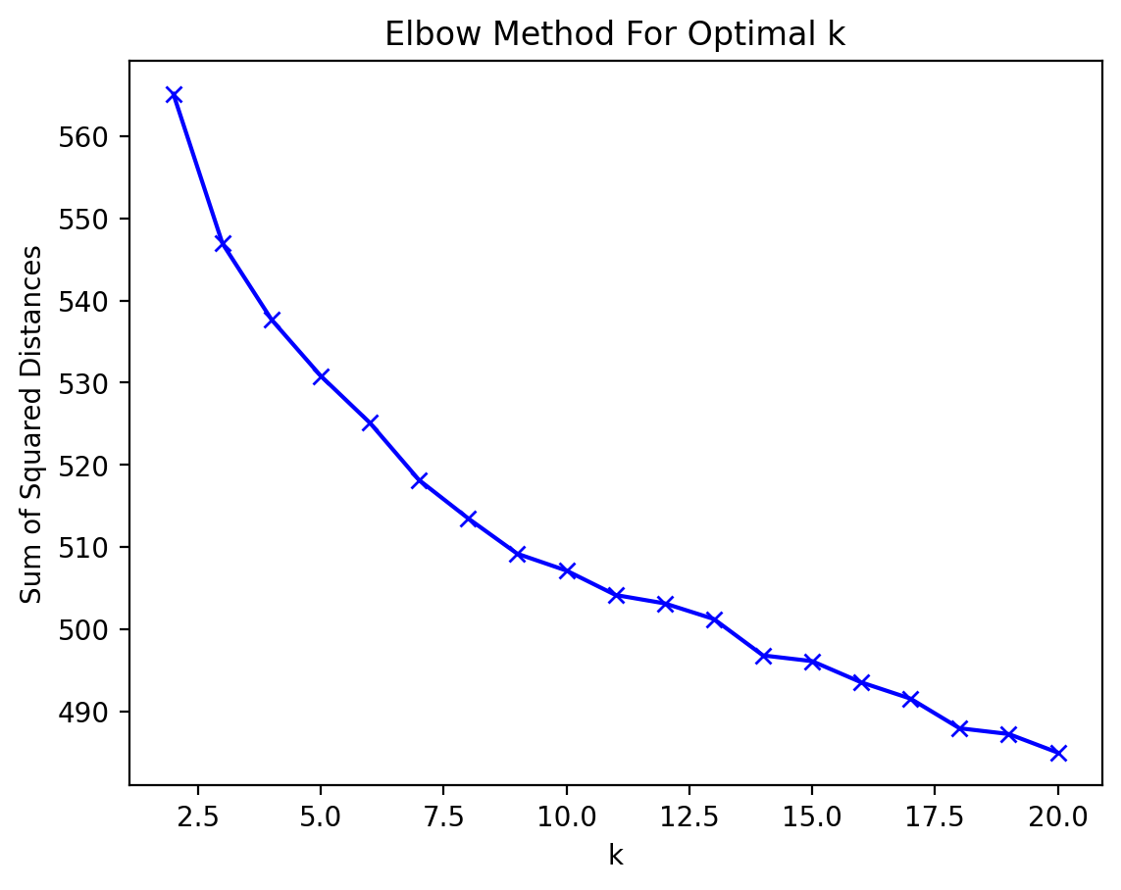
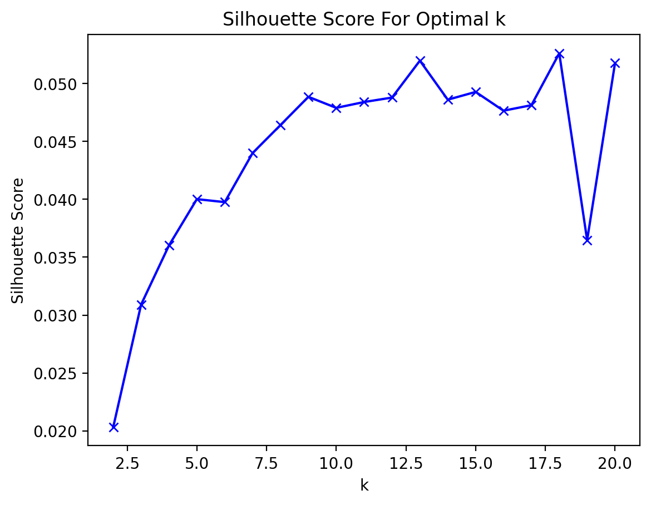

Slide 12
Cluster # | # Docs | Avg. # Words
1 | 160 | 52.01
3 | 27 | 288.07
5 | 38 | 103.16
7 | 136 | 190.03
9 | 20 | 96.95
Cluster # | # Docs | Avg. # Words
2 | 46 | 809.46
4 | 27 | 288.07
6 | 39 | 164.33
8 | 30 | 16.53
10 | 76 | 657.67

Slide 14
Timing metrics
MEASURES | DISTANCE | GRAVITY | DIAMETER
VENUS | 0,11 | 0,45 | 0,17
MERCURY | 0,44 | 0,70 | 0,18
SATURN | 0,75 | 0,32 | 0,47
14

Slide 15
SOFTWARE ARCHITECTURE and Implementation
15

Slide 16
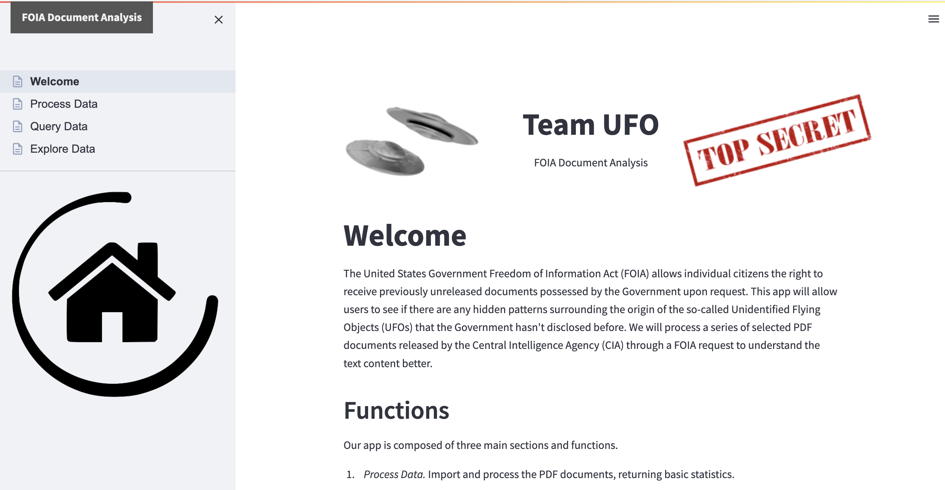
SOFTWARE DEMO
You can replace the image on the screen with your own work. Just right-click on it and select “Replace image”
16

Slide 17
THANK YOU! QUESTIONS?
17

