Slide 1
TEAM UFO
ISTE 612: Information Retrieval and Text Mining
…Exploring the World Of
Declassified Government Documents…
Cory Maclauchlan, John Myers, Arivirku Thirugnanam

Slide 2
Agenda
01
02
03
04
PROBLEM Description
The data
Tool Needs and Software Design
Exploration, Preprocessing, and Representations
MODELS used
results
Indexing and Clustering Techniques
Parameter Customization Metrics
2

Slide 3
01
The Problem
Tool Needs and Software Design
3

Slide 4
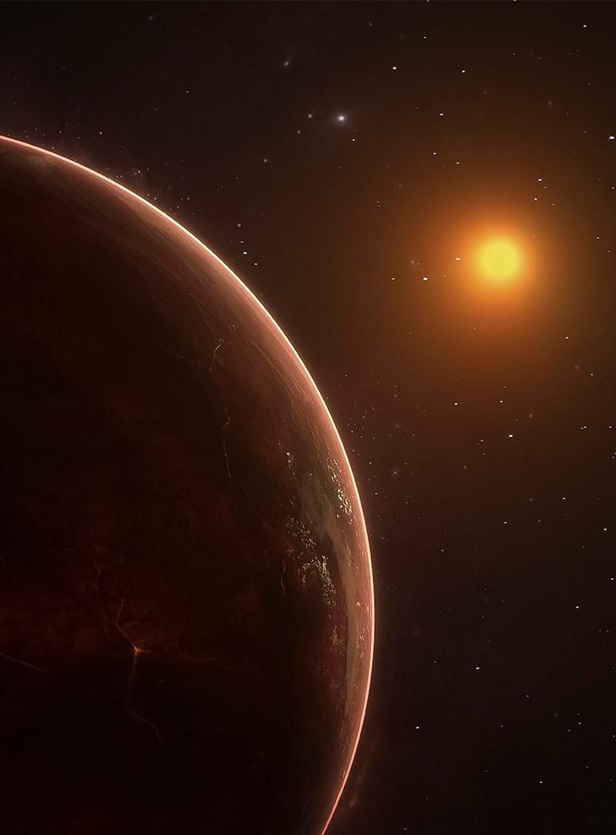
Why develop this?
Information Here
4

Slide 5
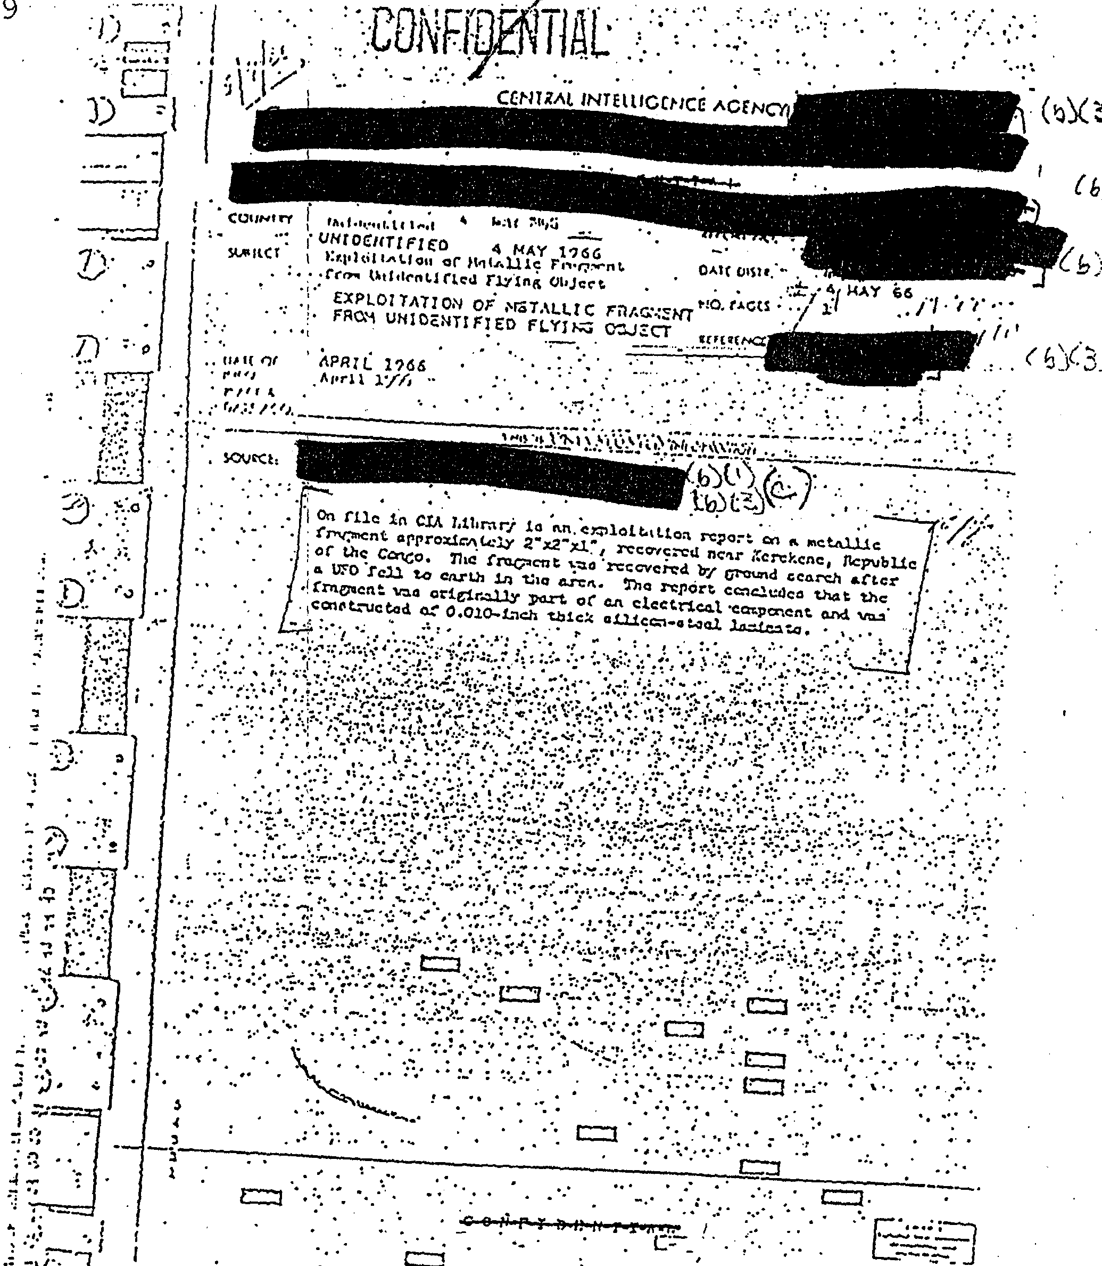
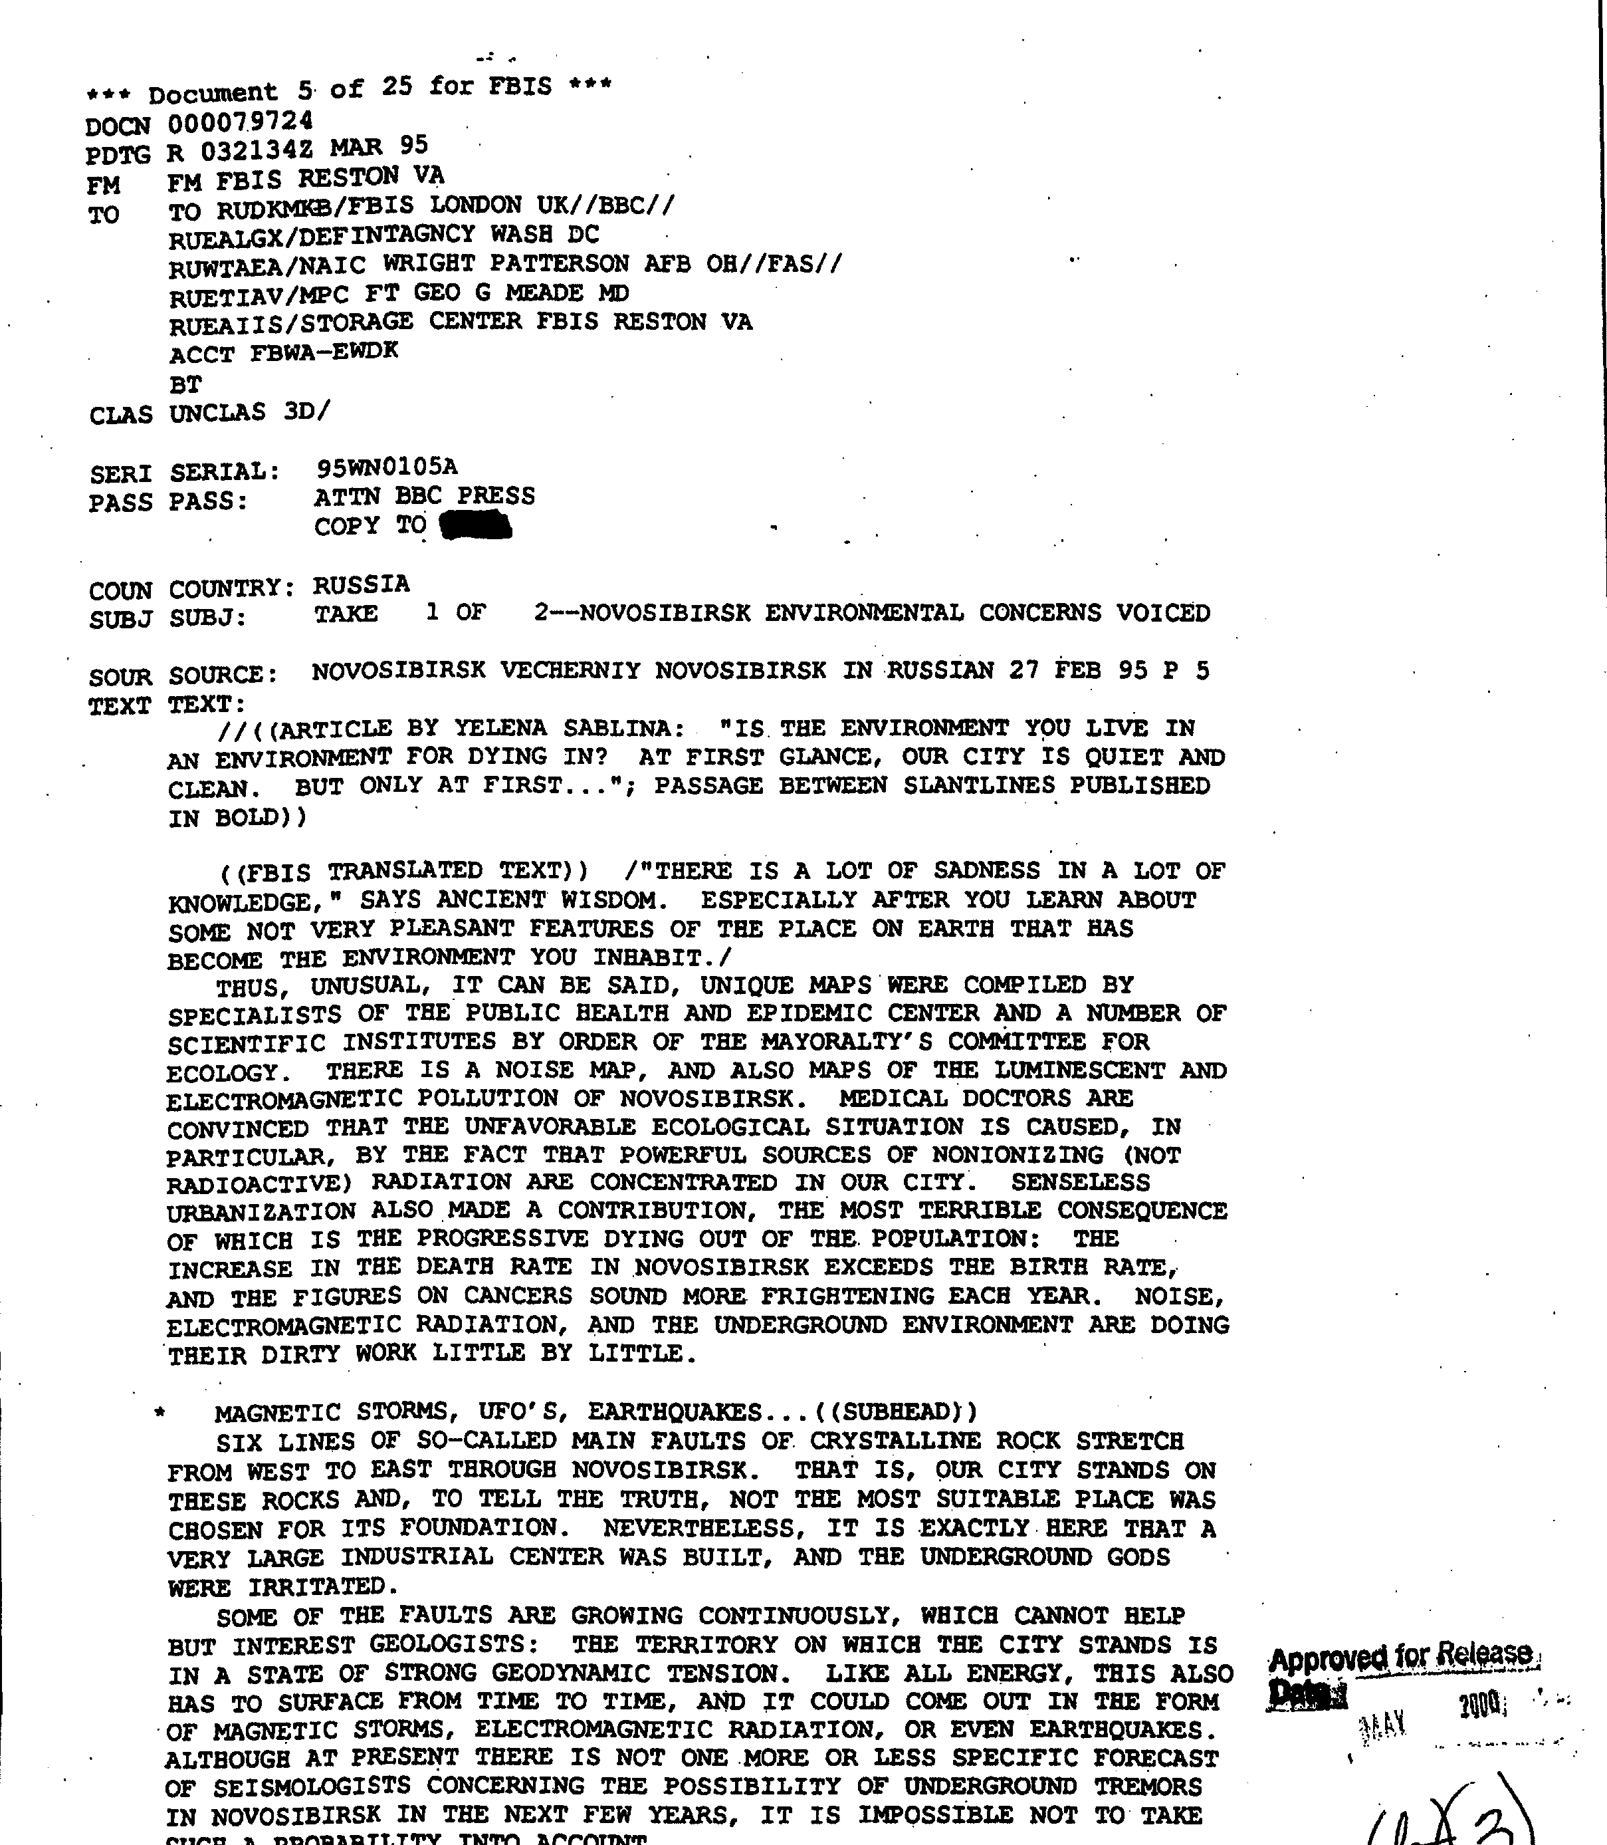
The Data
713 PDFs, of varying quality. All scans of paper documents.
5

Slide 6
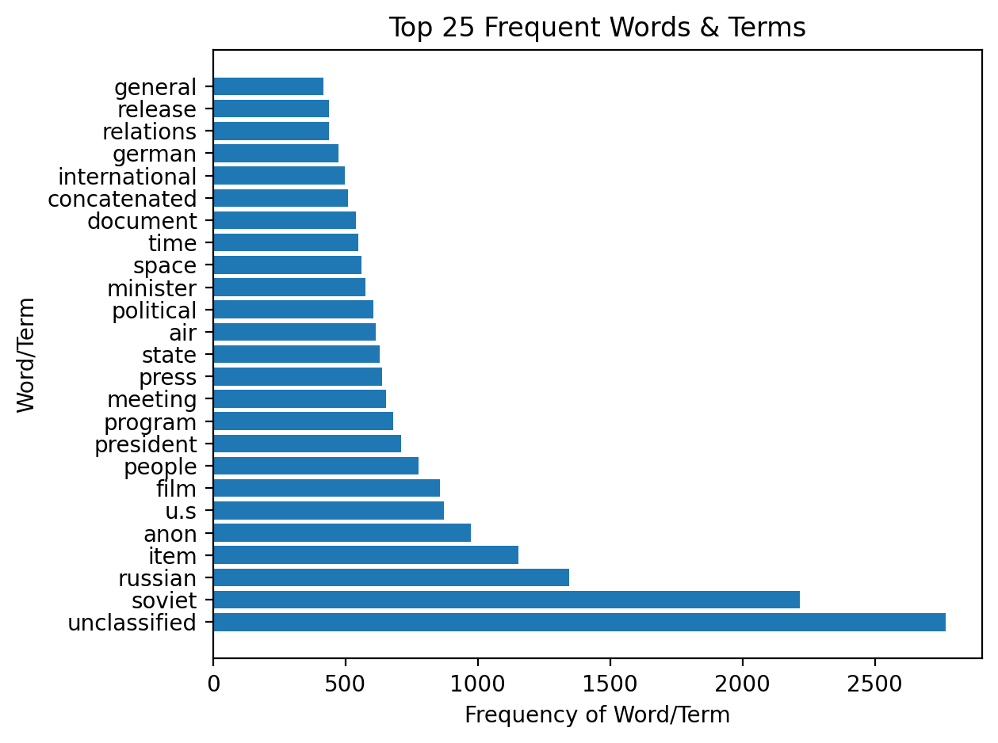
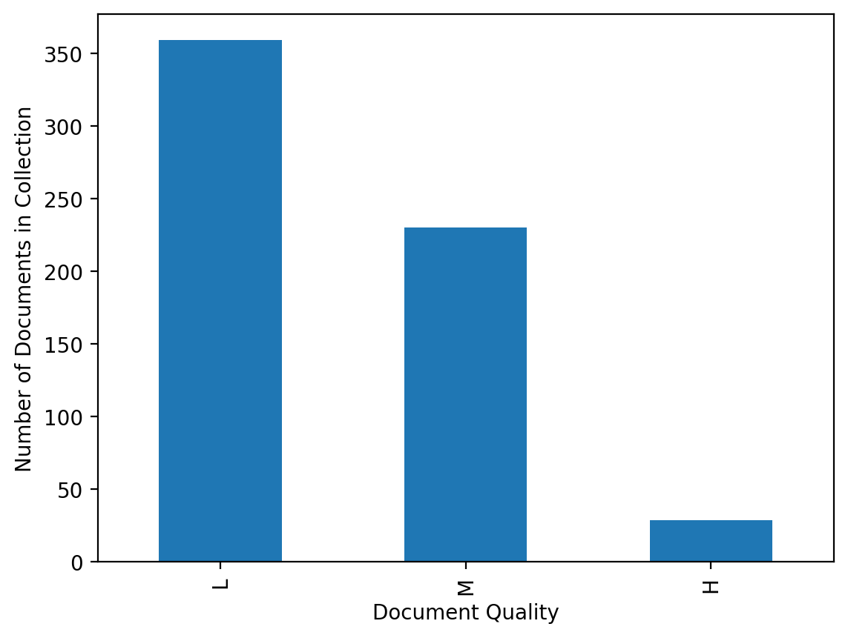
Document set Attributes

Slide 7
Data Preprocessing and representation
Here’s an assortment of alternative resources whose style fits the one of this template
7

Slide 8
Learning Models Used
K-Means
Learning Model 2
K-Means Limitations:
K-means Clustering algorithm is an unsupervised learning method that requires lots of fine-tuning and one should keep in mind its limitations and drawbacks.
As per my analysis, it doesn’t work well with small size datasets.
It doesn’t perform well on datasets which has uniform Distribution.
It needs to find some optimal value of k using some external methods before feeding it to the algorithm’s parameter.
Stuff here
8

Slide 9
Tf means term-frequency while tf–idf means term-frequency times inverse document-frequency:

Slide 10
RESULTS!
This can be the part of the presentation where you introduce yourself, write your email…
10

Slide 11
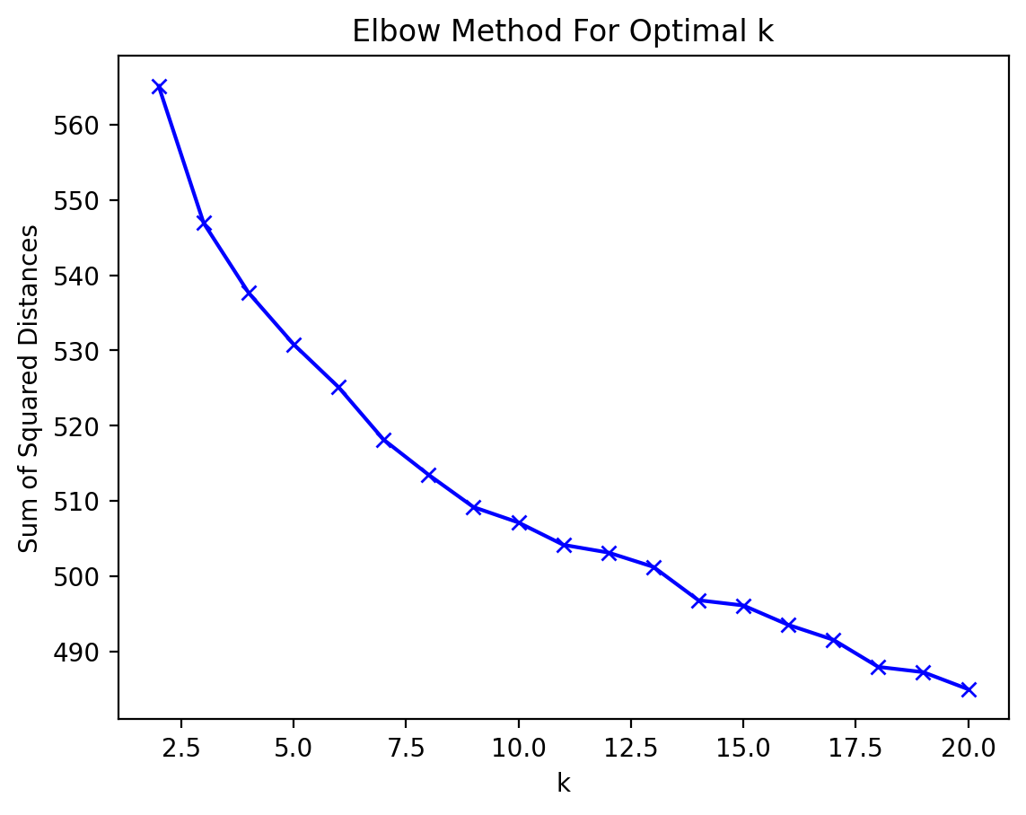
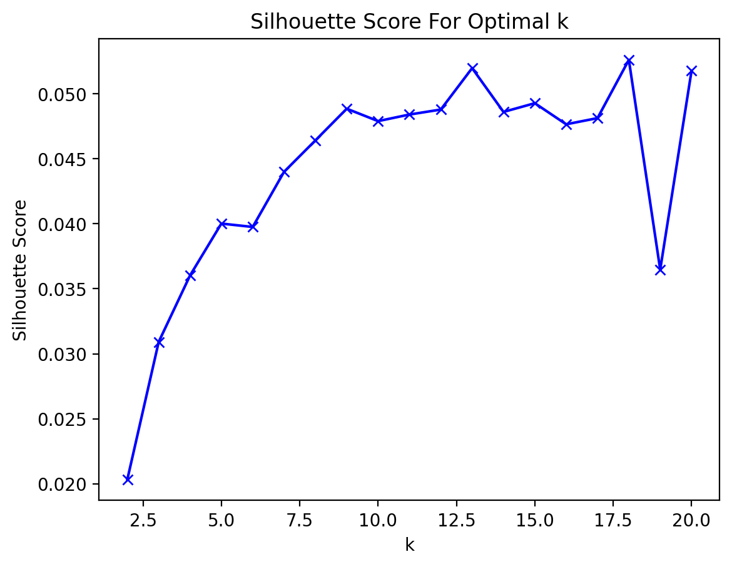

Slide 12
Cluster # | # Docs | Avg. # Words
1 | 160 | 52.01
3 | 27 | 288.07
5 | 38 | 103.16
7 | 136 | 190.03
9 | 20 | 96.95
Cluster # | # Docs | Avg. # Words
2 | 46 | 809.46
4 | 27 | 288.07
6 | 39 | 164.33
8 | 30 | 16.53
10 | 76 | 657.67

Slide 14
Timing metrics
MEASURES | DISTANCE | GRAVITY | DIAMETER
VENUS | 0,11 | 0,45 | 0,17
MERCURY | 0,44 | 0,70 | 0,18
SATURN | 0,75 | 0,32 | 0,47
14

Slide 15
SOFTWARE ARCHITECTURE and Implementation
15

Slide 16
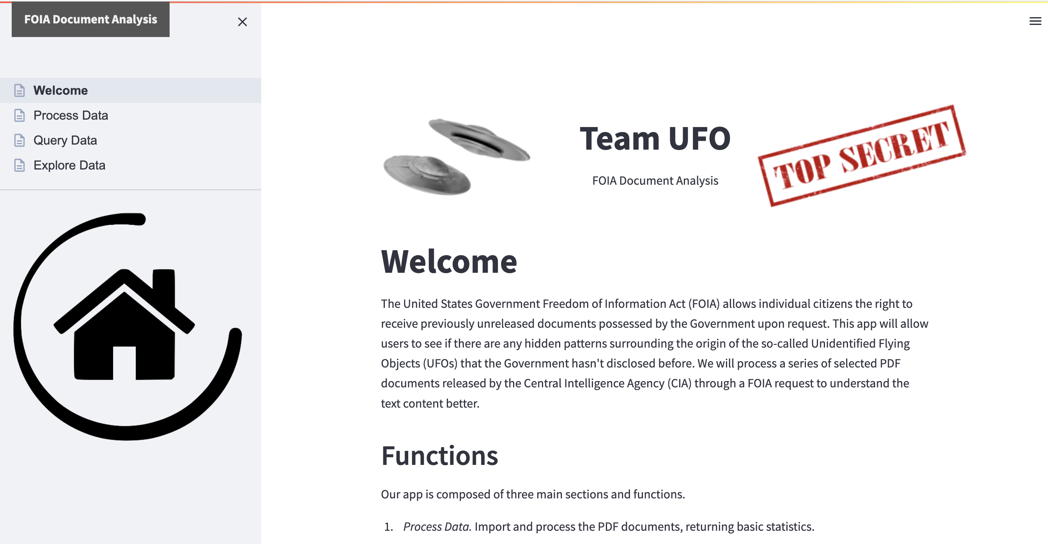
SOFTWARE DEMO
You can replace the image on the screen with your own work. Just right-click on it and select “Replace image”
16

Slide 17
THANK YOU! QUESTIONS?
17

