Slide 1
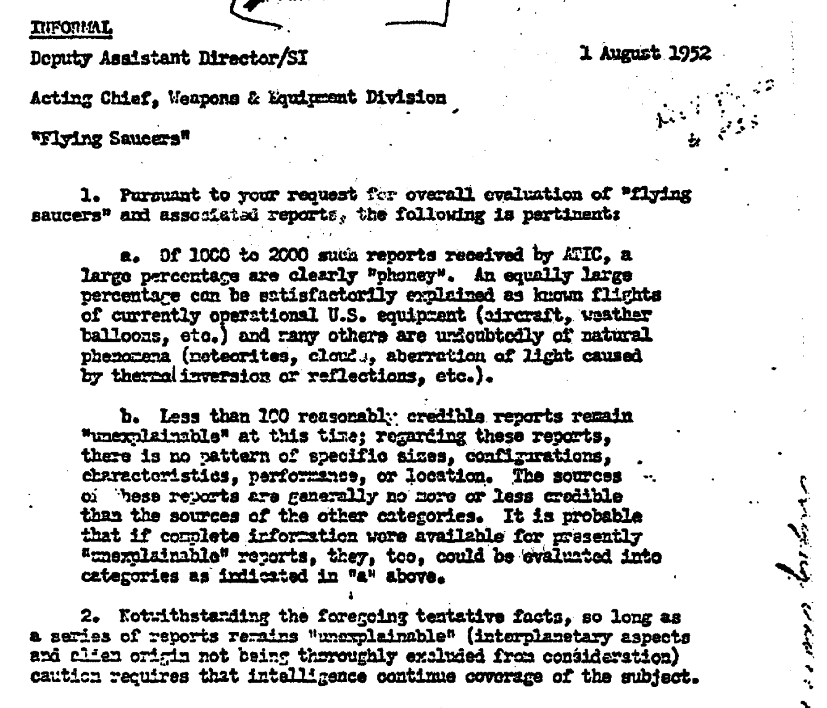
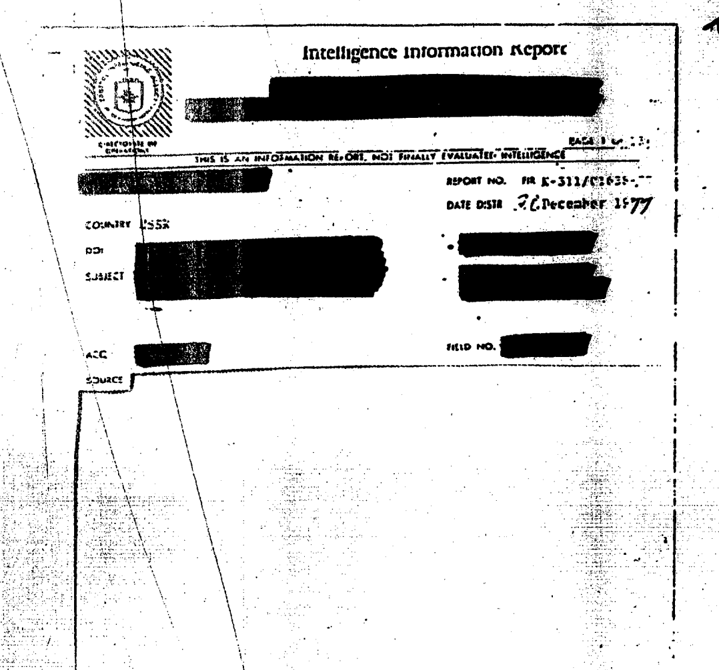
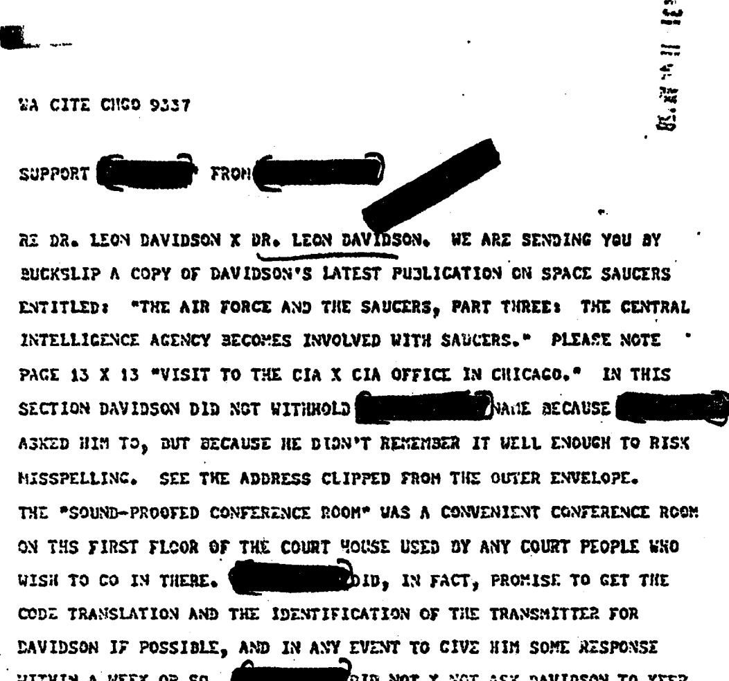
Backend Data Subsystem
Data Processing Pipeline
PDF Converter
Feature
Vectorizer
Model Fitter
Data
Conditioner
Data Processor
File System
Model & Parameter
Administration
Specification of:
Cluster Size
Initialization Method
Iterations
Feature Extraction Method
Doc | Words
doc1 | [unclass,ufo,saucer,…]
doc2 | [intelligence,report,…]
doc3 | [weapons,equipment,…]
Cluster Data
…
doc3
Visualization
Renderer
Display of:
Optimal Cluster Graph
K-Means Clusters
Word Cloud
Linkage to Source
doc2
Streamlit app
doc1
Visualization Subsystem

Slide 2
