Slide 1

SCAR
John Felen

Slide 2
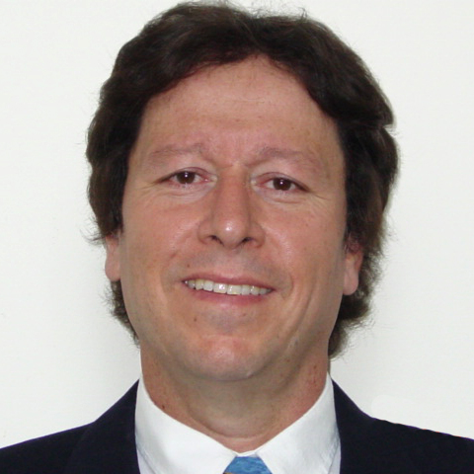
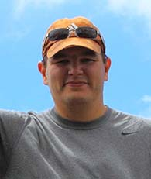
The Team
Dr. Taieb Znati and Dr. Bryan Mills
Zhong Zhuang
Currently: Corey Furmanski, Ryan Rahuba, and I

Slide 3
The Problem
File Could Not Be Accessed Anywhere( Solved Not By Us)
Malicious Server Owners
Server Faults

Slide 4
The Solution: SCAR
Scatter Conceal and Recover
Reed-Solomon Algorithm
Cryptography

Slide 5

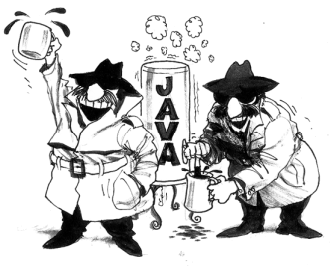






What We Used

Slide 6
Team Member Focus
The Presenter
Corey
Ryan

Slide 7
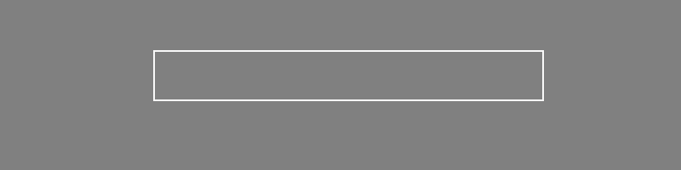
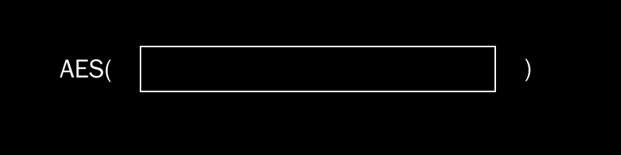

High-Level View
Original File
Encrypted File
Reed-Solomon
k chunks
N - k chunks

Slide 8
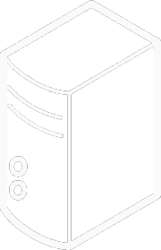
High-Level View
Hash-Chain
Store on Servers

Slide 9

Analysis
Brute Force:
Attacker takes any k combination and permutate the ordering
Assume their ordering is in sequential ordering relative to the file
They will get the correct file back if their ordering is right
Worst Case: $O\left( \left({N \atop k}\right)k! \right)$

Slide 10
Analysis
Does not include breaking AES
Assumes attacker knows k value and has all N chunks
This Brute Force is faster than others when k is much smaller than N

Slide 11
Android Implementation
Not Here

